Slide 1

Chapter 1
Computer Networks
and the Internet
Computer Networking: A Top Down Approach Featuring the Internet,
3rd edition.
Jim Kurose, Keith Ross
Addison-Wesley, July 2004.
Courtesy of J.F Kurose and K.W. Ross (All material copyright 1996-2006)

Slide 2
Chapter 1: Introduction
Our goal:
get “feel” and terminology
more depth, detail later in course
approach:
  use Internet as example
Overview:
what’s the Internet
what’s a protocol?
network edge
network core
access network
Internet/ISP structure
performance: loss, delay
protocol layers, service models
network modeling

Slide 3
Chapter 1: roadmap
  1.1 What is the Internet?
  1.2 Network edge
  1.3 Network core
  1.4 Network access
  1.5 Internet structure and ISPs
  1.6 Delay & loss in packet-switched networks
  1.7 Protocol layers, service models

Slide 4





What’s the Internet: “nuts and bolts” view
millions of connected computing devices: hosts = end-systems
  PCs workstations, servers
  PDAs phones, toasters
running network apps
communication links
  fiber, copper, radio, satellite
  transmission rate = bandwidth
routers: forward packets (chunks of data)
router
workstation
server
mobile
local ISP
regional ISP
company
network

Slide 5
What’s the Internet: “nuts and bolts” view
protocols control sending, receiving of msgs
  e.g., TCP, IP, HTTP, FTP, PPP
Internet: “network of networks”
  loosely hierarchical
  public Internet versus private intranet
Internet standards
  RFC: Request for comments
  IETF: Internet Engineering Task Force
router
workstation
server
mobile
local ISP
regional ISP
company
network

Slide 6
What’s the Internet: a service view
communication infrastructure enables distributed applications:
  Web, email, games, e-commerce, database, voting, file sharing
communication services provided to apps:
  connectionless
  connection-oriented

Slide 7
What’s a protocol?
human protocols:
“what’s the time?”
“I have a question”
introductions
… specific msgs sent
… specific actions taken when msgs received, or other events
network protocols:
machines rather than humans
all communication activity in Internet governed by protocols
protocols define format, order of msgs sent and received among network entities, and actions taken on msg transmission, receipt

Slide 8


What’s a protocol?
a human protocol and a computer network protocol:
Hi
TCP connection
req
Hi
TCP connection
response
Got the
time?
Get http://www.awl.com/kurose-ross
2:00
<file>
time

Slide 9
A closer look at network structure:
network edge: applications and hosts
network core:
  routers
  network of networks
access networks, physical media: communication links

Slide 10
Chapter 1: roadmap
  1.1 What is the Internet?
  1.2 Network edge
  1.3 Network core
  1.4 Network access
  1.5 Internet structure and ISPs
  1.6 Delay & loss in packet-switched networks
  1.7 Protocol layers, service models

Slide 11
The network edge:
end systems (hosts):
  run application programs
  e.g. Web, email
  at “edge of network”
client/server model
  client host requests, receives service from always-on server
  e.g. Web browser/server; email client/server
peer-peer model:
  minimal (or no) use of dedicated servers
  e.g. Skype, KaZaA

Slide 12
Network edge: connection-oriented service
Not provided by connection-oriented service but by TCP!
Goal: data transfer between end systems
handshaking: setup (prepare for) data transfer ahead of time
  Hello, hello back human protocol
  set up “state” in two communicating hosts
TCP - Transmission Control Protocol
  Internet’s connection-oriented service
TCP service [RFC 793]
reliable, in-order byte-stream data transfer
  loss: acknowledgements and retransmissions
flow control:
  sender won’t overwhelm receiver
congestion control:
  senders “slow down sending rate” when network congested

Slide 13
Network edge: connectionless service
Goal: data transfer between end systems
  same as before!
  No handshaking
UDP - User Datagram Protocol [RFC 768]: Internet’s connectionless service
  unreliable data transfer
  no flow control
  no congestion control
App’s using TCP:
HTTP (Web), FTP (file transfer), Telnet (remote login), SMTP (email)
App’s using UDP:
streaming media, teleconferencing, DNS, Internet telephony

Slide 14
Chapter 1: roadmap
  1.1 What is the Internet?
  1.2 Network edge
  1.3 Network core
  1.4 Network access
  1.5 Internet structure and ISPs
  1.6 Delay & loss in packet-switched networks
  1.7 Protocol layers, service models

Slide 15
The Network Core
mesh of interconnected routers
the fundamental question: how is data transferred through net?
  circuit switching: dedicated circuit per call: telephone net
  packet-switching: data sent thru net in discrete “chunks”

Slide 16
Network Core: Circuit Switching
End-end resources reserved for “call”
link bandwidth, switch capacity
dedicated resources: no sharing
circuit-like (guaranteed) performance
call setup required

Slide 17
Network Core: Circuit Switching
network resources (e.g., bandwidth) divided into “pieces”
pieces allocated to calls
resource piece idle if not used by owning call (no sharing)
dividing link bandwidth into “pieces”
  frequency division
  time division

Slide 18
Circuit Switching: FDMA and TDMA
Example:
FDMA
4 users
frequency
time
TDMA
frequency
time
Notes:
Two simple multiple access control techniques.
Each mobile’s share of the bandwidth is divided into portions for the uplink and the downlink. Also, possibly, out of band signaling.
As we will see, used in AMPS, GSM, IS-54/136

Slide 19
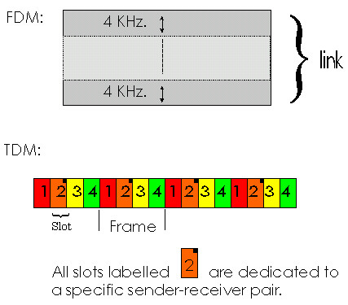
Example: Multiplexing in Circuit-Switched Networks
A telephone voice transmission circuit uses 4KHz bandwidth. Suppose a physical link has capacity to support 4 circuits:
FDM approach:
  Bandwidth is divided into four frequency bands
  Allocate a 4KHz circuit to one call
TDM approach:
  Time is divided into frames
  Each frame has four slots
  Each circuit assigned same slot in each frame

Slide 20
Example: Circuit Switching
How long will it take to send a file of 640,000 bits from host A to host B over a circuit-switched network.
Suppose all links in the network are TDM with:
  24 slots and
  have a bit rate of 1.536Mbps
It takes 500 msec to establish an end-to-end circuit before host A begins transmitting to B
How long will it take to send file?
Transmission rate for each circuit = 1.536 Mbps / 24 = 64 Kbps
Time to send 640 Kbits file = (640000 bits)/(64 Kbits/sec) = 10 seconds
Including circuit setup overhead, time to send file is 10.5 seconds
This calculation is independent of the # of end-to-end links and does not include propagation delays

Slide 21
Network Core: Packet Switching
each end-end data stream divided into packets
user A, B packets share network resources
each packet uses full link bandwidth
resources used as needed
resource contention:
aggregate resource demand can exceed amount available
congestion: packets queue, wait for link use
store and forward: packets move one hop at a time
  Node receives complete packet before forwarding
Bandwidth division into “pieces”
Dedicated allocation
Resource reservation

Slide 22
Packet Switching: Statistical Multiplexing
10 Mbs
Ethernet
A
C
statistical multiplexing
1.5 Mbs
B
queue of packets
waiting for output
link
D
E
Sequence of A & B packets does not have fixed pattern ➔ statistical multiplexing.
In TDM each host gets same slot in revolving TDM frame.

Slide 23
Packet switching versus circuit switching
Packet switching allows more users to use network!
1 Mbit link
each user:
  100 kbps when “active”
  active 10% of time
circuit-switching:
  10 users
packet switching:
  with 35 users, probability > 10 active less than .0004
N users
1 Mbps link

Slide 24
Packet switching versus circuit switching
Is packet switching a “slam dunk winner?”
Great for bursty data
  resource sharing
  simpler, no call setup
Excessive congestion: packet delay and loss
  protocols needed for reliable data transfer, congestion control
Q: How to provide circuit-like behavior?
  bandwidth guarantees needed for audio/video apps
  still an unsolved problem (chapter 7)

Slide 25
Packet-switching: store-and-forward
L
R
R
R
Takes L/R seconds to transmit (push out) packet of L bits on to link or R bps
Entire packet must arrive at router before it can be transmitted on next link: store and forward
delay = 3L/R (assuming zero propagation delay)
Example:
L = 7.5 Mbits
R = 1.5 Mbps
delay = 15 sec

Slide 26
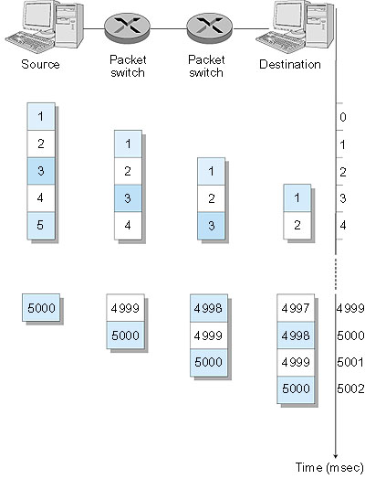
Packet Switching: Message Segmenting
Now break up the message into 5000 packets
Each packet 1,500 bits
1 msec to transmit packet on one link
pipelining: each link works in parallel
Delay reduced from 15 sec to 5.002 sec

Slide 27
Network Core: Packet Switching (Cont’d)
Advantages and disadvantages of segmentation
Advantages:
  More efficient → less delays
  Handles bit errors more efficiently
    Entire message does not require retransmission
    Less overhead in terms of bandwidth
Disadvantage:
  Each packet has a header vs. one header per message
  In most cases, this overhead is small

Slide 28
Network Core: Packet Switching (Cont’d)
Packet switching vs. circuit switching:
Advantages of packet switching:
  Offers better bandwidth sharing than circuit switching
  Simpler, more efficient, and robust
Limitations of packet switching:
  Not suitable for real-time services
    IP telephony, video conference, etc.
  Variable and unpredictable delays

Slide 29
Packet-switched networks: forwarding
Goal: move packets through routers from source to destination
  we’ll study several path selection (i.e. routing)algorithms (chapter 4)
datagram network:
  destination address in packet determines next hop
  routes may change during session
  analogy: driving, asking directions
virtual circuit network:
  each packet carries tag (virtual circuit ID), tag determines next hop
  fixed path determined at call setup time, remains fixed thru call
  routers maintain per-call state

Slide 30
Network Taxonomy
Telecommunication
networks
Circuit-switched
networks
Packet-switched
networks
FDM
TDM
Networks
with VCs
Datagram
Networks
Datagram network is not either connection-oriented
or connectionless.
Internet provides both connection-oriented (TCP) and
connectionless services (UDP) to apps.

Slide 31
Chapter 1: roadmap
  1.1 What is the Internet?
  1.2 Network edge
  1.3 Network core
  1.4 Network access
  1.5 Internet structure and ISPs
  1.6 Delay & loss in packet-switched networks
  1.7 Protocol layers, service models

Slide 32
Access networks
Q: How to connect end systems to edge router?
residential access nets
institutional access networks (school, company)
mobile access networks
Keep in mind:
bandwidth (bits per second) of access network?
shared or dedicated?

Slide 33
Residential access: point to point access
Dialup via modem
  up to 56Kbps direct access to router (often less)
  Can’t surf and phone at same time: can’t be “always on”
ADSL: asymmetric digital subscriber line
  up to 1 Mbps upstream (today typically < 256 kbps)
  up to 8 Mbps downstream (today typically < 1 Mbps)
  FDM: 50 kHz - 1 MHz for downstream
  4 kHz - 50 kHz for upstream
  0 kHz - 4 kHz for ordinary telephone

Slide 34
Residential access: cable modems
HFC: hybrid fiber coax
  asymmetric: up to 30Mbps downstream, 2 Mbps upstream
network of cable and fiber attaches homes to ISP router
  homes share access to router
deployment: available via cable TV companies

Slide 35
Company access: local area networks
company/univ local area network (LAN) connects end system to edge router
Ethernet:
  shared or dedicated link connects end system and router
  10 Mbs, 100Mbps, Gigabit Ethernet
deployment: institutions, home LANs
LANs: chapter 5

Slide 36
Wireless access networks
shared wireless access network connects end system to router
  via base station aka “access point”
wireless LANs:
  802.11b/g (WiFi): 11-54 Mbps
wider-area wireless access
  provided by telco operator
  3G ~ 384 kbps
    Will it happen??
  GPRS in Europe/US
router
base
station
mobile
hosts

Slide 37
Home networks
Typical home network components:
ADSL or cable modem
router/firewall/NAT
Ethernet
wireless access
point
wireless
laptops
to/from
cable
headend
cable
modem
router/
firewall
wireless
access
point
Ethernet
(switched)

Slide 38
Chapter 1: roadmap
  1.1 What is the Internet?
  1.2 Network edge
  1.3 Network core
  1.4 Network access
  1.5 Internet structure and ISPs
  1.6 Delay & loss in packet-switched networks
  1.7 Protocol layers, service models

Slide 39
Internet structure: network of networks
roughly hierarchical
at center: “tier-1” ISPs (e.g., MCI, Sprint, AT&T, Cable and Wireless), national/international coverage
  treat each other as equals
Tier-1 providers also interconnect at public network access points (NAPs)
Tier-1 providers interconnect (peer) privately
Tier 1 ISP
NAP
Tier 1 ISP
Tier 1 ISP

Slide 40
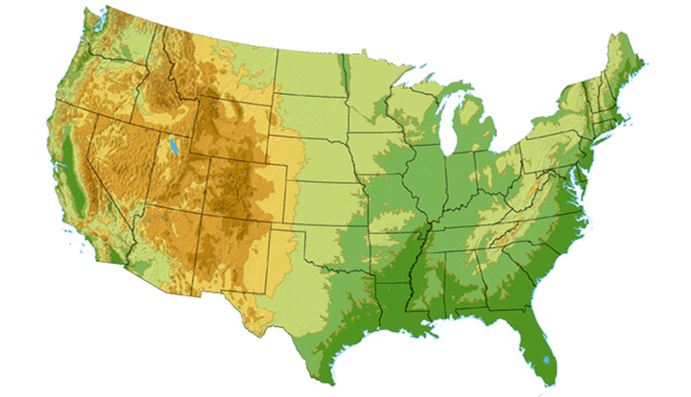

Tier-1 ISP: e.g., Sprint
Sprint US backbone network
DS3 (45 Mbps)
OC3 (155 Mbps)
OC12 (622 Mbps)
OC48 (2.4 Gbps)
Seattle
Tacoma
POP: point-of-presence
to/from backbone
Stockton
New York
Cheyenne
Chicago
Pennsauken
…
peering
….
Relay
San Jose
Roachdale
Wash. DC
Kansas City
Anaheim
…
…
…
Atlanta
to/from customers
Fort Worth
Orlando

Slide 41
Internet structure: network of networks
“Tier-2” ISPs: smaller (often regional) ISPs
  Connect to one or more tier-1 ISPs, possibly other tier-2 ISPs
Tier-2 ISPs also peer privately with each other, interconnect at NAP
Tier-2 ISP pays tier-1 ISP for connectivity to rest of Internet
tier-2 ISP is customer of
tier-1 provider
Tier-2 ISP
Tier-2 ISP
Tier 1 ISP
NAP
Tier 1 ISP
Tier 1 ISP
Tier-2 ISP
Tier-2 ISP
Tier-2 ISP

Slide 42
Internet structure: network of networks
“Tier-3” ISPs and local ISPs
  last hop (“access”) network (closest to end systems)
local
ISP
Tier 3
ISP
local
ISP
local
ISP
local
ISP
Local and tier- 3 ISPs are customers of
higher tier ISPs
connecting them to rest of Internet
Tier-2 ISP
Tier-2 ISP
Tier 1 ISP
NAP
Tier 1 ISP
Tier 1 ISP
Tier-2 ISP
Tier-2 ISP
Tier-2 ISP
local
ISP
local
ISP
local
ISP
local
ISP

Slide 43
Internet structure: network of networks
a packet passes through many networks!
local
ISP
Tier 3
ISP
local
ISP
local
ISP
local
ISP
Tier-2 ISP
Tier-2 ISP
Tier 1 ISP
NAP
Tier 1 ISP
Tier 1 ISP
Tier-2 ISP
Tier-2 ISP
Tier-2 ISP
local
ISP
local
ISP
local
ISP
local
ISP

Slide 44
Chapter 1: roadmap
  1.1 What is the Internet?
  1.2 Network edge
  1.3 Network core
  1.4 Network access
  1.5 Internet structure and ISPs
  1.6 Delay & loss in packet-switched networks
  1.7 Protocol layers, service models

Slide 45
How do loss and delay occur?
packets queue in router buffers
packet arrival rate to link exceeds output link capacity
packets queue, wait for turn
packet being transmitted (delay)
A
B
packets queueing (delay)
free (available) buffers: arriving packets
dropped (loss) if no free buffers

Slide 46
Four sources of packet delay
1. nodal processing:
  check bit errors
  determine output link
2. queueing
  time waiting at output link for transmission
  depends on congestion level of router
transmission
A
propagation
B
nodal
processing
queueing

Slide 47
Delay in packet-switched networks
3. Transmission delay:
R=link bandwidth (bps)
L=packet length (bits)
time to send bits into link = L/R
4. Propagation delay:
d = length of physical link
s = propagation speed in medium (~2x10⁸ m/sec)
propagation delay = d/s
Note: s and R are very different quantities!
transmission
A
propagation
B
nodal
processing
queueing

Slide 48
Caravan analogy
100 km
100 km
ten-car
caravan
toll
booth
toll
booth
Cars “propagate” at
100 km/hr
Toll booth takes 12 sec to service a car (transmission time)
car~bit; caravan ~ packet
Q: How long until caravan is lined up before 2nd toll booth?
Time to “push” entire caravan through toll booth onto highway = 12*10 = 120 sec
Time for last car to propagate from 1st to 2nd toll both: 100km/(100km/hr)= 1 hr
A: 62 minutes

Slide 49
Caravan analogy (more)
100 km
100 km
ten-car
caravan
toll
booth
toll
booth
Yes! After 7 min, 1st car at 2nd booth and 3 cars still at 1st booth.
1st bit of packet can arrive at 2nd router before packet is fully transmitted at 1st router!
  See Ethernet applet at AWL Web site
Cars now “propagate” at
1000 km/hr
Toll booth now takes 1 min to service a car
Q: Will cars arrive to 2nd booth before all cars serviced at 1st booth?

Slide 50
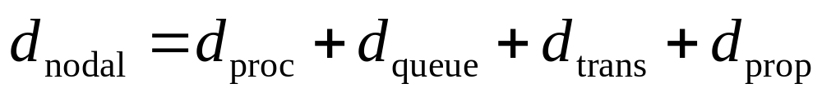
Nodal delay
d_{proc} = processing delay
  typically a few microsecs or less
d_{queue} = queuing delay
  depends on congestion
d_{trans} = transmission delay
  = L/R, significant for low-speed links
d_{prop} = propagation delay
  a few microsecs to hundreds of msecs

Slide 51

Queueing delay (revisited)
R=link bandwidth (bps)
L=packet length (bits)
a=average packet arrival rate
traffic intensity = La/R
La/R ~ 0: average queueing delay small
La/R -> 1: delays become large
La/R > 1: more “work” arriving than can be serviced, average delay infinite!

Slide 52
Packet loss
queue (aka buffer) preceding link in buffer has finite capacity
when packet arrives to full queue, packet is dropped (aka lost)
lost packet may be retransmitted by previous node, by source end system, or not retransmitted at all

Slide 53
Chapter 1: roadmap
  1.1 What is the Internet?
  1.2 Network edge
  1.3 Network core
  1.4 Network access
  1.5 Internet structure and ISPs
  1.6 Delay & loss in packet-switched networks
  1.7 Protocol layers, service models

Slide 54
Protocol “Layers”
Networks are complex!
many “pieces”:
  hosts
  routers
  links of various media
  applications
  protocols
  hardware, software
Question:
Is there any hope of organizing structure of network?
Or at least our discussion of networks?

Slide 55
Organization of air travel
ticket (purchase)
baggage (check)
gates (load)
runway takeoff
airplane routing
ticket (complain)
baggage (claim)
gates (unload)
runway landing
airplane routing
airplane routing
a series of steps

Slide 56

Layering of airline functionality
ticket (purchase)
baggage (check)
gates (load)
runway (takeoff)
airplane routing
ticket (complain)
baggage (claim
gates (unload)
runway (land)
airplane routing
ticket
baggage
gate
takeoff/landing
airplane routing
airplane routing
airplane routing
departure
airport
intermediate air-traffic
control centers
arrival
airport
Layers: each layer implements a service
  via its own internal-layer actions
  relying on services provided by layer below

Slide 57
Why layering?
Dealing with complex systems:
explicit structure allows identification, relationship of complex system’s pieces
  layered reference model for discussion
modularization eases maintenance, updating of system
  change of implementation of layer’s service transparent to rest of system
  e.g., change in gate procedure doesn’t affect rest of system
layering considered harmful?

Slide 58
Internet protocol stack
application: supporting network applications
  FTP, SMTP, HTTP
transport: host-host data transfer
  TCP, UDP
network: routing of datagrams from source to destination
  IP, routing protocols
link: data transfer between neighboring network elements
  PPP, Ethernet
physical: bits “on the wire”
application
transport
network
link
physical

Slide 59
Encapsulation
source
message
M
application
transport
network
link
physical
segment
H_{t}
M
H_{t}
datagram
H_{n}
H_{n}
H_{t}
M
frame
H_{l}
H_{n}
H_{t}
M
link
physical
switch
destination
H_{n}
H_{t}
M
network
link
physical
M
application
transport
network
link
physical
H_{l}
H_{n}
H_{t}
M
H_{n}
H_{t}
M
H_{t}
M
H_{n}
H_{t}
M
H_{l}
H_{n}
H_{t}
M
router

Slide 60
Layering: logical communication
Each layer:
distributed
“entities” implement layer functions at each node
entities perform actions, exchange messages with peers
application
transport
network
link
physical
network
link
physical
application
transport
network
link
physical
application
transport
network
link
physical
application
transport
network
link
physical

Slide 61
Layering: logical communication
data
E.g.: transport
take data from app
add addressing, reliability check info to form “datagram”
send datagram to peer
wait for peer to ack receipt
analogy: post office
application
transport
network
link
physical
transport
ack
network
link
physical
application
transport
network
link
physical
data
data
application
transport
network
link
physical
application
transport
network
link
physical
transport

Slide 62
Layering: physical communication
data
application
transport
network
link
physical
network
link
physical
application
transport
network
link
physical
data
application
transport
network
link
physical
application
transport
network
link
physical

Slide 63
Introduction: Summary
Covered a “ton” of material!
Internet overview
what’s a protocol?
network edge, core, access network
  packet-switching versus circuit-switching
Internet/ISP structure
performance: loss, delay
layering and service models
You now have:
context, overview, “feel” of networking
more depth, detail to follow!

