Slide 1
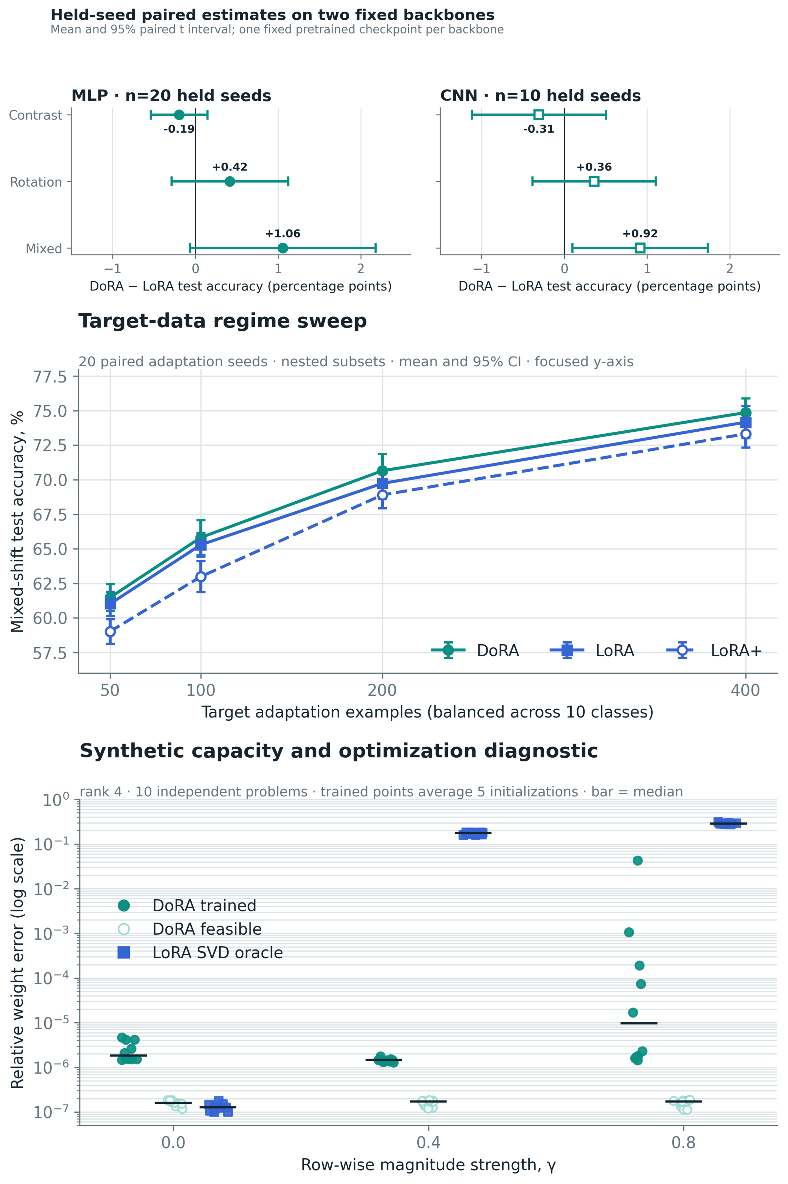
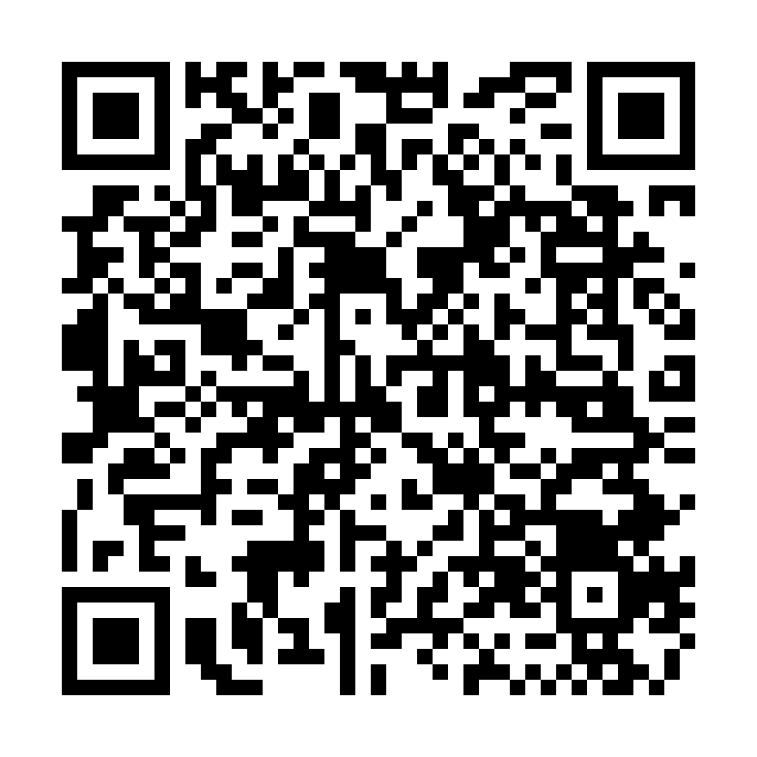
When does DoRA help?
Geometry, budgets, and held-seed few-shot adaptation
Vladislav Lapin · MIPT FPMI / AI360 · AIRI Summer School 2026
Why separate magnitude from direction?
HELD-SEED MIXED-SHIFT ESTIMATES
LoRA adds a low-rank update BA, coupling row direction and row norm. DoRA writes W = m ⊙ (W₀ + BA) / ‖W₀ + BA‖₂, so BA controls direction while m controls row scale.
Research question: does this extra degree of freedom improve target adaptation after fair selection, budget controls, and negative controls?
+1.06 pp MLP · +0.92 pp CNN
15/20 MLP pairs and 8/10 CNN pairs favored DoRA. Holm-adjusted p=.382213 (MLP) / .158955 (CNN): internal fixed-checkpoint evidence, not external replication.
LoRA
W₀
+ BA
Ŵ = W₀ + BA
DoRA
W₀
V = W₀ + BA
V / ‖V‖₂
m ⊙ V/‖V‖₂
direction
independent row scale m
Same rank r; DoRA adds d_out trainable magnitude parameters.
Figure 1. LoRA couples scale and direction; DoRA models row scale explicitly.
Frozen protocol before held-seed evaluation
Pilot only (validation): learning rate, early stopping, and rank allocation.
Held-seed: 20 MLP + 10 CNN adaptation seeds; one fixed checkpoint each; 3 shifts; Holm families m=9 / 6 / 3 (secondary descriptive).
Baselines: frozen, magnitude-only, LoRA, LoRA+ (fixed B/A=16), matched-budget LoRA, budgeted DoRA, and full fine-tuning.
Robustness: 4 nested data regimes; 10 synthetic targets × 5 initializations.
1,960 saved result rows; 1,840 training / optimization jobs.
Figure 2. Held-seed estimate → data regime → capacity / optimization diagnostic.
Negative controls prevent a victory-only story
Target-test evaluation followed the frozen validation-selected protocol. Internal confirmation on fixed checkpoints; exact CIs, raw/adjusted p-values, and rank budgets are in the repository.
Contrast (MLP): magnitude-only 96.90% > DoRA 95.18%.
Rotation (MLP): matched-budget LoRA = DoRA = 93.89%.
Mixed (MLP): matching the parameter budget reduces the DoRA gap to +0.53 pp; its CI crosses zero.
Scope: Digits, one fixed pretrained base per architecture, and one target split already seen during exploratory work. This is a controlled mechanism study, not an LLM-scale benchmark.
What the controls still support
- Mixed shift: DoRA reaches 75.22% (MLP) and 80.53% (CNN), near full FT (75.17%, 80.67%) with ~12-15% of its trainable parameters.
- Fairer baselines: matched-budget LoRA leaves +0.53 pp; DoRA-LoRA+ Holm p=.050935 (> .05); budgeted DoRA +.82 pp (secondary Holm p=.347089).
- Synthetic diagnostic (gamma=.8): DoRA is representationally exact; 44/50 runs reach error <10^-3. LoRA oracle mean error is .289.
- Next test: heterogeneous row-norm drift, retaining LoRA and magnitude-only controls.
[1] Hu et al. LoRA. ICLR 2022. [2] Liu et al. DoRA. ICML 2024.
[3] Hayou et al. LoRA+. ICML 2024. Statistical protocol and raw CSV: GitHub.
Code, raw results, notebook, and report → public GitHub repository.
CODE + DATA

