Slide 1
OSI MODEL
Open Systems Interconnection Basic Reference Model

Slide 2
Contents
1. What is OSI?
2. OSI Layers
2.1. Layer 1: Physical Layer
2.2. Layer 2: Data Link Layer
2.3. Layer 3: Network Layer
2.4. Layer 4: Transport Layer
2.5. Layer 5: Session Layers
2.6. Layer 6: Presentation Layer
2.7. Layer 7: Application Layer

Slide 3
1. What is OSI?
The Open Systems Interconnection model (OSI model) is a model that was developed by the ISO and it describes the rules and procedures for the interoperability of diverse communication systems with standard protocols.
In this model, a networking system was divided into 7 layers. Within each layer, one or more entities implement its functionality. Each entity interacted directly only with the layer immediately beneath it, and provided facilities for use by the layer above it.

Slide 4
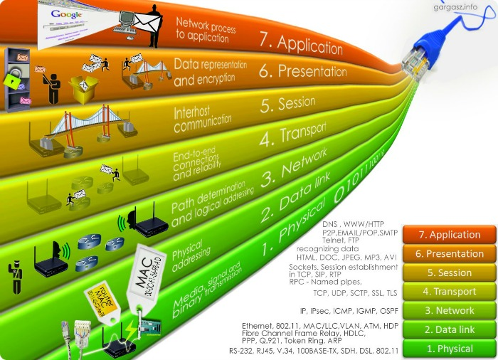
2. OSI Layers

Slide 5
2.1. Layer 1: Physical Layer
defines the method of transferring data from one device to another:
converts bits to electronic signals for outgoing messages;
converts electronic signals into bits for incoming messages;
controls the interface between the computer and network media (coaxial cable, twisted pair).
Protocol: IEEE 802.15 (Bluetooth), 802.11 Wi-Fi, Etherloop, GSM
Data Type: Bit

Slide 6
2.2. Layer 2: Data Link Layer
it provides interaction of networks at the physical level and controls errors that may occur:
received from the physical layer, the data presented in bits, it packs into frames, checks them for integrity;
corrects errors (generates a second request for a damaged frame) and sends it to the network layer;
interact with one or more physical layers, controlling and controlling this interaction.
Protocol: PPP, IEEE 802.22, ARP, L2TP
Data Type: Bit/Frame

Slide 7
2.3. Layer 3: Network Layer
provides definition of the data transfer path:
translation of logical addresses and names in physical;
defines the shortest routes, switching and routing;
keeps track of problems and "congestion" in the network.
Protocol:IPv4, IPv6, Ipsec
Data Type: Packet

Slide 8
2.4. Layer 4: Transport Layer
provides reliable data transfer from sender to recipient:
controls the flow of data between the parties by segmenting long data streams into “smaller” chunks of data;
collects pieces of data in their original sequence at the receiving end;
provides confirmations of successful transmissions and repeated requests for packets that come with errors.
Protocol: TCP, UDP, SCTP
Data Type: Segment/Datagram

Slide 9
2.5. Layer 5: Session Layers
ensures the maintenance of a communication session, allowing applications to interact with each other for a long time:
manages session creation/termination;
information exchange;
task synchronization;
determining the right to transfer data and maintaining the session during periods of inactivity of applications.
Protocol: RPC, PAP
Data Type: PDU (Protocol Data Units)

Slide 10
2.6. Layer 6: Presentation Layer
provides data organization when sending it:
protocol conversion and data encoding/decoding;
for outgoing messages, converts data to a common format for transmission over the network; for incoming messages, converts data from a common network format to a format that the receiving application can understand;
redirect requests to another network resource if they cannot be processed locally.
Protocol: ASCII, EBCDIC
Data Type: PDU (Protocol Data Units)

Slide 11
2.7. Layer 7: Application Layer
the top level of the model, which provides the interaction of user applications with the network:
allows applications to use network services (remote access to files and databases, email forwarding)
responsible for the transfer of proprietary information;
provides applications with error information;
creates requests to the presentation level.
Protocol: HTTP, FTP, POP3
Data Type: PDU (Protocol Data Units)

Slide 12
Thanks for your attention!

