Slide 1
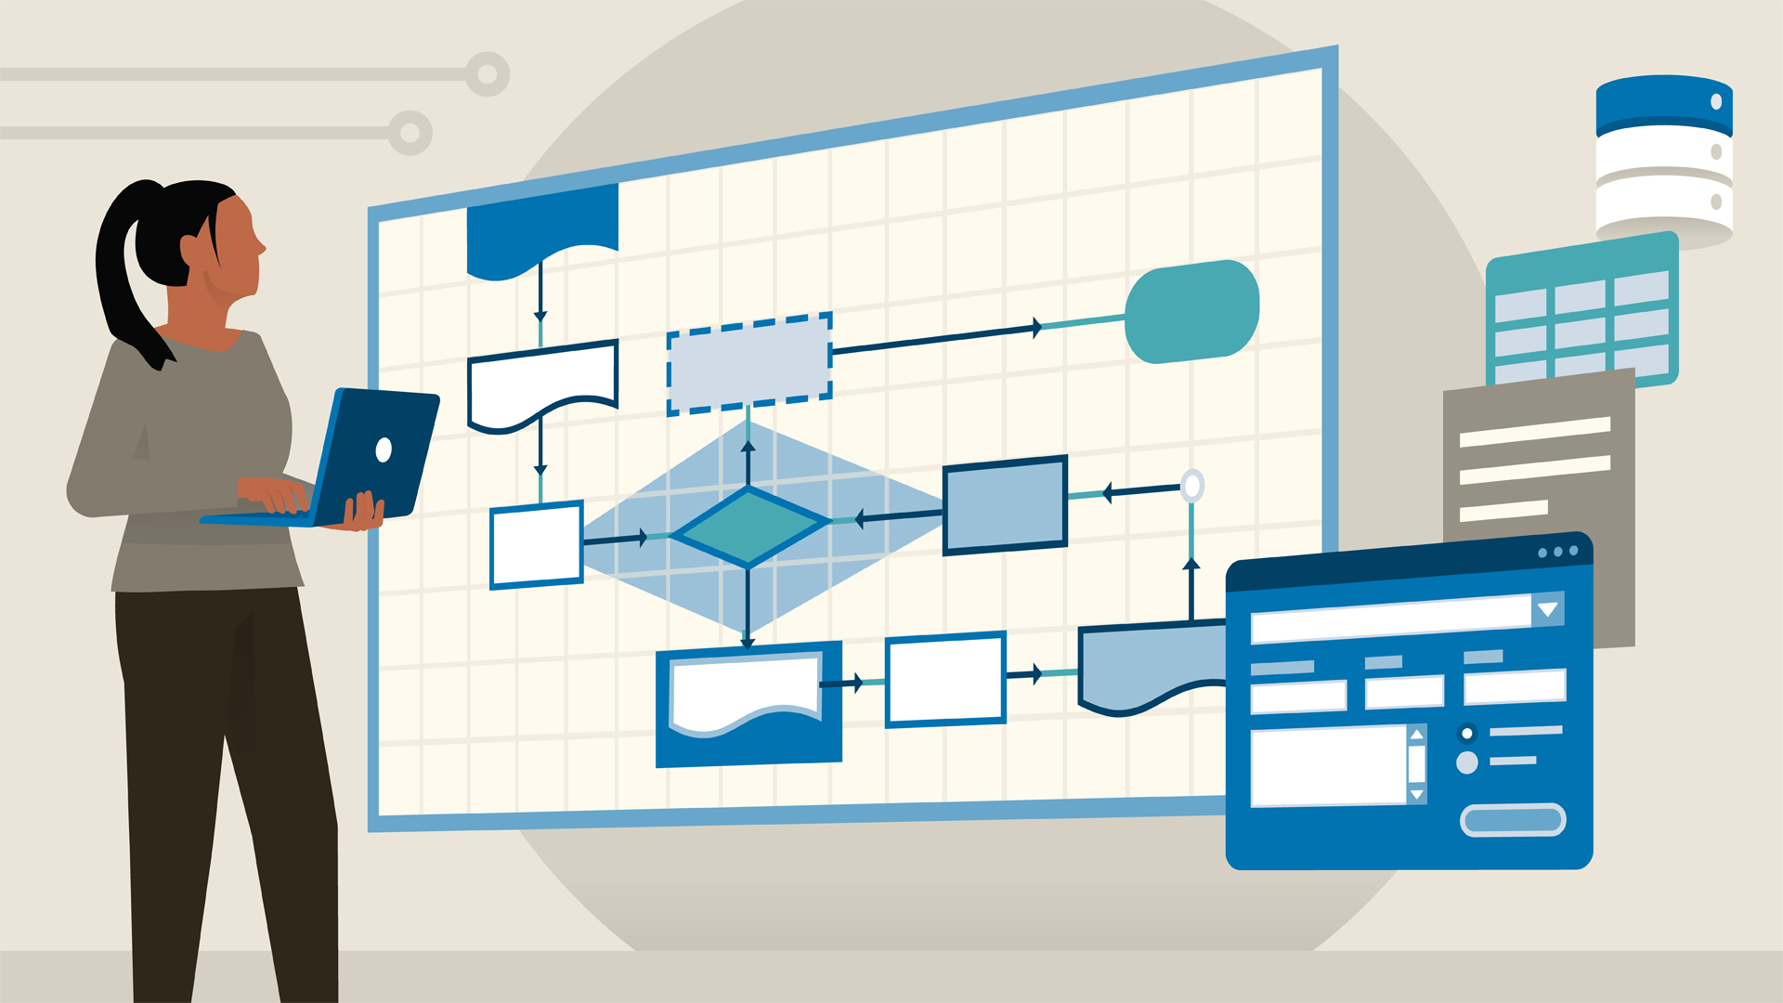
Software Development Life Cycle Models

Slide 2
Hello…

Slide 3
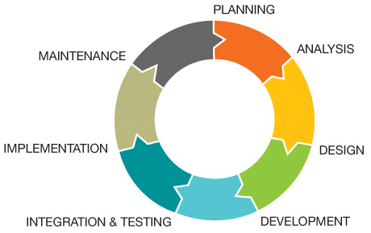
SDLC Model
The Software Development Life Cycle (SDLC) provides a systematic process for building and delivering software applications from inception to completion.

Slide 4
SDLC Models
01
Waterfall model
02
V- model
03
RAD model
04
Agile model

Slide 5
Waterfall Model
Waterfall is the oldest and most straightforward of the structured SDLC methodologies.
There are strict phases and each phase needs to be completed first before going to the next phase.
Each phase relies on information from the previous stage and has its own project plan.

Slide 6
Waterfall Model Phases
Development of system requirements
Software requirements development
Analysis
Projection
Coding
Testing
Exploitation

Slide 7
Each phase has specific deliverables and a review process.
Advantages
Of Waterfall
Model
Phases are processed and completed one at a time.
Works well for smaller projects where requirements are very well understood.
It reinforces the notions of “define before design” and “design before code”.

Slide 8
Disadvantages Of Waterfall Model
Adjusting scope during the life cycle can kill a project.
No working software is produced until late during the life cycle.
High amounts of risk and uncertainty.
Poor model for complex and object- oriented projects.
Poor model for long and ongoing projects.
Poor model where requirements are at a moderate to high risk of changing.

Slide 9
When To Use Waterfall Model
Such model is highly used where requirements are clear and there will be no changes in the development time.
We can find such scenarios in defence projects, where requirements will be clear since before they write requirements they will analyses well.
We can also name this kind of life cycle model for migration projects, where requirements will be same only platform or languages may vary / change.
Also can use for projects where sponsor themselves will do testing activities, since till the completion of the coding we will not deliver the project.

Slide 10
V model (development through testing)
This model has an algorithm that is more close to modern methods, but still has several disadvantages. It is one of the main practices of extreme programming.
Planning projects and requirements
Production, operation and maintenance
Product requirements analysis and specification
System and Acceptance Testing
Development of an architectural project at the highest level
Integration and Testing
Detailed project development
Unit testing
Coding

Slide 11
Rapid Application Development (RAD)
Rapid Application Development Model or RAD for short, is a “try before you buy” approach to software development.
end users can produce better feedback when examining a live system.
lower level of rejection when the application is placed into production, but this success most often comes at the expense.
The end user is allowed to work with the screens online.

Slide 12
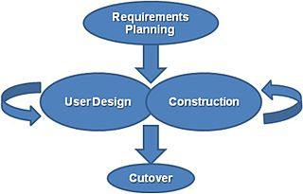
RAD Model Process

Slide 13
Advantages of RAD Model
• RAD reduces the development time and reusability of components help to speed up development.
• All functions are modularized so it is easy to work with.
• For large projects RAD require highly skilled engineers in the team.
• Customers are the witness in lots of time.

Slide 14
• Both end customer and developer should be committed to complete the system in a much abbreviated time frame.
• If commitment is lacking RAD will fail.
• RAD is based on Object Oriented approach and if it is difficult to modularize the project the RAD may not work well.
Disadvantages of RAD Model

Slide 15
When To Use RAD Model
Model When there is a need to create a system that can be modularized in 2-3 months of time.
It should be used if there is high availability of designers for modelling and the budget is high enough to afford their cost along with the cost of automated code generating tools.
This model should be chosen only if resources with high business knowledge are available and there is a need to produce the system in a short span of time.

Slide 16
Agile model believes that every project needs to be handled differently and the existing methods need to be tailored to best suit the project requirements.
In Agile, the tasks are divided to time boxes (small time frames) to deliver specific features for a release.
Agile Model
Iterative approach is taken and working software build is delivered after each iteration.

Slide 17
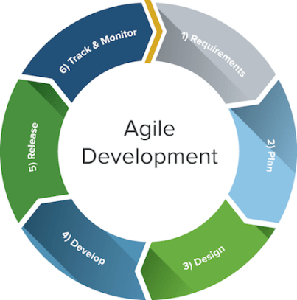
Agile Model

Slide 18
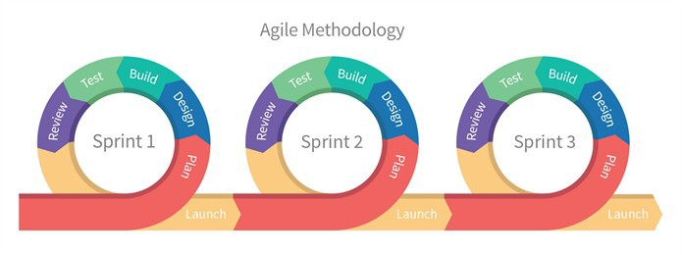
Agile model

Slide 19

Advantages of Agile Model
• Is a very realistic approach to software development.
• Promotes teamwork and cross training.
• Functionality can be developed rapidly and demonstrated.
• Resource requirements are minimum.
• Suitable for fixed or changing requirements
• Delivers early partial working solutions.
• Good model for environments that change steadily.
• Minimal rules, documentation easily employed.
• Enables concurrent development and delivery within an overall planned context.
• Little or no planning required.
• Easy to manage.
• Gives flexibility to developers.

Slide 20

Disadvantages of Agile Model
• Not suitable for handling complex dependencies.
• More risk of sustainability, maintainability and extensibility.
• An overall plan, an agile leader and agile PM practice is a must without which it will not work.
• Strict delivery management dictates the scope, functionality to be delivered, and adjustments to meet the deadlines.
• Depends heavily on customer interaction, so if customer is not clear, team can be driven in the wrong direction.
• There is a very high individual dependency, since there is minimum documentation generated.
• Transfer of technology to new team members may be quite challenging due to lack of documentation.

Slide 21
Comparison
 | Waterfall | V-model | RAD | Agile
Understanding Requirements | Beginning | Beginning | Intermediate | Advanced
Duration | Long | Long | Short | Short
Cost | Low | Expensive | High | Medium
Document and training required | Vital | Yes | Yes | No
Guarantee of success | Less | High | High | High
Client satisfaction | Low | Low | High | High
Risk involvement | High | Very low | Medium | Low
Developers level | Beginners | Intermediate | Advanced | Advanced
Implementation | Easy | Complex | Easy | Easy

Slide 22
Thank you…

