Slide 1
Kanban
balance approach

Slide 2
What is Kanban?
Kanban is a simple method of managing and improving work in human systems. This approach aims to manage work by balancing needs with available capacity and improving handling of system-level bottlenecks.
Principles:
Make work visible
Help work to flow
Limit work in progress

Slide 3
1. Make work visible
The first step in introducing Kanban is to visualize your workflow. This is made in the form of a Kanban board, consisting of a simple board and sticky notes or cards. Each card on the board represents a task.

Slide 4

1. Make work visible
There are three columns in the classic Kanban board model:
“To Do”: This column lists tasks that are not already running. (aka “backlog”)
“Doing”: Consists of tasks that are performed.
“Done”: Consists of tasks that are completed.

Slide 5
2. Help work to flow
At the heart of Kanban is the concept of Flow. This means that cards must pass through the system as evenly as possible, without long waiting or blocking. Anything that impedes the flow must be critically examined.

Slide 6
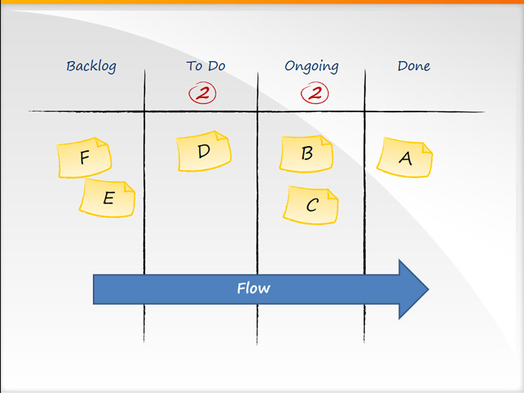
2. Help work to flow
The Flow concept is critical, and by measuring Flow indicators and working to improve them, you can significantly increase the speed of delivery processes by reducing cycle times and improving the quality of your products or services, receiving faster feedback from your customers - internal or external.

Slide 7
3. Limit work in progress
A key aspect of Kanban is to reduce the number of multi-tasking tasks that most teams and brainworkers tend to perform, and instead encourage them: “Stop starting! And start to finish! "

Slide 8
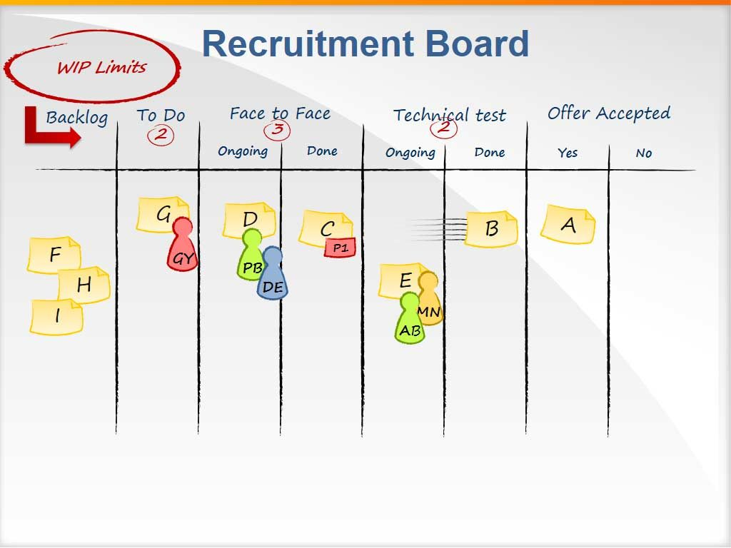
3. Limit work in progress
Work in progress - the restrictions defined at each stage of the work process on the Kanban board encourage team members to finish work at hand and only after that proceed to the next stage of work.

Slide 9
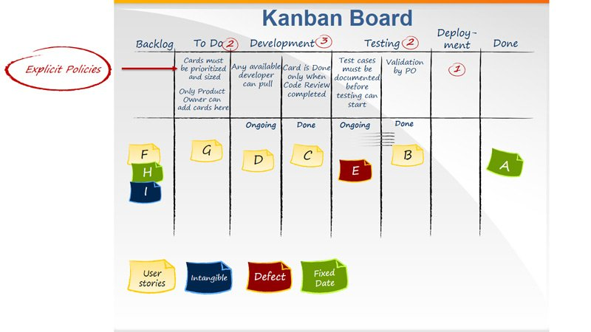
Software development
Kanban boards can demonstrate complex workflows depending on the complexity of the workflow and the need to visualize and study certain parts of the workflow to identify bottlenecks in order to eliminate them.

Slide 10
The difference between Kanban and Scrum:
in Kanban there is no time frame for anything (neither for tasks, nor for sprints)
Challenge Longer and Less in Kanban
in kanban, an assessment of the timing of the assignment is not mandatory or not carried out
in kanban, “team speed” is absent and only the average time for the full implementation of the task is taken into account
It is not possible to use Kanban in its purest form for development, since this is not the basis and methodology, but you can apply the Kanban method to Scrum to get even better results.

