Slide 1
Scrum
this is a flexible way to manage a project
Notes:
1

Slide 2
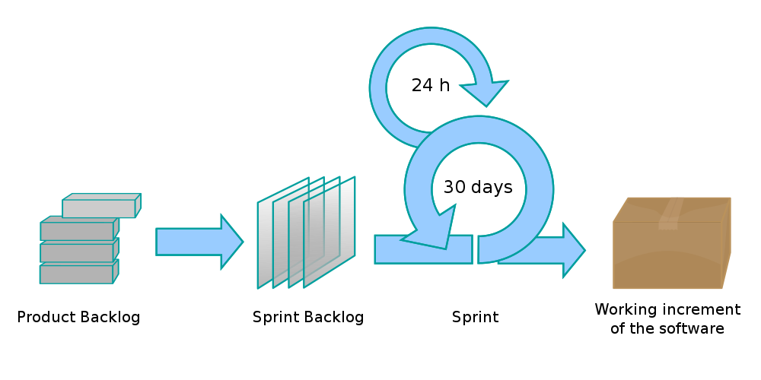
What is Scrum?
Scrum is an iterative and incremental framework for managing product development. Scrum allows in rigidly fixed and short-term iterations, called sprints, to provide the end user with working software with new features for which the highest priority is determined.
Notes:
1

Slide 3
What is Scrum?
A key principle of Scrum is the double recognition that customers will change their minds about what they want or need (often called variability of requirements), and that unpredictable problems will arise for which a predictive or planned approach is not suitable. Thus, Scrum takes an empirical evidence-based approach, recognizing that the problem cannot be fully understood or determined in advance, and instead focuses on how to maximize the team’s ability to quickly complete tasks, respond to emerging requirements, and adapt to evolving technology and changing market conditions.
Notes:
1

Slide 4
Workflow
Sprint - an iteration in the battle during which the functional growth of the software is created. This is rigidly fixed in time. The duration of one sprint is from 1 to 4 weeks.
The Scrum methodology suggests holding a planning meeting at the beginning of the sprint, in which team members figure out how many elements they can complete, and then create a list of sprint tasks — a list of tasks that must be completed during the sprint.
During a fast Scrum sprint, the Scrum team takes on a small set of functions from idea to coded and tested functionality. In the end, these functions are fulfilled, that is, encoded, tested and integrated into a developing product or system.
Notes:
1

Slide 5
Workflow
On each sprint day, all team members must attend Scrum's daily meetings, including ScrumMaster and the product owner. Meeting time no more than 15 minutes. During this time, team members share what they worked on the previous day, will work on that day, and identify any obstacles to progress.
The Scrum model sees daily quarrels as a way to synchronize team members when they discuss sprint performance.
At the end of the sprint, the team reviews the sprint, during which the team demonstrates new features for the software or any other participant who wants to provide feedback that could affect the next sprint.
Notes:
1

Slide 6
Workflow
This feedback loop when developing Scrum software can lead to changes in recently delivered functionality, but with the same probability it can lead to a revision or addition of elements to the product backlog.
Another activity in Scrum project management is a sprint retrospective at the end of each sprint. The entire team participates in this meeting, including ScrumMaster and software. A meeting is an opportunity to think about a sprint that has ended and identify opportunities for improvement.
Notes:
1

Slide 7
Artifacts
A project backlog is a list of functional requirements, ordered by importance for implementation. Elements in this list are called user stories or journal items. The project’s wishbook is open for editing by all participants in the Scrum process.
The sprint wait log contains the functionality selected by the product owner from the product run log. All functions are divided into tasks, each of which is evaluated by the scrum team. Every day, the team estimates the amount of work that needs to be done to complete the sprint.
Notes:
1

Slide 8
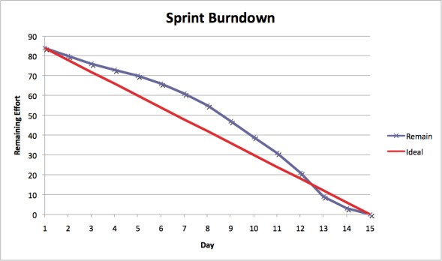
Artifacts
Additional artifacts resulting from Scrum's flexible methodology are the sprint recession chart and the release recession chart. Burndown charts show the amount of work left in either a sprint or release and are an effective tool in Scrum software development to determine if a sprint or release is scheduled so that all scheduled work is completed by the desired date.
Notes:
1

Slide 9
Roles
The product owner represents the interests of end users and other interested parties in the product. The product owner is responsible for prioritizing the Scrum development process to ensure that it meets the requirements as additional information about the system being created, its users, the team, and so on.
The Scrum master holds meetings, monitors compliance with all the principles of the fight, resolves contradictions and protects the team from distractions. This role does not imply anything but the proper conduct of the scrum process.
Notes:
1

Slide 10
Roles
The development team is a multifunctional project development team consisting of professionals of various profiles: testers, architects, analysts, programmers, etc. Ideally, the size of the team is from 3 to 9 people. The team is the only fully involved development partner and is responsible for the overall result. No one but the team can interfere in the development process during the sprint.
Notes:
1

Slide 11
Main activities
Product backlog
requirements
priorities
Sprint backlog
Planning the sprint backlog
define a sprint goal
choice of user stories for the sprint
separation of user stories into tasks
estimate of effort
Daily Scrum
what is done, what will we do
Update tasks and burndown chart
Sprint review
Sprint retrospective

