Slide 1
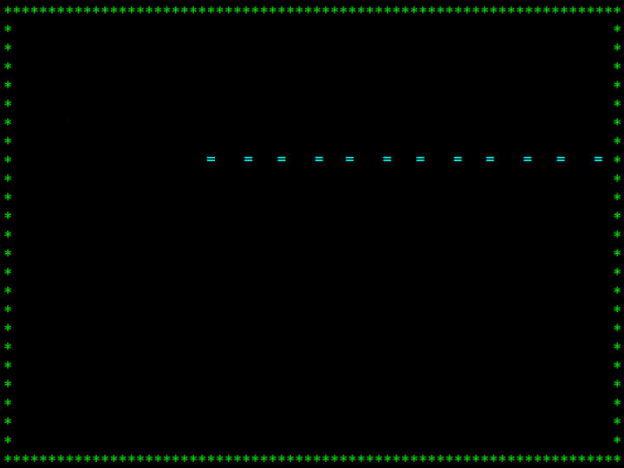

TEAM “COMPITIVE”

Slide 2
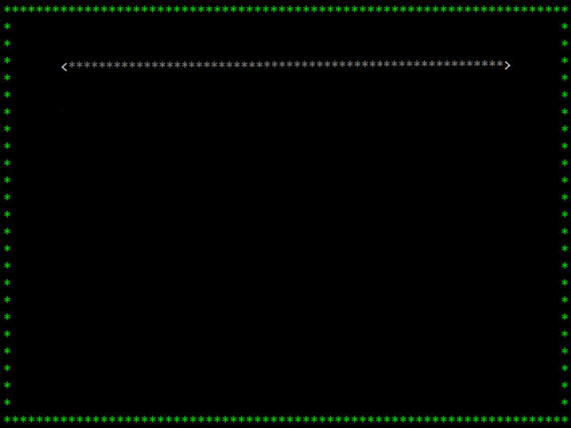
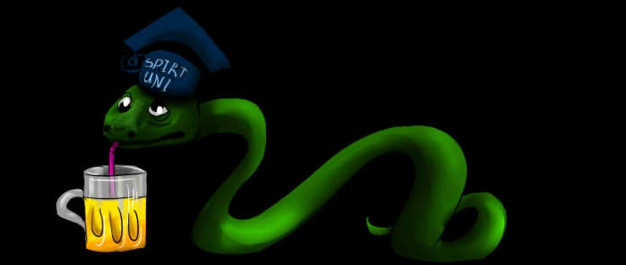
THE GAME
DRUNK SNAKE:
To make the classic snake a bit more different we decided to change the controls of the game after the 7th level;
After every two pieces of food we change the locations of all the obstacles.

Slide 3




THE TEAM
Kiril:
Added borders;
Added methods;
Alexander:
Added Menu;
Added obstacles;
Vladislav:
Added levels;
Added change of controls;
Boyana:
Added Best Score;
Made the presentation.

Slide 4
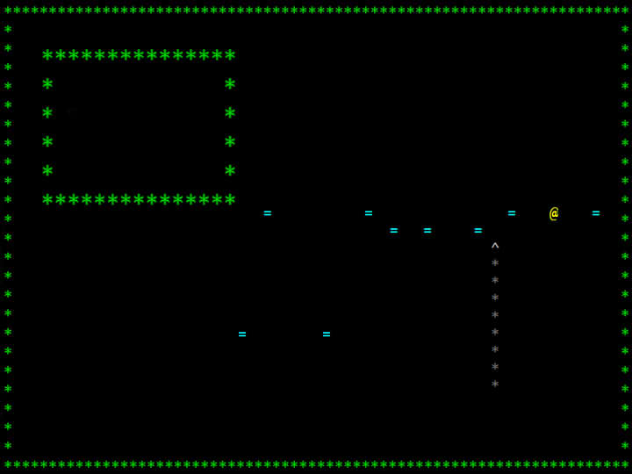
THANKS FOR YOUR ATTENTION!

