Slide 1


Data cleaning and visualization
CNN articles 2013-2022

Slide 2
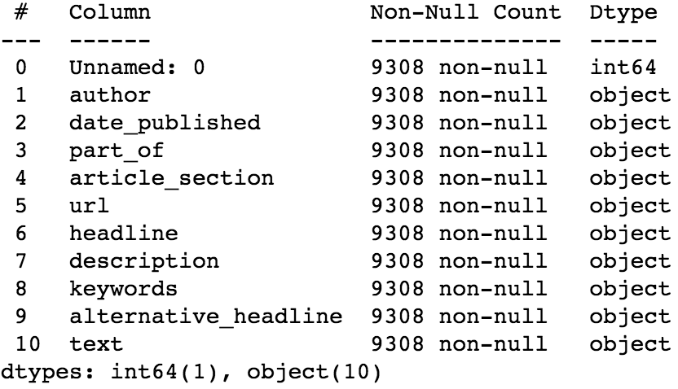

Raw data
This dataset contains all CNN
articles from 2019 to 2022

Slide 3
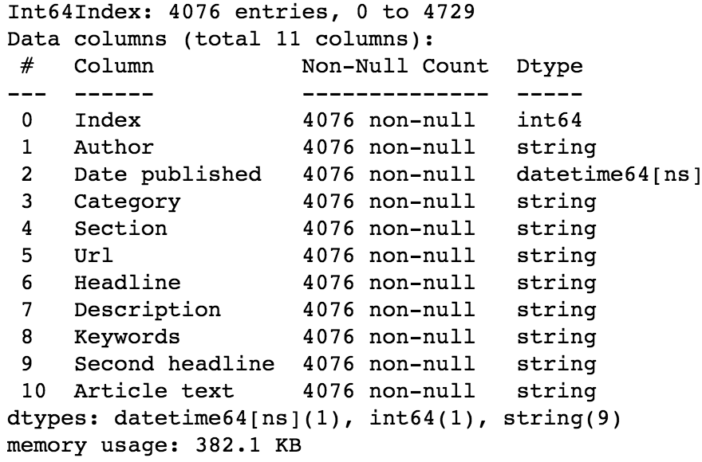
Duplicates and missing data
After cleaning and type change
Dataset contains 5232 duplicates and 0 null cells

Slide 4
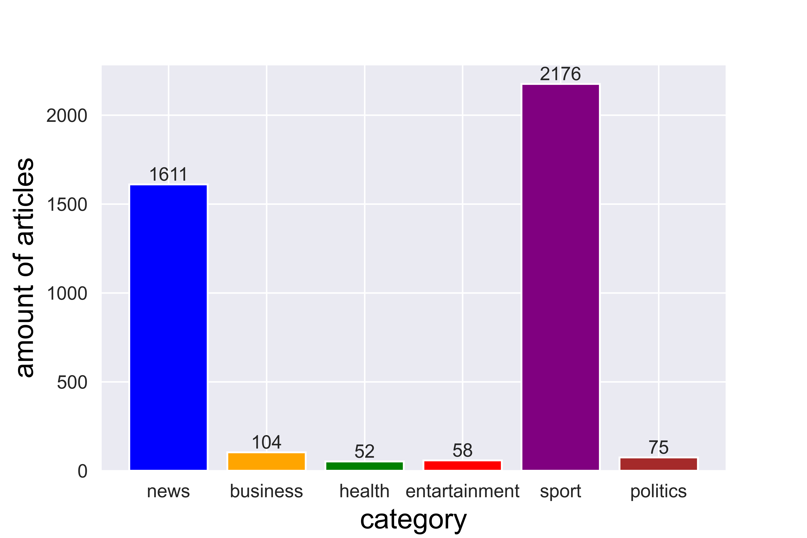

Data visualization
Top categories of CNN
articles

Slide 5
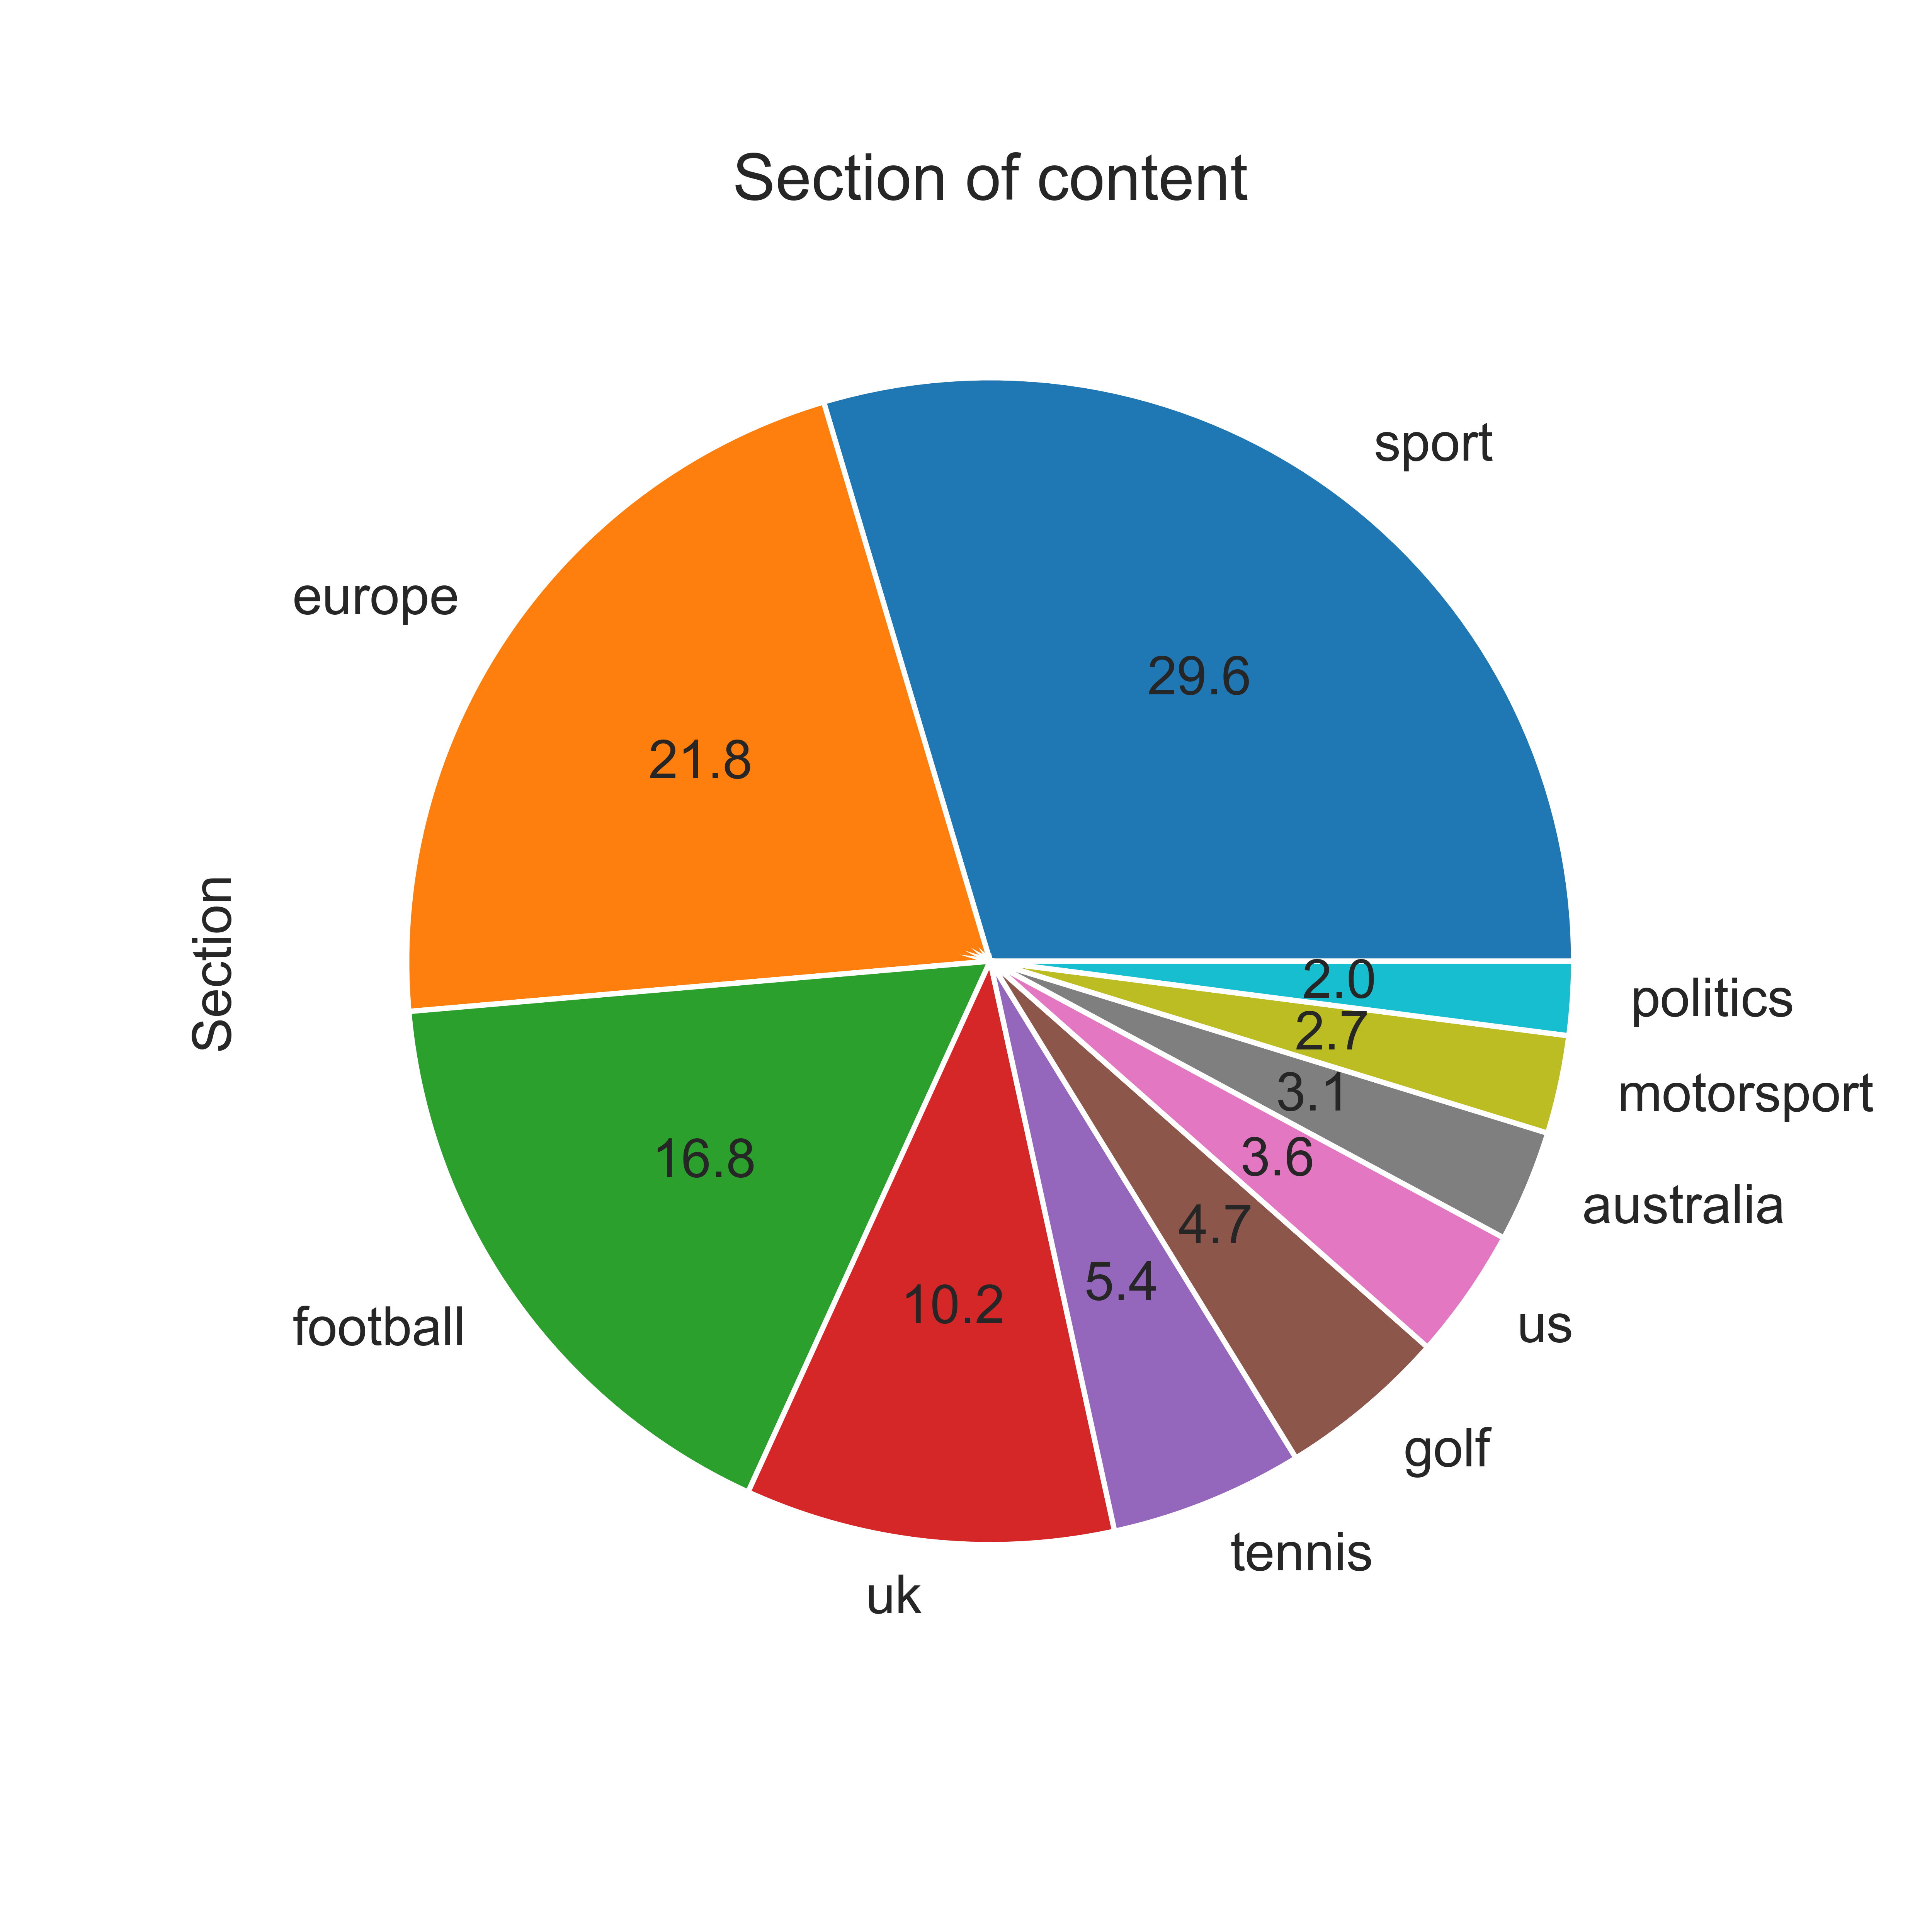
Data visualization
Section of content chart (top 10 sections)

Slide 6
Data visualization
Section of content chart (all sections)

Slide 7
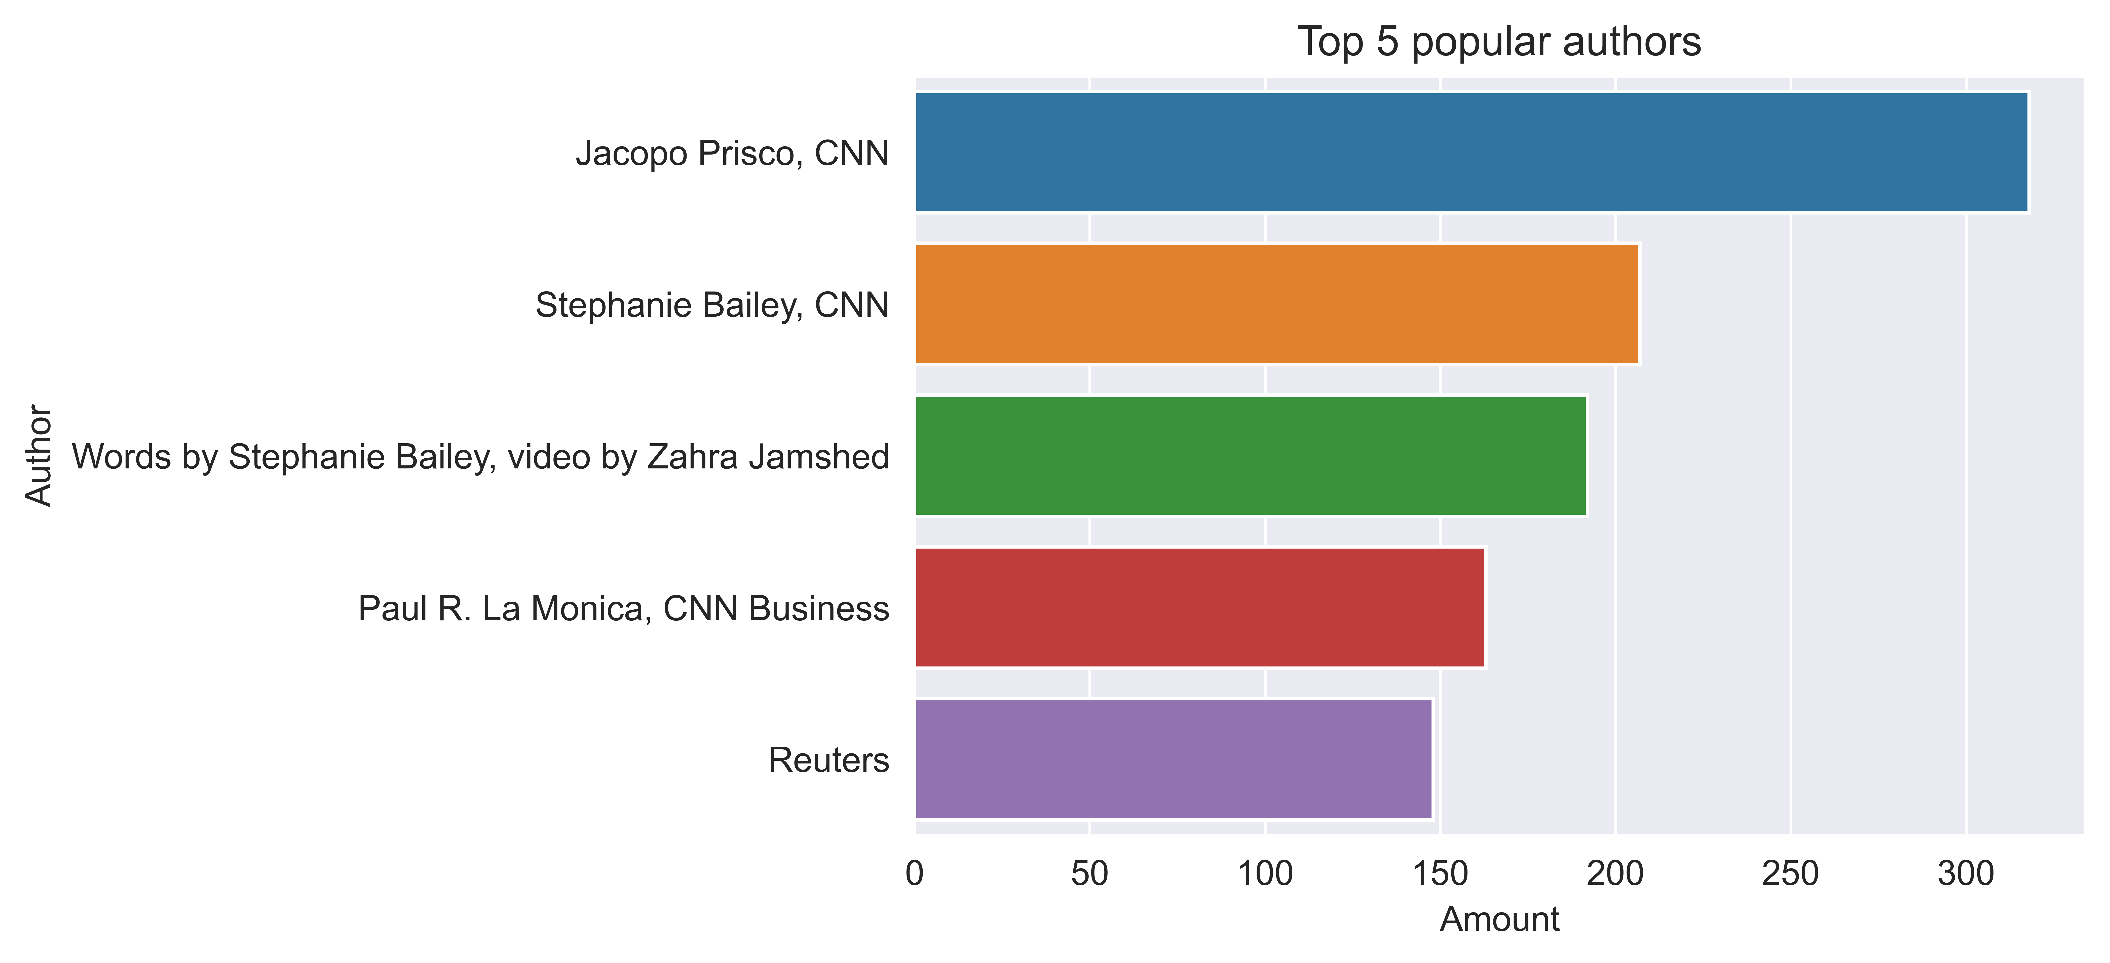
Data visualization
Top 5 popular authors chart (by amount of articles)

