Slide 1
Introduction
Introduction
Contributions
Motivation
Methodology
Results

Slide 2
Introduction
CNNs for the Object Classification are trained on ImageNet, and overall show a good accuracy on Validation Set
Previous studies have shown that brightness is an important feature

Slide 3
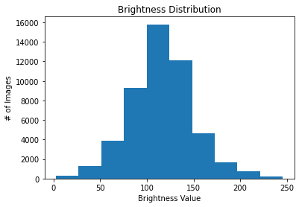
Introduction
It is important to study the effect of brightness on CNNs
Test how CNNs would perform on dark images separately (categorical perspective)
However, validation set does not have enough dark images

Slide 4
Introduction
It is possible to increase the size of validation set by creating images with reduced brightness (percentage perspective)
The premodel can affect the CNN accuracy as well
Additional effects on CNNs can be provided by dataset’s balance, type, and size

Slide 5
Contributions
Investigate how the brightness feature of images can affect the premodel and CNN inference accuracy and compare different brightness types.
Compare the accuracy of several CNNs, and test different CNN combinations with the premodel.
Analyze comprehensively what effects the size, balance, and type of the dataset have on the classification accuracy.

Slide 6
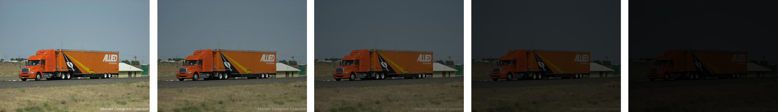
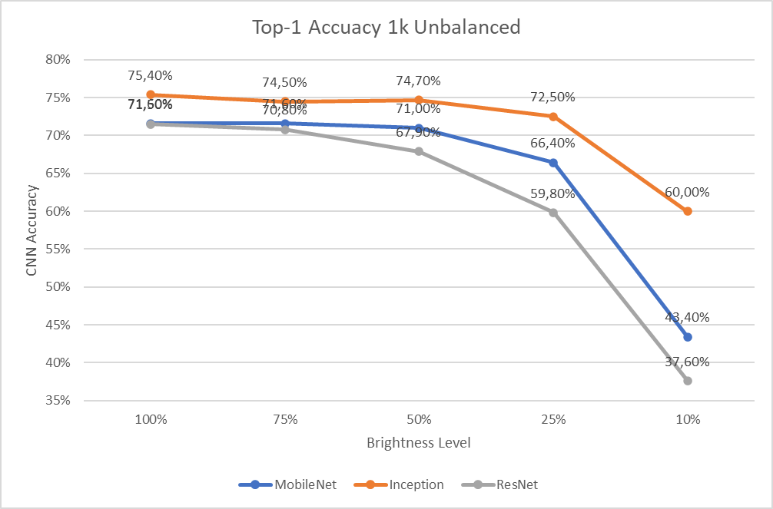
Motivation
We reduce brightness on an unbalanced dataset
See that accuracy drops significantly only after 50% decrease

Slide 7
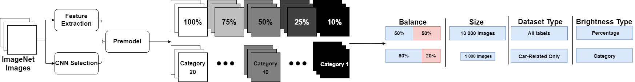
Phase I
Phase II
Phase III

Slide 8
Methodology
Phase I: Premodel & Dataset Creation
Create dataset & select CNNs for the Premodel
Reduce brightness of ImageNet, create balanced/unbalanced/car-related datasets of different size
Split ImageNet into 20 categories

Slide 9
Methodology
Phase II: Balance and Size
Get CNN Accuracy of datasets with every size and balance
Compare the effects of dataset size on the CNN and Premodel Accuracy
Study the effects of dataset class balance on the CNN and Premodel Accuracy

Slide 10
Methodology
Phase III: Dataset & Brightness
Find corresponding category for each dataset
Get CNN accuracy for corresponding categories, analyze and compare the effect of brightness type
Study the difference between car-related and usual datasets

Slide 11
Phase I

Slide 12
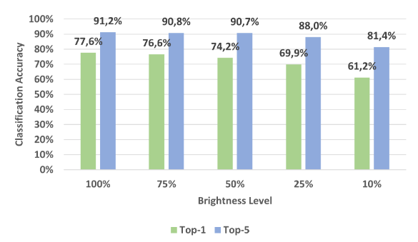
Experimental Results: Premodel Creation
Premodel should use 2 CNNs
MobileNet is essential, because ~70% of the dataset has this class
Inception individually is better than ResNet
Selected CNNs: MobileNet and Inception

Slide 13
Phase II

Slide 14
Experimental Results: Class Balance
The premodel is used
The Balanced datasets have lower accuracy
Because most of the easy images are removed from them
Size has little to no effect
Premodel shows better results with Unbalanced Datasets

Slide 16
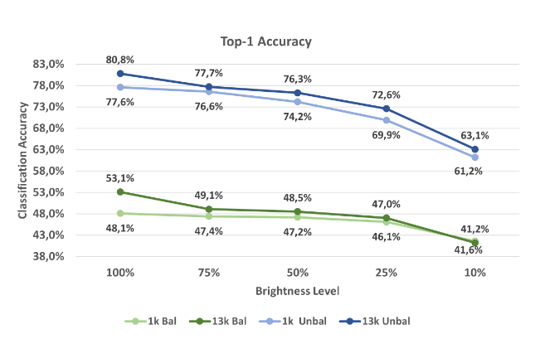
Experimental Results: Size Comparison
The size was compared using premodel
1k/13k Balanced/Unbalanced datasets were used
The effect of size is not that noticeable

Slide 17
Phase III

Slide 18
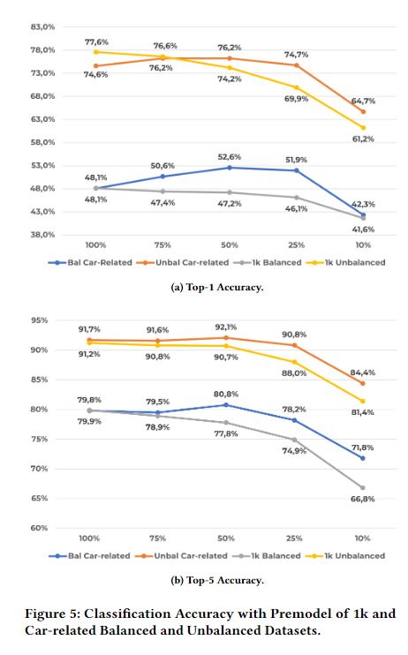
Experimental Results: Type Comparison
Compares the accuracy of car-related datasets with the Balanced and Unbalanced ones
The premodel is used
Conclusion is that the difference lies in image features
For example, car-related datasets have lower average brightness, higher contrast, etc.

Slide 19
Experimental Results: Brightness Comparison
Category images have almost the same accuracy even as the brightness significantly decreases
Percentage Images have the same trend for the first 4 brightness levels
However, the 10% brightness level shows a drastic accuracy drop, while the corresponding category shows much better results

Slide 20
Brightness Comparison With Premodel
Premodel shows better results than percentage perspective, because it uses both MobileNet and Inception, and switches between them
In some cases, premodel accuracy is worse than Inception accuracy, because it makes an incorrect prediction and selects MobileNet, which cannot classify this image
Premodel is better than Categorical Perspective in datasets with high brightness
Premodel is worse in lower brightness, because Categories have dark images, that still have a bright object

Slide 21
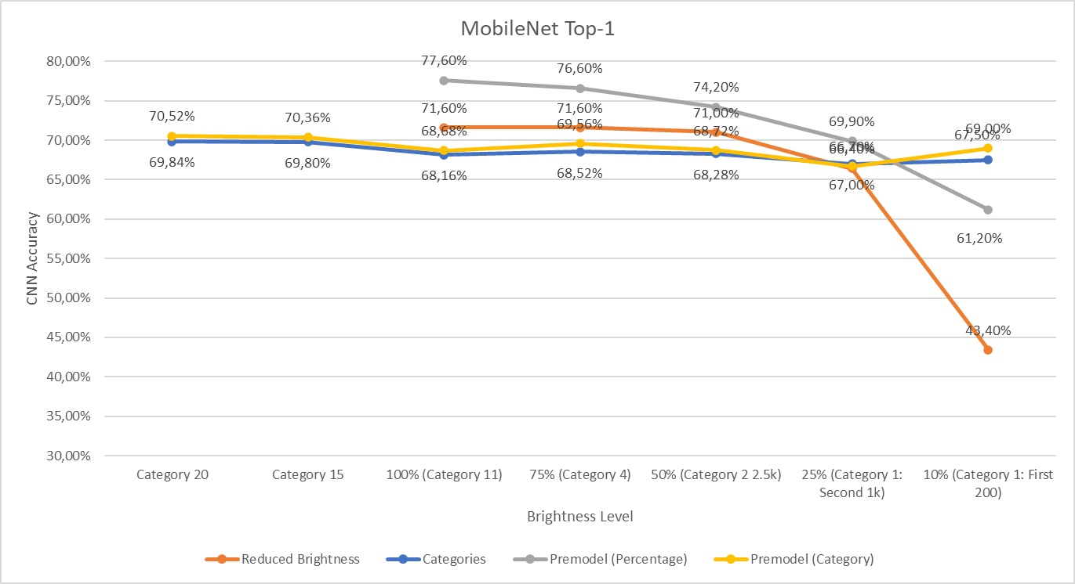

Slide 22
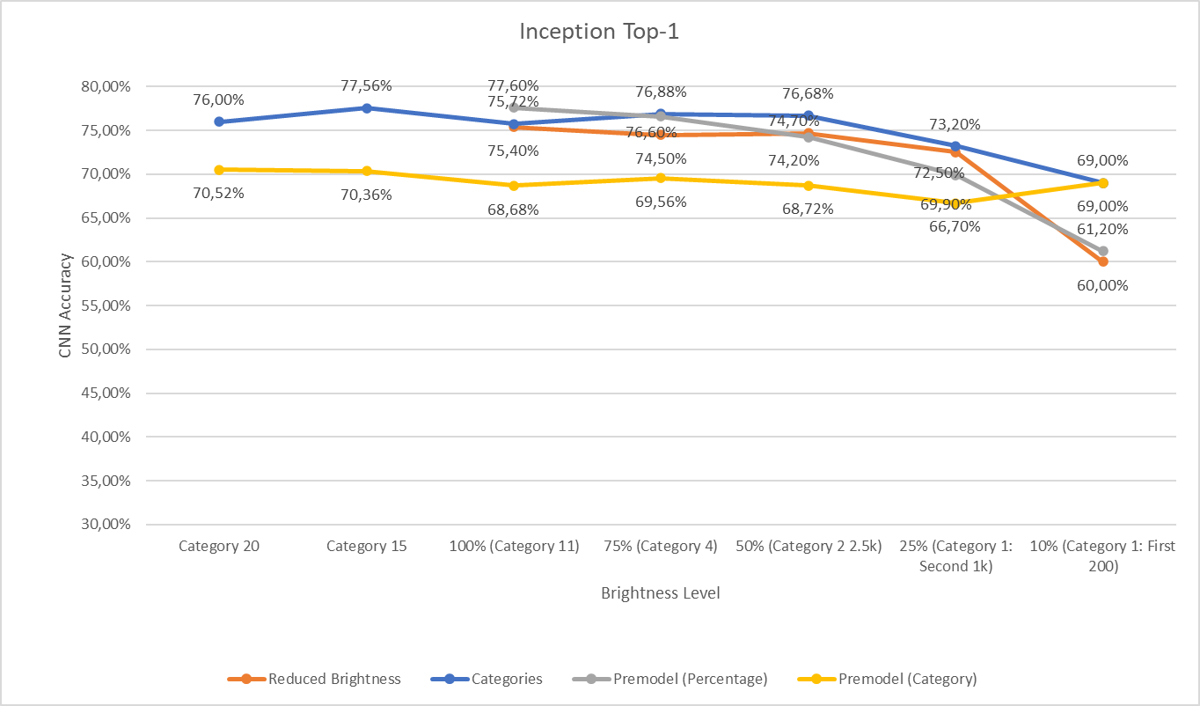

Slide 23
