Slide 1
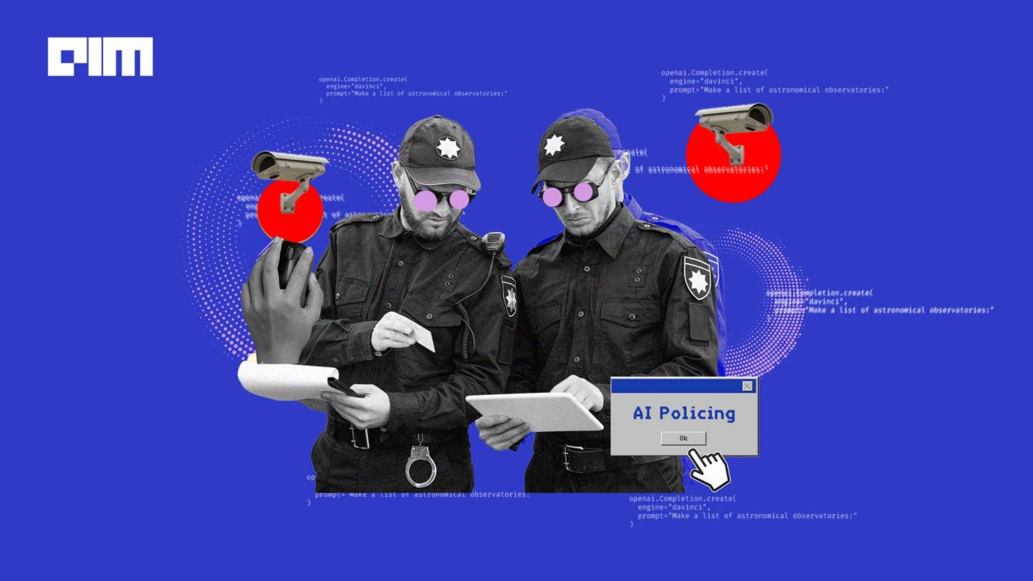

Predictive Policing

Slide 2
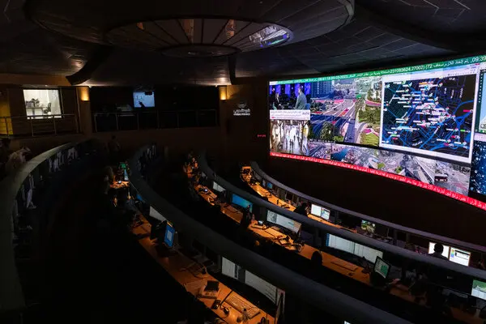
Definition
Predictive policing is the application of analytical techniques to identify high-risk targets for police
intervention and prevent crime by making statistical predictions.
This concept was explored in many different books, movies, articles, animated series. Every occurrence of such an exploration brought with it a doubt about the feasibility of such a system.
LETS GET STARTED

Slide 3
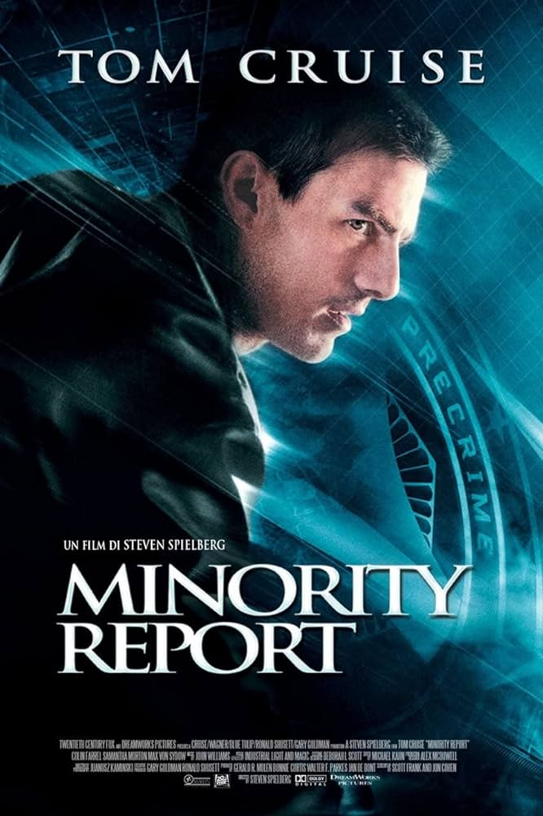

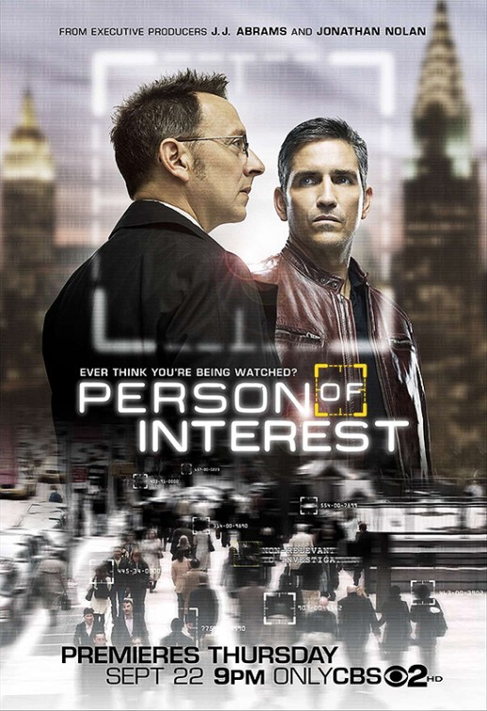
Exploration Cases of Predictive Policing in Science Fiction
OPTION 3
Presentations are communication tools.

Slide 4
What domains and subdomains are best representative of predictive policing?
Perception
Computer vision
Learning
Machine learning
Reasoning
Inductive Reasoning
Statistical Reasoning
Planning
Planning and scheduling
Optimisation
Searching

Slide 5
Benefits Drawbacks
Crime prevention
Informed decision-making
Advancement of the criminal justice system
The progressive uses of predictive policing
Privacy concerns
Lack of accuracy
Discrimination
Accountability

Slide 6
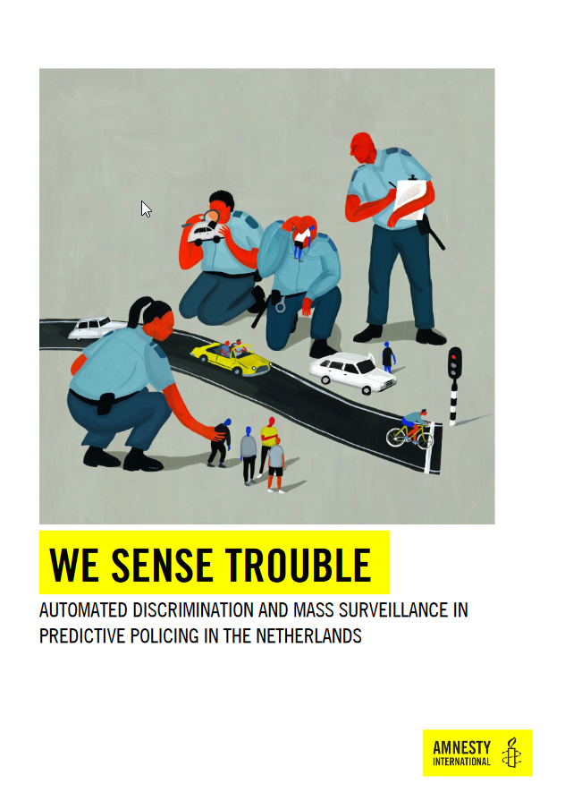



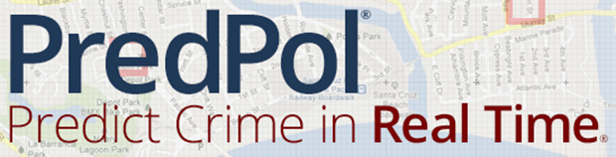
Feasibility

Slide 7
Sources:
Halley, C. (2022). What happens when police use AI to predict and prevent crime? JSTOR Daily. https://daily.jstor.org/what-happens-when-police-use-ai-to-predict-and-prevent-crime/
Michelle McQuigge, The Canadian Press. (2020, 1 september). Predictive policing tools use in Canada spark human rights concerns: report. vancouversun. https://vancouversun.com/news/local-news/predictive-policing-tools-use-in-canada-spark-human-rights-concerns-report
Van Der Steen, P. (2023, 18 augustus). De dubieuze jacht op ‘mobiel banditisme’ in het Koopwalhalla van Roermond - wordt vervolgd. Amnesty International. https://www.amnesty.nl/wordt-vervolgd/criminaliteit-voorspellen-roermond-politie
Bhuiyan, J., Levin, S., & Chang, A. (2021, 17 november). Revealed: the software that studies your Facebook friends to predict who may commit a crime. the Guardian. https://www.theguardian.com/us-news/2021/nov/17/police-surveillance-technology-voyager
Predictive Policing: Using technology to reduce crime. (2017, 21 september). FBI: Law Enforcement Bulletin. https://leb.fbi.gov/articles/featured-articles/predictive-policing-using-technology-to-reduce-crime
https://www.amnesty.nl/content/uploads/2020/09/Report-Predictive-Policing-RM-7.0-FINAL-TEXT_CK-2.pdf
https://ggw.studenttheses.ub.rug.nl/405/1/1718-RCG%20%20WOERDEN,%20CL%20van,%20Ma-thesis.pdf

Slide 8
Good reads:
Amnesty International report on use of Predictive Policing techniques in Roermond
MA Thesis Charlotte van Woerden “PREDICTIVE POLICING A LEGAL AND ETHICAL EXPLORATION”
Psycho Pass manhwa or watch the anime
thanks for
watching

