Slide 1
Extractive summarisation of UK annual reports narratives
By: Vladislav Yotkov Supervisor: Jonathan Shapiro

Slide 2
Financial Reports
Obligatory (financial performance reporting)
Periodic (annual, bi-annual, quarterly)
Regulated (by SEC¹, FRC², etc)
Informative (to investors, customers, etc)
SEC = Securities and Exchange Commission (USA)
FRC = Financial Reporting Council (UK)
Notes:
annual report
noun
a company's yearly report to shareholders, documenting its activities and finances in the previous financial year.

Slide 3
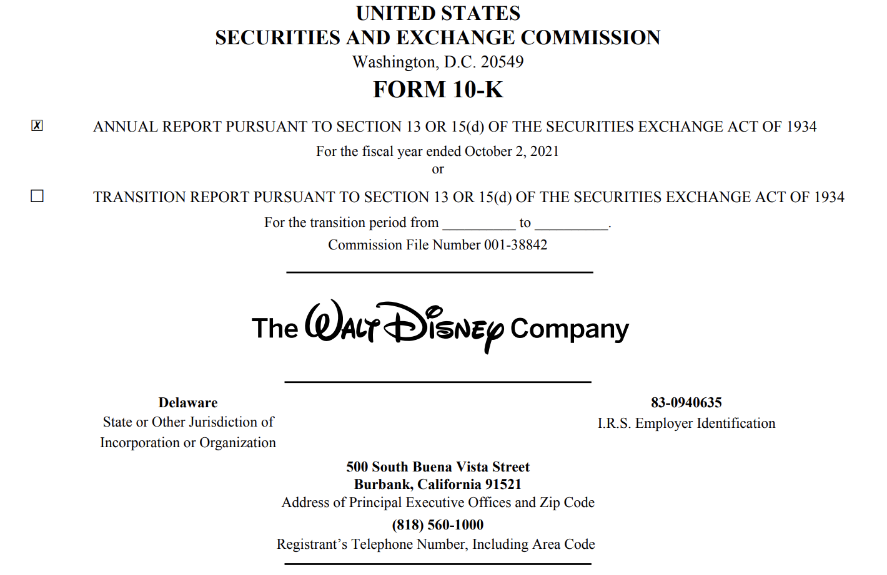
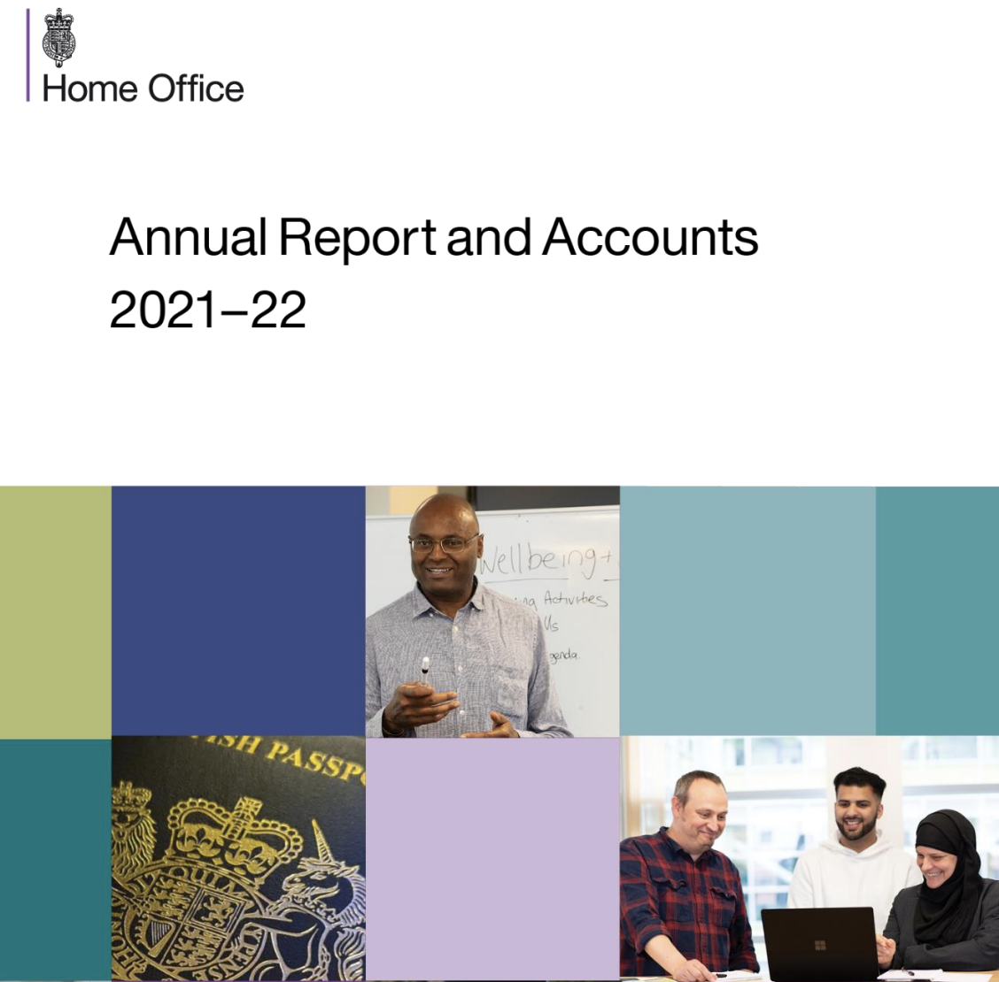
Examples of Financial Reports
10-K (filed to the SEC)
UK Annual Reports (filed to the FRC)
Disney Annual Report 2021 (https://thewaltdisneycompany.com/app/uploads/2022/01/2021-Annual-Report.pdf)
Home Office Annual Report 2021-2022 (https://www.gov.uk/government/collections/ho-annual-reports-and-accounts)

Slide 4
Properties of Financial Reports
10-K
UK Annual Reports
Plain text
Rigid Structure
Strict Conventions
Allows XML Parsing
Large-scale processing
Glossy
Extremely long (~80 pages on average)
Variable nomenclature (20+ unique section titles)
Embedded visual elements (info-graphics, tables)

Slide 5
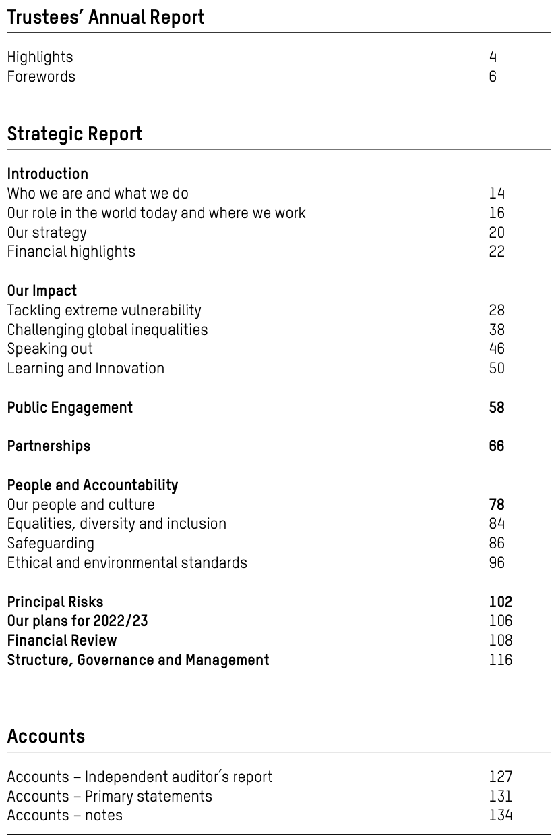

UK ANNUAL REPORT Example
Oxfam Annual Report 21/22
Oxfam Annual Report 21/22

Slide 6
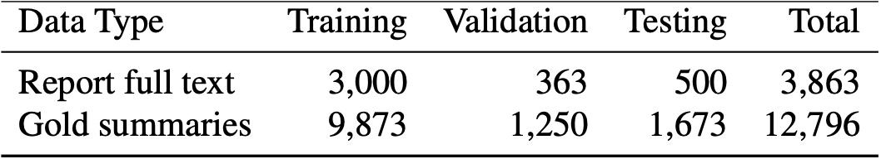
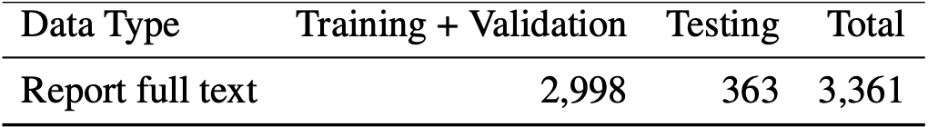
Financial Narrative Summarisation (FNS)
The FNS¹ Task
The FNS¹ Data
Annual (part of the FNP² Workshops)
Recent (only since 2020)
Shared (i.e., a collaborative competition)
State-of-the-art (for financial data)
El-Haj et al., FNP 2022
Data used in this Project
FNS = Financial Narrative Summarisation
FNP = Financial Narrative Processing
Mahmoud El-Haj, Nadhem Zmandar, Paul Rayson, Ahmed AbuRa’ed, Marina Litvak, Nikiforos Pittaras, George Giannakopoulos, Aris Kosmopoulos, Blanca Carbajo-Coronado, and Antonio Moreno-Sandoval. 2022. The Financial Narrative Summarisation Shared Task (FNS 2022). In Proceedings of the 4th Financial Narrative Processing Workshop @LREC2022, pages 43–52, Marseille, France. European Language Resources Association.
Mahmoud El-Haj, Paul Rayson, and Nadhem Zmandar. 2022. Proceedings of the 4th Financial Narrative Processing Workshop @LREC2022. European Language Resources Association, Marseille, France, edition.

Slide 7
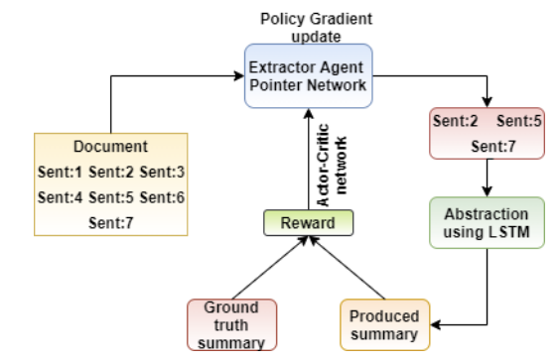
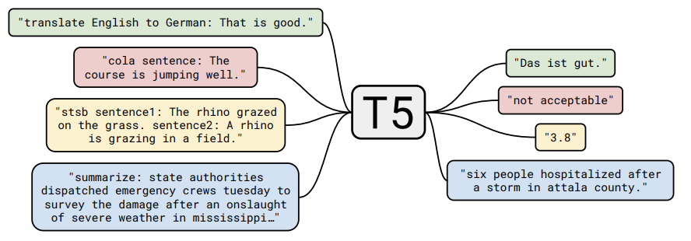
Inspirational Models (FNS21)
My Inspiration¹
Others’ Inspiration²
Zmandar et al. (2021)
T5 model, taken from: Raffel et al. (2020)
Zmandar, N., Singh, A., El-Haj, M., & Rayson, P. (2021). Joint abstractive and extractive method for long financial document summarization. Proceedings of the 3rd Financial Narrative Processing Workshop, 99–105. https://aclanthology.org/2021.fnp-1.19
Orzhenovskii, M. (2021). T5-LONG-EXTRACT at FNS-2021 shared task. Proceedings of the 3rd Financial Narrative Processing Workshop, 67–69. https://aclanthology.org/2021.fnp-1.12
Colin Raffel, Noam Shazeer, Adam Roberts, Katherine Lee, Sharan Narang, Michael Matena, Yanqi Zhou, Wei Li, and Peter J. Liu. "Exploring the Limits of Transfer Learning with a Unified Text-to-Text Transformer." Journal of Machine Learning Research 21, no. 140 (2020): 1-67. http://jmlr.org/papers/v21/20-074.html.

Slide 8
Inspirational Models (FNS21)
My Inspiration¹
Others’ Inspiration²
Recurrent Extractor (extracts salient report sentences)
Attention-based (i.e., weighted word relevancy measure)
Second best FNS21 model (based on ROUGE F1 scores)
Transformer-based Abstractor (generates the start of a summary)
Greedy Sentence Matching (extracts report sentences matching the start sequence)
Best FNS21 model (based on ROUGE F1 scores)
Zmandar et al. (2021)
Orzhenovskii (2021)
Zmandar, N., Singh, A., El-Haj, M., & Rayson, P. (2021). Joint abstractive and extractive method for long financial document summarization. Proceedings of the 3rd Financial Narrative Processing Workshop, 99–105. https://aclanthology.org/2021.fnp-1.19
Orzhenovskii, M. (2021). T5-LONG-EXTRACT at FNS-2021 shared task. Proceedings of the 3rd Financial Narrative Processing Workshop, 67–69. https://aclanthology.org/2021.fnp-1.12
Colin Raffel, Noam Shazeer, Adam Roberts, Katherine Lee, Sharan Narang, Michael Matena, Yanqi Zhou, Wei Li, and Peter J. Liu. "Exploring the Limits of Transfer Learning with a Unified Text-to-Text Transformer." Journal of Machine Learning Research 21, no. 140 (2020): 1-67. http://jmlr.org/papers/v21/20-074.html.
Notes:
Extractive vs Abstractive

Slide 9
Project Proposal
Two models for Extractive Summarisation:
A FinRNN model with pre-trained financial word embeddings¹.
A fine-tuned FinBERT² for text classification.
Evaluate against:
baselines: TextRank³, LexRank⁴, and
official FNS22 models on the validation set.
Rahimikia, E., Zohren, S., & Poon, S.-H. (2021). Realised volatility forecasting: Machine learning via financial word embedding. SSRN Electronic Journal, preprint, 1–20. https://doi.org/10.2139/ ssrn.3895272
Yang, Y., UY, M. C. S., & Huang, A. (2020). Finbert: A pretrained language model for financial communications.
Erkan, G., & Radev, D. R. (2004). Lexrank: Graph-based centrality as salience in text summarization. Journal of Artificial Intelligence Research.
Mihalcea, R., & Tarau, P. (2004). Textrank: Bringing order into text. Proceedings of the 2004 Conference on Empirical Methods in Natural Language Processing, 404–411. https://aclanthology.org/W04-3252.

Slide 10
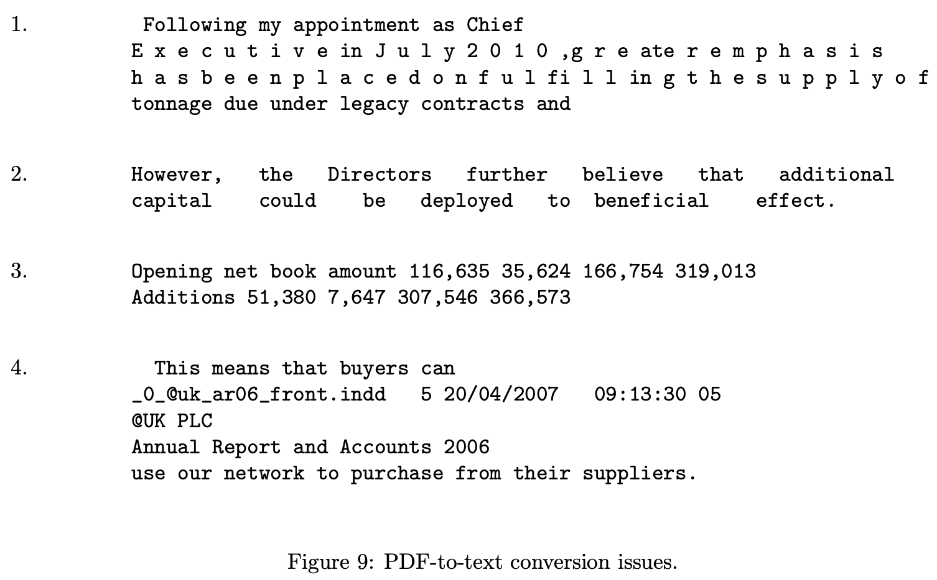
Data: Report-to-text (Provided BY FNS TASK)
Glossy Report
CFIE-FRSE Extraction¹
Plain Text
Extremely long (~80 pages on average)
Variable nomenclature (20+ unique section titles)
Embedded visual elements (info-graphics, tables)
The FNS Data
El-Haj et al., FNP 2022
Extracted from FNS22 data²
https://github.com/drelhaj/CFIE-FRSE
Mahmoud El-Haj, Nadhem Zmandar, Paul Rayson, Ahmed AbuRa’ed, Marina Litvak, Nikiforos Pittaras, George Giannakopoulos, Aris Kosmopoulos, Blanca Carbajo-Coronado, and Antonio Moreno-Sandoval. 2022. The Financial Narrative Summarisation Shared Task (FNS 2022). In Proceedings of the 4th Financial Narrative Processing Workshop @LREC2022, pages 43–52, Marseille, France. European Language Resources Association.

Slide 11
Data: Text-to-Sentences
Plain Text
Pre-processing
Sentence Matching
Sentence-level dataset
Sentence | Label
our priority this year is to commercialise the onshare product and to become cash positive. | 1
our existing and other new products, and a much reduced cash burn rate, will assist us in that endeavour. | 1
jack bekhor jamie true joint chief executive officers 21 june 2007 09 … | 0
Extracted from FNS22 data¹
Extracted from FNS22 data¹
Mahmoud El-Haj, Nadhem Zmandar, Paul Rayson, Ahmed AbuRa’ed, Marina Litvak, Nikiforos Pittaras, George Giannakopoulos, Aris Kosmopoulos, Blanca Carbajo-Coronado, and Antonio Moreno-Sandoval. 2022. The Financial Narrative Summarisation Shared Task (FNS 2022). In Proceedings of the 4th Financial Narrative Processing Workshop @LREC2022, pages 43–52, Marseille, France. European Language Resources Association.
Notes:
Rigorous Pre-processing pipeline, which is rule-based with hand-crafted case-specific text transformations.

Slide 12
Data: Handling imbalance
Sentence-level dataset
Handling Imbalance
Sentence | Label
our priority this year is to commercialise the onshare product and to become cash positive. | 1
our existing and other new products, and a much reduced cash burn rate, will assist us in that endeavour. | 1
jack bekhor jamie true joint chief executive officers 21 june 2007 09 … | 0
Non-summary : summary = 10 : 1 (i.e., an imbalanced dataset with a total of ~3,500,000 sentences)
Under-sampling (90% majority class reduction)
French Back-translation¹ (using MarianMT² for English-French-English translation, and 80% majority under-sampling)
Extracted from FNS22 data
Vu Cong Duy Hoang, Philipp Koehn, Gholamreza Haffari, and Trevor Cohn. Itera- tive back-translation for neural machine translation. In Proceedings of the 2nd Work- shop on Neural Machine Translation and Generation, pages 18–24, Melbourne, Australia, July 2018. Association for Computational Linguistics.
Marcin Junczys-Dowmunt, Roman Grundkiewicz, Tomasz Dwojak, Hieu Hoang, Kenneth Heafield, Tom Neckermann, Frank Seide, Ulrich Germann, Alham Fikri Aji, Nikolay Bogoychev, Andre ́ F. T. Martins, and Alexandra Birch. Marian: Fast neural machine translation in c++, 2018.

Slide 13
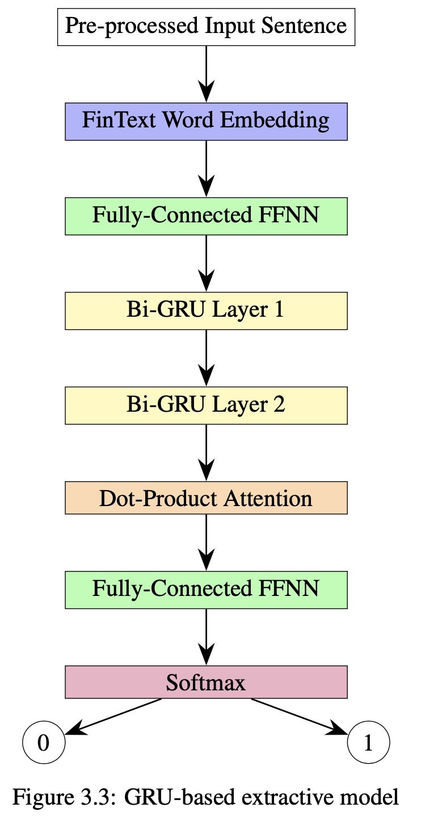
Financial RNN (FinRNN)
Financial FastText Word Embeddings¹ (i.e., deal with noisy text and OOV words)
Bidirectional Recurrent Layers² (i.e., capture left-to-right and right-to-left context)
Scaled Dot-Product Attention³ (i.e., focus the most relevant words in the context)
Rahimikia, Eghbal and Zohren, Stefan and Poon, Ser-Huang, Realised Volatility Forecasting: Machine Learning via Financial Word Embedding (July 28, 2021). Available at SSRN 3895272
M. Schuster and K. K. Paliwal, "Bidirectional recurrent neural networks," in IEEE Transactions on Signal Processing, vol. 45, no. 11, pp. 2673-2681, Nov. 1997, doi: 10.1109/78.650093.
Ashish Vaswani, Noam Shazeer, Niki Parmar, Jakob Uszkoreit, Llion Jones, Aidan N. Gomez, Łukasz Kaiser, and Illia Polosukhin. 2017. Attention is all you need. In Proceedings of the 31st International Conference on Neural Information Processing Systems (NIPS'17). Curran Associates Inc., Red Hook, NY, USA, 6000–6010..

Slide 14
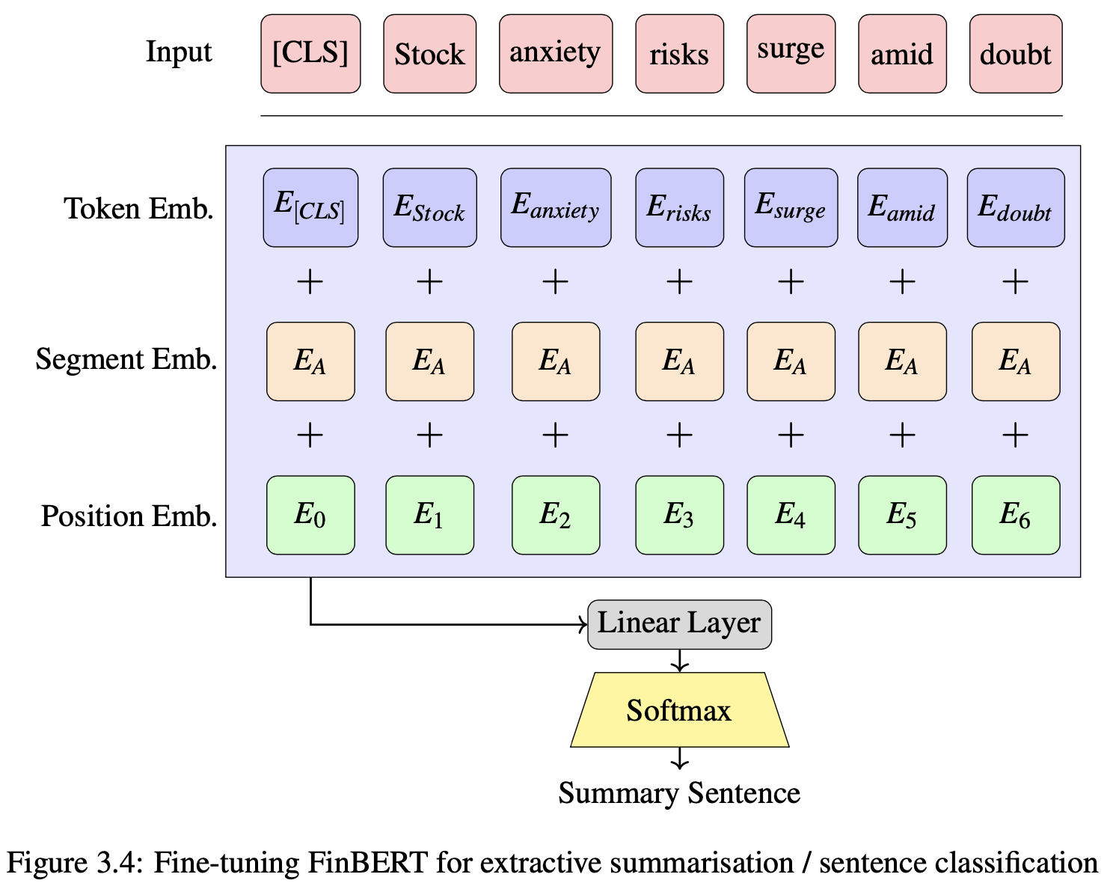
Financial BERT (FinBERT)
Multi-head Self-Attention¹ (i.e., contextual awareness with various aspects of relationships between words)
Sentence Embeddings¹ ([CLS]-token summarises sentence-level representations)
Domain-specific² (BERT-base pre-trained on 4.9B tokens from financial corpora)
Jacob Devlin, Ming-Wei Chang, Kenton Lee, and Kristina Toutanova. 2019. BERT: Pre-training of Deep Bidirectional Transformers for Language Understanding. In Proceedings of the 2019 Conference of the North American Chapter of the Association for Computational Linguistics: Human Language Technologies, Volume 1 (Long and Short Papers), pages 4171–4186, Minneapolis, Minnesota. Association for Computational Linguistics.
Yi Yang, Mark Christopher Siy UY, and Allen Huang. Finbert: A pretrained lan- guage model for financial communications, 2020

Slide 15
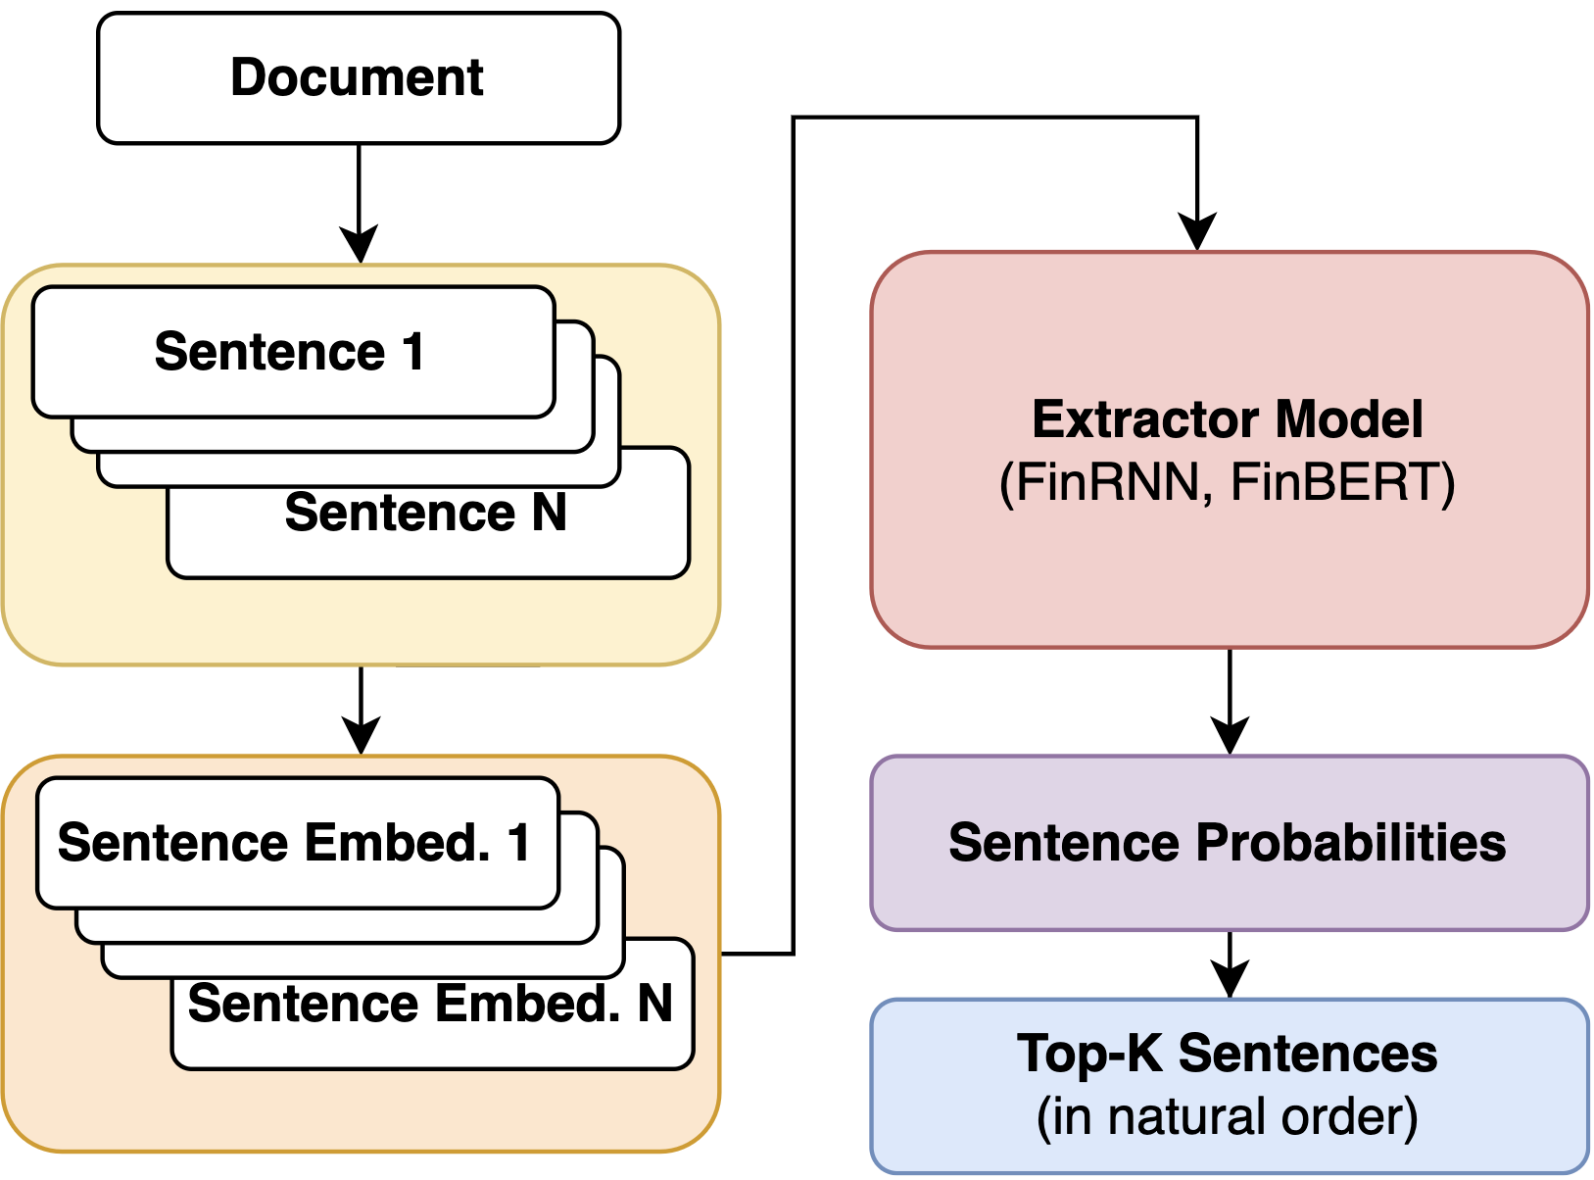
Summary Generation
1 summary ≤ 1,000 words (part of FNS Task regulations)
Top-K Sentences (highest probability sentences in their natural order, fitting in the word limit)

Slide 16
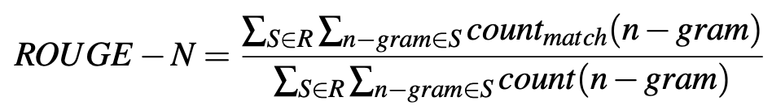

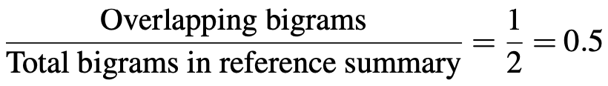

ROUGE-N Metric
Definition:
ROUGE-2 Example:
Main Summarisation Metric
Measures overlapping units (n-grams)
Based on Recall
c = “Fox can run” (candidate summary)
c* = “Fox can walk” (reference summary)
bigrams_{c} = {(“Fox”,“can”),(“can”,“run”)}
bigrams_{c*} = {(“Fox”,“can”),(“can”,“walk”)}
Chin-Yew Lin. Rouge: A package for automatic evaluation of summaries. In Text summarization branches out, pages 74–81, 2004.

Slide 17
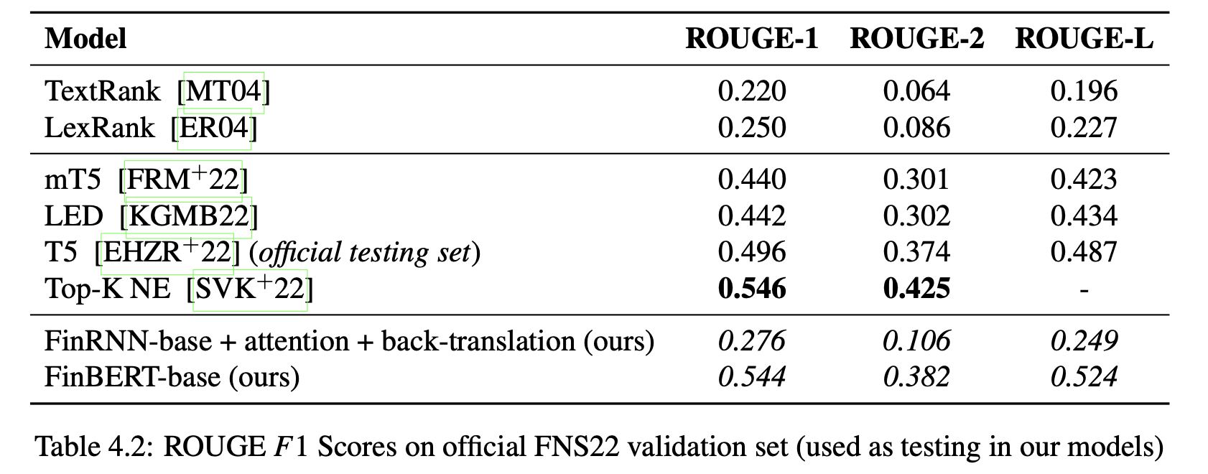
Evaluation
Baselines
Best overall
Best English
Ours

Slide 18
Output Quality: Summary
Technical Reminders
For a random report:
1 summary ≤1,000 words¹ (i.e., word limit imposed by FNS organisers)
1 report ≥ 60,000 words on avg²
ROUGE-N = lexical overlap
ROUGE-N ≠ semantic similarity
Top-K Summary Generation
FinBERT + data augmentation
~50% matches the gold summary
Semantically convincing (i.e., produced summary is not wrong per se; just does not match lexically the gold standard)
FinRNN + attention
0% matches with gold summary
Bias towards long & lexically diverse sentences (e.g., focuses numerical expressions, linguistic enumerations)
Mahmoud El-Haj, Nadhem Zmandar, Paul Rayson, Ahmed AbuRa’ed, Marina Litvak, Nikiforos Pittaras, George Giannakopoulos, Aris Kosmopoulos, Blanca Carbajo-Coronado, and Antonio Moreno-Sandoval. 2022. The Financial Narrative Summarisation Shared Task (FNS 2022). In Proceedings of the 4th Financial Narrative Processing Workshop @LREC2022, pages 43–52, Marseille, France. European Language Resources Association.
Marina Litvak and Natalia Vanetik. Summarization of financial reports with AMUSE. In Proceedings of the 3rd Financial Narrative Processing Workshop, pages 31–36, Lancaster, United Kingdom, 15-16 September 2021. Association for Com- putational Linguistics.

Slide 19
Output Quality: Examples
FinRNN-base + attention
FinBERT + data augmentation
The risks and uncertainties referred to above include actions or decisions by governmental and regulatory bodies, or changes in the regulatory framework in which the group operates, which may impact the ability of the group to carry on its businesses; changes or advances in technology, and availability of resources such as spectrum, necessary to use new or existing technology, or customer and consumer preferences regarding technology; the performance of the markets in the uk, the eu and the wider region in which the group operates; the ability of the group to realise the benefits it expects from existing and future projects and investments it is undertaking or plans to or may undertake;
Paul, who is a chartered accountant and has a wealth of experience in senior finance positions, joins us as an independent non-executive director and chairman of the audit committee. The first point worth noting, and celebrating, is the strength of our financial performance. The visibility of revenues with a contracted order book of £5.7 billion, inflation-linked pricing, and the opportunity to increase utilisation of our infrastructure, places arqiva in a very strong position to continue to deliver stable profitable growth. In december 2013, the group established facilities in arqiva smart financing limited (a group company) that support the group's smart energy metering contracts by financing the purchase of communication hubs.
Green → exact match Red → mismatch
with gold standard

Slide 20
Conclusion
Managed to:
Design a FinRNN and fine-tune FinBERT
Integrate Attention and implement data augmentation
Beat baseline models: TextRank and LexRank
Perform competitively against official models

Slide 21


Harwich Haven Authority: Annual Report and Financial Statements 2018. Accessible at:
https://hha.co.uk/wp-content/uploads/2019/06/HHA-ANNUAL-REPORT-2018_AW_LOW_SPREADS.pdf
Notes:
As I have managed to achieve the aim and goals, I would like to conclude the screencast with this very nice pixelated sunrise, which you might have already correctly guessed that belongs to a glossy UK annual report:
- Harwich Haven Authority Annual Report and Financial Statements 2018
That said, I am looking forward to the next text summarisation challenges after my graduation, continuing on this NLP journey.
Thank you!

Slide 22
APPENDIX: BASELINE MODELS

Slide 23
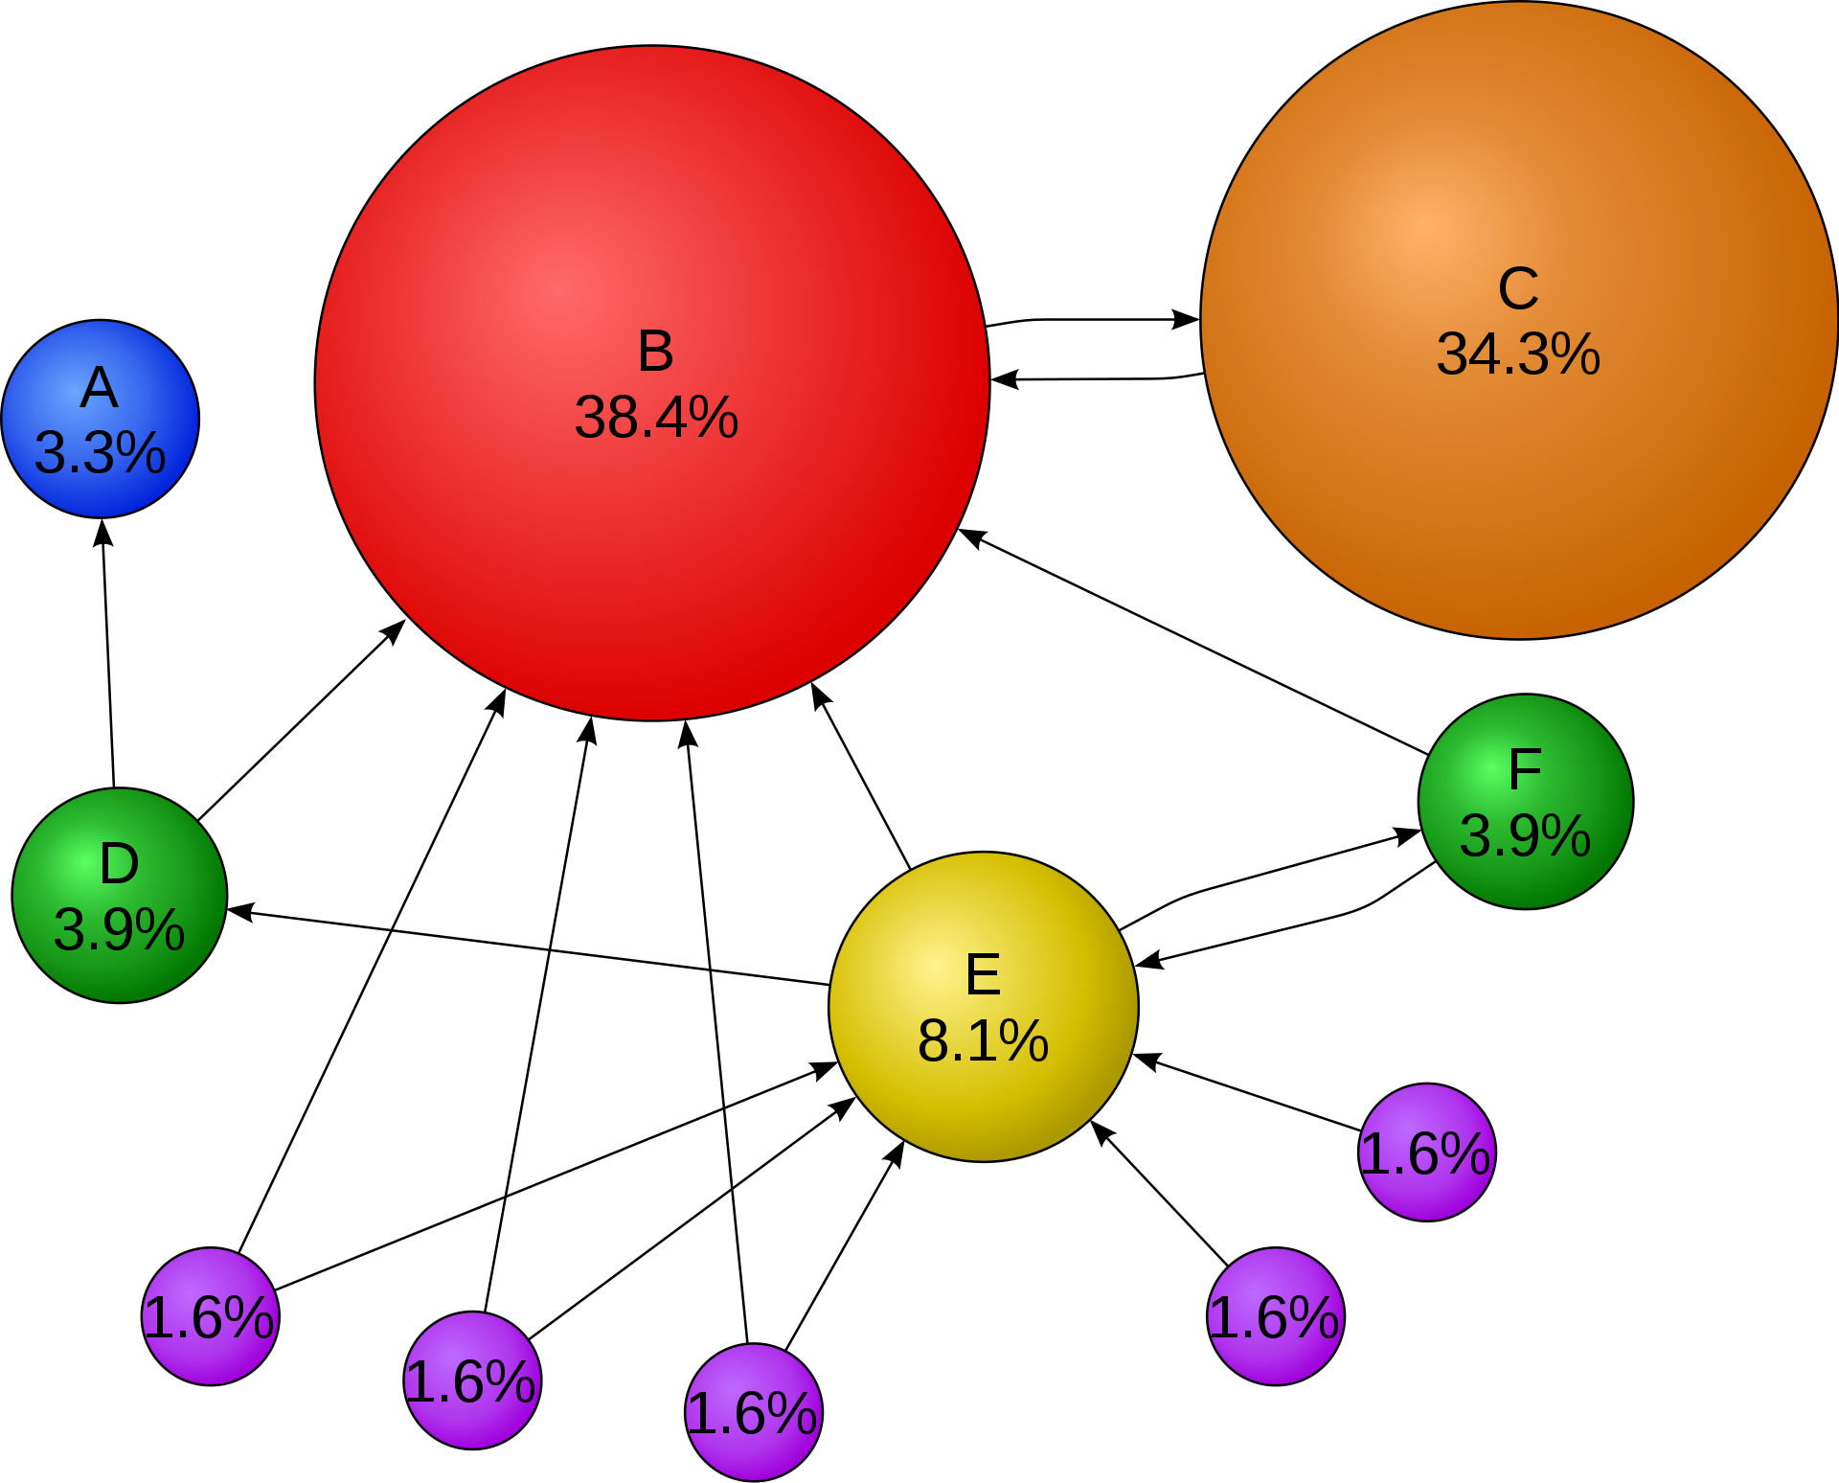
Baseline models
PageRank
TextRank
LexRank
https://en.wikipedia.org/wiki/PageRank

Slide 24
Attention Mechanism

