Slide 1
The Weather Station
By Vlad Netrebchenko

Slide 2
full documentation at github.com/Vladnet47/Weather-Station

Slide 3
Overview

Slide 4
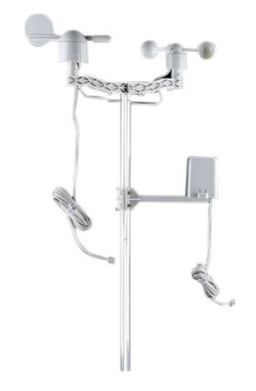
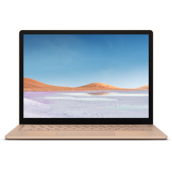
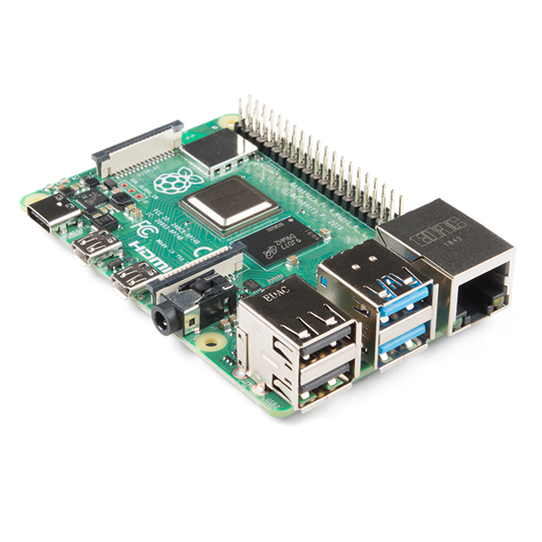
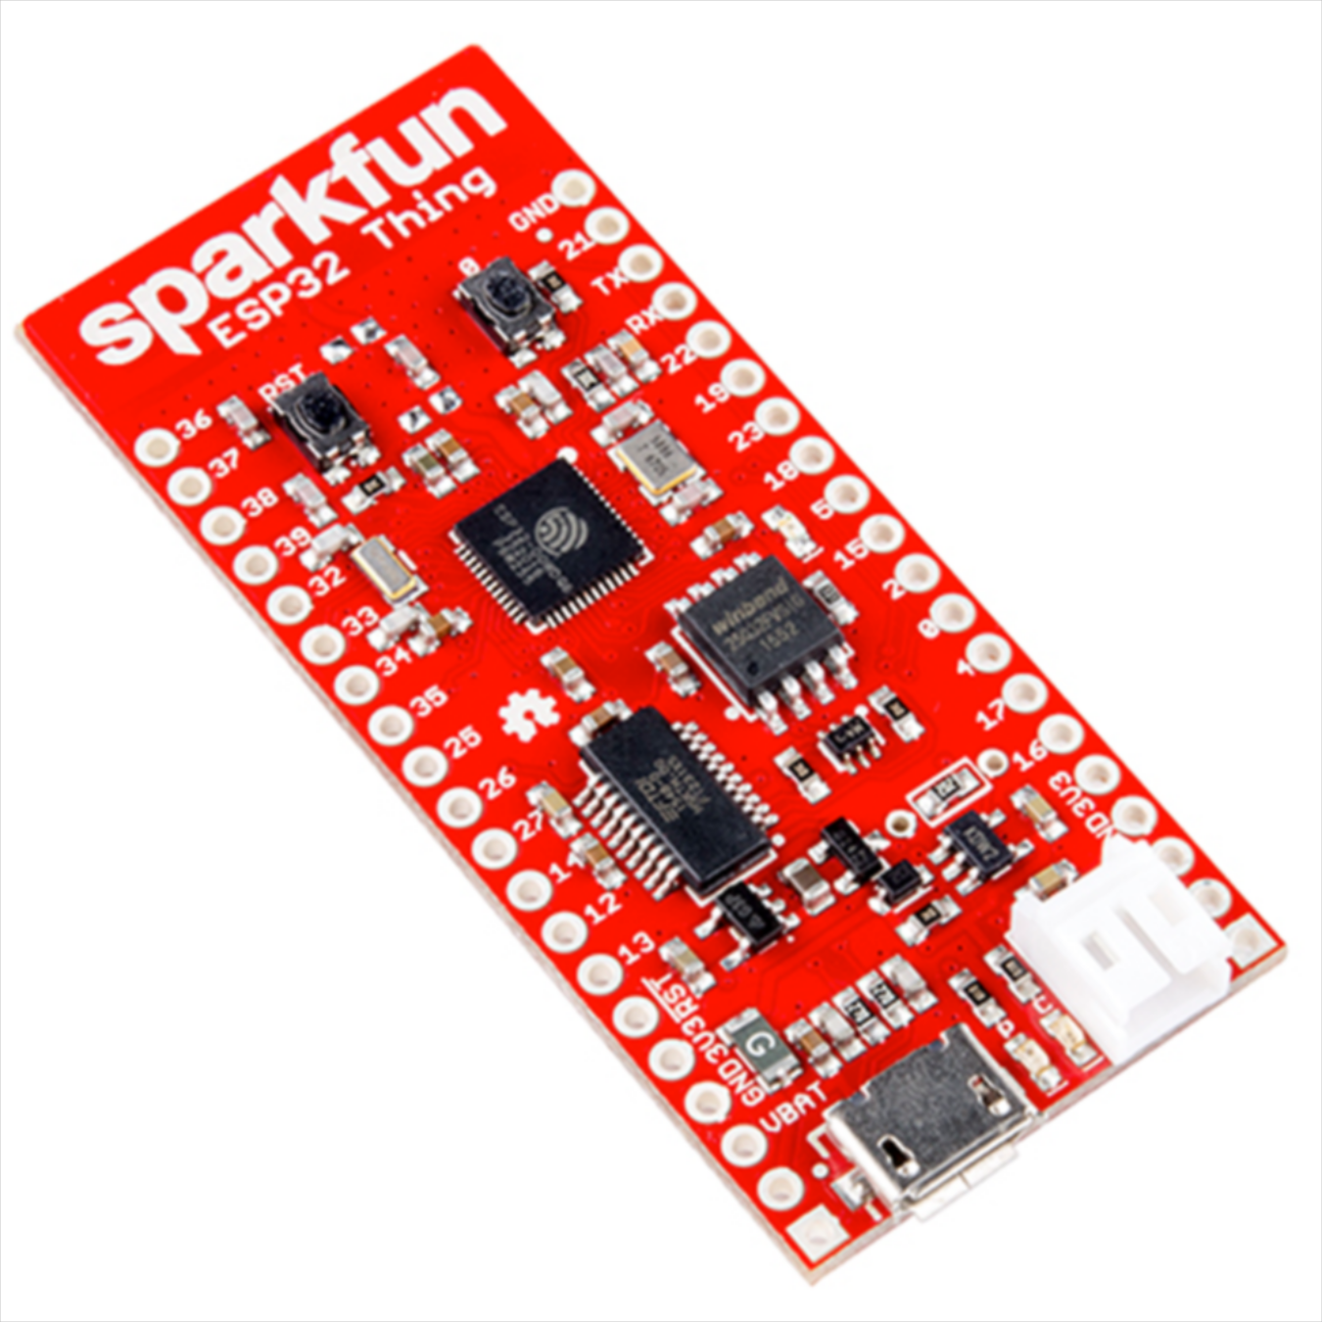
wired
wireless

Slide 5
Sensor Readings
wind speed in mpg
wind direction in deg. from north, clockwise
rainfall in inches per update

Slide 6
Microcontroller
esp32 thing
(re)connects to network
reads sensors
sends data to server

Slide 7
Sending Data (HTTP POST)
header: 192.168.2.10:8080/weatherstation/windrain
body: winddir=1.0&windspeed=1.0&rainfall=1.0
server ip address
port
api endpoint

Slide 8
Server
raspberry pi 4
accepts data through api
stores in database
erases outdated data (>14 days)
provides visualization

Slide 9
Microcontroller Configuration

Slide 10
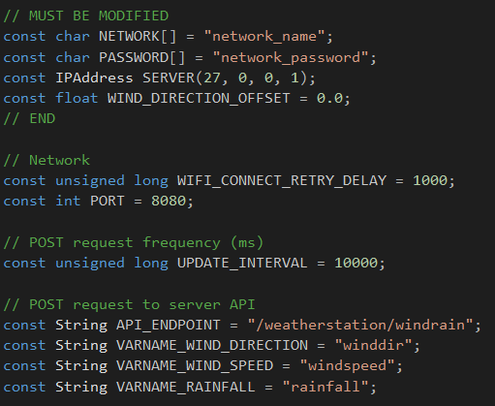
Config.h
network details
calibrate wind direction
change data sending frequency

Slide 11
Server Configuration

Slide 12

Usage
visualize data through grafana
configure database through pgAdmin

Slide 13
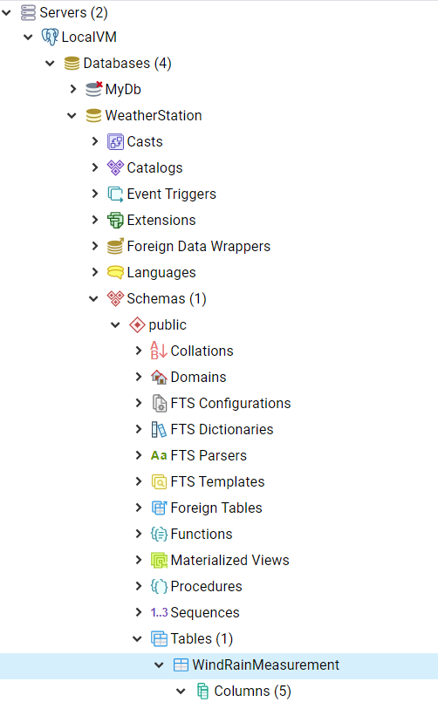
PgAdmin
download from pgadmin.org
connect to server
port: 5432
username: postgres
password: postgres
modify tables/columns

Slide 14
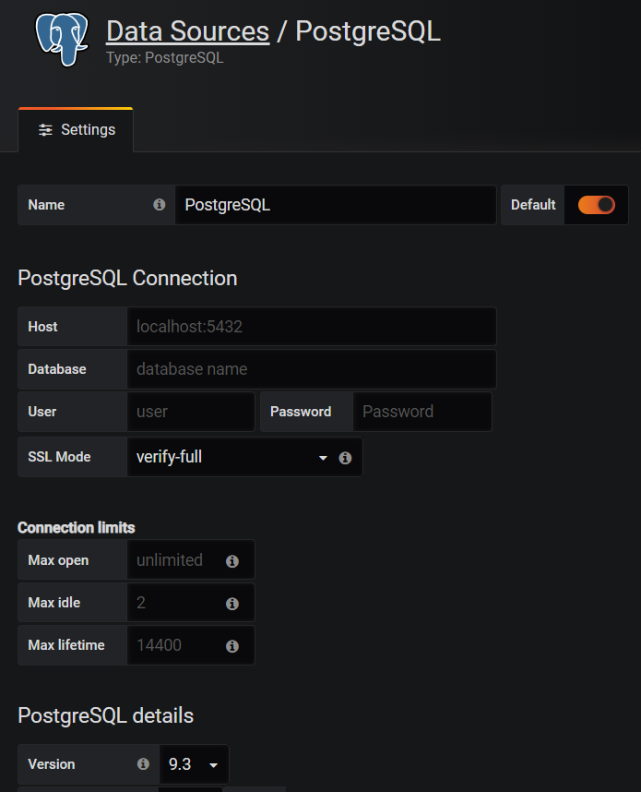
Grafana
go to 192.168.4.10:3000
username: admin
password: admin
add postgreSQL data source
create dashboard with views
server ip address

Slide 15
Internal Server Configuration

Slide 16
API
Receives and stores data
Weather Station
Manager
Erases outdated data
Grafana
Visualizes data
Browser
Database
PgAdmin

Slide 17
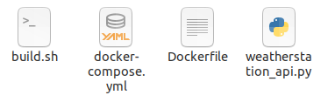
Module
builds docker image
source code
configures and builds docker container
defines docker image

Slide 18
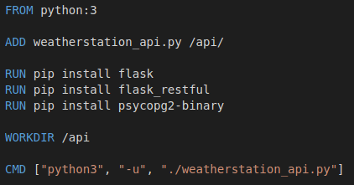
Dockerfile
add source code
install dependencies
launch service with command

Slide 19
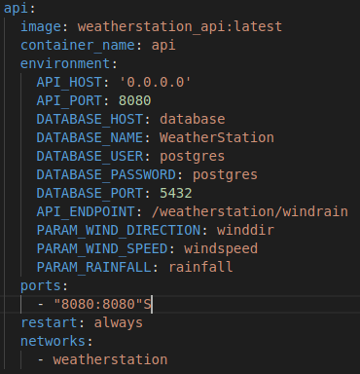
Docker-Compose
select image
pass configuration variables
expose ports
connect to network

Slide 20
Launch Container
cd container_folder
./build.sh
docker-compose up -d

