Slide 1
The Weather Station
By Vlad Netrebchenko

Slide 2
full documentation at github.com/Vladnet47/Weather-Station

Slide 3
Overview

Slide 4
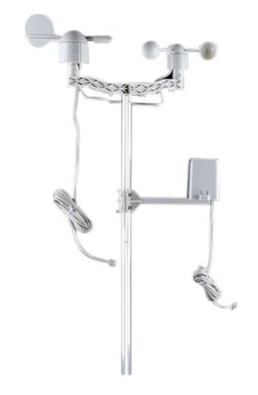
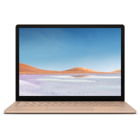
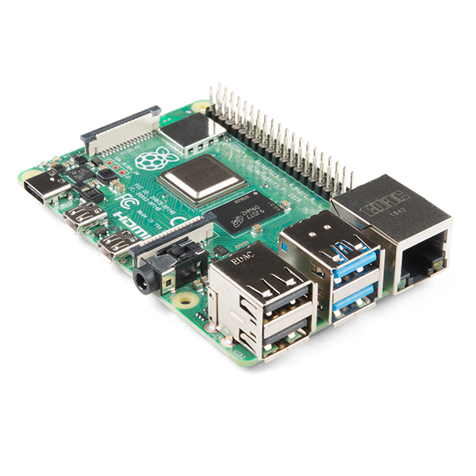
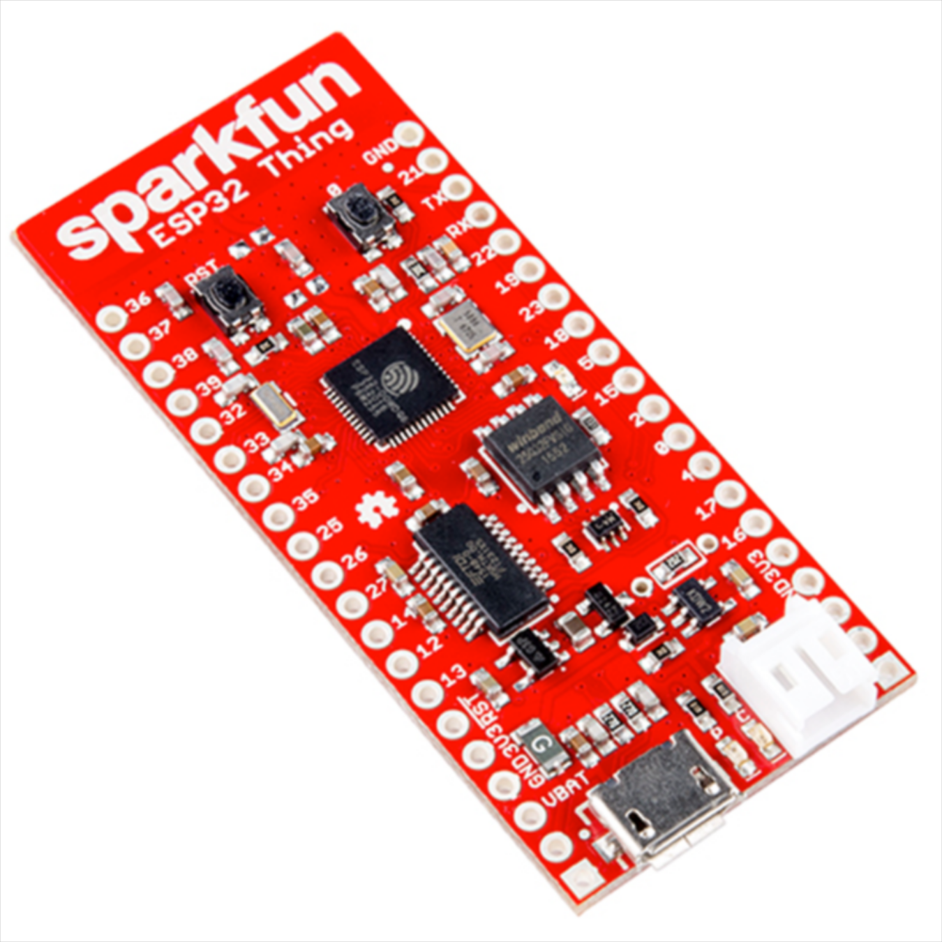
wired
wireless

Slide 5
Sensor Readings
wind speed in mpg
wind direction in deg. from north, clockwise
rainfall in inches per update

Slide 6
Microcontroller
esp32 thing
(re)connects to network
reads sensors
sends data to server

Slide 7
Sending Data (HTTP POST)
header: 192.168.2.10:8080/weatherstation/windrain
body: winddir=1.0&windspeed=1.0&rainfall=1.0
server ip address
port
api endpoint

Slide 8
Server
raspberry pi 4
accepts data through api
stores in database
erases outdated data (>14 days)
provides visualization

Slide 9

Usage
visualize data through grafana
configure database through pgAdmin

Slide 10
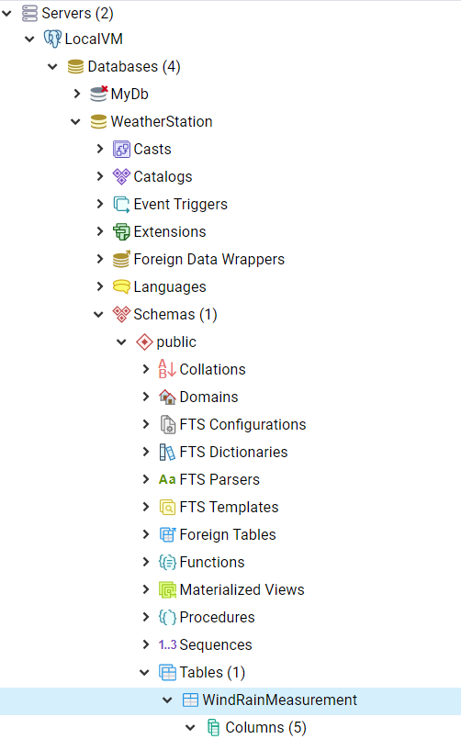
PgAdmin
download from pgadmin.org
connect to server
port: 5432
username: postgres
password: postgres
modify tables/columns

Slide 11
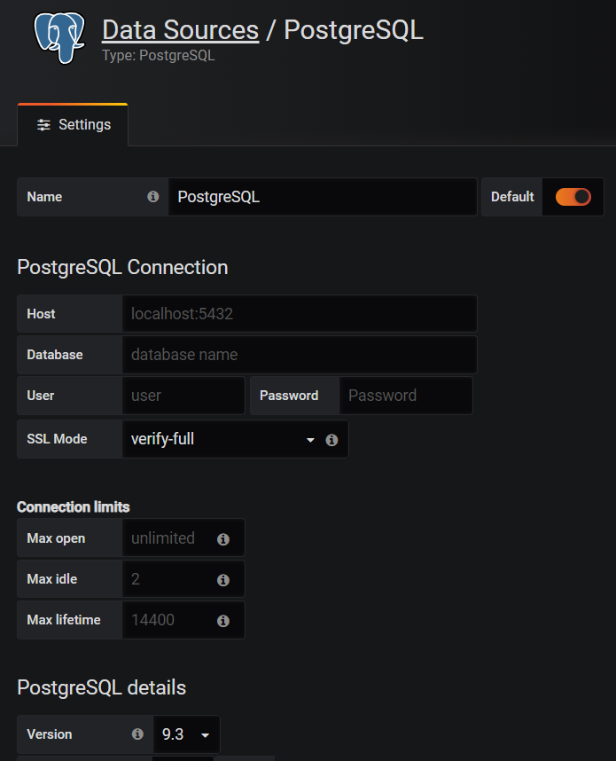
Grafana
go to 192.168.4.10:3000
username: admin
password: admin
add postgresQL data source
create dashboard with views
server ip address

Slide 12
Microcontroller Configuration

Slide 13
Server Configuration

