Slide 1
Internship Presentation – Dijenu in Bottega (DJB)
Front-End Development with AI Assistance Vladyslav Bezzubko

Slide 2
Company Overview
Bulgarian tech start-up building a local e-commerce marketplace
Mission: modern tools for Bulgarian sellers & buyers
Team of 3; Agile sprints; code reviews in GitHub
My stack: React • TypeScript • Tailwind CSS

Slide 3
Project & My Role
Marketplace inspired by Emag/Rozetka, tailored to Bulgaria
Responsibilities
Responsive UI from Figma
State & props management, API wiring
Localization (EN/BG) & accessibility
Performance checks & QA

Slide 4
Best Practice: AI-Assisted Development
Tools used: ChatGPT, GitHub Copilot
Use cases
Scaffolding complex components (tables, filters, modals)
Refactoring & debugging hints
Edge-case exploration
Developer retains design intent & code ownership

Slide 5
Benefits & Challenges
Benefits
35–45% faster first drafts
Wider pattern exploration
Earlier detection of edge cases
Challenges
Verbose/outdated suggestions
Breakpoints, accessibility, i18n (Bulgarian text expansion)
Risk of reduced ownership without review

Slide 6
Methodology
Self-observation
Daily logs: time vs. output; degree of AI use
Content analysis
GitHub commits: readability, maintainability, responsiveness
Interviews
Lead & teammate: AI for well-specified tasks; human for ambiguity
Ethics: transparency and human-in-the-loop review

Slide 7
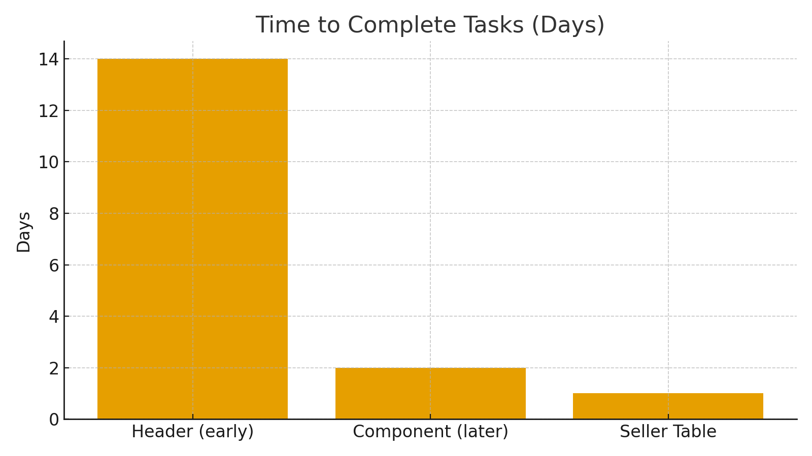
Results
Faster delivery with a consistent review/refactor tax
Prompt literacy → higher-quality suggestions
AI best for scaffolding; humans for design & a11y

Slide 8
Conclusions
AI accelerates development when paired with human review
Prompt literacy is now a core developer skill
Human judgment governs design, i18n, and accessibility
Role shift: from code writer to code curator

