Slide 1




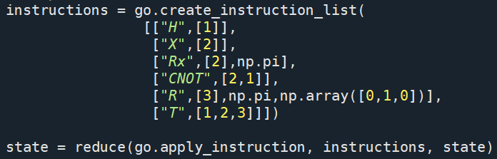
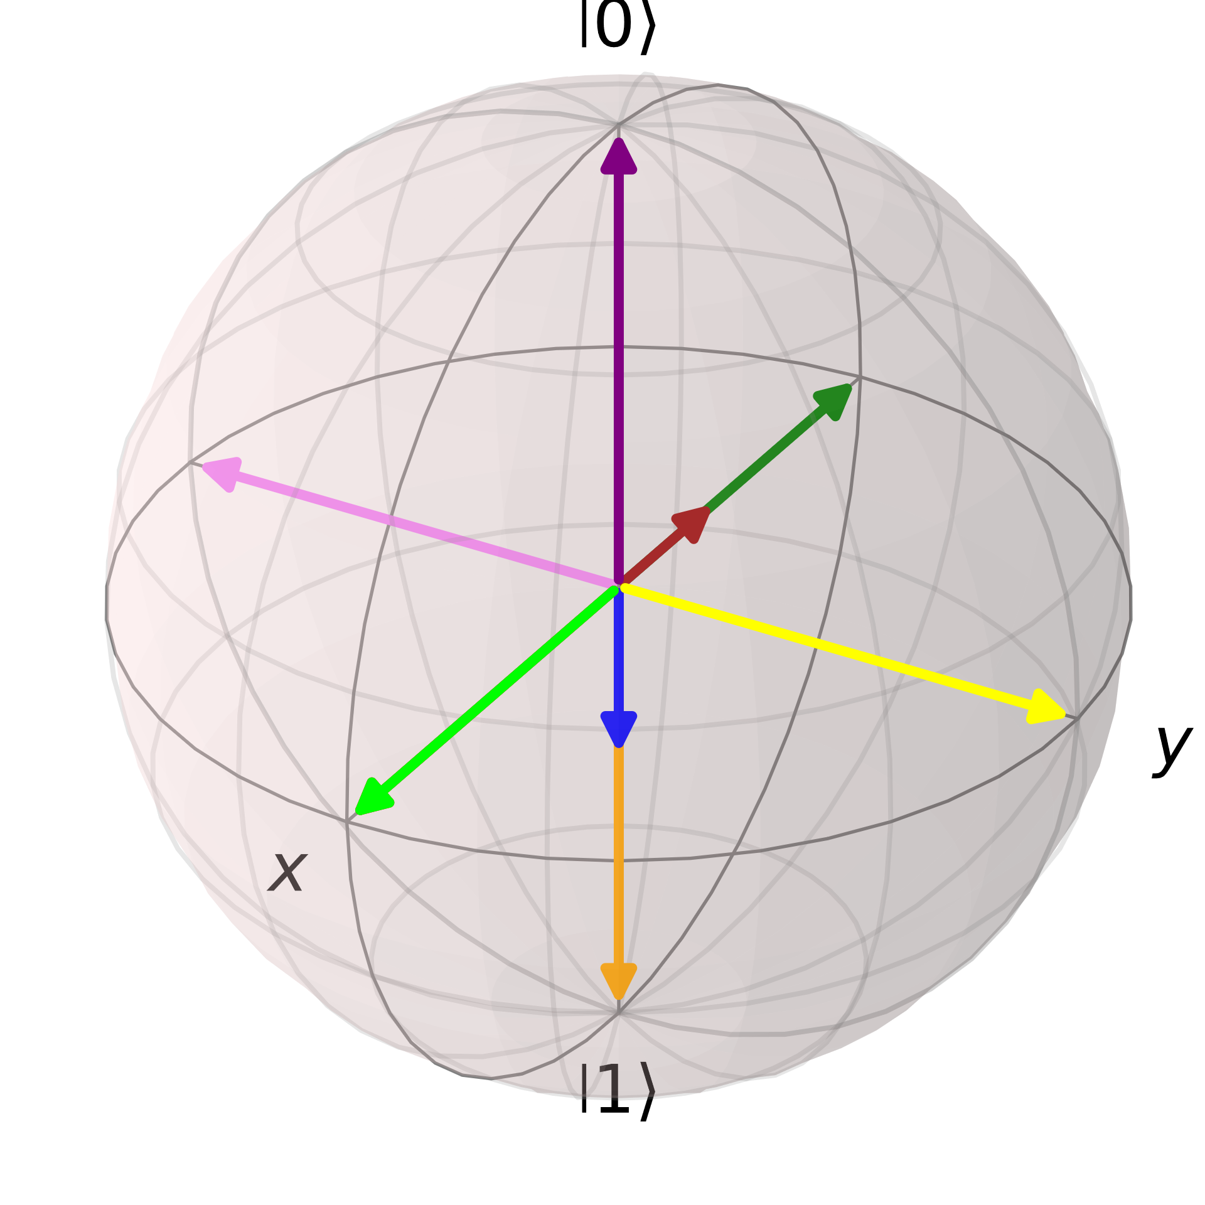
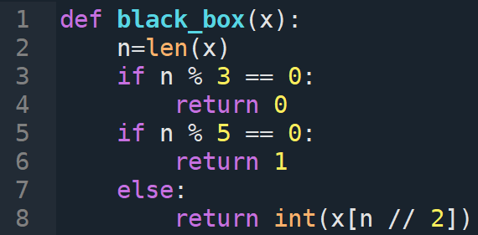
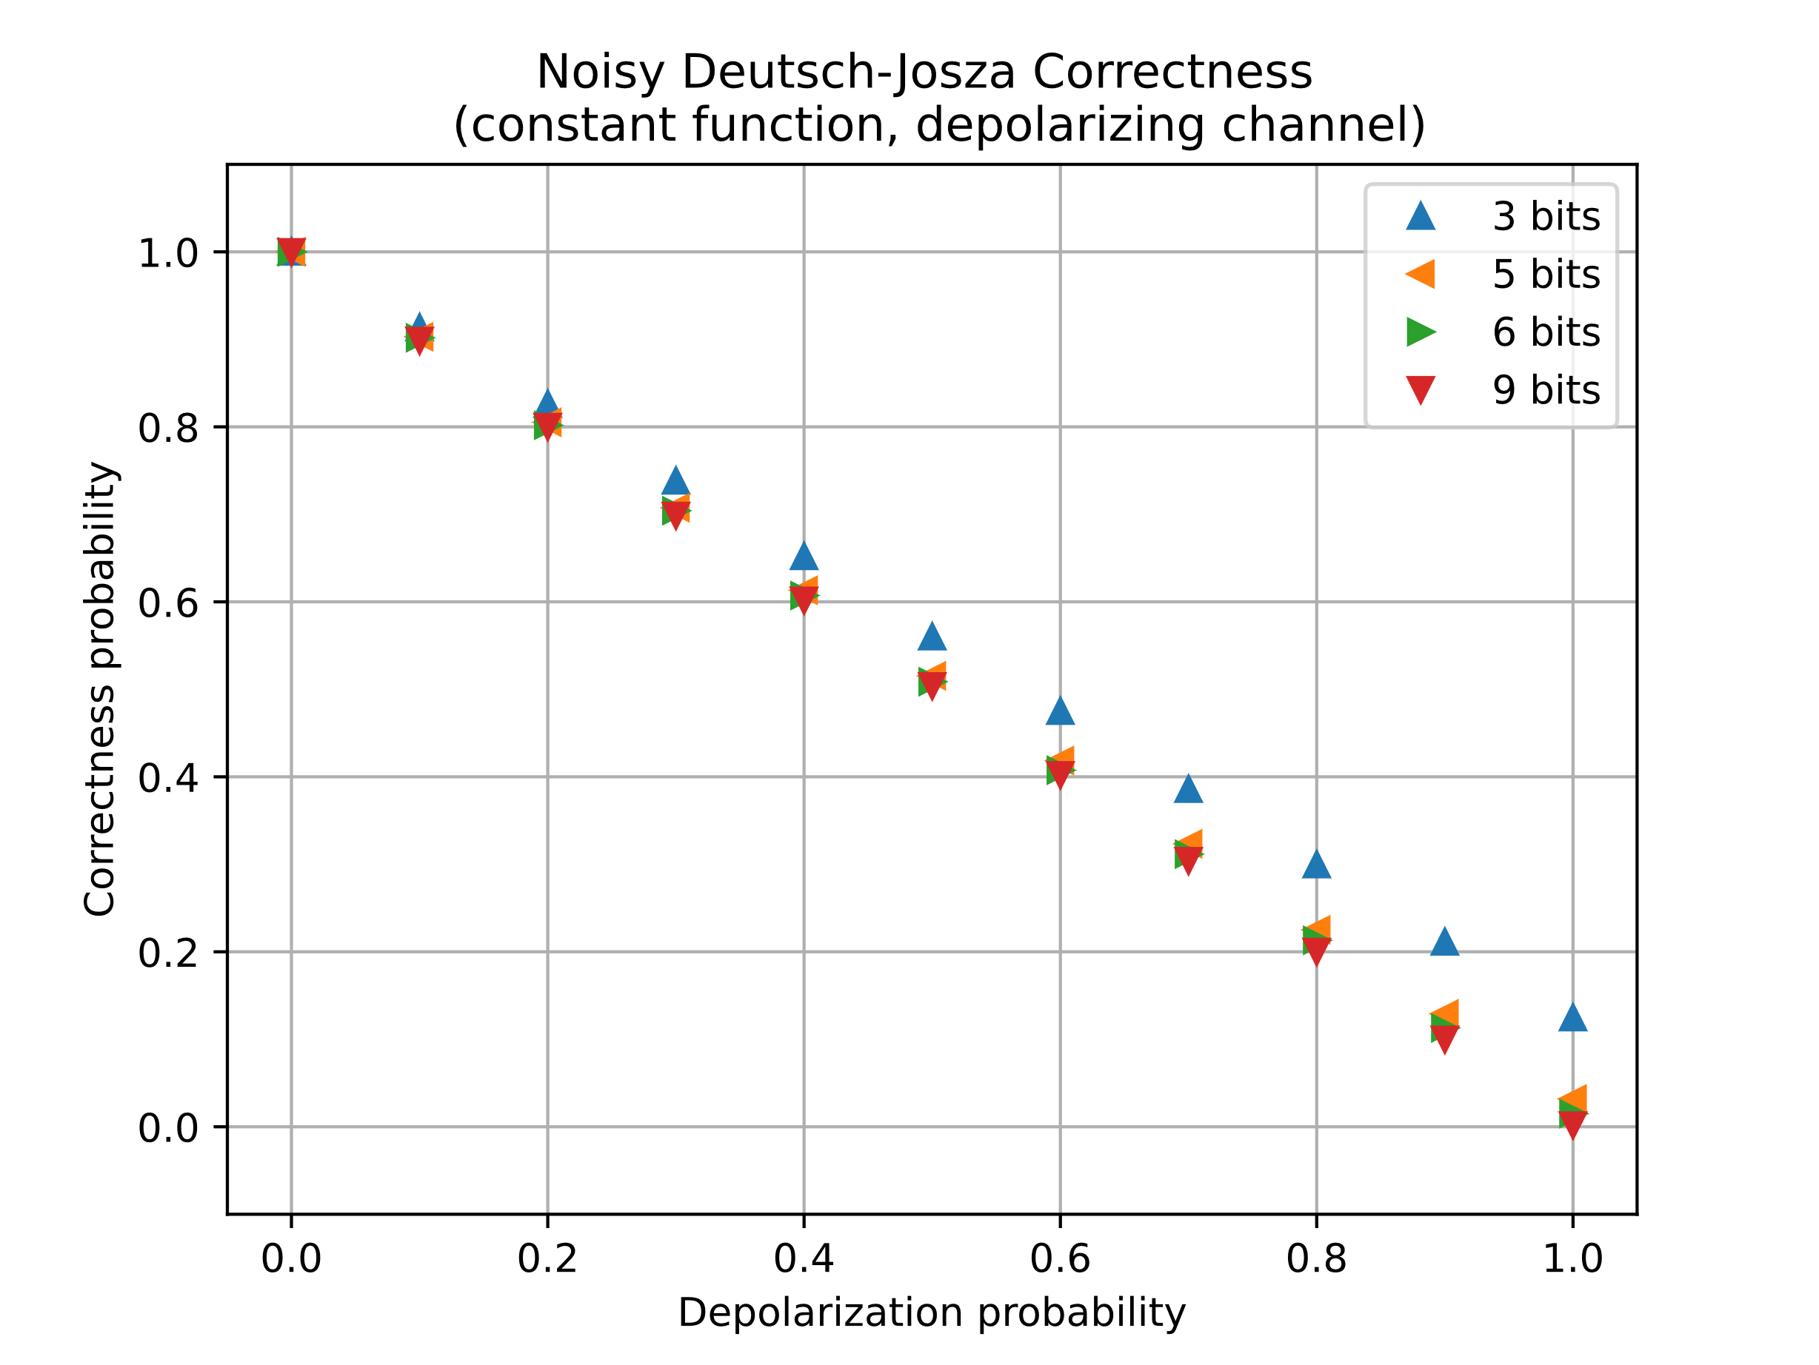
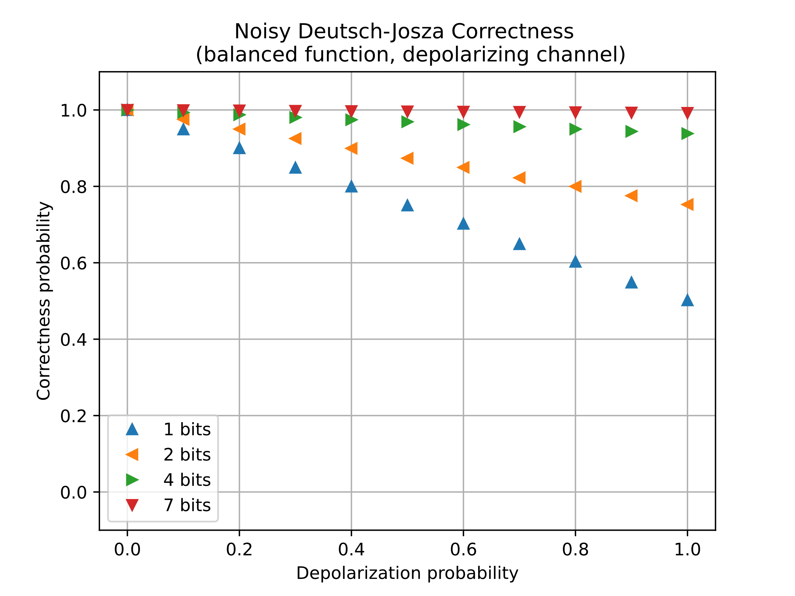
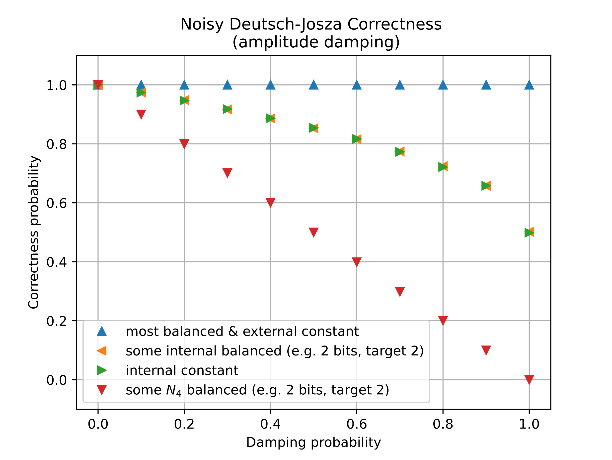
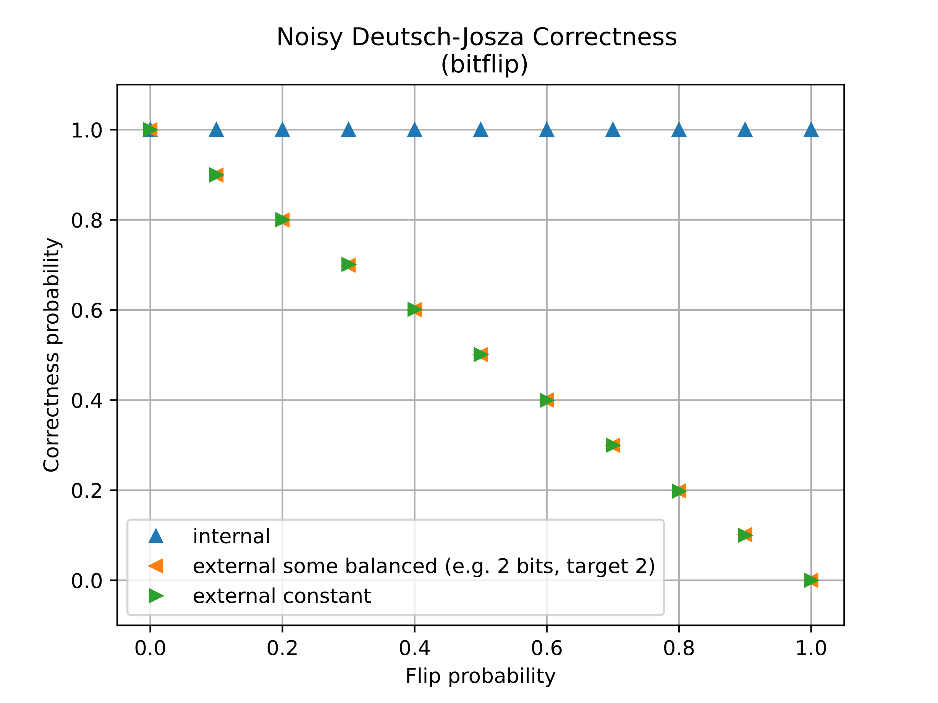
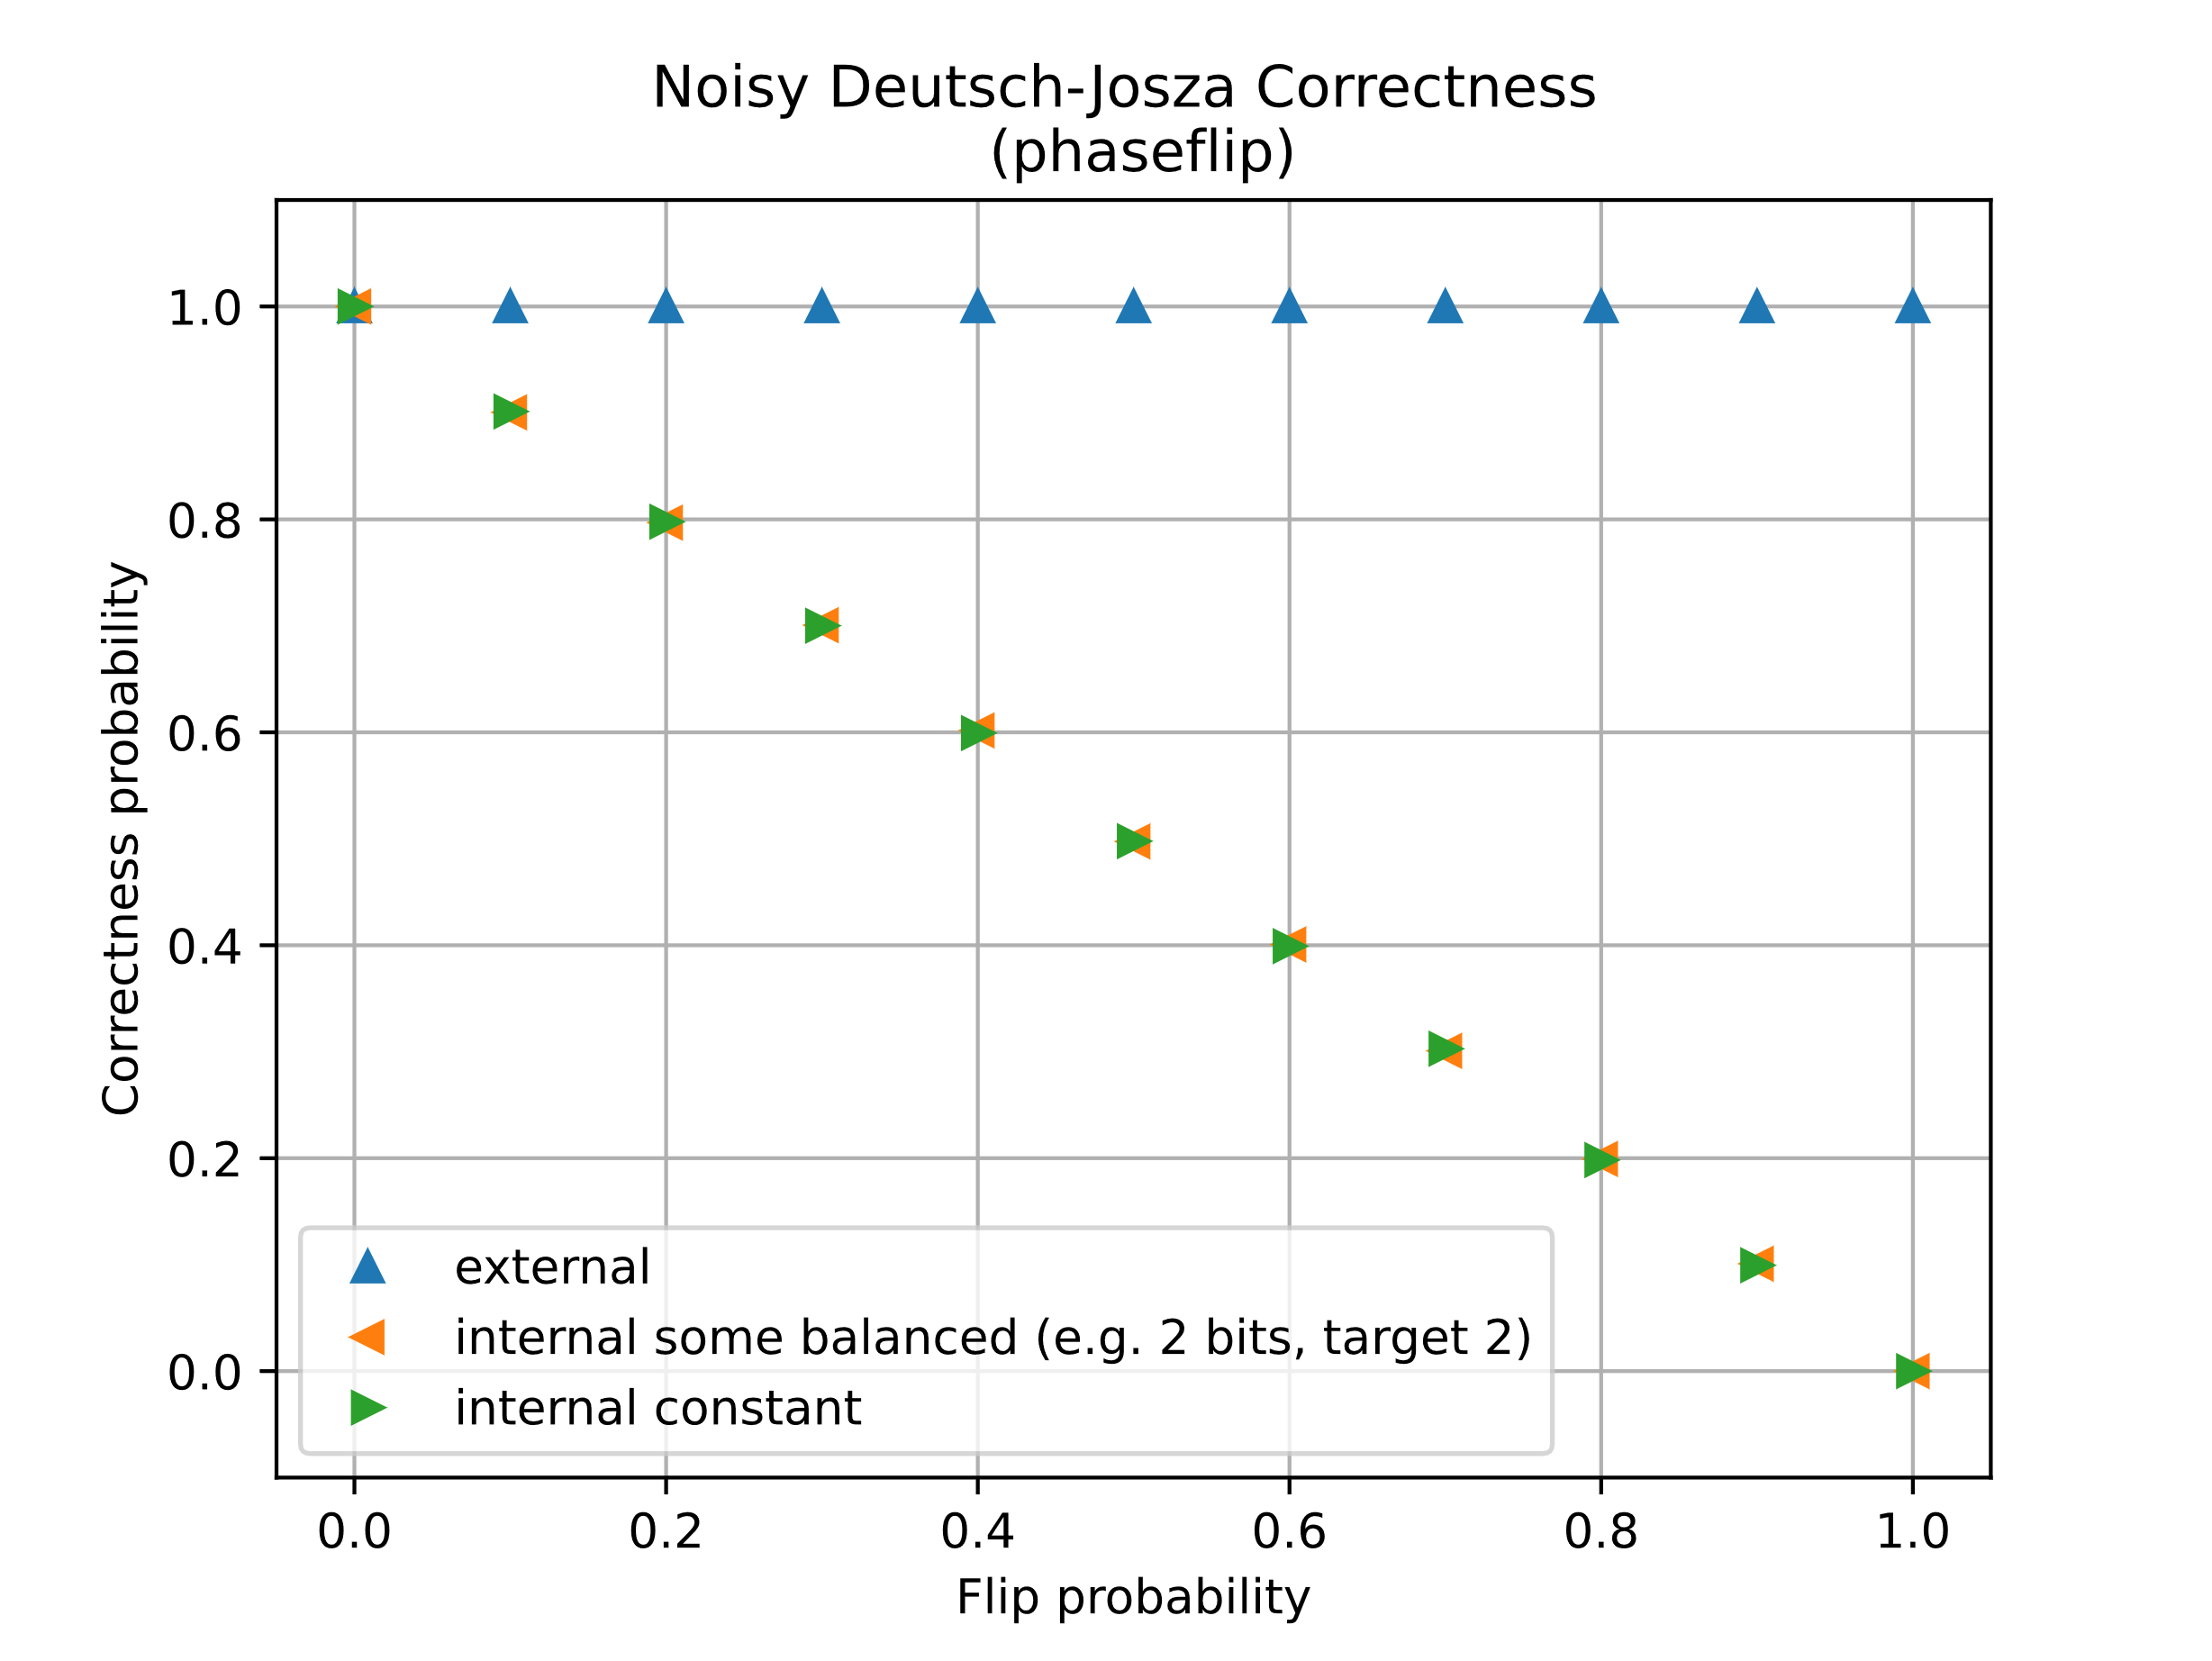



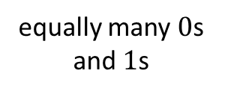









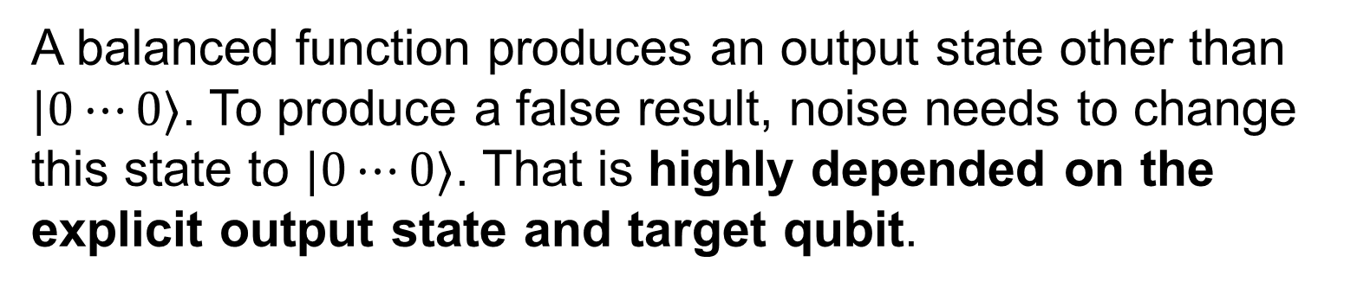



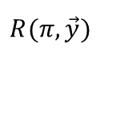

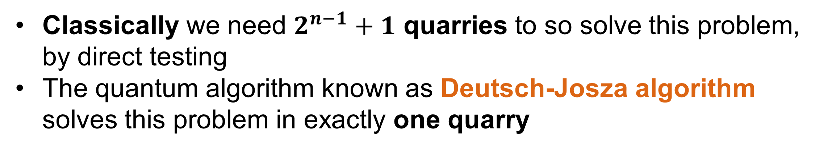




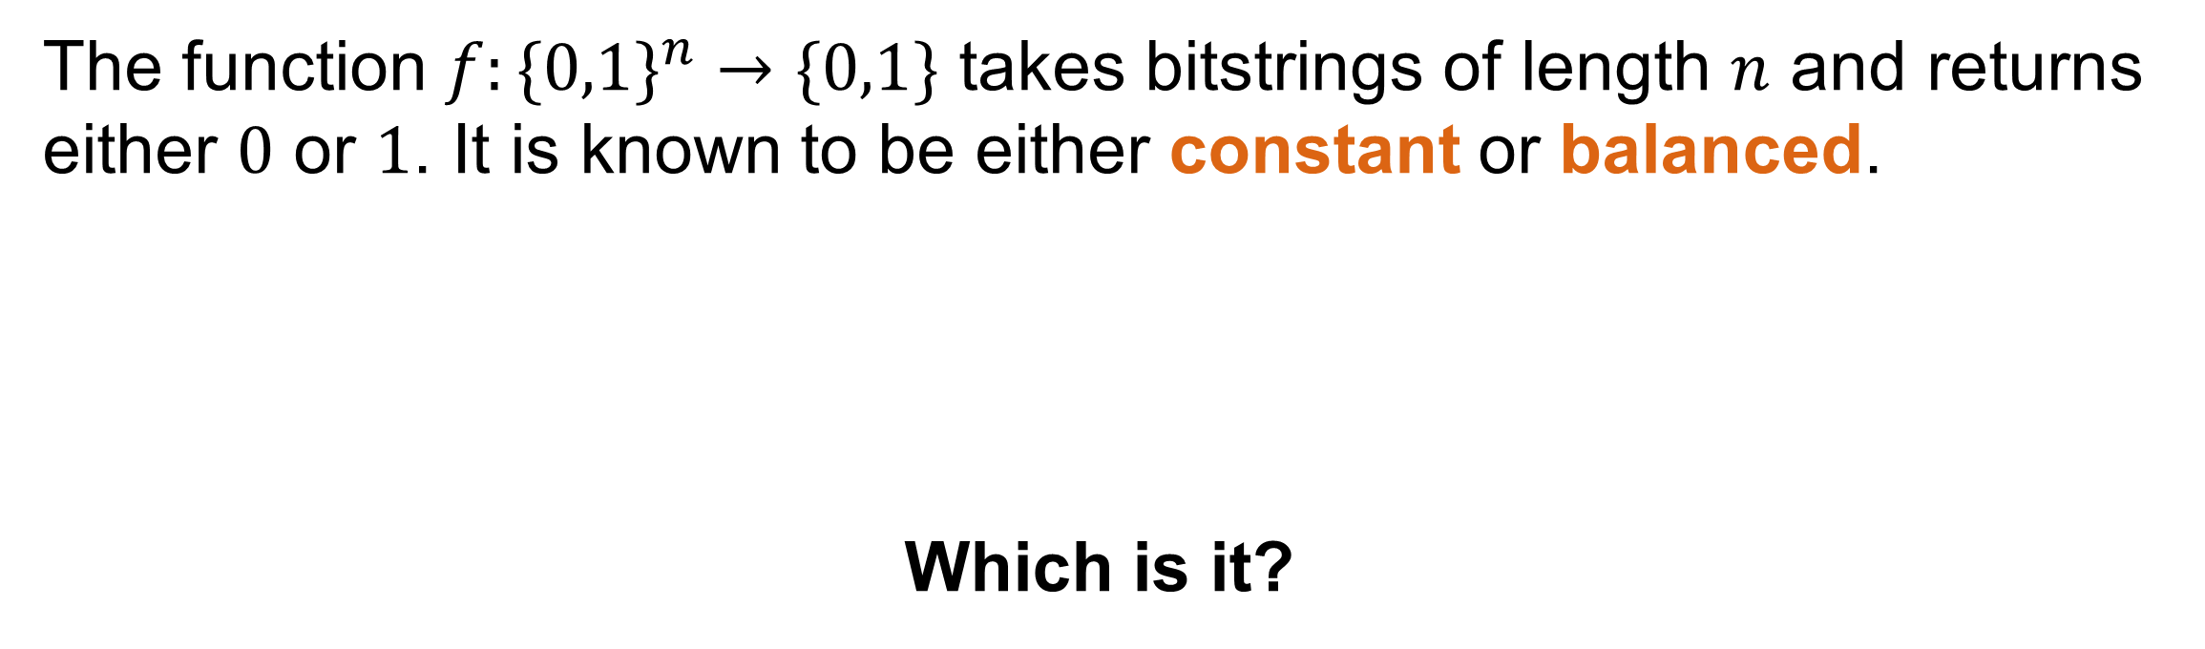


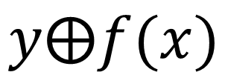






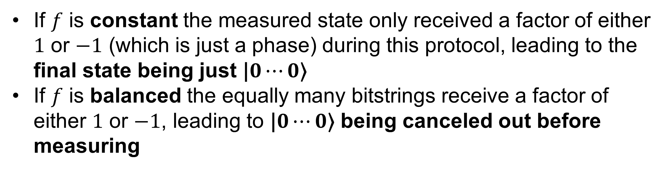


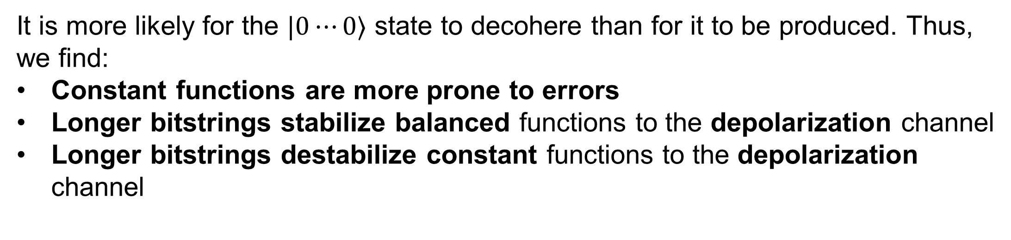



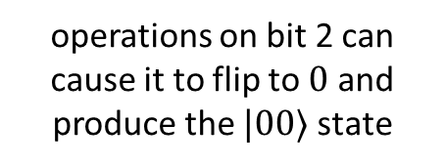
Creating a quantum computation simulation framework
Vladislav Guschakowski, Anantha Vasuvedan
Friedrich-Schiller-Universität Jena, Max-Wien-Platz 1, 07743 Jena, Germany
GitHub¹
arXiv:2312.04211
Motivation
Powerful quantum algorithms, such as Shor’s and Grover’s, have already been discovered since before 2000. But the experimental realization still presents a large obstacle, due to very high error rate in qubits. Thus, simulating quantum circuits is still necessary.²
Our goal is to create a modular and simple-to-use Python framework for simulating quantum circuits. The framework should be organized in a robust manner, with cooperative development and feature updates in mind.
Our project focuses on two aspects:
Learning how to create and maintain usable and expandable software frameworks in a research context.
Applying the framework to investigate the effect of noise on the Deutsch-Josza algorithm.
Framework
Deutsch - Josza algorithm
Tools & Workflow
Problem
Collaborative coding projects require a strong maintenance structure. Helpful practices for this purpose are:
Version control: logging changes between versions with the possibility to create development branches (GitHub)
Unit testing: testing single units of a framework, thus assuring all former features don’t break during updates
Jupyter Notebooks: prepared coding environments showing how to use a tool and allowing for quick experimentation
The function $f:\{0,1\}^{n}→\{0,1\}$ takes bitstrings of length $n$ and returns either $0$ or $1$. It is known to be either constant or balanced.
Which is it?
000…000
000…001
…
111…110
111…111
constant
1
1
…
1
1
000…000
000…001
…
111…110
111…111
balanced
1
0
…
0
1
$$f$$
all $0$ or all $1$
$$f$$
equally many $0$s and $1$s
Features
Classically we need $2^{n−1}+1$ quarries to so solve this problem, by direct testing
The quantum algorithm known as Deutsch-Josza algorithm solves this problem in exactly one quarry
Fully works with pure & mixed states as numpy arrays
Native gate & channel application
Quick and flexible instruction list syntax using the internal instruction class
oracle
simulation
$$H$$
$$0⋯0\text{⟩}$$
$$H^{⨂n}$$
$$x$$
$$U_{f}$$
$$x$$
$$H^{⨂n}$$
$$\text{|}0⋯0\text{⟩}$$
$→$ constant
applies
$$X$$
$$T$$
other state
$→$ balanced
$$R_{x}(π)$$
$$T$$
$$1\text{⟩}$$
$$H$$
$$y$$
$$y⨁f(x)$$
$$R(π,\vec{y})$$
$$T$$
Supports sparse matrices for pure states using scipy csr_matrix
creates superposition
of all bitstrings
Adds factor $(−1)^{f(x)}$ to each bitstring
dissolves
superposition
Supports projective measurements for any given set of projectors
Contains functions to create Bloch plots using Qutip
Contains functions to initialize Haar, Hilbert-Schmidt and Bures random states³
Quickly tensors out single qubit gates by using sparse matrices internally
If $f$ is constant the measured state only received a factor of either $1$ or $−1$ (which is just a phase) during this protocol, leading to the final state being just $\text{|}0⋯0\text{⟩}$
If $f$ is balanced the equally many bitstrings receive a factor of either $1$ or $−1$, leading to $\text{|}0⋯0\text{⟩}$ being canceled out before measuring
Noisy Deutsch - Josza
Blackbox function
To test the effect of noise on the Deutsch-Josza algorithm we used a specific black box function and applied single channels at all the possible noise positions.
Noise Possibilities
$$0⋯0\text{⟩}$$
$$N_{1}$$
$$H^{⨂n}$$
$$N_{2}$$
$$U_{f}$$
$$N_{3}$$
$$H^{⨂n}$$
$$N_{4}$$
internal
external
Depolarization channel
Amplitude damping channel
Bitflip channel
Phaseflip channel
thermalize state
Pull qubit towards $\text{|}0\text{⟩}$
Main results
Why are only some balanced configurations affected?
It is more likely for the $\text{|}0⋯0\text{⟩}$ state to decohere than for it to be produced. Thus, we find:
Constant functions are more prone to errors
Longer bitstrings stabilize balanced functions to the depolarization channel
Longer bitstrings destabilize constant functions to the depolarization channel
Internally we have a superposition state and externally not. Thus, we find:
Bitflips are only relevant externally
Phaseflips are only relevant internally
A balanced function produces an output state other than $\text{|}0⋯0\text{⟩}$. To produce a false result, noise needs to change this state to $\text{|}0⋯0\text{⟩}$. That is highly depended on the explicit output state and target qubit.
operations on bit 1 can‘t change bit 2, which would be necessary
e.g. 2-bit output state:
operations on bit 2 can cause it to flip to $0$ and produce the $\text{|}00\text{⟩}$ state
$$\text{|}01\text{⟩}$$
[1] Guschakowski, Vladislav; Vasuvedan, Anantha. "quantum-computer-simulation." GitHub Repository. [2] Nielsen, Michael A., and Isaac L. Chuang. Quantum computation and quantum information. Cambridge University Press, 2010.
[3] Alhambra, Álvaro M. "Quantum many-body systems in thermal equilibrium." PRX Quantum 4.4 (2023): 040201.
Contact us:
vladislav.guschakowski@uni-jena.de anantha.vasudevan@uni-jena.de

