Slide 1




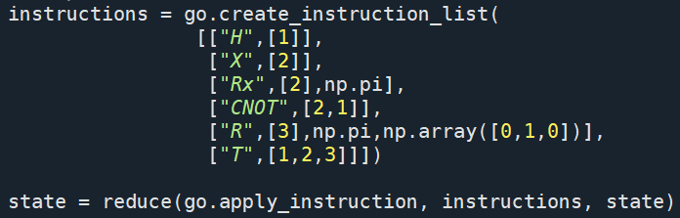
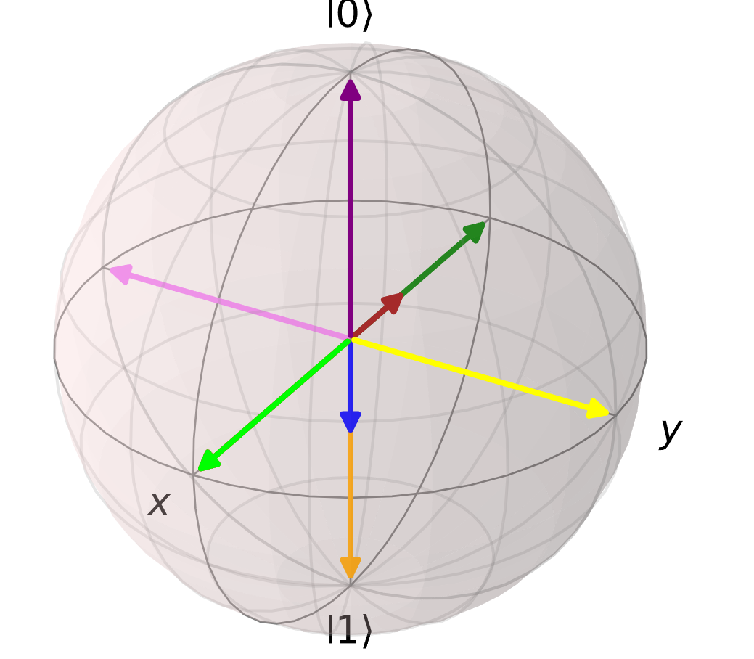
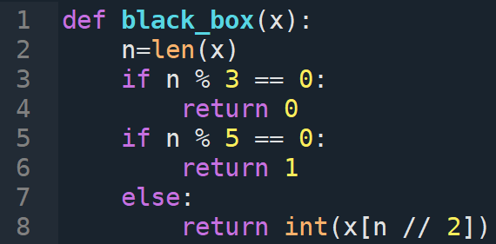
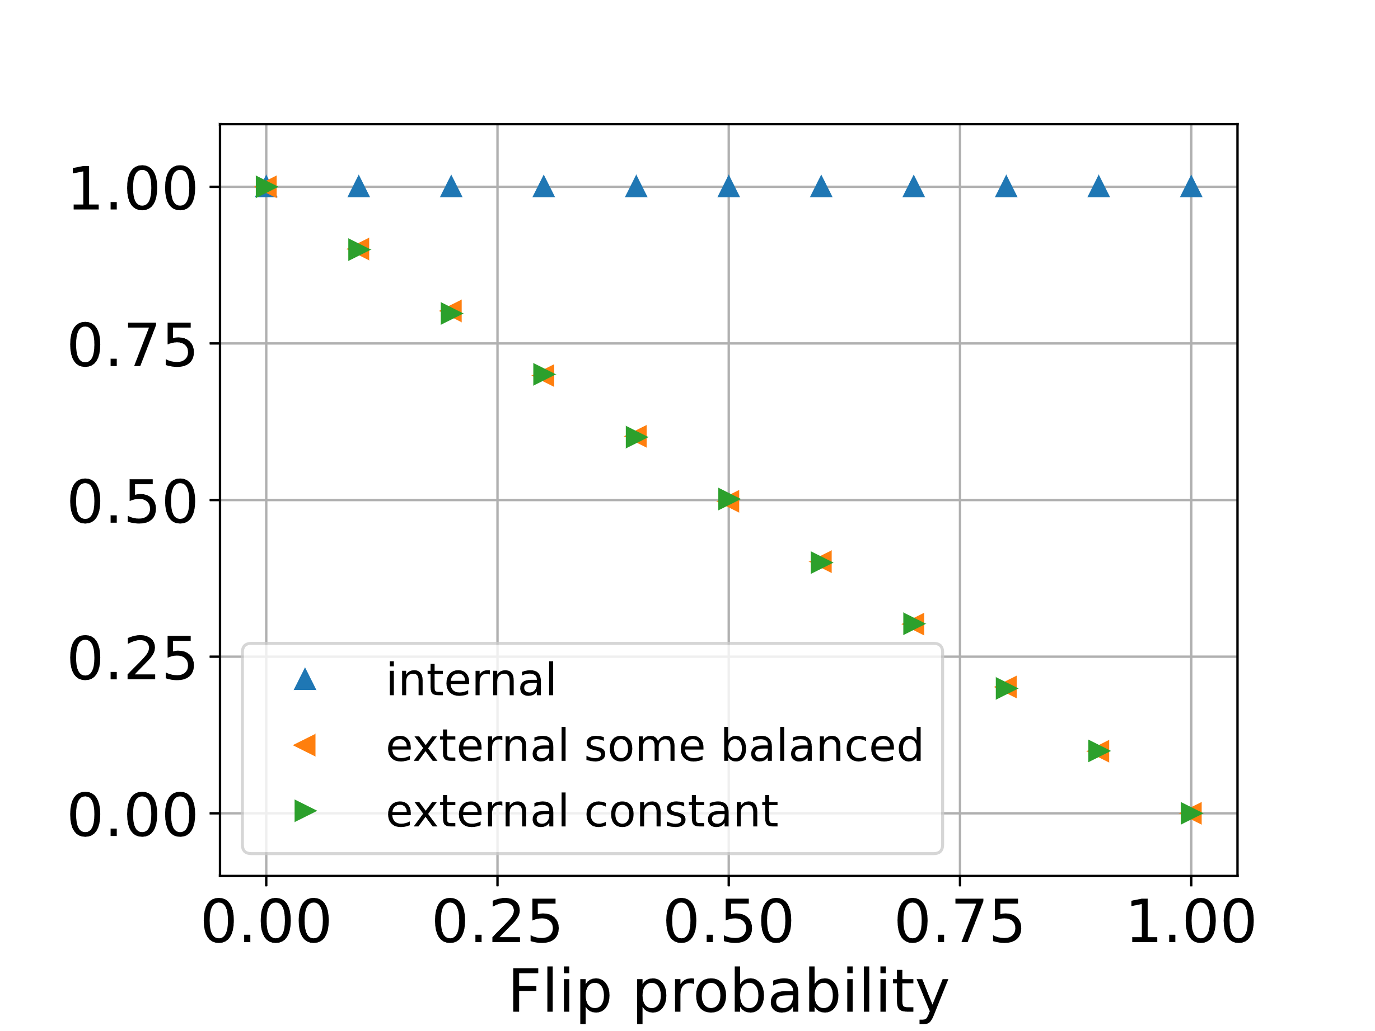



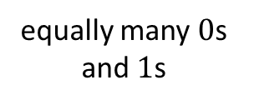









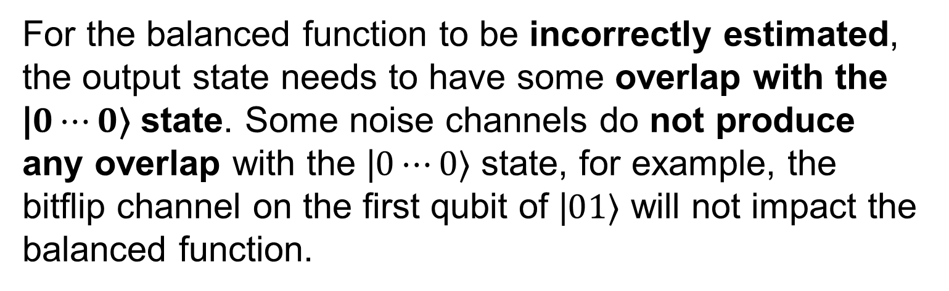

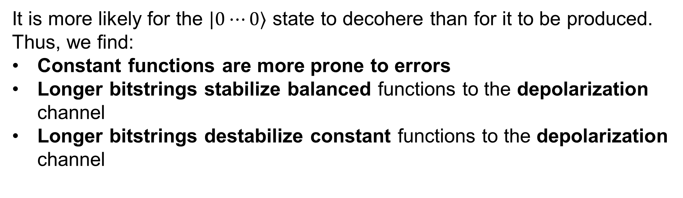





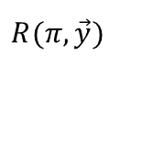

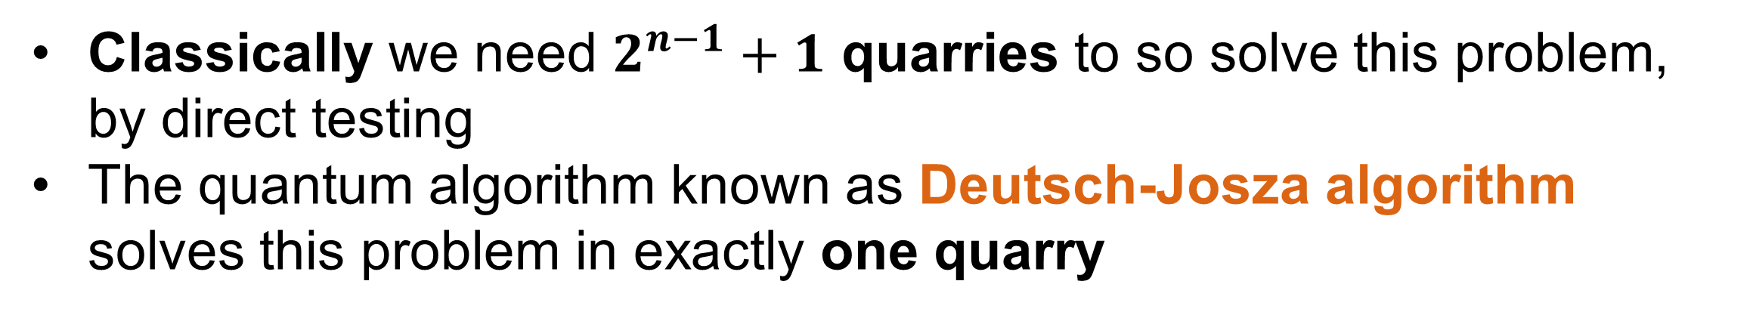




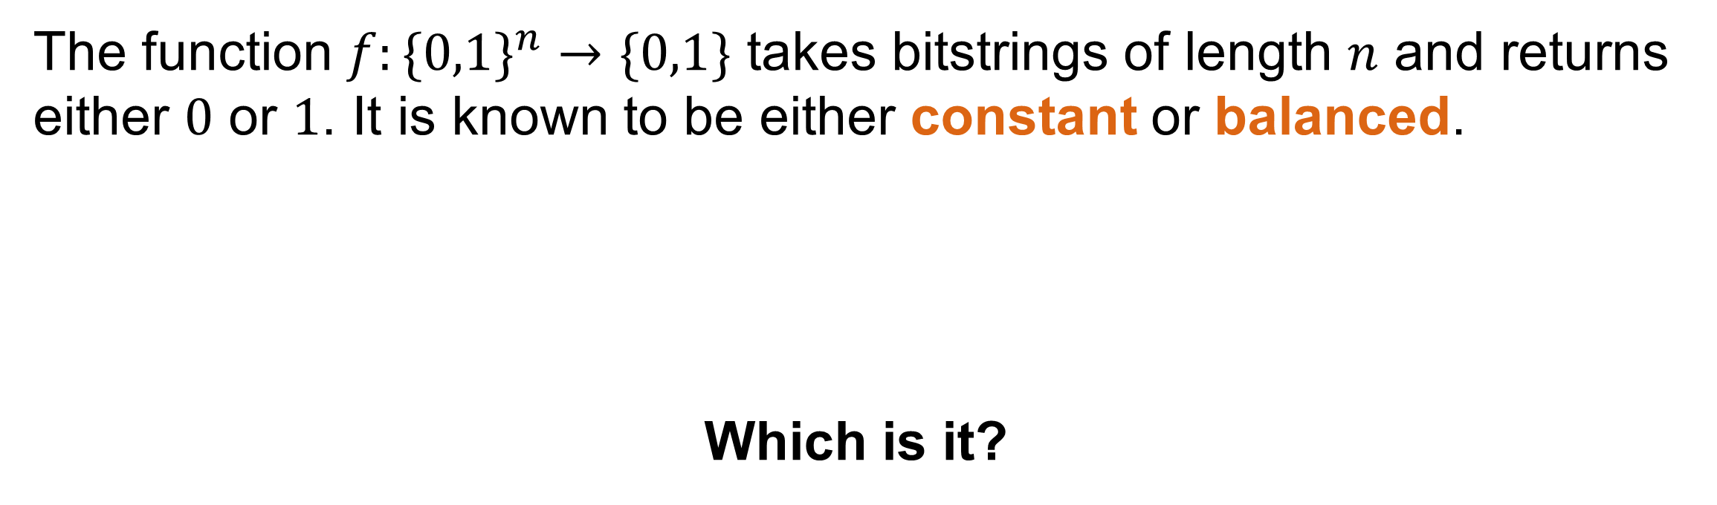


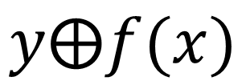





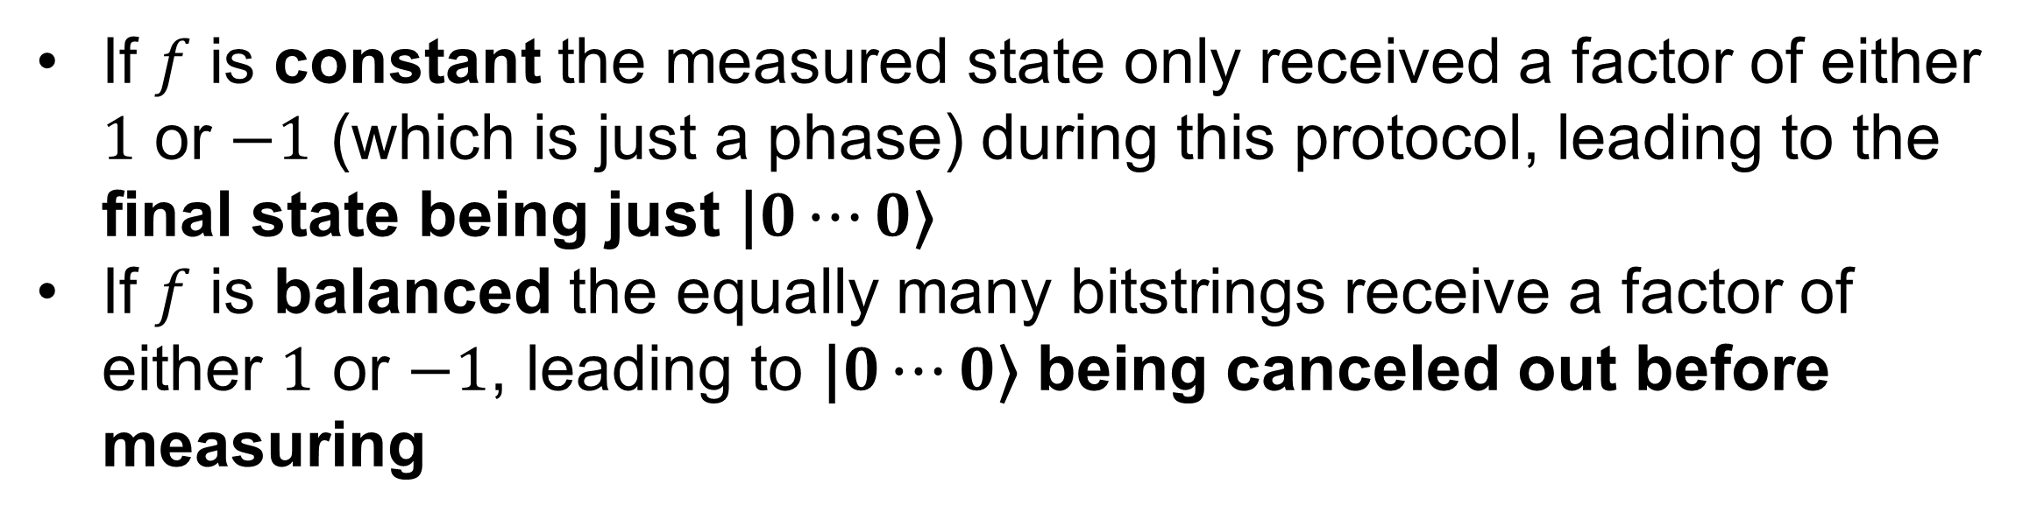


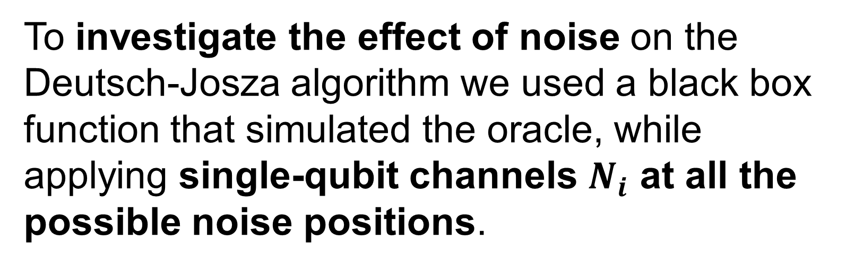
Creating a quantum computation simulation framework
Vladislav Guschakowski, Anantha Vasudevan
Friedrich-Schiller-Universität Jena, Max-Wien-Platz 1, 07743 Jena, Germany
GitHub¹
arXiv:2312.04211
Motivation
Powerful quantum algorithms, such as Shor’s and Grover’s, were already discovered over three decades ago. To this day the experimental realization of these algorithms still presents a large obstacle, due to high error rate in qubits. Thus, classical simulations of quantum circuits are still necessary².
Our goal is to create a modular and simple-to-use Python framework for simulating quantum circuits. The framework should be organized in a robust manner, with cooperative development and feature expansions in mind.
Our project focuses on two aspects:
Learning how to create and maintain usable and expandable software frameworks in a research context.
Applying the framework to investigate the effect of noise on the Deutsch-Josza algorithm.
Framework
Deutsch - Josza algorithm
Tools & Workflow
Problem
Collaborative coding projects require a strong maintenance structure. Helpful practices for this purpose are:
Version control: logging changes between versions with the possibility to create development branches (GitHub)
Unit testing: testing single units of a framework, thus assuring all former features don’t break during updates
Jupyter Notebooks: prepared coding environments showing how to use a tool and allowing for quick experimentation
The function $f:\{0,1\}^{n}→\{0,1\}$ takes bitstrings of length $n$ and returns either $0$ or $1$. It is known to be either constant or balanced.
Which is it?
000…000
000…001
…
111…110
111…111
constant
1
1
…
1
1
000…000
000…001
…
111…110
111…111
balanced
1
0
…
0
1
$$f$$
all $0$ or all $1$
$$f$$
equally many $0$s and $1$s
Classically we need $2^{n−1}+1$ quarries to so solve this problem, by direct testing
The quantum algorithm known as Deutsch-Josza algorithm solves this problem in exactly one quarry
Features
Fully works with pure & mixed states as numpy arrays
Native gate & channel application
Quick and flexible instruction list syntax using the internal instruction class
oracle
simulation
$$0⋯0\text{⟩}$$
$$H^{⨂n}$$
$$x$$
$$U_{f}$$
$$x$$
$$H^{⨂n}$$
$$\text{|}0⋯0\text{⟩}$$
$→$ constant
applies
$$H$$
$$X$$
$$T$$
other state
$→$ balanced
$$R_{x}(π)$$
$$T$$
$$1\text{⟩}$$
$$H$$
$$y$$
$$y⨁f(x)$$
$$R(π,\vec{y})$$
$$T$$
Supports sparse matrices for pure states using scipy csr_matrix
creates superposition
of all bitstrings
Adds factor $(−1)^{f(x)}$ to each bitstring
dissolves
superposition
Supports projective measurements for any given set of projectors
Contains functions to create Bloch plots using Qutip
Contains functions to initialize Haar, Hilbert-Schmidt and Bures random states³
Thus, classical simulations of quantum circuits by using sparse matrices
If $f$ is constant the measured state only received a factor of either $1$ or $−1$ (which is just a phase) during this protocol, leading to the final state being just $\text{|}0⋯0\text{⟩}$
If $f$ is balanced the equally many bitstrings receive a factor of either $1$ or $−1$, leading to $\text{|}0⋯0\text{⟩}$ being canceled out before measuring
Noisy Deutsch - Josza
Blackbox function
To investigate the effect of noise on the Deutsch-Josza algorithm we used a black box function that simulated the oracle, while applying single-qubit channels $N_{i}$ at all the possible noise positions.
Noise Possibilities
$$0⋯0\text{⟩}$$
$$N_{1}$$
$$H^{⨂n}$$
$$N_{2}$$
$$U_{f}$$
$$N_{3}$$
$$H^{⨂n}$$
$$N_{4}$$
internal
Depolarization channel
external
thermalize state
Amplitude damping channel
Bitflip channel
Phaseflip channel
Pull qubit towards $\text{|}0\text{⟩}$
Main results
Why are not all balanced configurations affected?
It is more likely for the $\text{|}0⋯0\text{⟩}$ state to decohere than for it to be produced. Thus, we find:
Constant functions are more prone to errors
Longer bitstrings stabilize balanced functions to the depolarization channel
Longer bitstrings destabilize constant functions to the depolarization channel
Internal noise positions act on equal superposition states, while external positions act on computational basis states, we therefore conclude:
Bitflips are only relevant externally
Phaseflips are only relevant internally
For the balanced function to be incorrectly estimated, the output state needs to have some overlap with the $\text{|}0⋯0\text{⟩}$ state. Some noise channels do not produce any overlap with the $\text{|}0⋯0\text{⟩}$ state, for example, the bitflip channel on the first qubit of $\text{|}01\text{⟩}$ will not impact the balanced function.
[1] Guschakowski, Vladislav; Vasuvedan, Anantha. "quantum-computer-simulation." GitHub Repository. [2] Nielsen, Michael A., and Isaac L. Chuang. Quantum computation and quantum information. Cambridge University Press, 2010.
[3] Alhambra, Álvaro M. "Quantum many-body systems in thermal equilibrium." PRX Quantum 4.4 (2023): 040201.
vladislav.guschakowski@uni-jena.de anantha.vasudevan@uni-jena.de

