Slide 1
AuraDB Knowledge Graph Creation
Vladislavs Babaņins

Slide 2
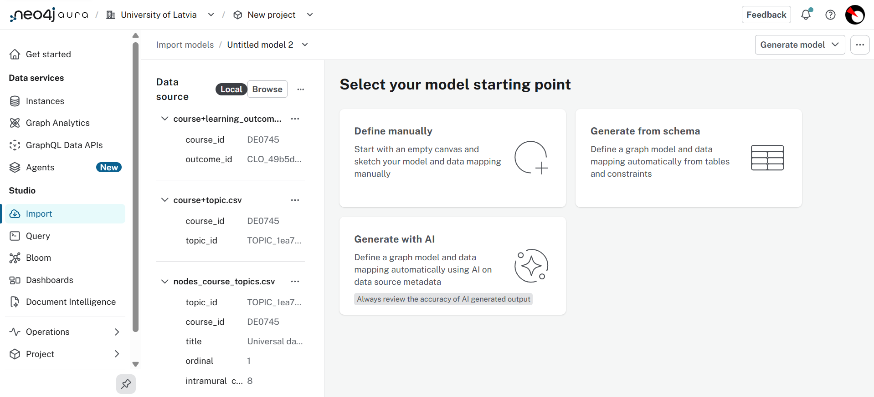
Data Import and Schema Generation in Neo4j AuraDB
1. Imported node and edge CSV files
2. Generated the graph model using Neo4j Aura's Generate with AI

Slide 3
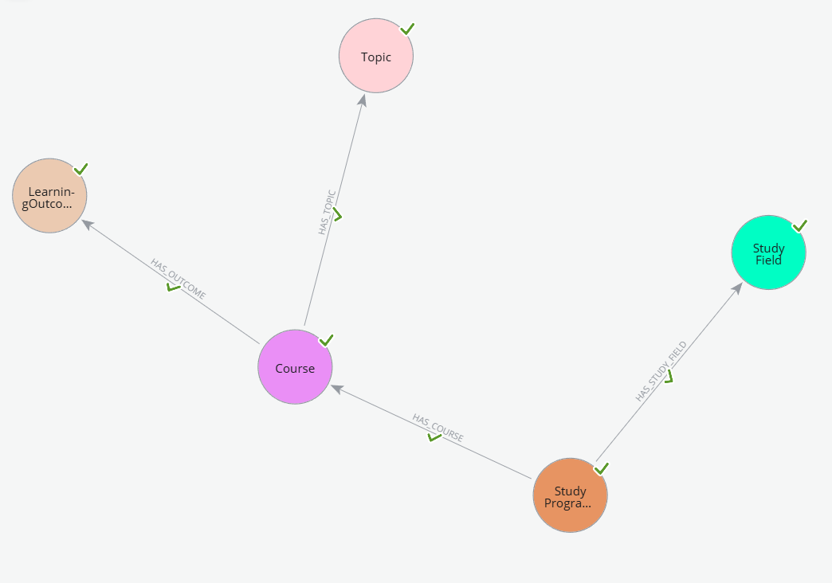
Core graph model
Node labels:
StudyProgram
Course
Topic
LearningOutcome
StudyField
Relationship types:
HAS_COURSE
HAS_TOPIC
HAS_OUTCOME
HAS_STUDY_FIELD

Slide 4
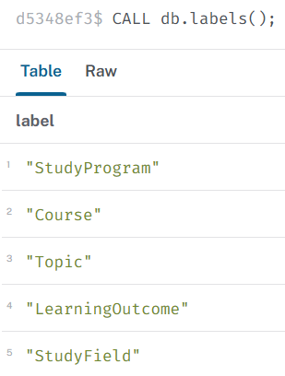
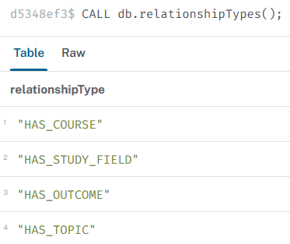
Schema Verification in Neo4j AuraDB

Slide 5
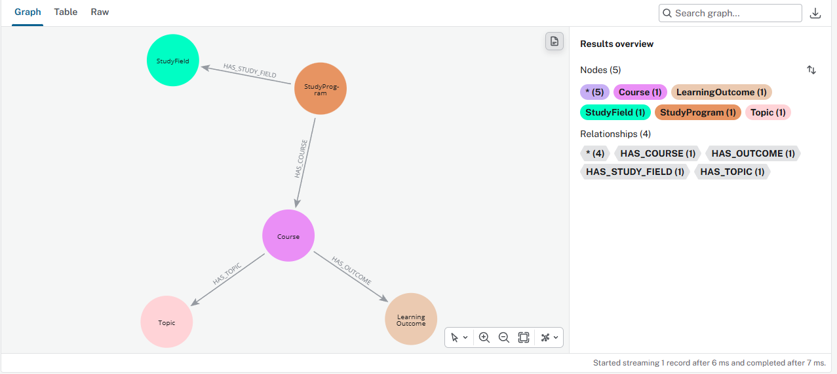
Graph Schema Visualization
CALL db.schema.visualization()

Slide 6
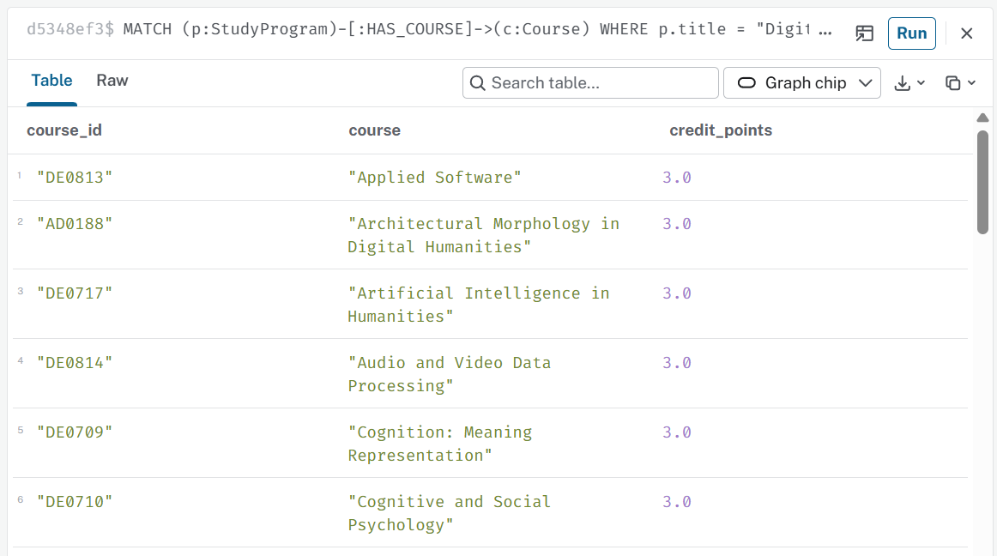
Query 1: Digital Humanities Courses
MATCH (p:StudyProgram)-[:HAS_COURSE]->(c:Course)
WHERE p.title = "Digital Humanities"
RETURN c.courseId AS course_id,
c.title AS course,
c.creditPoints AS credit_points
ORDER BY c.title;

Slide 7
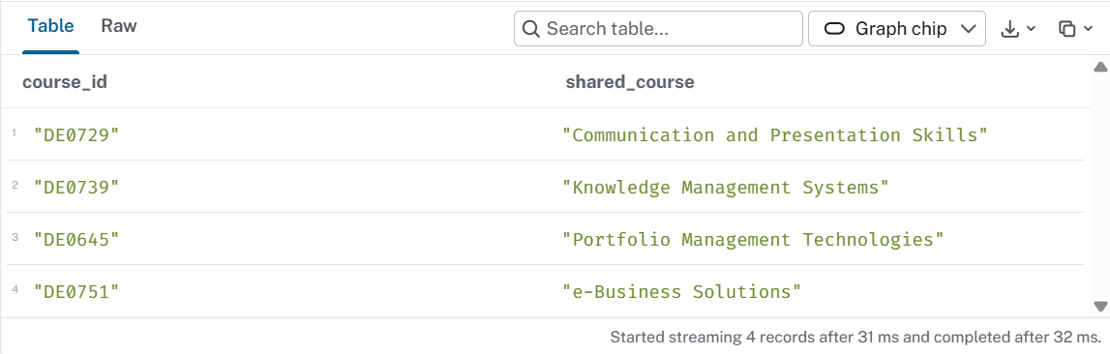
Query 2: Courses Shared by BI and DH
MATCH (dh:StudyProgram)-[:HAS_COURSE]->(c:Course)
<-[:HAS_COURSE]-(bi:StudyProgram)
WHERE dh.title = "Digital Humanities"
AND bi.title = "Business Informatics"
RETURN c.courseId AS course_id,
c.title AS shared_course
ORDER BY c.title;

Slide 8
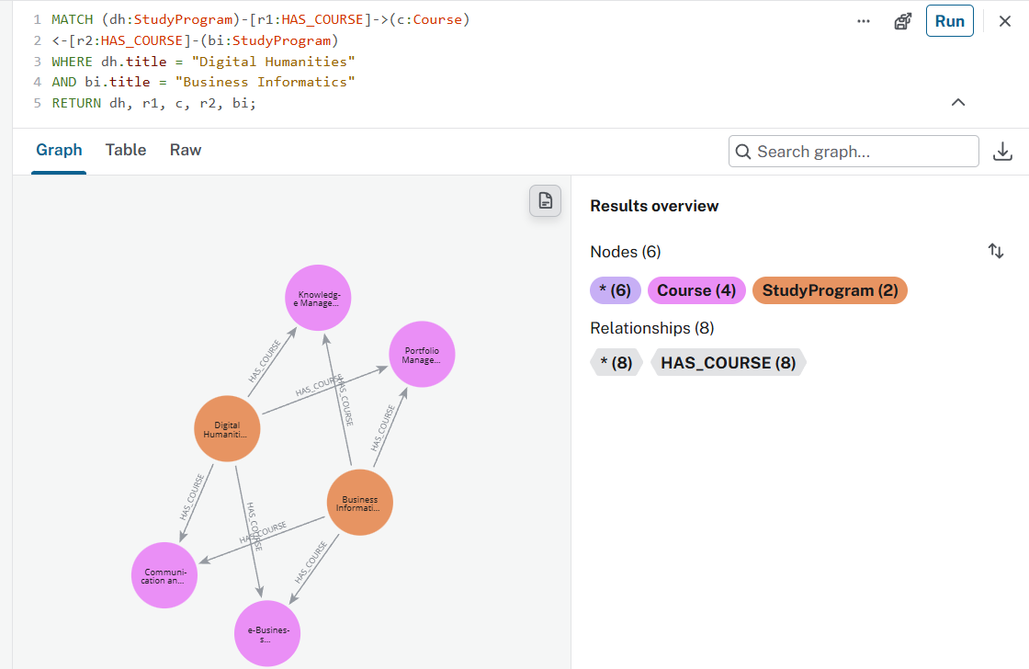
Courses Shared by BI and DH (Graph View)
MATCH (dh:StudyProgram)-[r1:HAS_COURSE]->(c:Course)
<-[r2:HAS_COURSE]-(bi:StudyProgram)
WHERE dh.title = "Digital Humanities"
AND bi.title = "Business Informatics"
RETURN dh, r1, c, r2, bi;

Slide 9
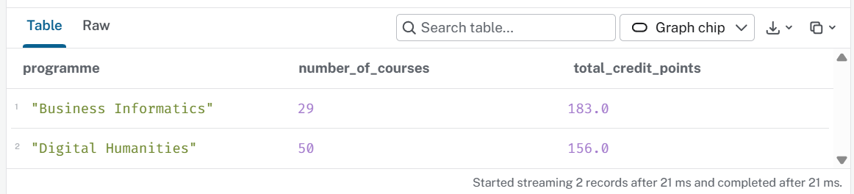
Query 3: Courses and Credits by Programme
MATCH (p:StudyProgram)-[r:HAS_COURSE]->(c:Course)
RETURN p.title AS programme,
count(c) AS number_of_courses,
sum(r.creditPoints) AS total_credit_points
ORDER BY programme;

Slide 10
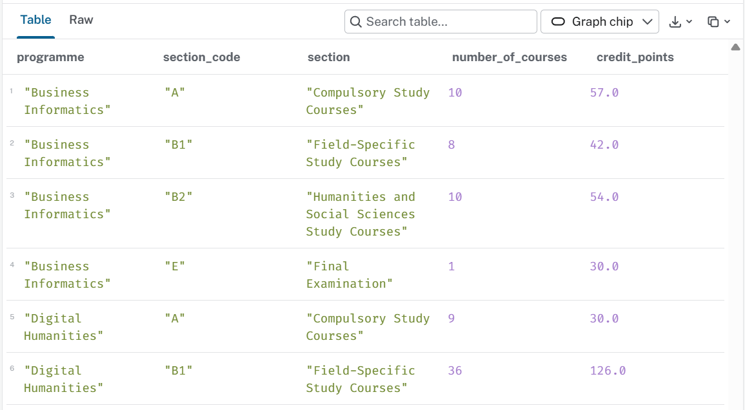
Query 4: Courses by Programme Section
MATCH (p:StudyProgram)-[r:HAS_COURSE]->(c:Course)
RETURN p.title AS programme,
r.sectionCode AS section_code,
r.sectionName AS section,
count(c) AS number_of_courses,
sum(r.creditPoints) AS credit_points
ORDER BY programme, section_code;

Slide 11
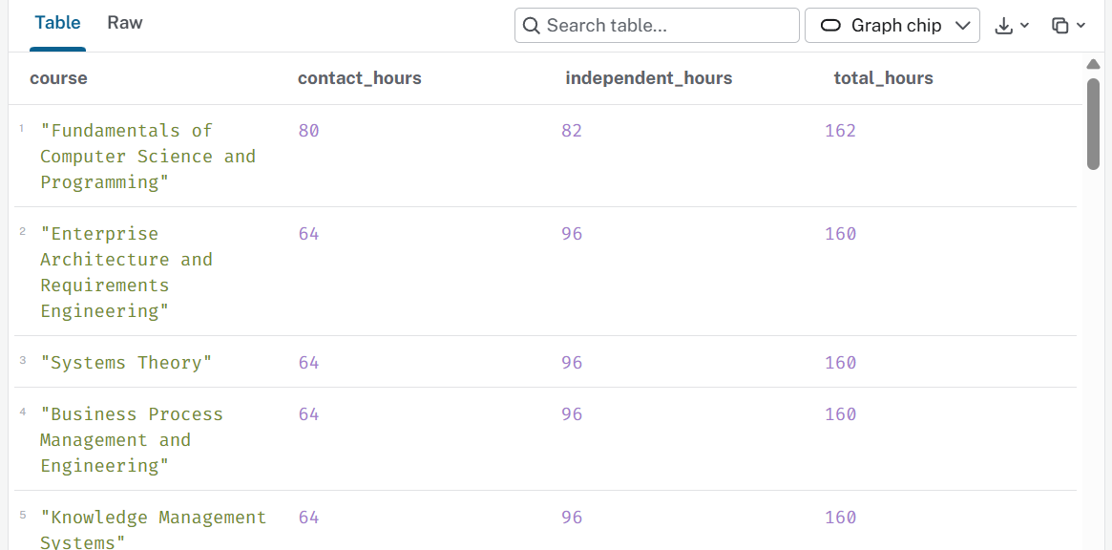
Query 5: Total Study Workload by Course
MATCH (c:Course)-[:HAS_TOPIC]->(t:Topic)
RETURN c.title AS course,
sum(coalesce(t.intramuralContactHours, 0)) AS contact_hours,
sum(coalesce(t.intramuralIndependentHours, 0)) AS independent_hours,
sum(
coalesce(t.intramuralContactHours, 0) +
coalesce(t.intramuralIndependentHours, 0)
) AS total_hours
ORDER BY total_hours DESC;

