Slide 1
Analysis of Query Length and Response Time in GPT-4 Model
Vladylena Halchuk

Slide 2
Objective:
Determine if there's a significant impact of query length (measured in tokens) on the response time of the GPT-4 model.

Slide 3
Methodology:
Data from total_tokens_vs_invoke_chain_time.csv was analyzed using Python libraries (Pandas, Seaborn, Matplotlib.Pyplot and Duckdb).
Scatter and regression plots were generated to visualize the data.
The correlation coefficient was calculated to quantify the relationship.
Data was binned into quartiles to identify potential thresholds in token count affecting response times.

Slide 4
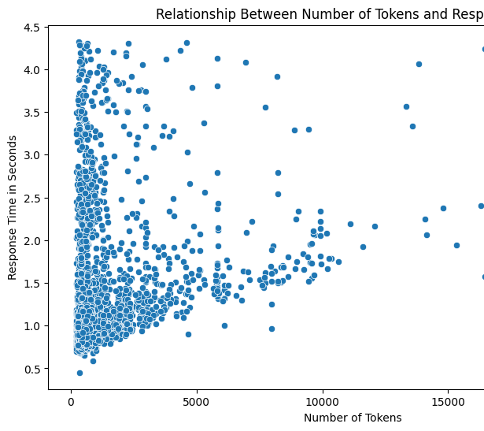
1. Scatter Plot Analysis:
Concentration of points suggests shorter response times for queries with fewer tokens.
As token count increases, response times show greater variability.

Slide 5
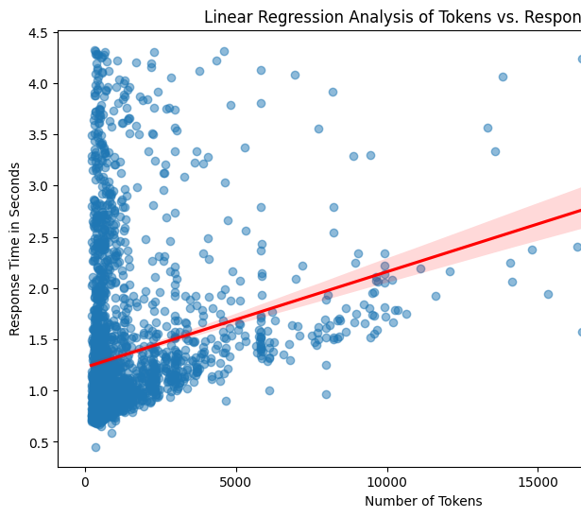
2. Regression Analysis:
A positive trend line indicates response times tend to increase with more tokens.
The wide confidence interval at higher token counts suggests more variability.

Slide 6
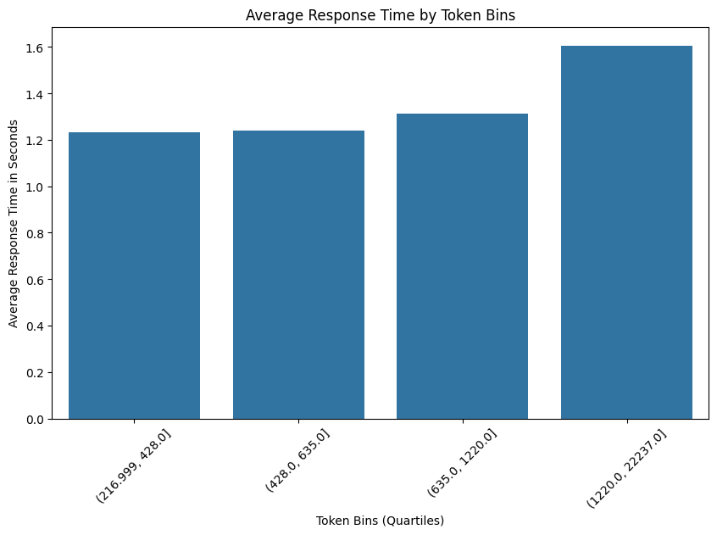
3. Average Response Time by Token Bins:
Quartile analysis does not show a consistent increase in response time with token count.

Slide 7
Correlation Coefficient:
Calculated value: 0.245
Indicates a positive but weak linear relationship between token count and response time.

Slide 8
Conclusion:
While there is a positive relationship between the number of tokens in a query and the GPT-4 model's response time, the relationship is weak. The response time does not consistently increase with the number of tokens across the observed data range. Other unexamined factors may also play a significant role in response times.

Slide 9
Recommendations:
Further investigation is recommended to identify additional factors influencing response time.
Simply reducing token count may not be an effective standalone strategy for significantly improving response time.

Slide 10

Thank you for your attention!

