Slide 1

Higgs Boson Machine Learning Challenge

Slide 2
Task Description
Discovery of the long awaited Higgs boson was announced July 4, 2012 and confirmed six months later. 2013 saw a number of prestigious awards, including a Nobel prize.
A key property of any particle is how often it decays into other particles. The ATLAS experiment has recently observed a signal of the Higgs boson decaying into two tau particles, but this decay is a small signal buried in background noise.
The goal of the Higgs Boson Machine Learning Challenge is to explore the potential of advanced machine learning methods to improve the discovery significance of the experiment.

Slide 3
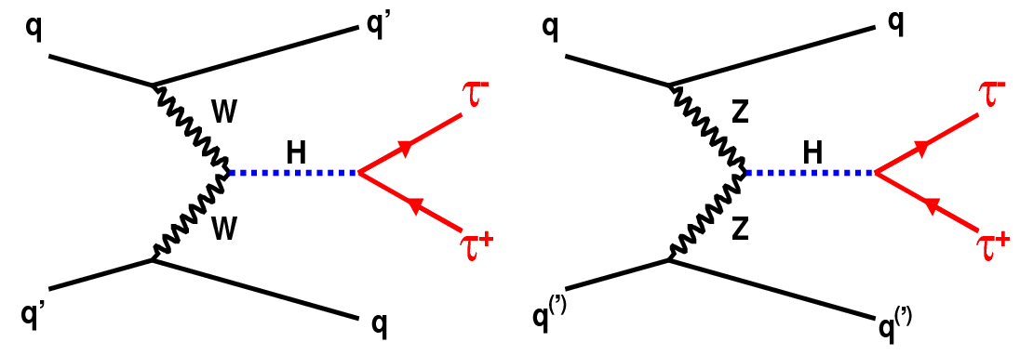
So we’ve got two types of events here:
We wanna learn
to distinguish them
Background
Signal

Slide 4
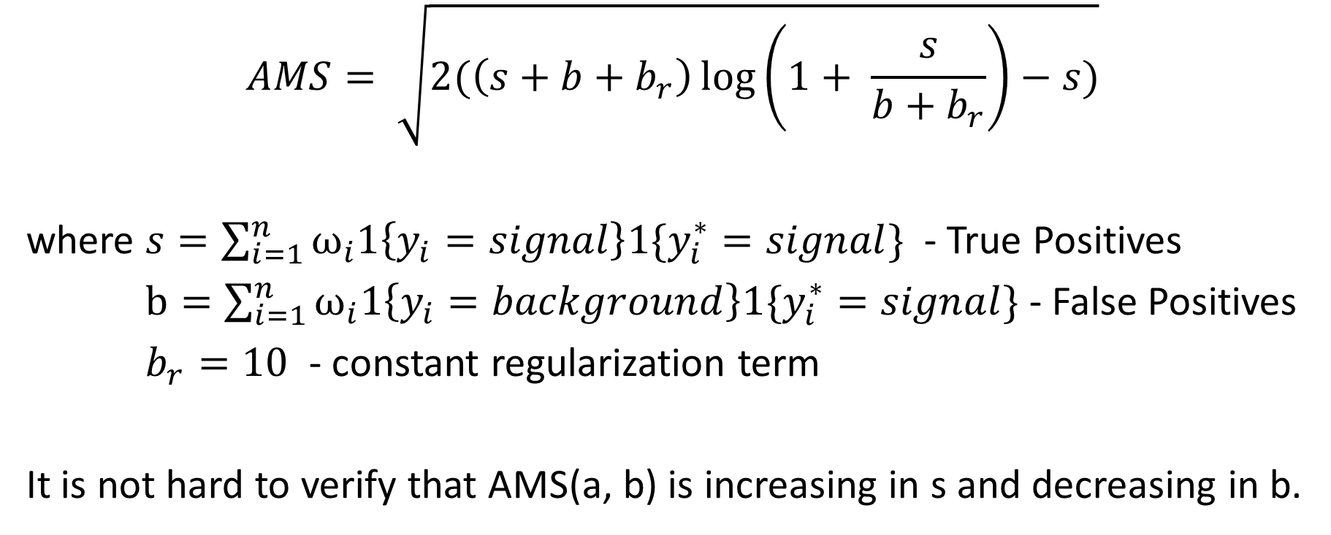
Metric
$$AMS= \sqrt{2(\left(s+b+b_{r}\right)\log\left(1+ \frac{s}{b+b_{r}}\right)−s)}$$
where $s=\sum_{i=1}^{n}{ω_{i}1\left\{y_{i}=signal\right\}1\{y_{i}^{∗}=signal\}}$ - True Positives
$b=\sum_{i=1}^{n}{ω_{i}1\left\{y_{i}=background\right\}1\{y_{i}^{∗}=signal\}}$ - False Positives
$b_{r}=10$ - constant regularization term
It is not hard to verify that AMS(a, b) is increasing in s and decreasing in b.

Slide 5
Data
250000 observations
30 features (29 continuous, 1 categorical)
Column with weights
Response (background or signal)

Slide 6
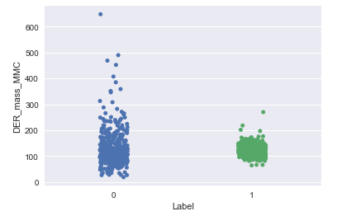
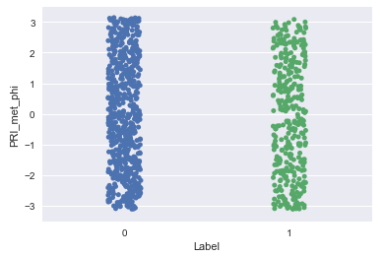
Data Preparation & Feature Engineering
Fill NA and inadequate data with the mean
Pairwise visualization of features and label
Throwing away some features, which contain more noise than useful information

Slide 7
Classifiers used
KNN (with different k)
Decision Tree Classifier
Random Forest Classifier
AdaBoost Classifier
Gradient Boosting Classifier
MLPClassifier (Neural Nets)
Gaussian Naive Bayes
Quadratic Discriminant Analysis

Slide 8

But what about our beloved metric AMS?
Experience shows me, that choosing the top 15% most-probable–signal-events as signals gives very good results. Though, this may be optimized somehow.
After some parameters tuning, we’ve got the winner…

Slide 9
Gradient Boosting Classifier!
Not all features used
Accuracy = 0.8362
AMS = 3.5729

