Slide 1

Project Seminar
On
Develop a AI/ML tool to detect whether a system / firewall /router / network is compromised. The technique should not rely only on IoCs (Indicators of Compromises) detection.
Presented by ( Sem : VI)
65 Dhananjay Chacherkar
69 Varad Chopkar
47 Rohan Assudani
67 Purvank Mudgal
Under the Guidance of
Chandak Sir
Assistant professor
IT Deptt., RCOEM, Nagpur
Department of Information Technology
Shri Ramdeobaba College of Engineering and Management, Nagpur

Slide 2
Agenda
Introduction
Motivation
Literature Study
Requirement Analysis
Timeline
Current Status
References

Slide 3
Introduction
Early detection of compromised systems, firewalls, routers, and networks is crucial for safeguarding critical information infrastructure.
Traditional methods heavily rely on Indicators of Compromise (IoCs), but our aim is to develop an innovative AI/ML tool that transcends IoC dependence.
Our focus lies on detecting compromises using advanced machine learning models, even when IoCs are unknown. Join us as we explore groundbreaking approaches to bolster cybersecurity resilience through non-IoC-based compromise detection.

Slide 4
Motivation
In today's digital era, safeguarding critical information infrastructure is paramount due . The ever-evolving threat landscape necessitates early detection of compromises within systems, firewalls, routers, and networks.
Traditional methods heavily rely on Indicators of Compromise (IoCs) for threat detection. However, this approach is limited by its dependence on known threat signatures, leaving systems vulnerable to emerging threats.
Our motivation lies in bridging this gap in cybersecurity defense. We aim to develop an innovative AI/ML tool capable of transcending IoC dependence. By leveraging advanced machine learning models, we seek to detect compromises even when IoCs are unknown.Together, let's pave the way for a safer and more secure digital landscape

Slide 5
Literature Study
This study proposes an AI/ML tool to detect system, firewall, router, or network compromises, using machine learning to expose intrusion detection systems and malicious network behavior, based on the quality of the dataset used.https://papers.ssrn.com/sol3/papers.cfm?abstract_id=4235236
This research proposes a Machine Learning-based Cyber Threat Intelligence Framework for Industrial Control System Network Traffic Indicators of Compromise Cyber-attacks on Critical Infrastructure. The Bagging Decision Trees model demonstrated the highest accuracy, precision, recall, and F1-score among the nine models studied. https://link.springer.com/book/10.1007/978-3-030-64690-5

Slide 6
This paper discusses the methods used by hackers to gain access to systems, their tools, and their skills. It identifies exploits and provides mitigation strategies. The paper also discusses the implementation of hacking phases, virtual machine specifications, and provides insights on protecting systems from compromise.https://www.ijfmr.com/

Slide 7
Requirement Analysis
Technology - Python , NLP(Neural Networks) , Machine Learning, Semi-supervised learning (mix of both supervised as well as unsupervised learning)
Data - Dataset can be downloaded from : https://dataverse.harvard.edu
Platform - Google Colab for training model

Slide 8
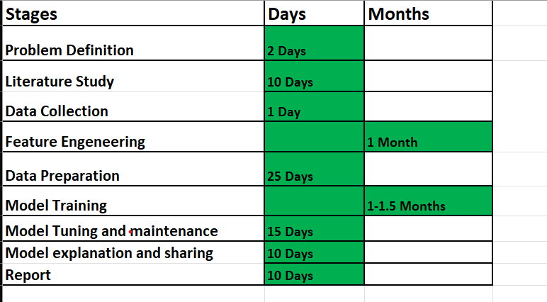
TimeLine

Slide 9
Current Status
The core idea behind machine learning is to enable computers to learn patterns and relationships within data in order to make predictions or decisions.
Training a model in machine learning is the act of using data to teach a machine learning algorithm to recognise patterns and relationships in the data, with the eventual objective of generating predictions or judgements based on fresh, previously unseen data.
Studying literature on supervised learning, as well as important concerns or real-time problems related to network vulnerability . Discovering and reviewing research papers using the links provided above.

Slide 10
References
Develop a AI/mL Tool to Descry Whether a System / Firewall /Router / Network is Compromise
Prashant Golhar , Yash Shriwas , Bhawna Bhoyar , Divyani Bhusari , Dhanraj Tikhat
Bachelor of Technology in the field of Computer science and Engineering, Information Technology, RTMNU Nagpur University, Nagpur, Maharashtra, India.
A Machine Learning based Threat Intelligence Framework for Industrial Control System Network Traffic Indicators of Compromise
Venkata Atluri Department of Electrical Engineering and Computer Science Alabama A&M University Normal, AL 35762, USA venkata.atluri@aamu.edu
Jeff Horne Savannah River National Laboratory Aiken, SC 29808 jeff.horne@srnl.doe.gov
COMPROMISING SYSTEMS: IMPLEMENTING HACKING PHASES
Marlon intal tayag and Maria emmalyn asuncion de vigal capuno
1College of Information and Communications Technology,Holy Angel University, Angeles, Philippines
2 Faculty of Information Technology, Future University, Khartoum, Sudan

Slide 11
Thank You !!!

