Slide 1

Project Seminar
On
Compromise Detection System using ML
Presented by ( Sem : VI), Grp No 11
65 Dhananjay Chacherkar
69 Varad Chopkar
47 Rohan Assudani
67 Purvank Mudgal
Under the Guidance of
Dr. Ashish Chandak Sir
Assistant professor
IT Deptt., RCOEM, Nagpur
Department of Information Technology
Shri Ramdeobaba College of Engineering and Management, Nagpur

Slide 2
Agenda
Introduction
Requirement Analysis
KDD DataSet
Evaluating Model Performance on the KDD Cup Dataset
Implementation of one-hot Encoding
Dataset Analysis
PCA
Final DataSet
K means Algorithm (Result and Evaluation of k means)
Final cluster plots
DBSCAN

Slide 3
Model Evaluation
Timeline
References

Slide 4
Introduction
To implement this project we are going to use Unsupervised machine learning.
How we are going to achieve it:-
Step1:-Preprocessing
Load the KDD dataset,perform clearing and preprocessing.
Step2:- Feature Selection/Extraction
Select relevant features or perform feature extraction to reduce dimensionality and focus on the most informative aspects of the data.
Step3 :- Clustering
Utilize K-means and DBSCAN algorithms for clustering the data. These algorithms are effective for identifying clusters in high-dimensional data

Slide 5
Step4:- Model Evaluation
Compare the performance of different clustering algorithms and configurations to identify the most effective approach
Step5:- Anomaly detection:-
Identify clusters that deviate significantly from the norm as potential anomalies. Anomalies may indicate compromised systems or unusual behavior.

Slide 6
Requirement Analysis
Technology - Python, Jupyter Notebook , Machine Learning, Unsupervised learning
Data - Dataset can be downloaded from :
https://kdd.ics.uci.edu/databases/kddcup99/kddcup99.html
Hardware - Minimum 16gb ram , Nvidia cuda GPU 4gb VRAM

Slide 7
KDD Dataset
The KDD Cup dataset is a well-known dataset used in machine learning and data mining competitions. It was created for the KDD Cup competition organized by ACM SIGKDD, which is a premier international conference in data mining and knowledge discovery.
The KDD data set is a standard data set used for the research on compromise detection systems.

Slide 8
Advantage of KDD dataset
Availability and Accessibility
This dataset contains network traffic data captured from a simulated environment, making it relevant to real-world scenarios.
The KDD dataset has been used as a benchmark dataset for evaluating performance of Compromise detection systems
The KDD Cup 1999 dataset was one of the earliest publicly available datasets for intrusion detection research. Its historical significance has contributed to its popularity and continued use in cybersecurity community.

Slide 9
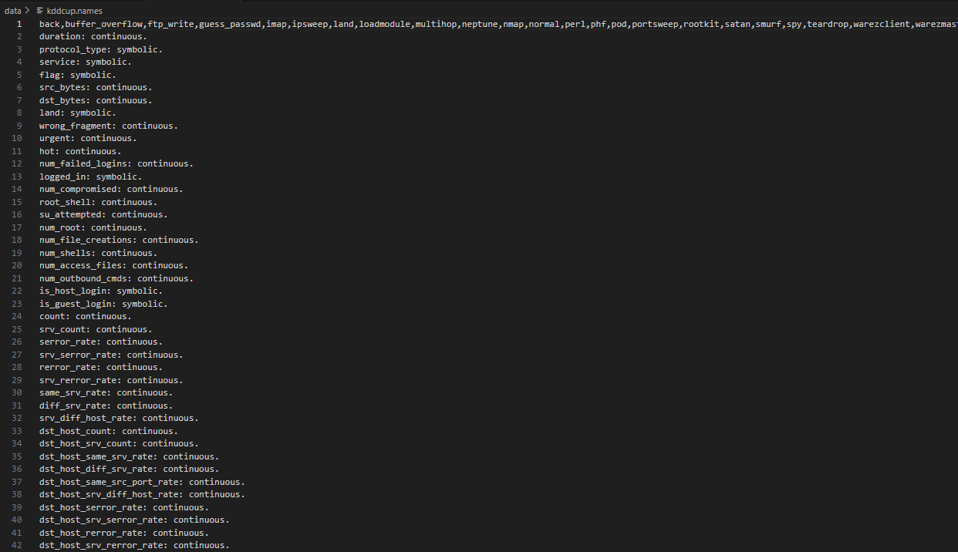
KDDCUP DATA

Slide 10
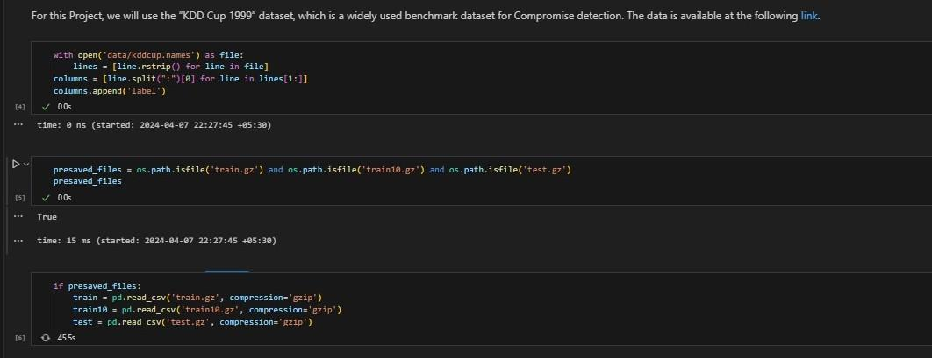
Evaluating Model Performance on the KDD Cup Dataset

Slide 11
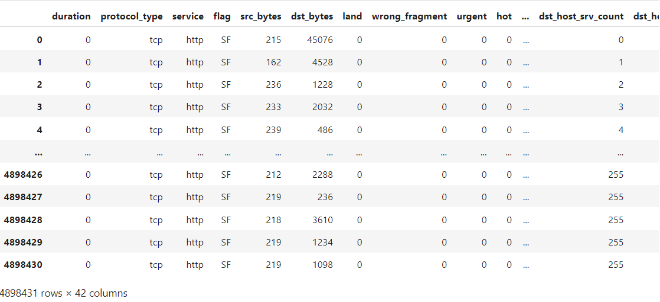

Slide 12
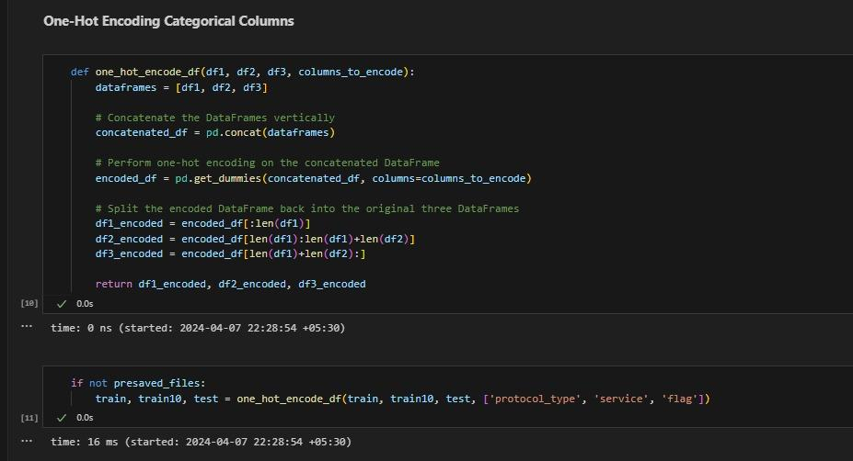
Implementation of one-hot Encoding

Slide 13
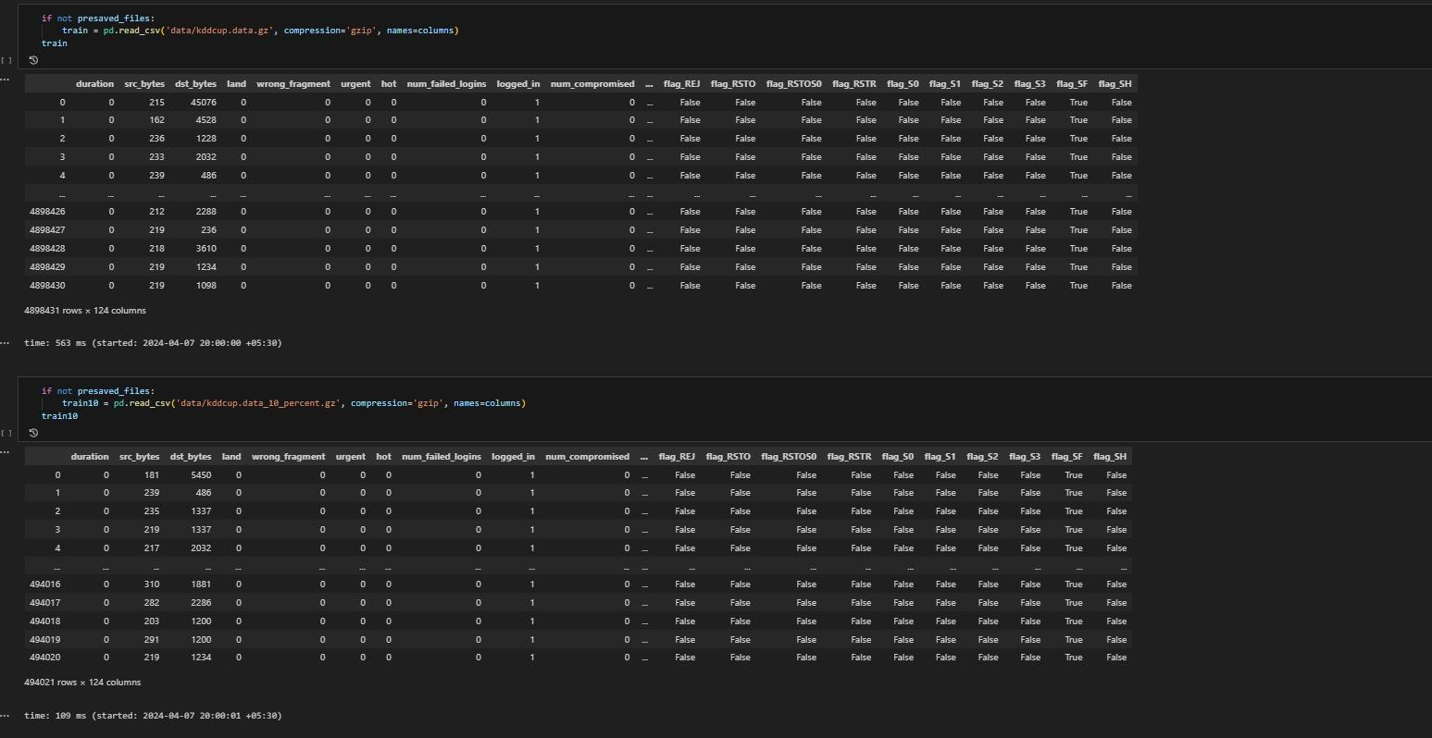

Slide 14
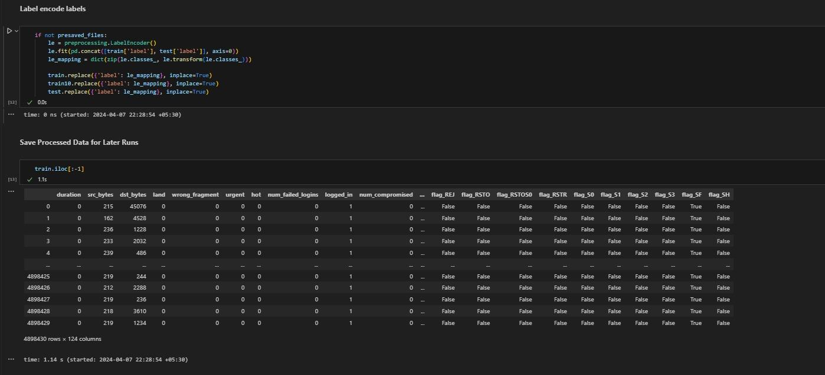

Slide 15
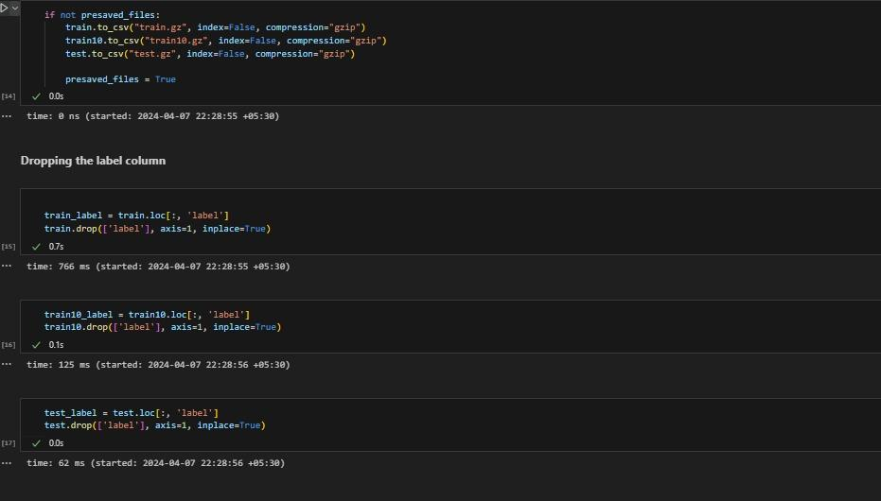

Slide 16
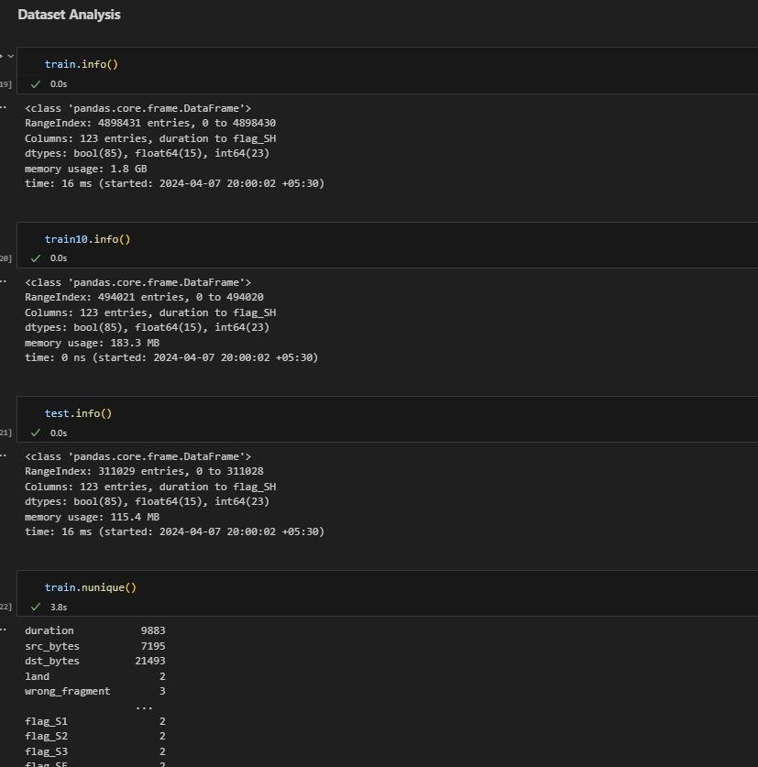
Dataset Analysis

Slide 17
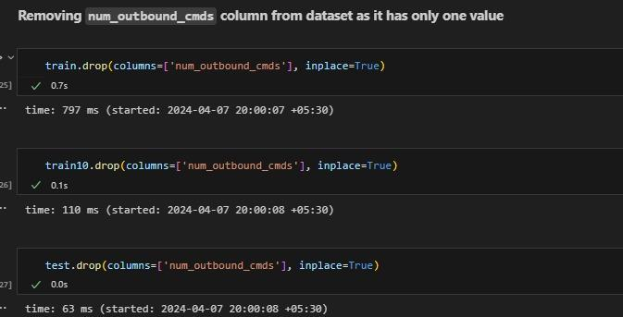

Slide 18
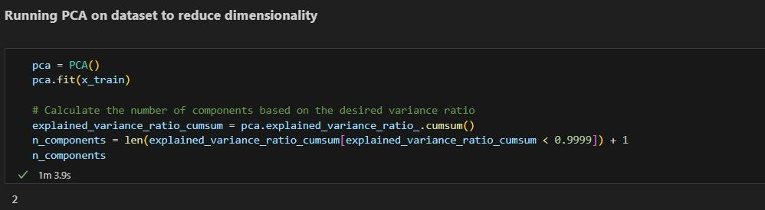
PCA
Principal Component Analysis (PCA). PCA is a statistical method used for dimensionality reduction, where it aims to transform a dataset into a lower-dimensional space while preserving as much of the variance in the data as possible.

Slide 19
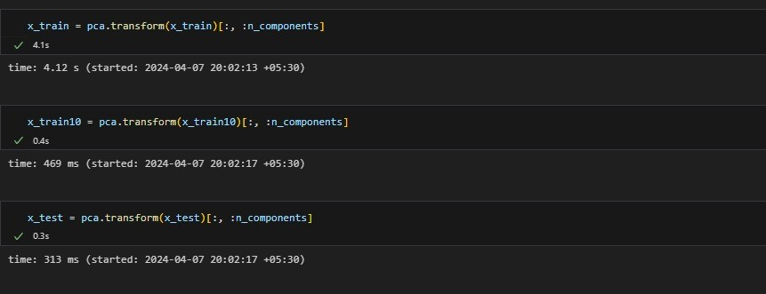

Slide 20
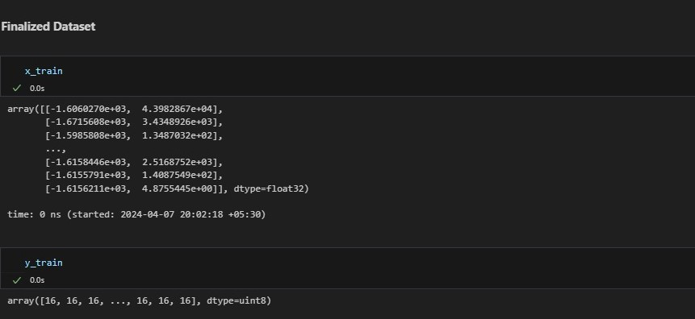
Final Dataset

Slide 21
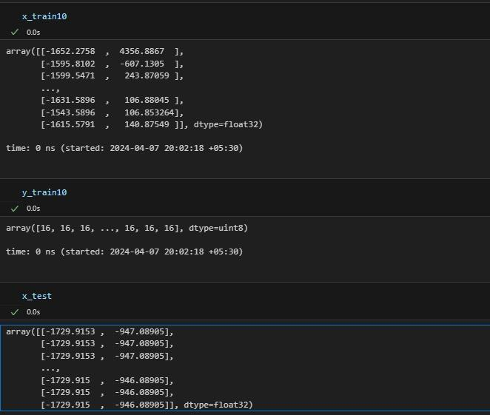

Slide 22
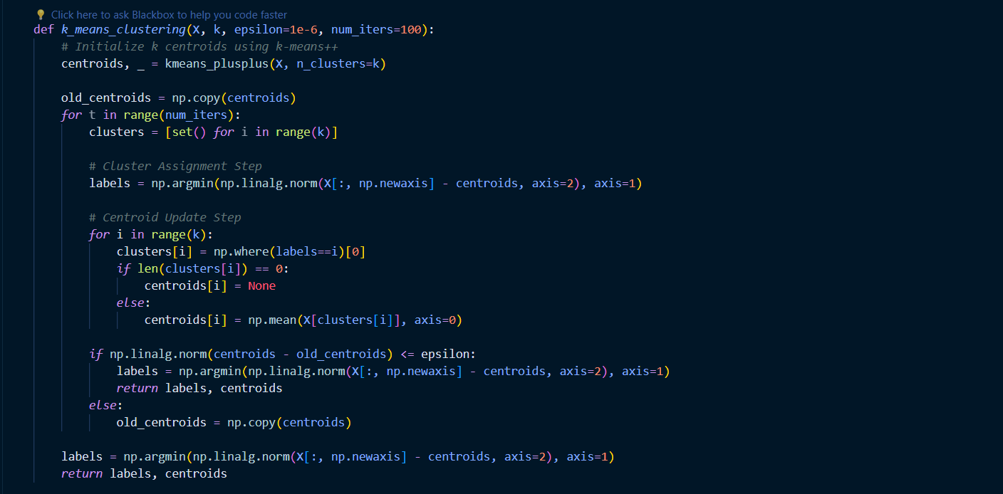
K-Means Algorithm
We will use K-Means to cluster the network traffic data and identify anomalies. Every data traffic is a feature vector of 41 dimension. We will use this feature representation to do the clustering.

Slide 23
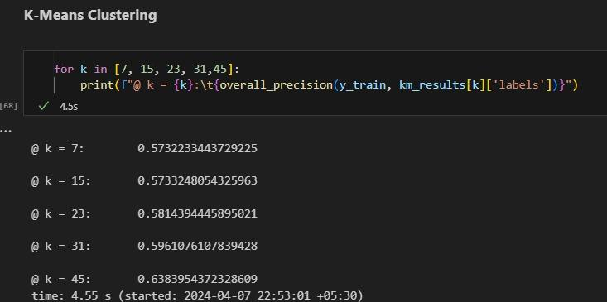
Evaluation of K means

Slide 24
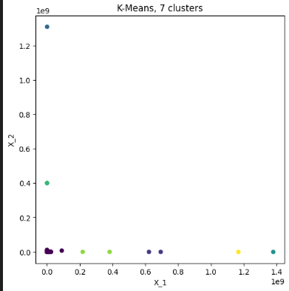
Final cluster plots
K=7

Slide 25
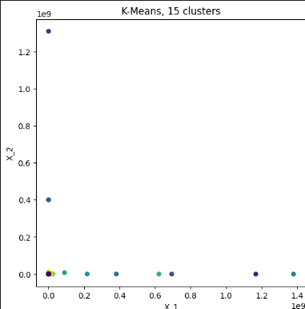
K=15

Slide 26
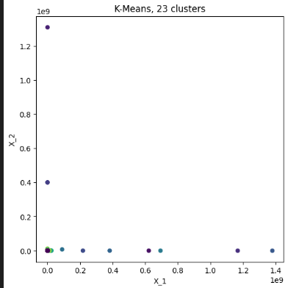
K=23

Slide 27
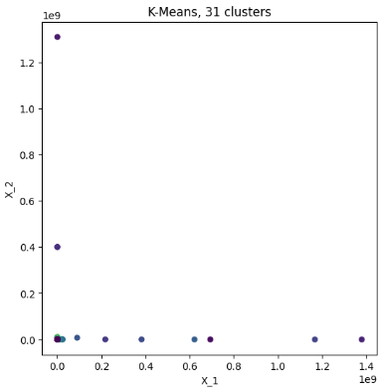
K=31

Slide 28
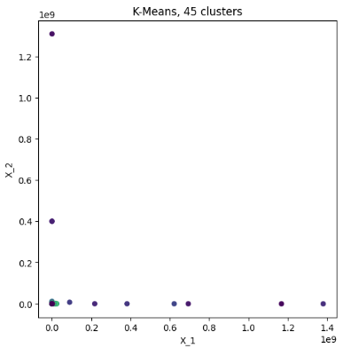
K=45

Slide 29
DBSCAN
DBSCAN is a clustering method that finds spherical or convex clusters(Complex Shapes or Nested Clusters)
It is suitable for compact, well-separated clusters and is affected by noise and outliers.
The algorithm requires two parameters: epsilon (neighborhood around a data point) and MinPts (minimum number of neighbors within eps radius).
DBSCAN does not specify the number of clusters, unlike K-Means which is sensitive to the number of clusters.
DBSCAN can work well with datasets with noise and outliers, while K-Means does not.

Slide 30
DBSCAN Algorithm
Calculate pairwise distances between samples. (Euclidean distance)
Initialize labels and cluster ID.
Loop over all samples.
Find samples within epsilon distance from current sample.
Expand cluster from current sample.
Loop over neighbors not yet assigned to a cluster.
Find samples within epsilon distance from neighbor.
Expand cluster from core point.
Add previously identified neighbor as noise to current cluster.

Slide 31
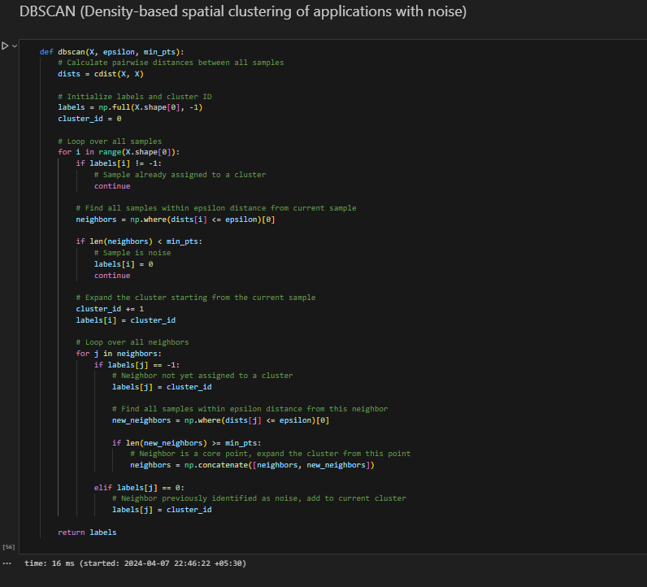

Slide 32
Model Evaluation
Evaluation Metrics Overview:
Conditional Entropy: Measures the average information needed to describe the outcome of one random variable given the value of another.
Recall: Measures the proportion of actual positive cases correctly identified by the model.
F1 Score: Harmonic mean of Precision and Recall, providing a balance.
Precision: Measures the proportion of positive predictions that were correct.

Slide 33
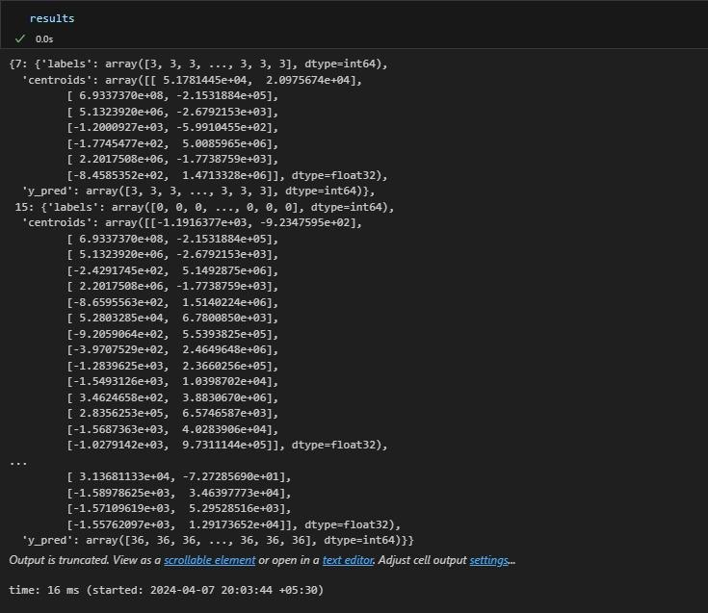
Results

Slide 34
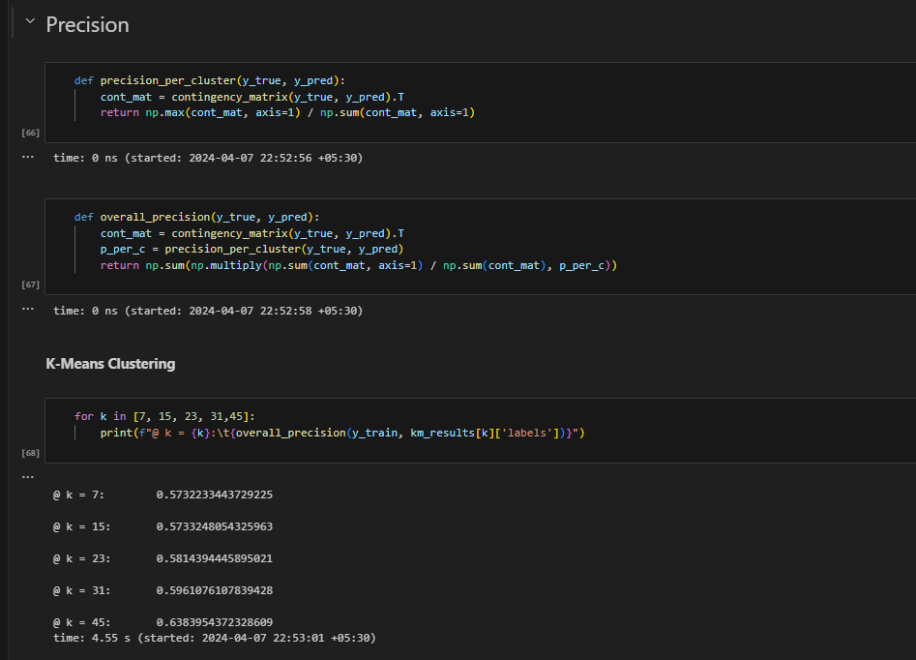
Precision

Slide 35
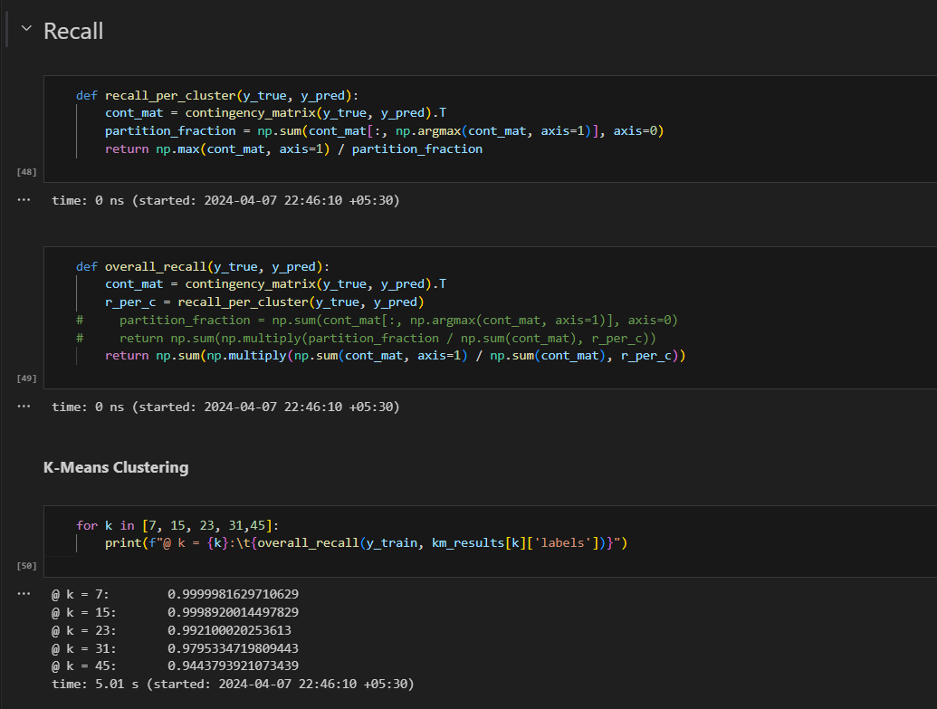
Recall

Slide 36
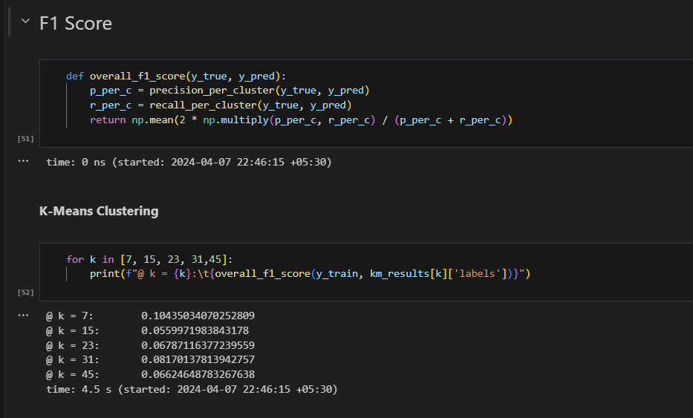
F1 Score

Slide 37
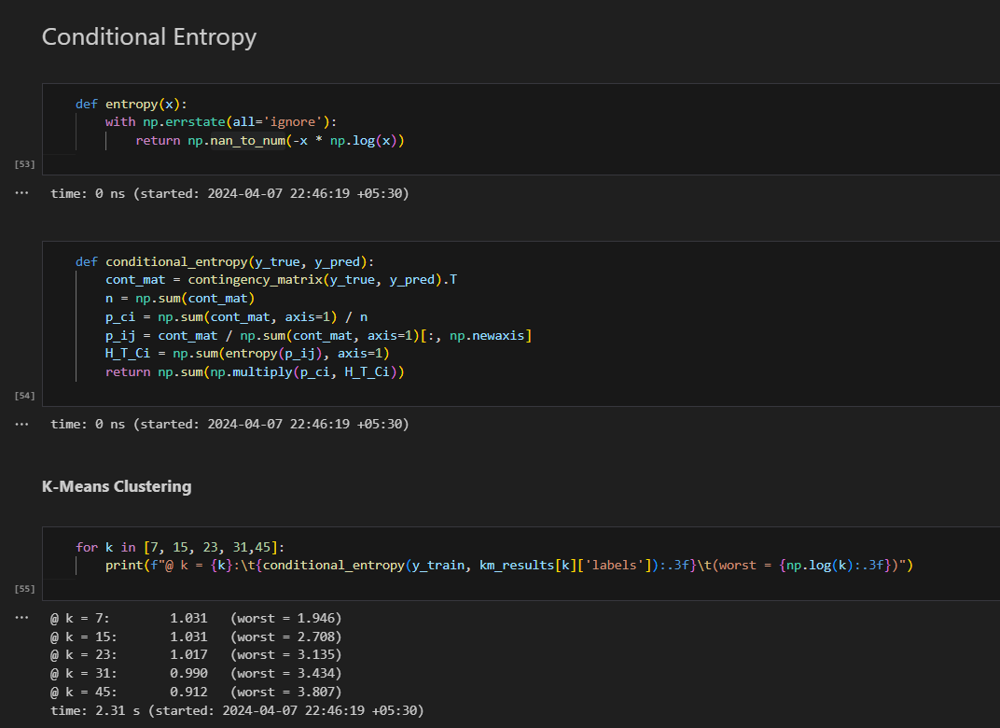
Conditional Entropy

Slide 38
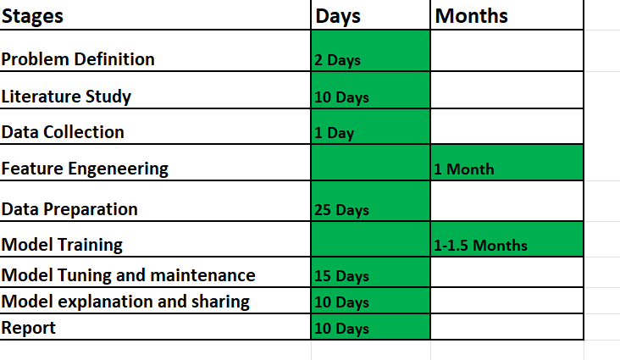
TimeLine

Slide 39
References
[1] S. Begum and S. Kumar, “IJESRT INTERNATIONAL JOURNAL OF ENGINEERING SCIENCES & RESEARCH TECHNOLOGY A COMPREHENSIVE STUDY ON ETHICAL HACKING,” vol. 5, no. 8, pp. 214–219, 2016.
[2] “Role of Ethical Hacking in System,” no. May, 2018. Electronic copy available at: https://ssrn.com/abstract=3391093 International Journal of Computer Science & Information Technology (IJCSIT) Vol 11, No 2, April 2019 35
[3] “What is white hat? - Definition from WhatIs.com.” [Online]. Available: https://searchsecurity.techtarget.com/definition/white-hat. [Accessed: 14-Mar-2019].
[4] “What is ethical hacker? - Definition from WhatIs.com.” [Online]. Available: https://searchsecurity.techtarget.com/definition/ethical-hacker. [Accessed: 14-Apr-2019].
[5] “Types of Hackers and What They Do: White, Black, and Grey | EC-Council Official Blog.” [Online].Available:https://blog.eccouncil.org/types-of-hackers-and-what-they-do-white-black-and-grey/. [Accessed: 14-Mar-2019].

Slide 40
Thank You !!!

