Slide 1
Honey Production in the US (2010-21’)
Data Anaylsis
By Alexander Hybner

Slide 2
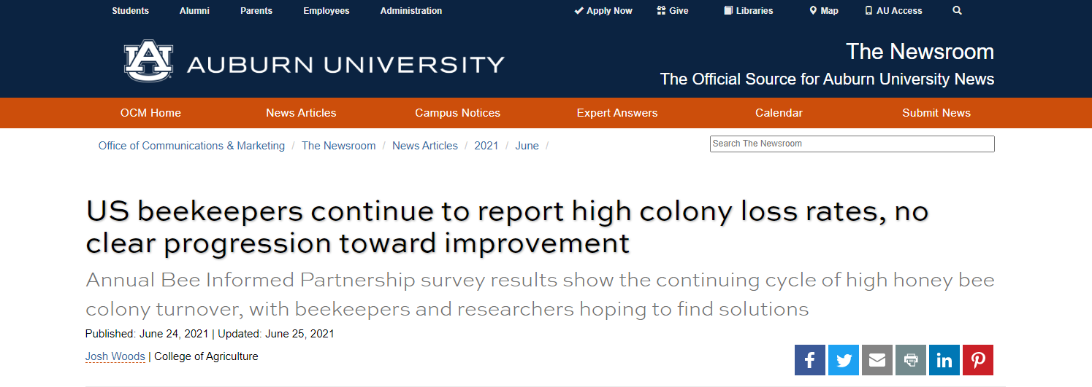
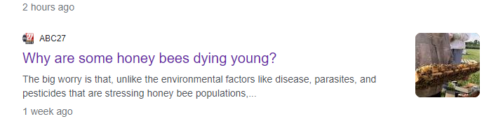
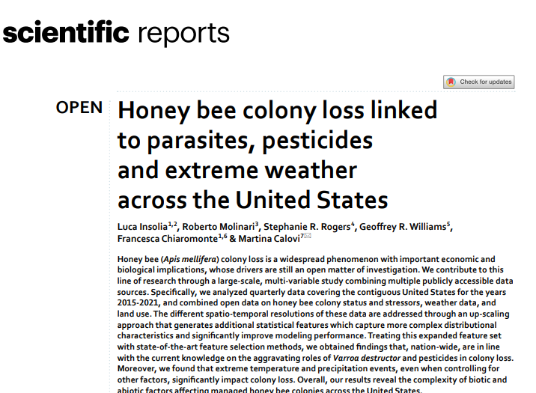
The Problem Statement
With several news articles released over the last couple of years reporting on national honeybee colony loss and Company & Cultural initiatives to “Save the Bees” in the U.S. , I wanted to know if there was any impact to the US Honey Production

Slide 3
Potential Benefits of Analytics:
Greater insight into honey yield per state and impact to honey production by investigating data from 2010 – 2021
into Timeline of Production of States’ Honey Production over a

Slide 4
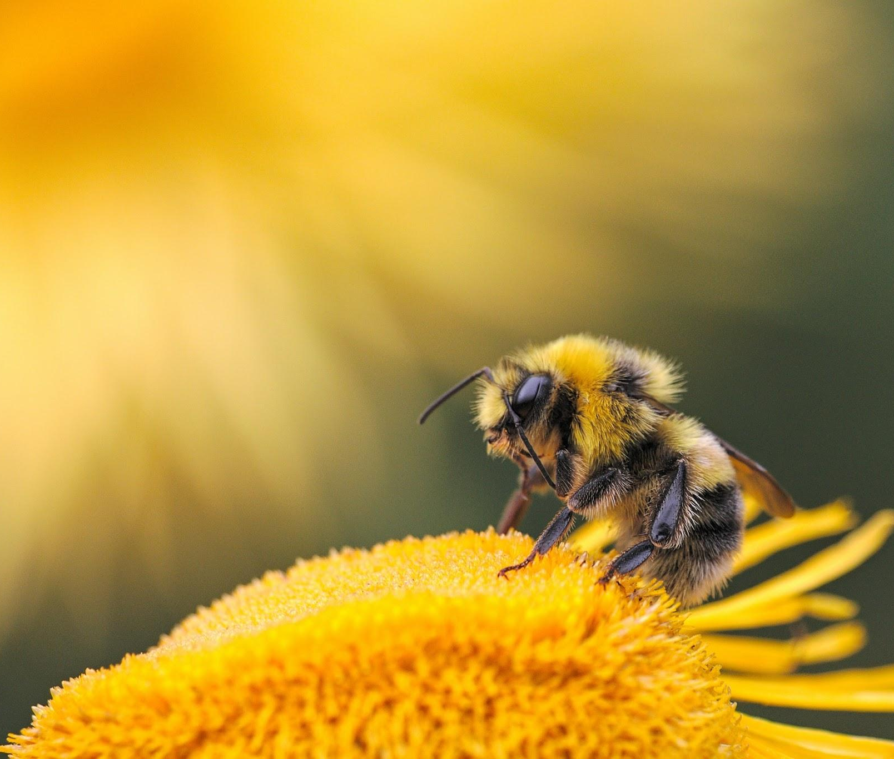
Methodology
We will talk about this first.
We will talk about this second.
We will talk about this last.

Slide 5
Findings & Insights

Slide 6
Findings
One of the keys to an effective presentation is keeping it simple, concentrate on your core message.
Make it easy for your audience to understand and respond.

Slide 7
Data Model:

Slide 8
Recommendations:
Remember that most of our presentation templates allow you to change the colors by editing the master – this works both in PowerPoint and Google Slides – , so you can adapt them to your needs.
Colors are emotional and evoke feelings. The right colors can help persuade and motivate, they can increase your audience's interest and improve learning comprehension and retention.

Slide 9
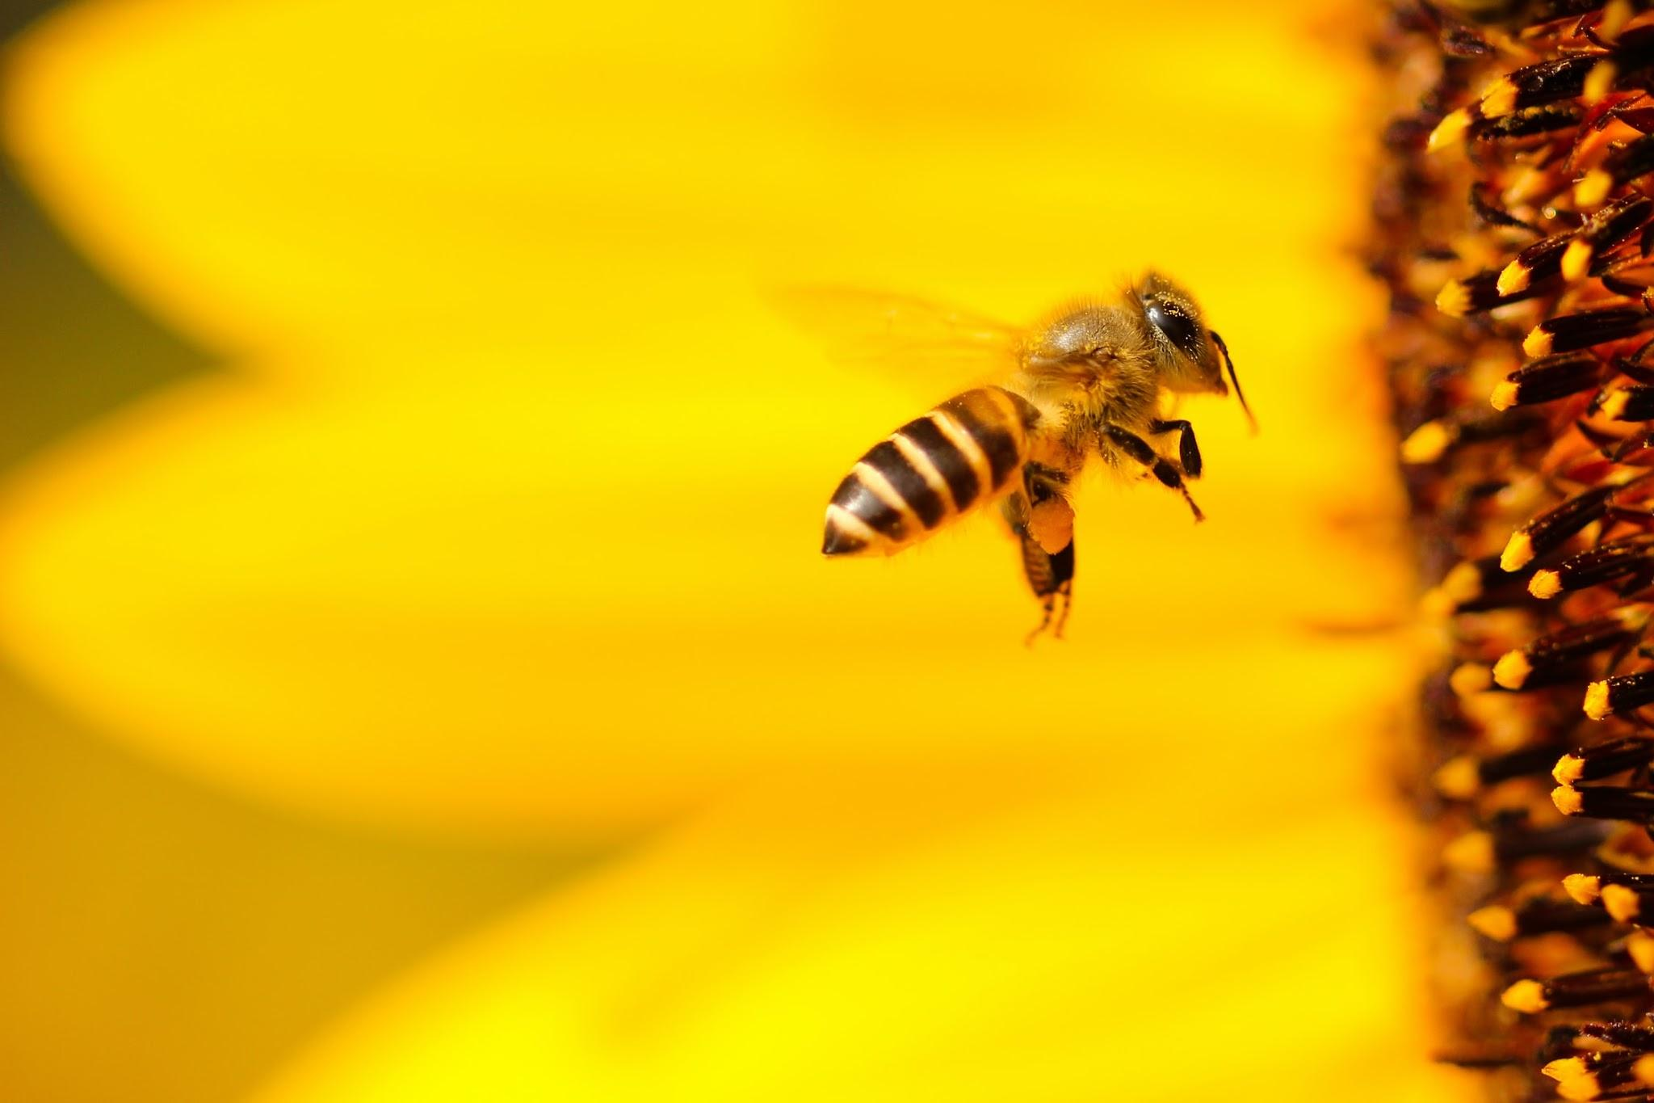
Future Work:
Point 1

Slide 10
a
b
c
d
e
f
g
h
i
j
k
l
m
n
o
p
q
r
s
t
u
v
w
x
y
z

Slide 11
a
b
c
d
e
f
g
h
i
j
k
l
m
n
o
p
q
r
s
t
u
v
w
x
y
z

Slide 12
Works Cited:
Insolia, Luca, et al. “Honey Bee Colony Loss Linked to Parasites, Pesticides and Extreme Weather across the United States.” Nature News, Nature Publishing Group, 1 Dec. 2022, https://www.nature.com/articles/s41598-022-24946-4.
Kaggle Dataset: https://www.kaggle.com/datasets/mohitpoudel/honey-production-in-us-20102021
Presentation Template: SlidesMania
Images: Unsplash

