Slide 1
HW5
Digit classification using Depthwise Separable Convolutions
林俊曄
2022/11/17 (四)
EE4292 IC Design Laboratory

Slide 2
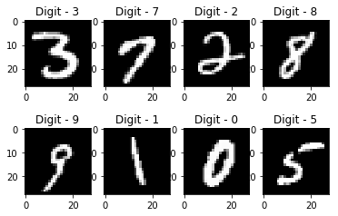
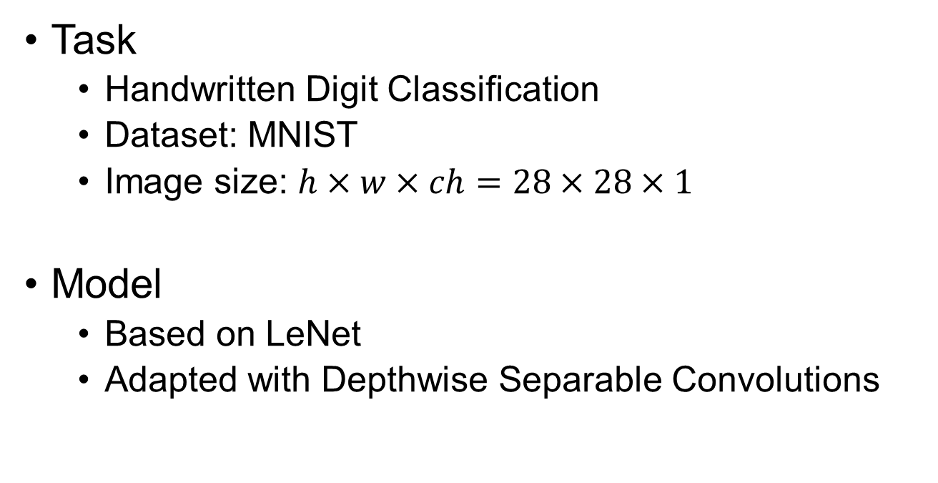
Introduction
Task
Handwritten Digit Classification
Dataset: MNIST
Image size: $h×w×ch=28×28×1$
Model
Based on LeNet
Adapted with Depthwise Separable Convolutions
image ref: https://medium.com/@himanshubeniwal/handwritten-digit-recognition-using-machine-learning-ad30562a9b64
EE4292 IC Design Laboratory

Slide 3
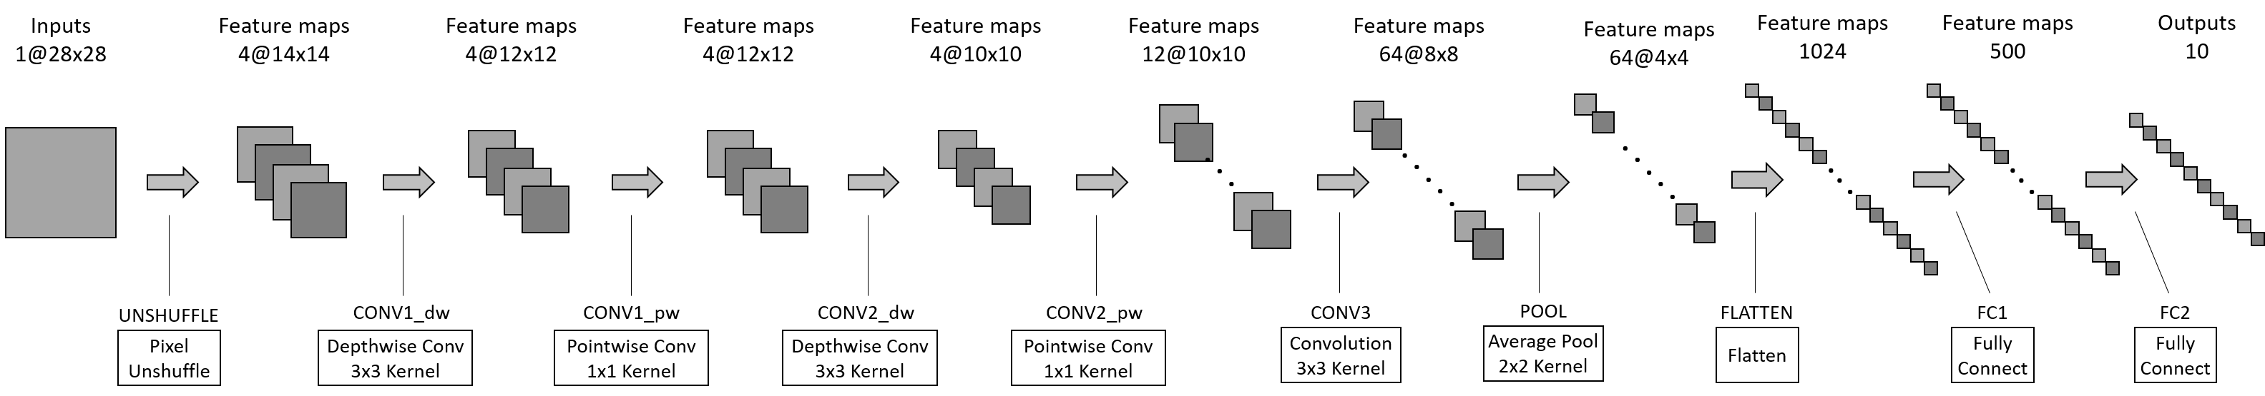

Model Architecture
notation:
$$channel@(height×width)$$
Only focus on convolution layers
(CONV1_dw, CONV1_pw, CONV2_dw, CONV2_pw, CONV3_POOL)
Other layers are provided in testbench

Slide 4
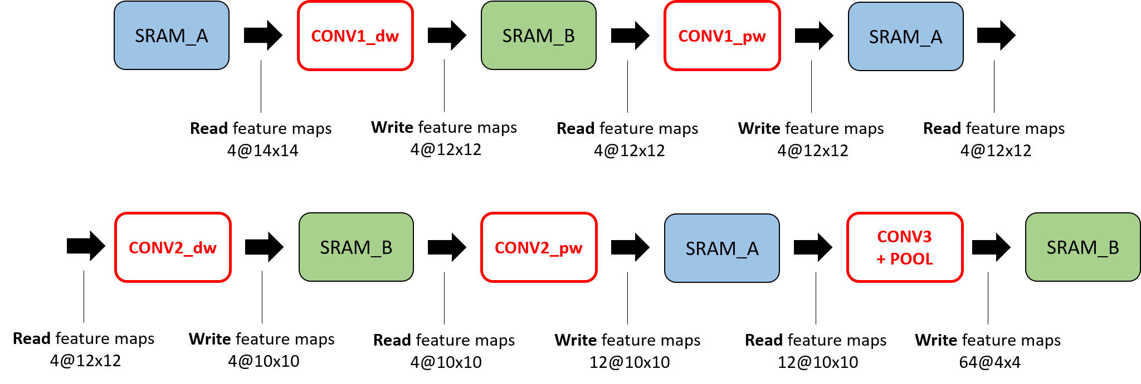
Data Flow
Two single-port SRAM groups (A and B)
You should access them in a ping-pong manner

Slide 5
Introduction of Different Convs
There are three types of convolution layers in HW5.
Depthwise Convolution (DWC)
Pointwise Convolution (PWC)
Standard Convolution (SC)
Since Standard Convolution layer (SC) is the main component in CNNs, we need to be familiar with it first.
Depthwise Separable Conv
(DSC)

Slide 6
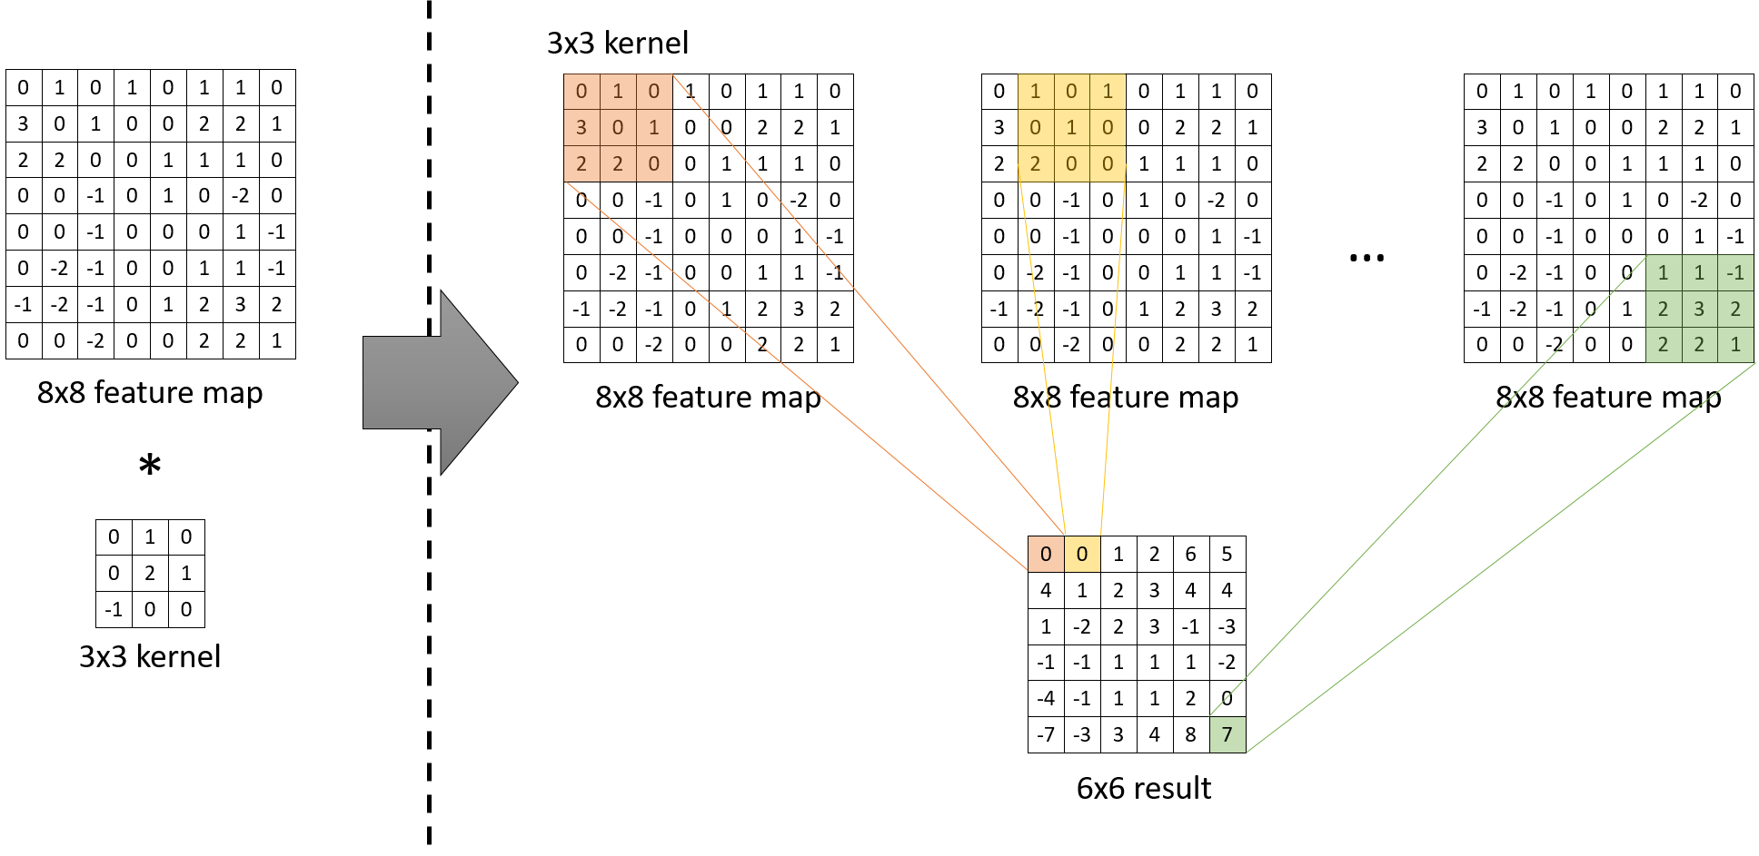
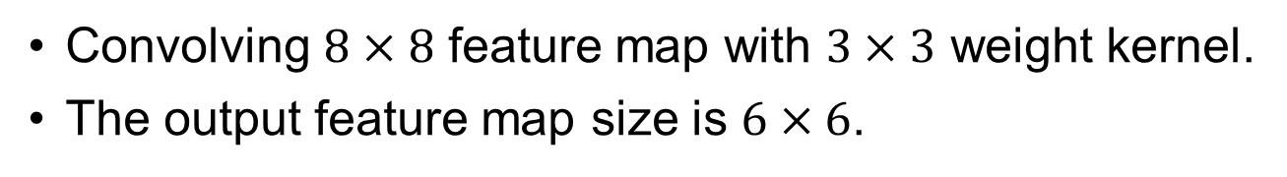
2D Convolution Operation
No padding is needed in this assignment.
Convolving $8×8$ feature map with $3×3$ weight kernel.
The output feature map size is $6×6$.

Slide 7
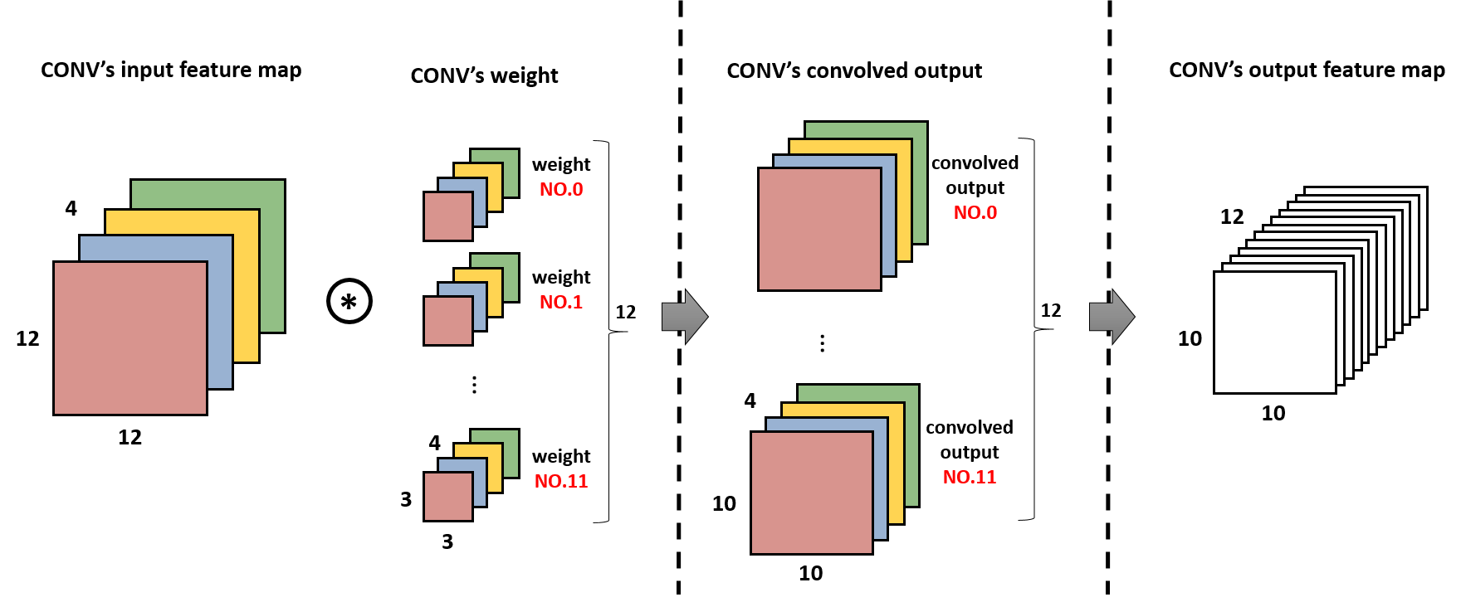


Standard Convolution Layer Example (1/2)
$$4@12×12$$
$$12@10×10$$
3D Convolution operation
Different from 2D Convolution operation, 3D Convolution operation has 3D input and 3D kernel.
Input feature map and weight kernel have same number of channels.
The channel numbers of output feature map is equal to number of 3D weight kernels.

Slide 8
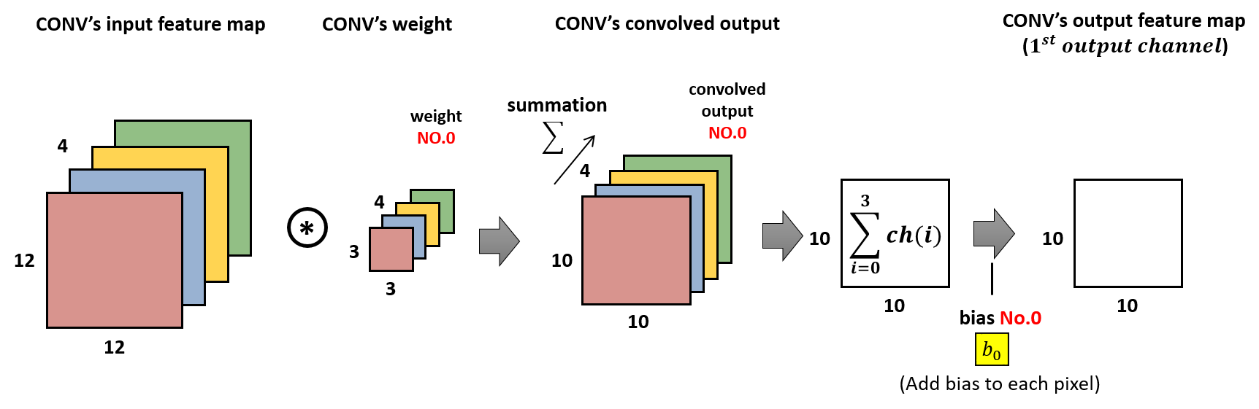

3D Convolution Operation (2/2)
$$4@12×12$$
1$@10×10$
Doing 3D Convolution operation needs to perform 2D convolution operation on each channel, and summing them up along the channel dimension.
In this Standard Convolution layer, since the channel number of output feature map is 12, we need to perform 3D convolution operation on input feature map 12 times, and each time use different 3D kernel.

Slide 9
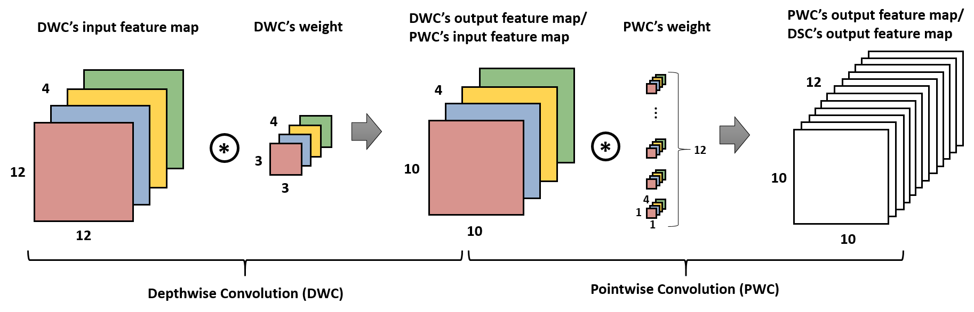

Depthwise Separable Convolution (1/3)
$$4@12×12$$
4$@10×10$
$$12@10×10$$
Depthwise Separable Convolution (DSC)
= Depthwise Convolution (DWC) + Pointwise Convolution (PWC)
Compared to Standard Convolution, DSC can reduce the number of operations and parameters.

Slide 10
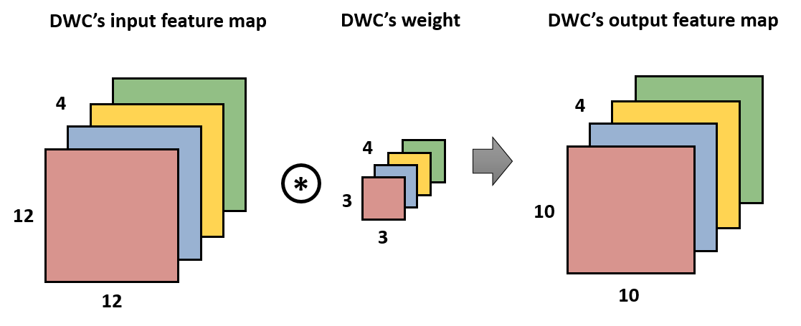

Depthwise Convolution (2/3)
$$4@12×12$$
4$@10×10$
The DWC applies 2D convolution operation to each input channel individually with corresponding 2D weight to produce the same number of output channels.
No channel-wise summation is required.

Slide 11
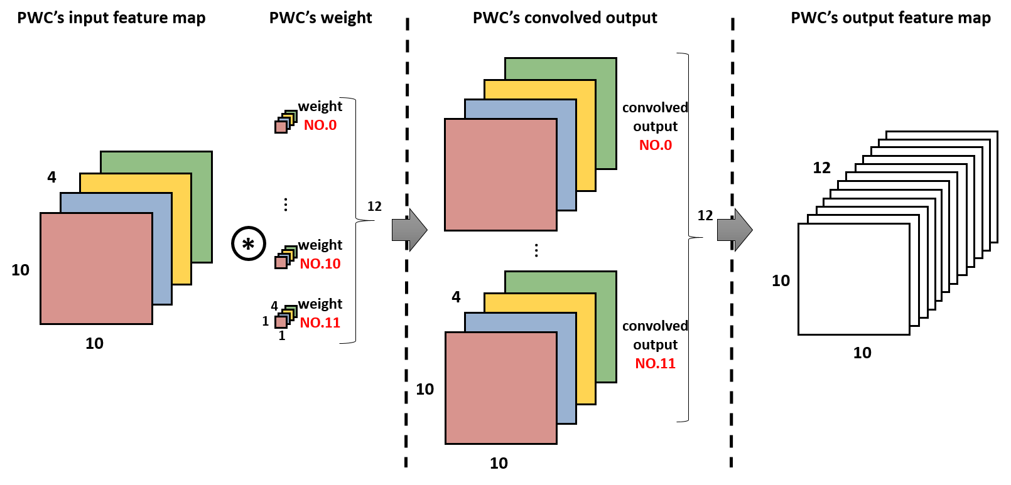

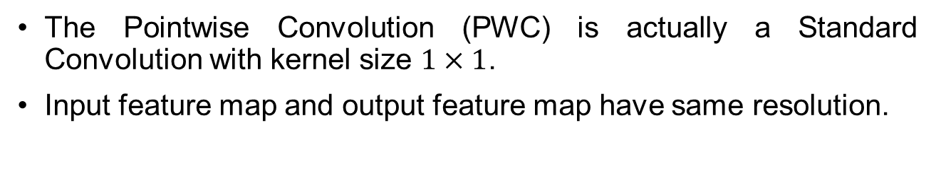
Pointwise Convolution (3/3)
4$@10×10$
$$12@10×10$$
The Pointwise Convolution (PWC) is actually a Standard Convolution with kernel size $1×1$.
Input feature map and output feature map have same resolution.

Slide 12
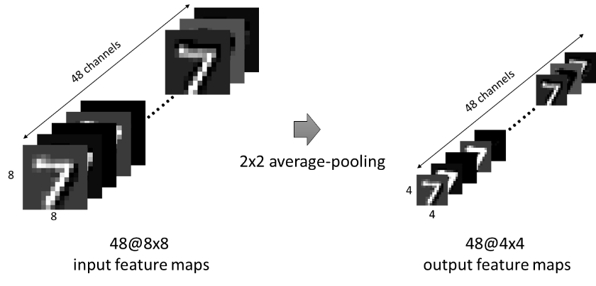
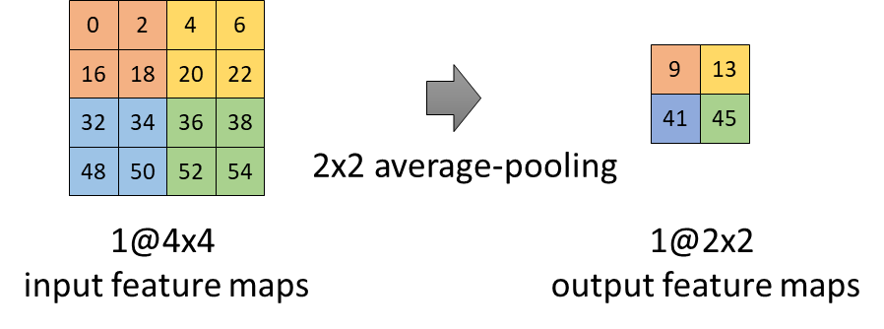
Pooling layer
Average Pooling (2D)
Average Pooling (3D)
Pooling layer is an operation of down-sampling.
We perform pooling on each channel of the input feature maps.

Slide 13
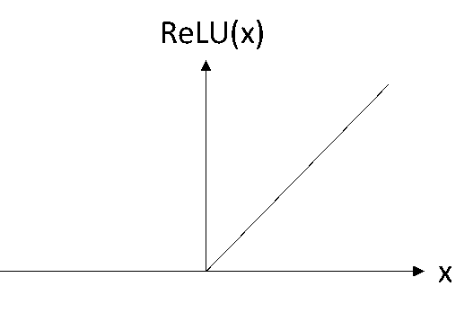
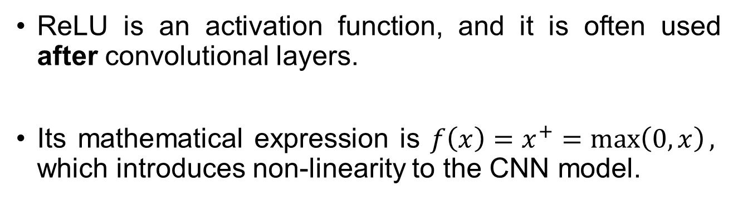
ReLU
ReLU is an activation function, and it is often used after convolutional layers.
Its mathematical expression is $f\left(x\right)=x^{+}=\max\left(0, x\right),$ which introduces non-linearity to the CNN model.

Slide 14
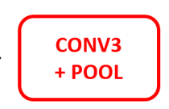
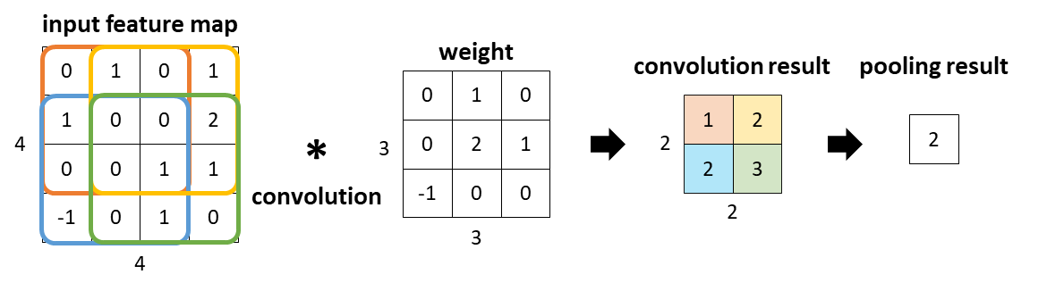
Hardware Design for
Here! We don’t want to save convolution results back to sram.
By merging the calculation of Standard Convolution and pooling, the data movement becomes more efficient.
To get one-pixel output of pooling, it requires 16 pixels from the input feature map. Therefore, we offer a way to access 4x4 pixels in one cycle.

Slide 15
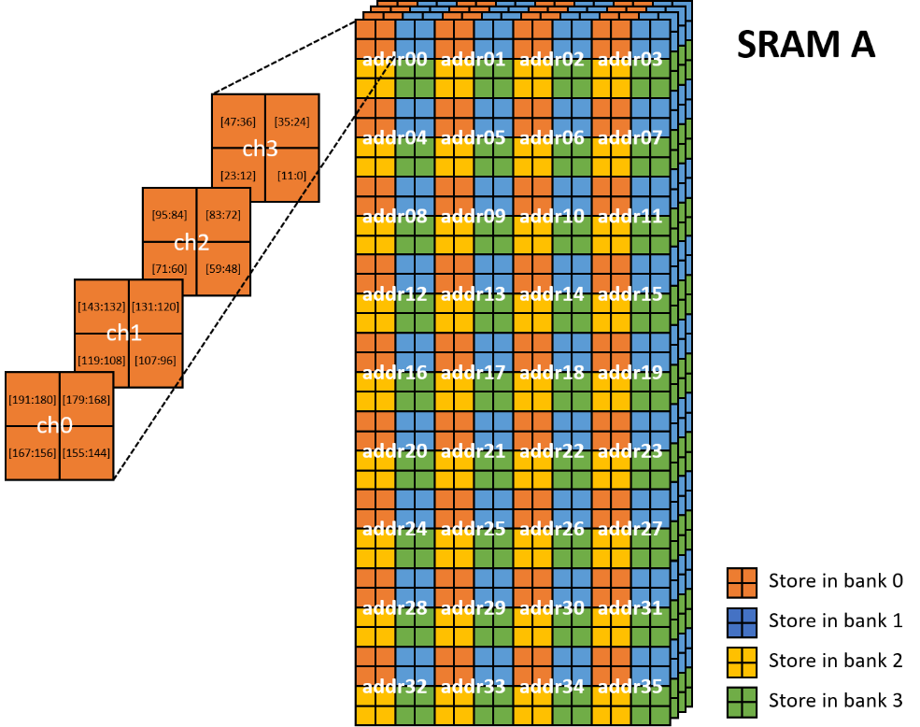
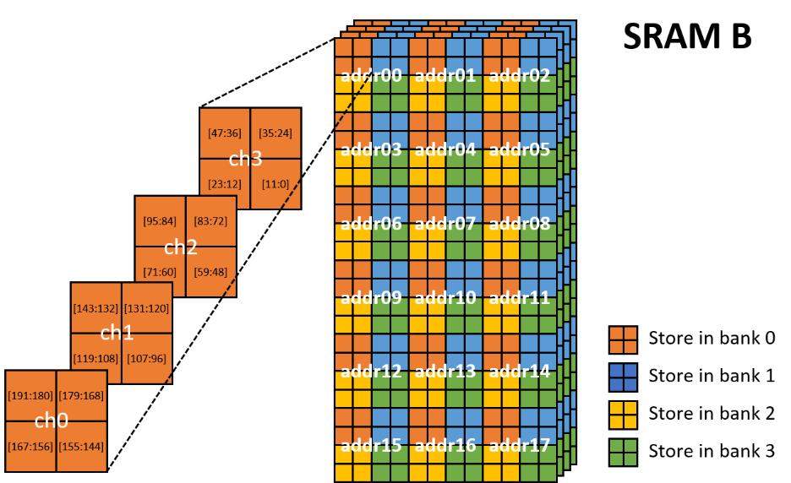
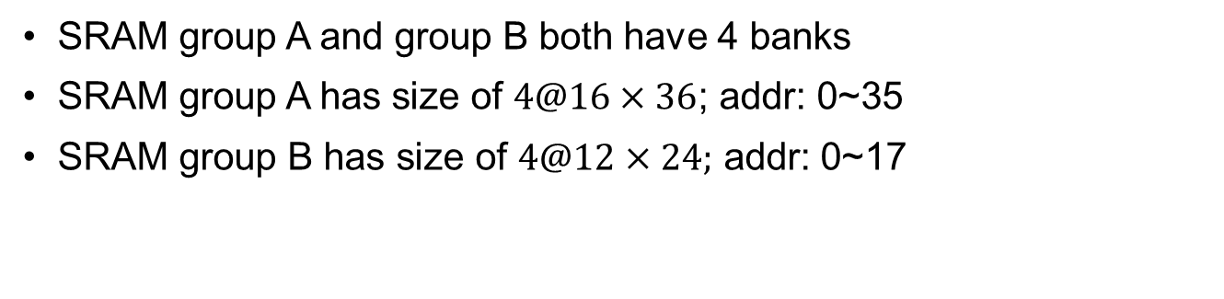
Details of feature map SRAM (1/2)
SRAM group A and group B both have 4 banks
SRAM group A has size of $4@16×36$; addr: 0~35
SRAM group B has size of $4@12×24;$ addr: 0~17

Slide 16
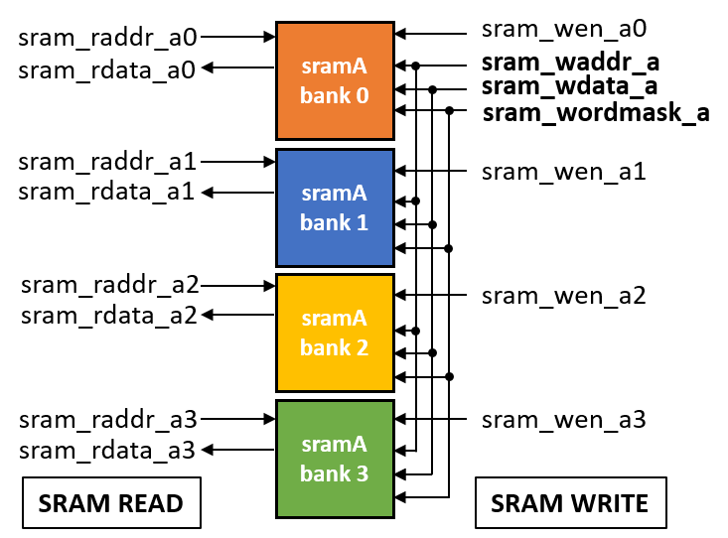
Details of feature map SRAM (2/2)
SRAM READ:
Each bank in the SRAM has different read-related ports
→ Read four banks parallelly
SRAM WRITE:
Each bank in the SRAM shares the same write-related ports
→ Write one bank at once

Slide 17
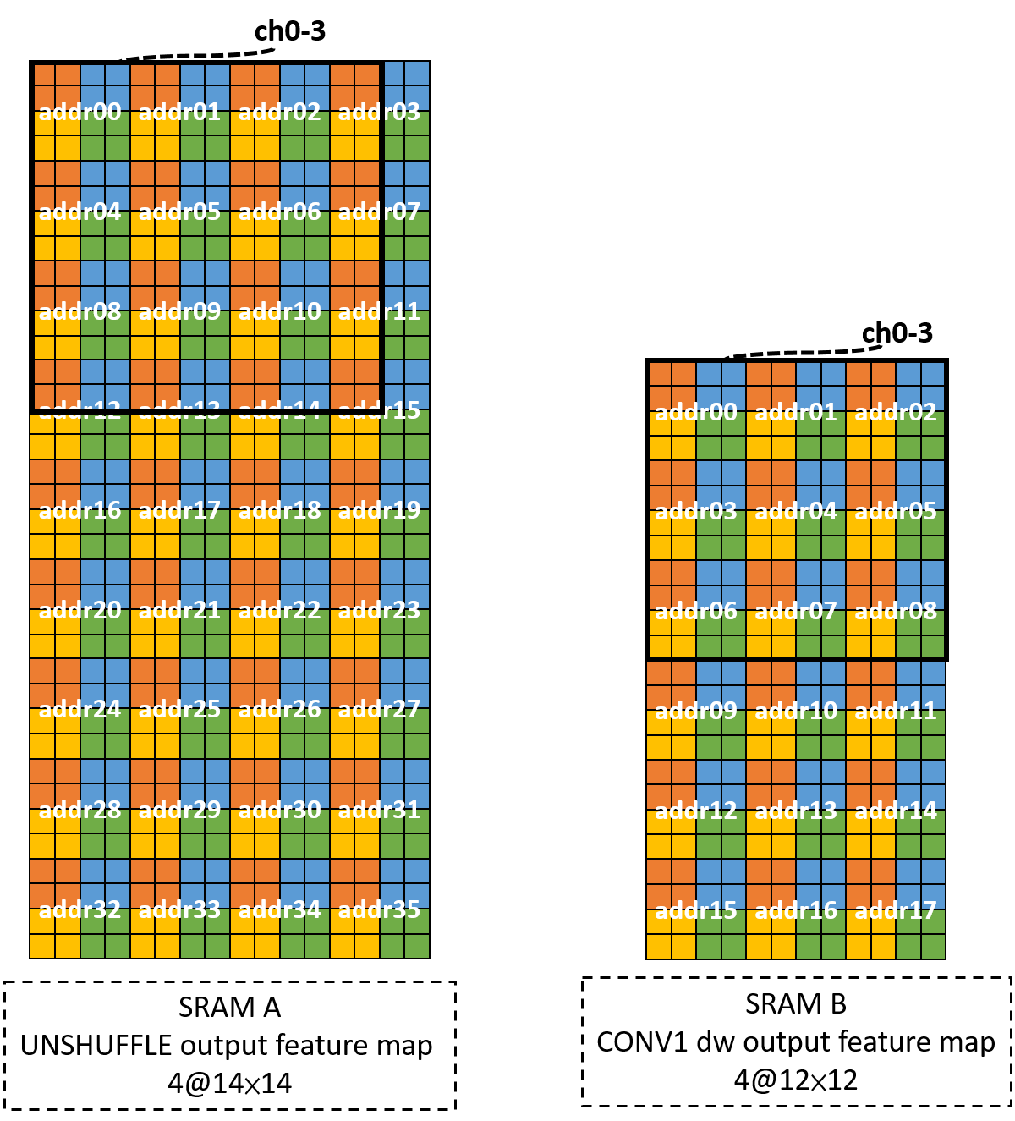
SRAM mapping for each layer (1/2)
After CONV1_dw
Please refer to the HW5 document for other layers’ SRAM mapping.

Slide 18
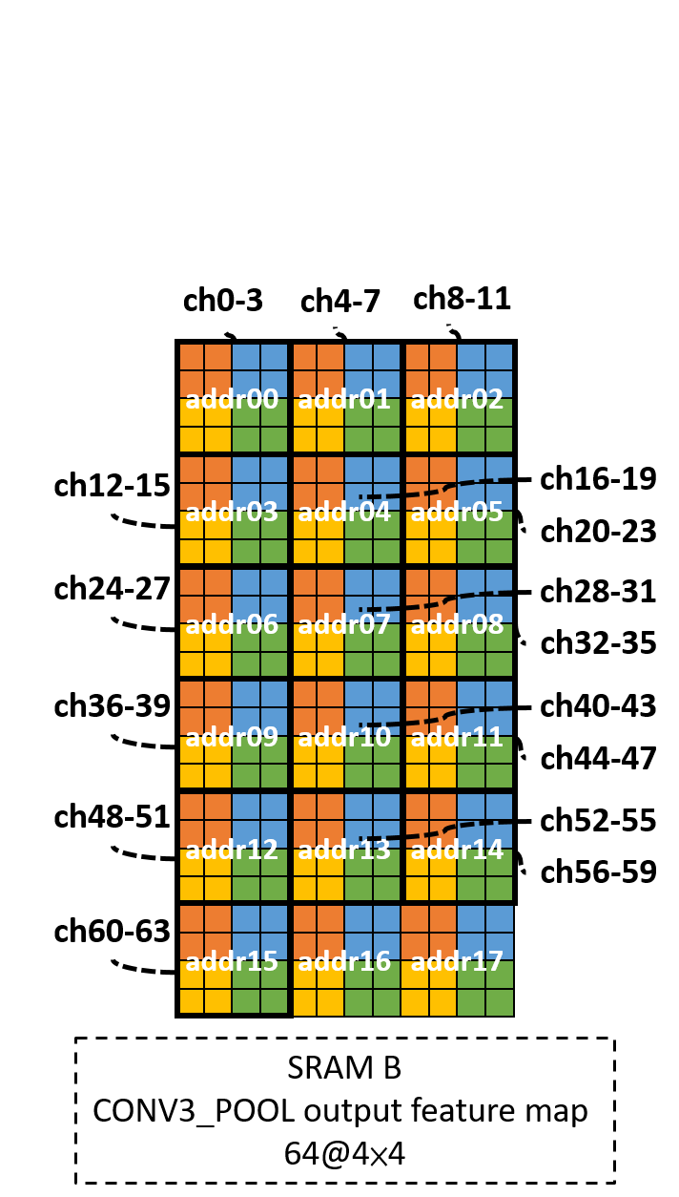
SRAM mapping for each layer (2/2)
For the output feature map of CONV3_POOL, whose output channel (i.e. 64) is larger than the SRAM (i.e. 4), we need to partition their feature maps along channel dimensions and store them into different addresses.

Slide 19
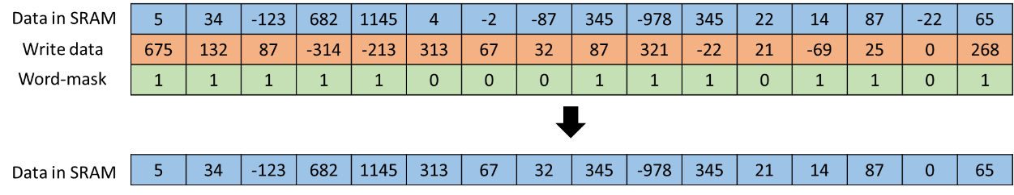
SRAM behavior with 16-bit word mask
Use sram_wordmask signal to select the data you want to overwrite
Be careful that word-mask is active low

Slide 20
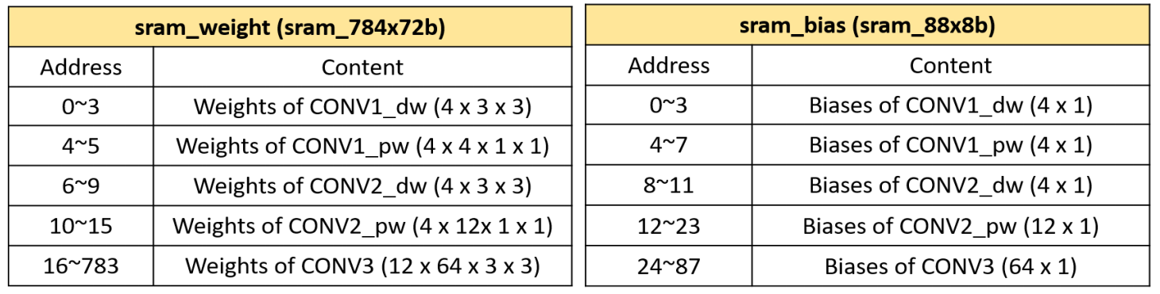
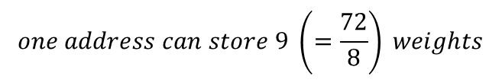
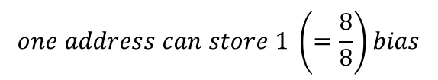
Details of parameter SRAM (1/3)
We use other two read-only SRAMs to store weights and biases respectively.
We use 8 bits to represent the value of model parameters.
$$one address can store 9 \left(=\frac{72}{8}\right) weights$$
$$one address can store 1 \left(=\frac{8}{8}\right)bias$$
location of all weights in sram_weight
location of all biases in sram_bias

Slide 21
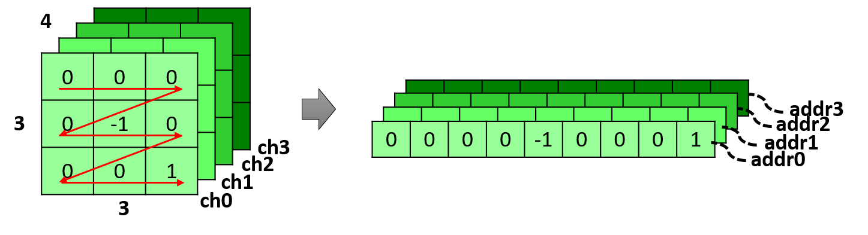
Details of parameter SRAM (2/3)
An example of mapping DWC weights into SRAM (CONV1_DW)
For DWC and SC weights, we store 9 weights into one address.

Slide 22
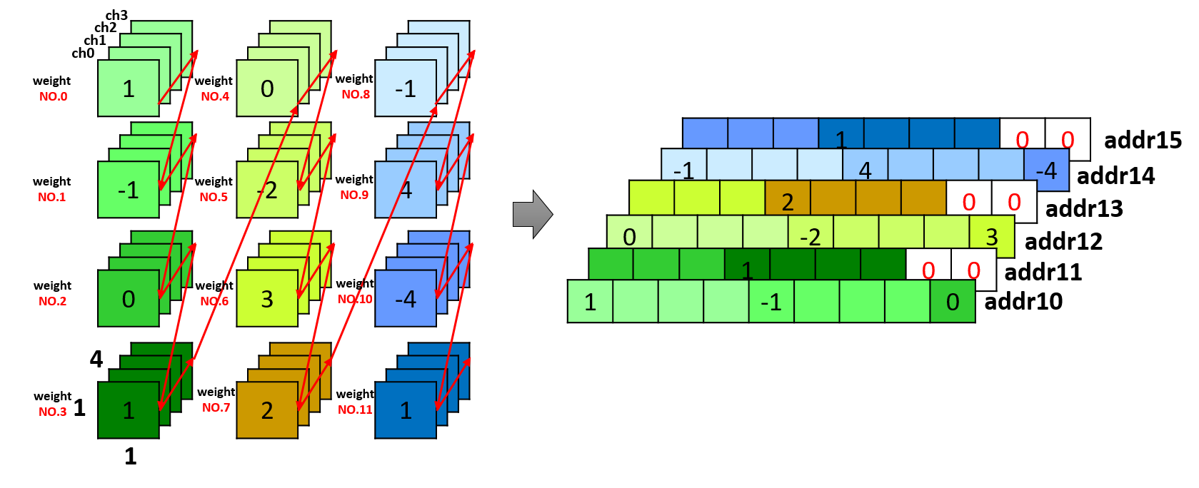
Details of parameter SRAM (3/3)
An example of mapping PWC weights into SRAM (CONV2_pw)
For PWC weights, because the number of weights cannot be evenly divided by 9, we store 16 weights into two addresses.

Slide 23
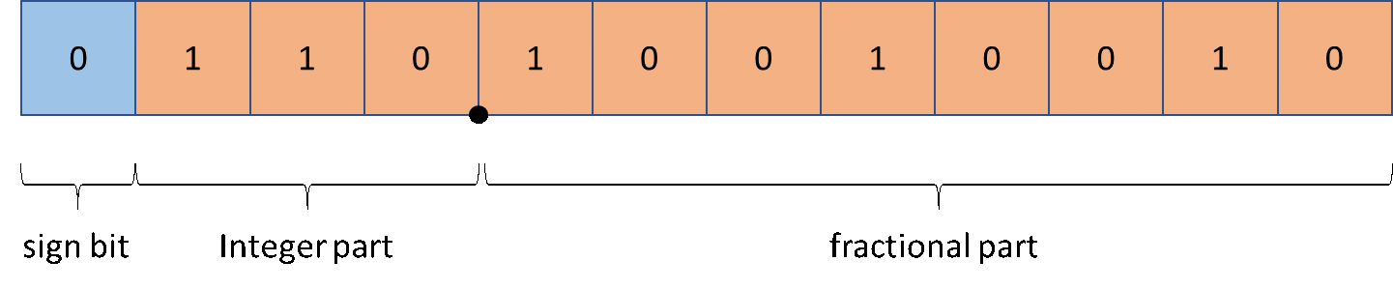
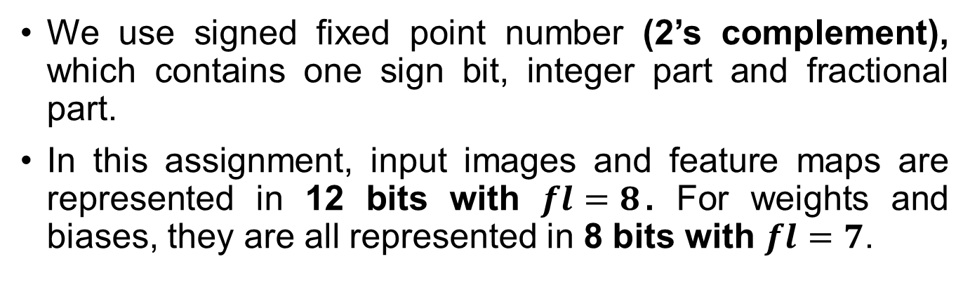
Quantization
We use signed fixed point number (2’s complement), which contains one sign bit, integer part and fractional part.
In this assignment, input images and feature maps are represented in 12 bits with $fl=8$. For weights and biases, they are all represented in 8 bits with $fl=7$.
An example of 12-bit fixed point number with fl=8
Please refer to the hw5 document for detailed quantization implementation.

Slide 24
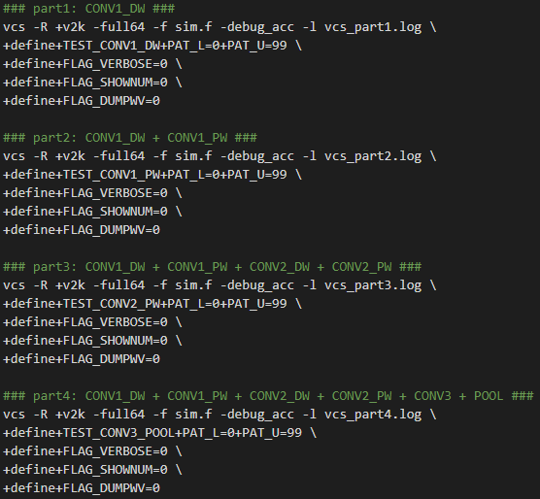
Simulation (1/1)
Simulation commands for each part are as below (in run_rtl.sh)

Slide 25
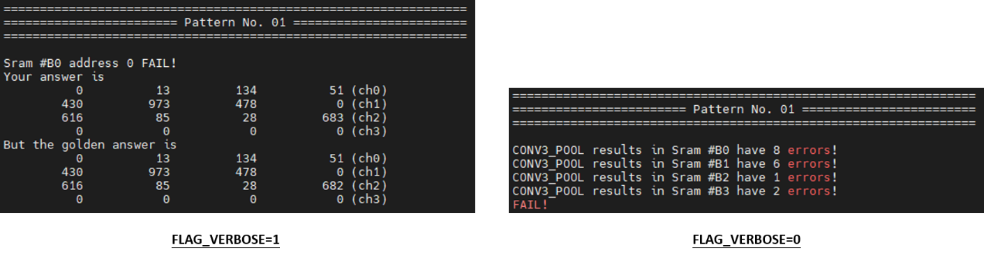
Simulation Flag (2/2)
1. TEST_*: Specify the layer you want to test
(e.g. TEST_CONV2_DW …)
2. PAT_L and PAT_U: Specify specific range of patterns
3. FLAG_VERBOSE: Show detailed reports or not
4. FLAG_SHOWNUM: Display the digit info or not
5. FLAG_DUMPWV: Dump fsdb waveform or not

Slide 26
Grading Policy (1/5)
1. Functionality Score (5%)
2. Basic Synthesis Score (6%)
3. PI Ranking Score (4%)

Slide 27
Grading Policy (2/5)
1. Functionality Score (5%)
Part1: CONV1_dw (1%)
(w/ TEST_CONV1_DW flag)
Part2: CONV1_dw + CONV1_pw (1%)
(w/ TEST_CONV1_PW flag)
Part3: CONV1_dw + CONV1_pw + CONV2_dw + CONV2_pw (1%)
(w/ TEST_CONV2_PW flag)
Part4: CONV1_dw + CONV1_pw + CONV2_dw + CONV2_pw +
CONV3 + POOL (2%)
(w/ TEST_CONV3_POOL flag)

Slide 28
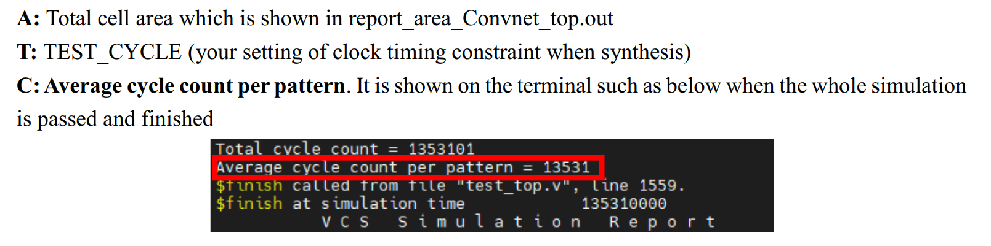
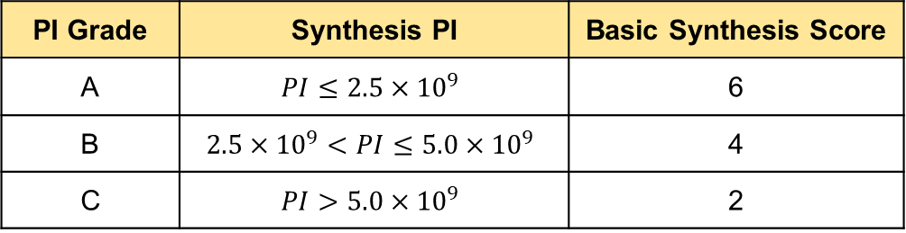

Grading Policy (3/5)
2. Basic Synthesis Score (6%) (only for those who pass part4)
$$PI=A×T×C$$
PI Grade | Synthesis PI | Basic Synthesis Score
A | $$PI≤2.5×{10}^{9}$$ | 6
B | $$2.5×{10}^{9}<PI≤5.0×{10}^{9}$$ | 4
C | $$PI>5.0×{10}^{9}$$ | 2

Slide 29
Grading Policy (4/5)
3. PI Ranking Score (4%)
(Only for those who achieve PI Grade A and submit before deadline)
The PI ranking score is decided by your relative rank in the class!

Slide 30
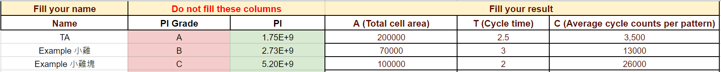
Bonus & PI Score Board (5/5)
Only for those who submit the homework before the deadline
3% bonus score for the best work
1% bonus score for the second-best work
HW5 PI Score Board
https://docs.google.com/spreadsheets/d/1QTRWhU83an1oRDc4yb0q8PpBxHJda2TXBqY8TwEoYUs/edit?usp=sharing

Slide 31
Notice
Do not modify I/O, testbench, or patterns
Do not modify synthesis scripts except the two parts mentioned in the document

Slide 32
Submission
Deadline
12/ 8 23:59
Submit to eeclass
Make sure the file delivery and organization meet the requirement
Wrong file delivery or organization will get 1% punishment
If you have any question, feel free to
Ask TA during the lab time
Ask on eeclass discussion
(maybe other students also have the same question!)
Do not show your code on eeclass discussion or email your code to TA. Coding and debugging by yourself!

