Slide 1
HW3/ HW3.1
Logic Synthesis
林俊曄
2022/10/20 (四)
EE4292 IC Design Laboratory

Slide 2
Outline
HW3.1
HW3
EE4292 IC Design Laboratory

Slide 3
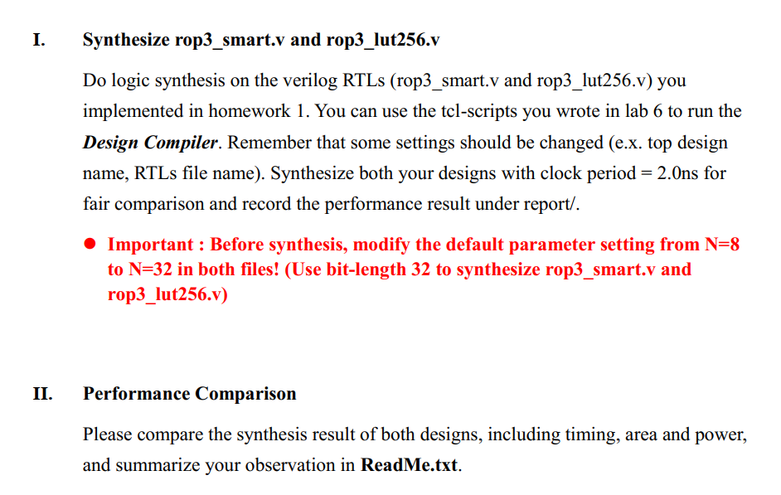
HW3.1 (1%)
EE4292 IC Design Laboratory

Slide 4
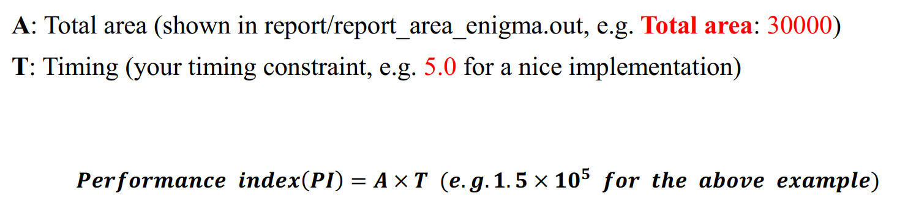
HW3 (5%)
Your HW3 grade is decided by Performance Index (PI)
EE4292 IC Design Laboratory

Slide 5
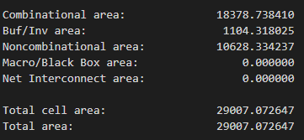
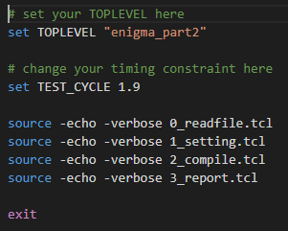
HW3 PI report
report_area_enigma_part.out
synthesis.tcl
Make sure your timing slack >= 0!
(report_time_enigma_part.out)
EE4292 IC Design Laboratory

Slide 6
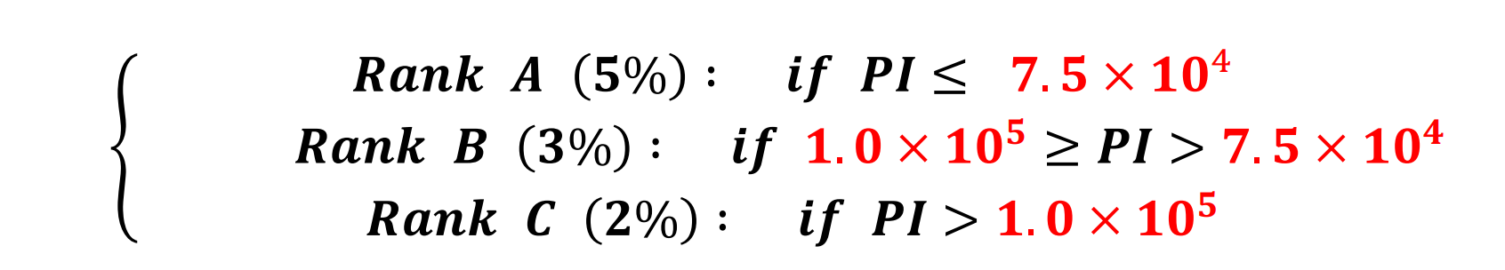
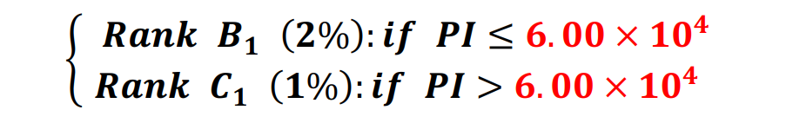
HW3: Two Policy
There are two grading policies provided.
Policy1 (for enigma_part3.v)
Policy2 (for enigma_part2.v)
EE4292 IC Design Laboratory

Slide 7
HW3 Notice
Your hdl design must follow the reference waveform.
Encrypt signal won’t be zero during the encryption/ decryption
You can decide when to pull up the code_valid signal
Make sure your RTL code can pass all the test pattern in HW2. (Encryption + Decryption)
Write a text file misc.txt summarizing your Rank, PI and your Area and Timing as well.
EE4292 IC Design Laboratory

Slide 8
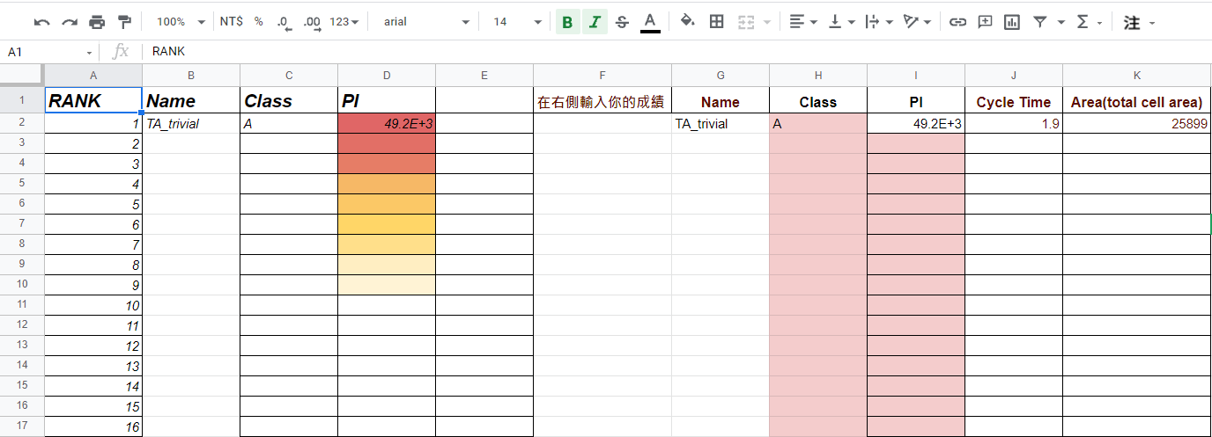
HW3 PI score board
https://docs.google.com/spreadsheets/d/1dl1GzKpgraq6kuWynEiuNXLR0TI8k68Lo_ccoQnAa4g/edit?usp=sharing
Late assignment will not be counted in rank!!
You can only fill in these two blocks.
The excel will calculate and rank your PI.
8
EE4292 IC Design Laboratory

Slide 9
Submission
Deadline 11/03
Submit to eeclass
Make sure the file delivery and organization meet the requirement
Wrong file delivery or organization will get 1% punishment
If you have any question
Feel free to ask on eeclass discussion
(maybe other students also have the same question!)
Do not show your code or email your code to TA.
Coding by yourself!
EE4292 IC Design Laboratory

