Slide 1
HW2
Enigma
林俊曄
2022/10/13 (四)
EE4292 IC Design Laboratory

Slide 2

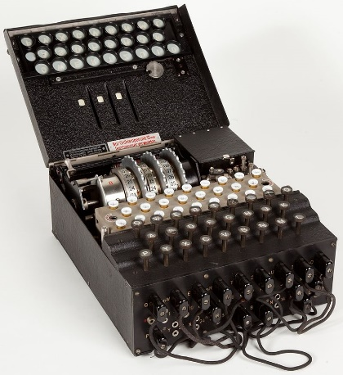
Introduction
Enigma
The electro-mechanical rotor cipher machine
Used by German military in World War II
Two operation mode:
Encrypt:
Input: 6-bits plaintext, Output: 6-bits ciphertext
E.g., Do you → ut.hDd
Decrypt:
Input: 6-bits ciphertext, Output: 6-bits plaintext
E.g., ut.hDd → Do you
image ref: https://en.wikipedia.org/wiki/Enigma_machine
EE4292 IC Design Laboratory

Slide 3
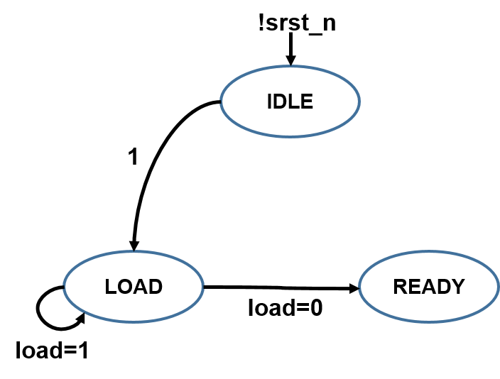
Enigma FSM
IDLE state:
Do not thing
LOAD state:
Initialize rotors
READY state:
Perform encryption or decryption
EE4292 IC Design Laboratory

Slide 4
Enigma Mechanism Overview
Flow:
Forward rotor mapping + Inverse rotor mapping
Forward rotor mapping (solid arrows)
Input: index; Output: value
Inverse rotor mapping (dotted arrows)
Input: value; Output: index
EE4292 IC Design Laboratory

Slide 5
Toy Example (6 symbols)
symbol | hex num
a | 00
b | 01
c | 02
d | 03
e | 04
f | 05
Structure: Rot + Ref (Fixed)
Rot[6] = {01, 02, 03, 00, 05, 04}
Ref[6] = {05, 04, 03, 02, 01, 00}
toy ascii table
Rot
Ref
b
c
d
a
f
e
f
e
d
c
b
a
idx
00
01
02
03
04
05
idx
00
01
02
03
04
05

Slide 6
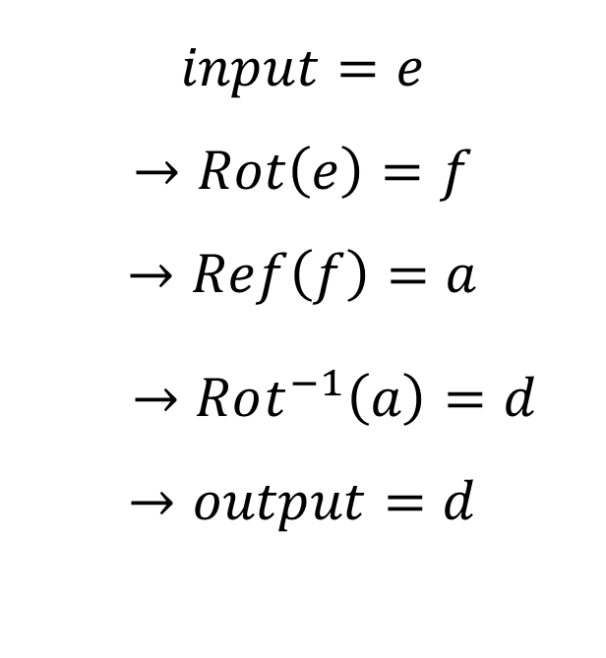
Encrypt “e”
$$input=e$$
$$→Rot\left(e\right)=f$$
$$→Ref\left(f\right)=a$$
$→Rot^{−1}\left(a\right)=d$
$$→output=d$$
toy ascii
table
00
01
02
03
04
05
a
b
c
d
e
f
b
c
d
a
f
e
Rot
f
e
d
c
b
a
Ref
EE4292 IC Design Laboratory

Slide 7
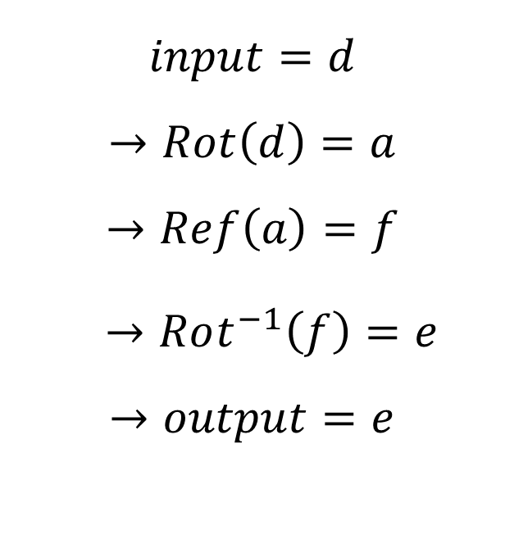
Decrypt “d”
$$input=d$$
$$→Rot\left(d\right)=a$$
$$→Ref\left(a\right)=f$$
$→Rot^{−1}\left(f\right)=e$
$$→output=e$$
toy ascii
table
00
01
02
03
04
05
a
b
c
d
e
f
b
c
d
a
f
e
Rot
f
e
d
c
b
a
Ref
EE4292 IC Design Laboratory

Slide 8
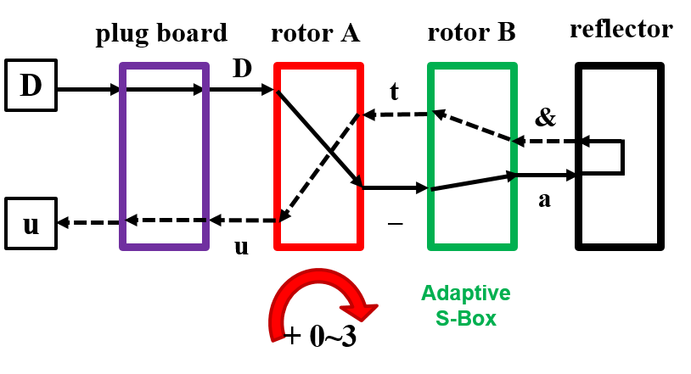
Enigma Structure
Plug Board x 1
Not fixed
Rotors x 2
Not fixed
Reflector x 1
Fixed
Structure of our Enigma
If all tables are fixed, than the encryption would be easy to crack !
EE4292 IC Design Laboratory

Slide 9
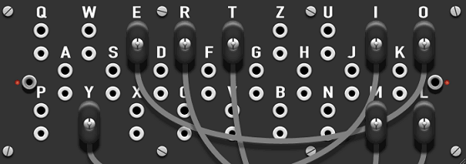













Plug Board (PB)
image ref: https://piotte13.github.io/enigma-cipher/
idx
value
idx
value
idx
value
00
a
00
d
00
d
The PB doesn’t move after initialization.
One line connects two letters together.
There are 16 lines on PB.
01
b
01
b
01
c
02
c
02
c
02
b
03
d
03
a
03
a
04
e
04
e
···
04
&
···
···
$$1^{st} line$$
$(a, d)$
···
···
$$2^{rd} line$$
$(b,c)$
$${16}^{th} line$$
$(e,\&)$
···
···
···
···
···
···
···
···
61
_
61
_
61
_
62
+
62
+
62
+
63
&
63
&
63
e
$$0$$
$$1$$
$$2$$
$$31$$
$$32$$
$$cycle$$
$$(t)$$
$$load a$$
$load d$
$load b$
$$load \&$$
PB behavior in LOAD state
EE4292 IC Design Laboratory

Slide 10

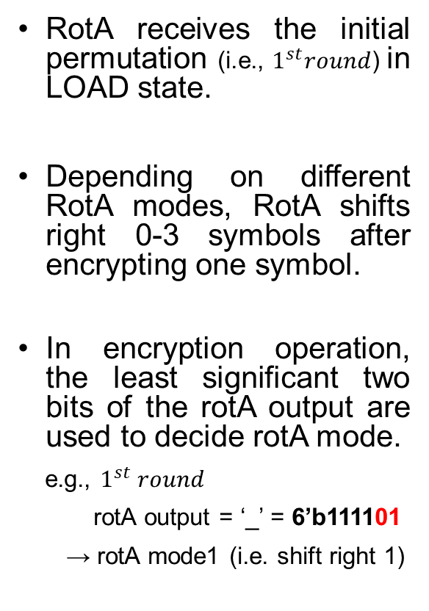


RotorA (RotA)
RotA receives the initial permutation (i.e., $1^{st}round$) in LOAD state.
Depending on different RotA modes, RotA shifts right 0-3 symbols after encrypting one symbol.
In encryption operation, the least significant two bits of the rotA output are used to decide rotA mode.
e.g., $1^{st} round$
rotA output = ‘_’ = 6’b111101
→ rotA mode1 (i.e. shift right 1)
idx
value
idx
value
idx
value
00
j
00
Y
00
Q
01
X
01
j
01
e
02
E
02
X
02
W
03
g
03
E
03
Y
04
?
04
g
04
j
···
shift right 1
···
shift right 3
···
shift right 1
···
···
···
···
···
···
···
···
···
61
e
61
Q
61
G
62
W
62
e
62
I
63
Y
63
W
63
c
$$1^{st} round$$
$$2^{nd} round$$
$$3^{rd} round$$
mode 1
(‘_’ = 6’b111101)
mode 3
(‘l’ = 6’b001011)
mode 1
(‘J’ = 6’b101001)
RotA behavior in READY state
EE4292 IC Design Laboratory

Slide 11
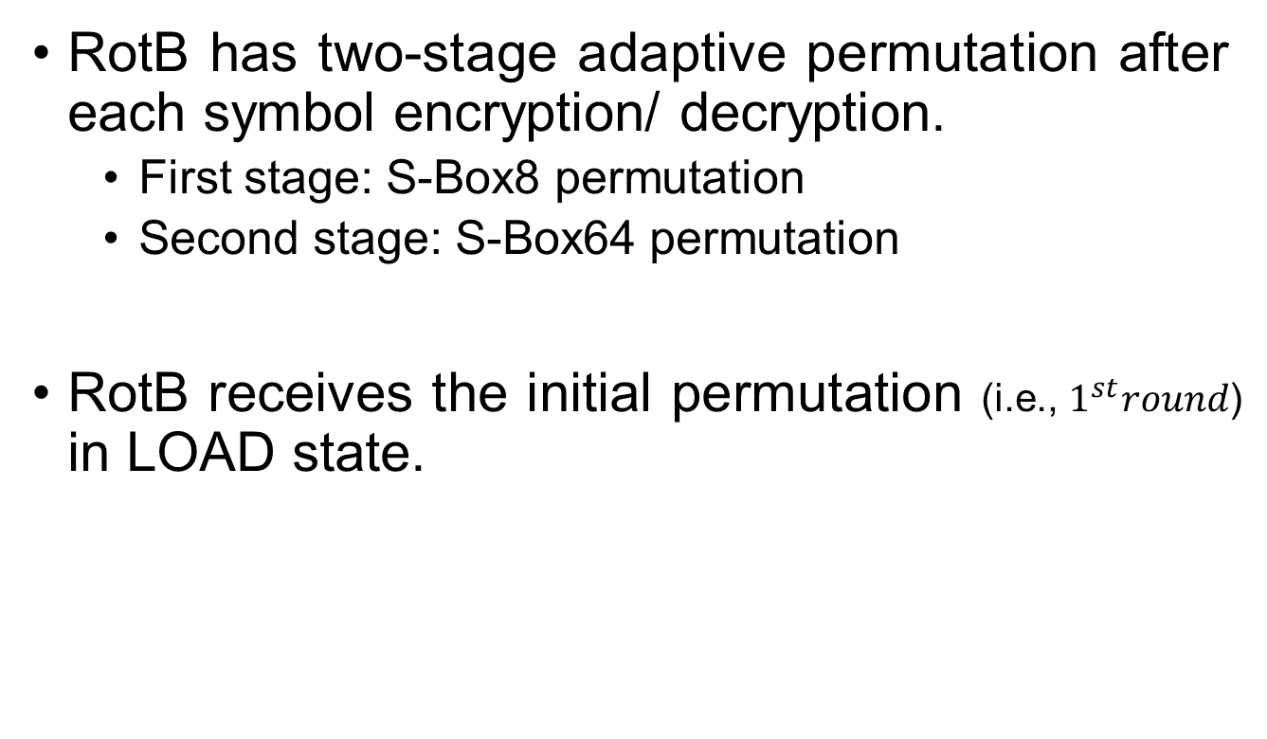
RotorB (RotB)
RotB has two-stage adaptive permutation after each symbol encryption/ decryption.
First stage: S-Box8 permutation
Second stage: S-Box64 permutation
RotB receives the initial permutation (i.e., $1^{st}round$) in LOAD state.
EE4292 IC Design Laboratory

Slide 12
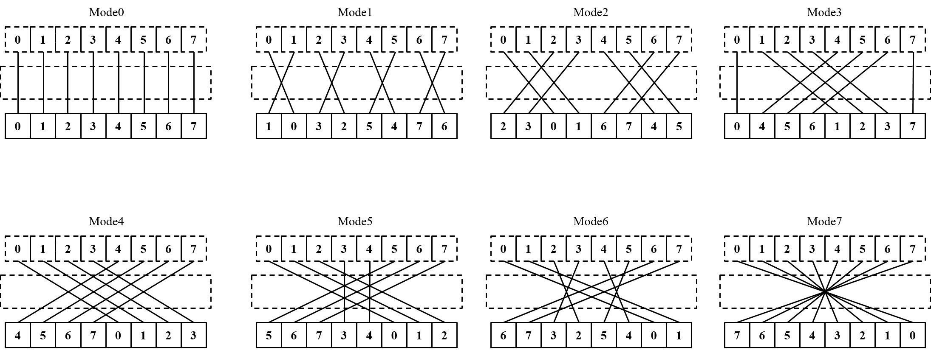
RotB First Stage: S-Box8
The S-Box8 applies for each eight contiguous symbols and has eight possible modes.
In encryption, the modes are decided by the least significant three bits of the rotB output.
(e.g., ‘a’ = 6’b000000 → mode 0)
EE4292 IC Design Laboratory

Slide 13
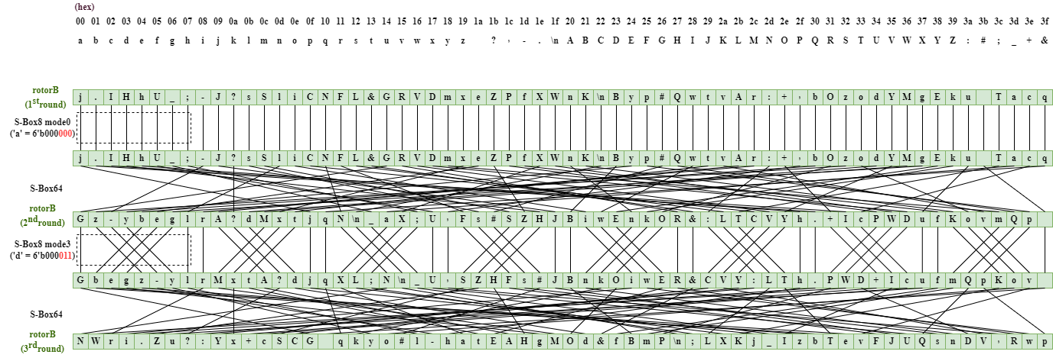
RotB First Stage: S-Box8
EE4292 IC Design Laboratory

Slide 14
RotB Second Stage: S-Box64
The second-stage S-Box64 follows a fixed permutation as shown in the following figure.
EE4292 IC Design Laboratory

Slide 15
RotB Second Stage: S-Box64
EE4292 IC Design Laboratory

Slide 16
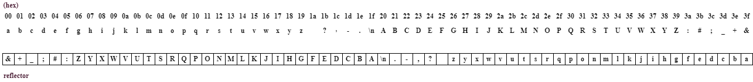
Reflector (Ref)
The reflector is a fixed table that has the reverse order of the ASCII table.
EE4292 IC Design Laboratory

Slide 17
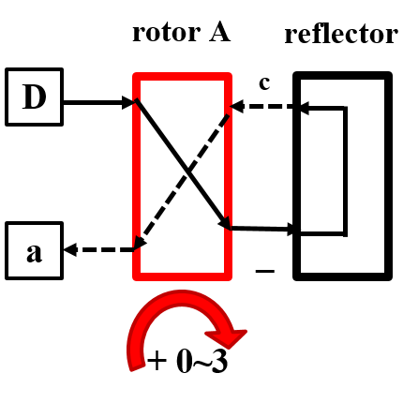
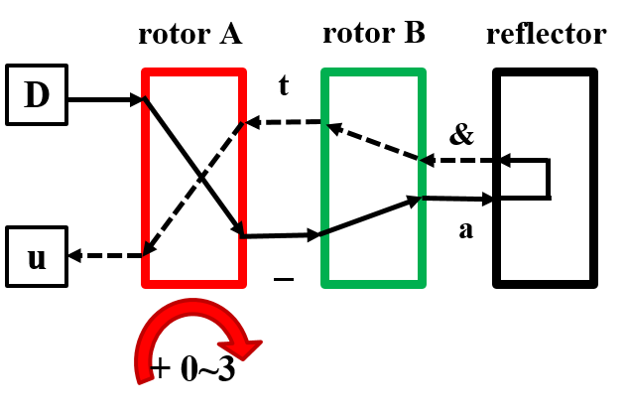
Step in this homework
Part1 (rotA + ref) (2%)
Part2 (rotA + rotB + ref) (4%)
Part3 (PB + rotA + rotB + ref) (4%)
Note: Your testbench must follow the reference waveform. Otherwise, your RTL codes might not pass the simulation when TA uses his testbench to evaluate.
EE4292 IC Design Laboratory

Slide 18
Part1 (rotA + ref) (2%)
Given the behavior model, implement the testbench test_enigma_part1.v for encrypting patten1 (1%).
Change the behavior model to your synthesizable RTL code enigma_part1.v (1%)
Note: Execute part1/sim/run_rtl.sh to check all the cases in Part1.
EE4292 IC Design Laboratory

Slide 19
Part2 (rotA + rotB + ref) (4%)
Implement the synthesizable Enigma RTL code enigma_part2.v (2%)
Write the testbench test_enigma_part2.v for encrypting/ decrypting pattern1-2 (2%)
Note: Execute part2/sim/run_rtl.sh to check all the cases in Part2.
EE4292 IC Design Laboratory

Slide 20
Part3 (PB + rotA + rotB + ref) (4%)
Implement the synthesizable Enigma RTL code enigma_part3.v (2%)
Write the testbench test_enigma_part3.v for encrypting/ decrypting pattern1-2 (1%)
Write the testbench test_enigma_part3_display.v to decrypt and save the results of pattern2-3 in ASCII format (1%)
Note: Execute part3/sim/run_rtl.sh and part3/sim/run_display.sh to check all the cases in part3.
EE4292 IC Design Laboratory

Slide 21
Part3 Cont’d
You need to decrypt and save pattern2-3 in ASCII format.
You can refer to display_enigma_code.v and show_enigma_code.v for displaying ASCII decrypted texts.
e.g.,
$vcs –R +v2k –full64 show_enigma_code.v +define+PAT1
$vcs –R +v2k –full64 show_enigma_code.v +define+PAT2

Slide 22
Notices
Your testbench must follow the reference waveform. Otherwise, your RTL codes might not pass the simulation when TA uses his testbench to evaluate.
TA will use unreleased patterns to evaluate your homework. Therefore, Do not design your hardware by the given datasets.
e.g., Different 16 lines for PB connection
EE4292 IC Design Laboratory

Slide 23
Submission
Deadline
10/27 11:59 p.m.
Submit to eeclass
Make sure the file delivery and organization meet the requirement
Wrong file delivery or organization will get 1% punishment
If you have any question
Feel free to ask on eeclass discussion
(maybe other students also have the same question!)
Do not show your code or email your code to TA.
Coding by yourself!
EE4292 IC Design Laboratory

Slide 24
Appendix
https://www.youtube.com/watch?v=ybkkiGtJmkM&t=202s&ab_channel=JaredOwen
EE4292 IC Design Laboratory

