Slide 1



Youssef Azzaoui Hee Namkung
The Next-Gen Social App

Slide 2


A new and inovative social app !
Be able to see people around you on a map.
Be able to access to their profile, see some of their Facebook pictures .
Discuss with people around you.
Create events on some particular location.

Slide 3




Client-Server architecture and many API involved

Slide 4
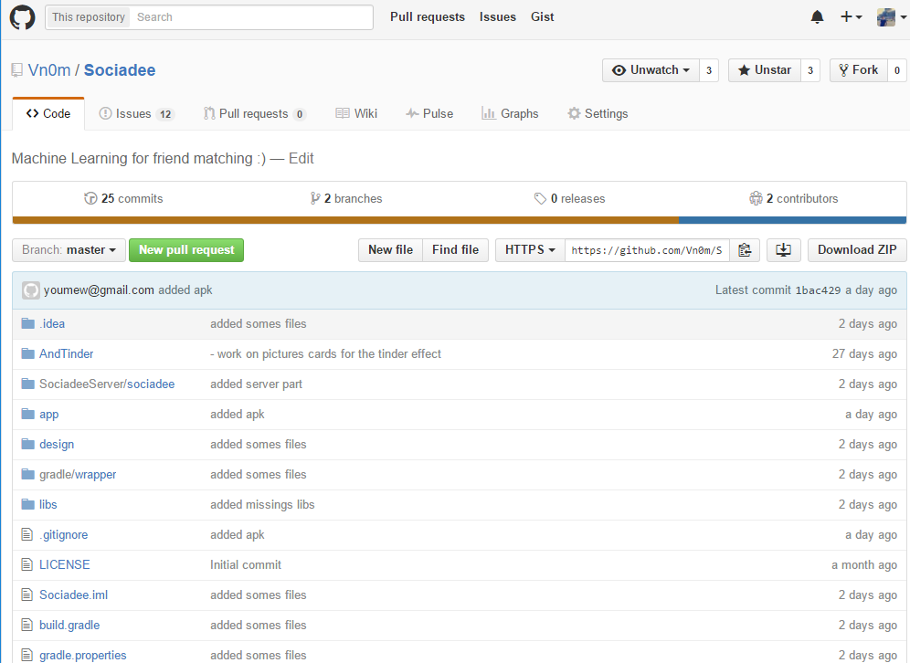
GitHub for collaborative development

Slide 5

Login activity
Connect to Facebook with GraphAPI , get name , profile picture and facebook token
Send facebook token to server
Server verify token authenticity, get user details from Facebook, check if user already exist within the Database create user on the DB if not or update user details
Server return server-token which is user key in the DB

Slide 6
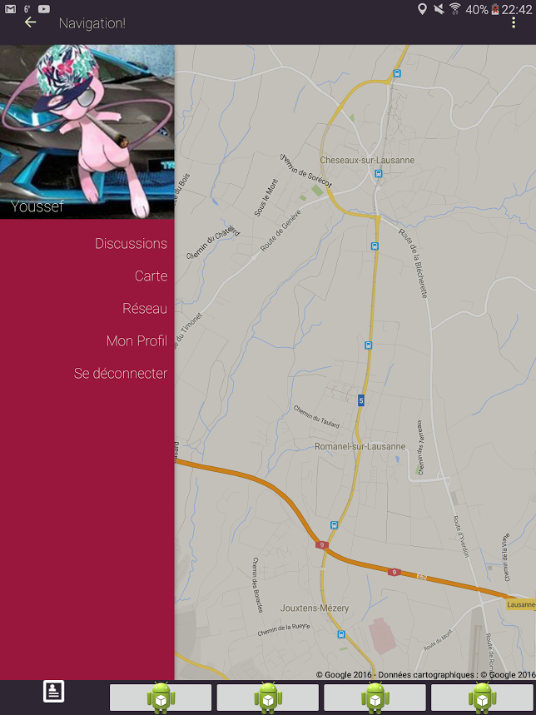
Main Activity
Widget toolbar
DrawerLayout Synchonized
Fragments
Bottom menu (still in dev.)

Slide 7
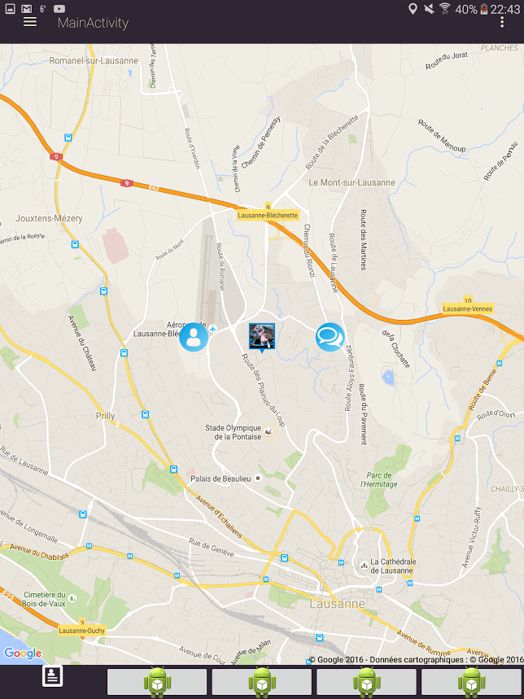
Map
Google Map inside fragment (Painful)
Customized markers dynamically generated
Animated Buttons
Gps positionning

Slide 8
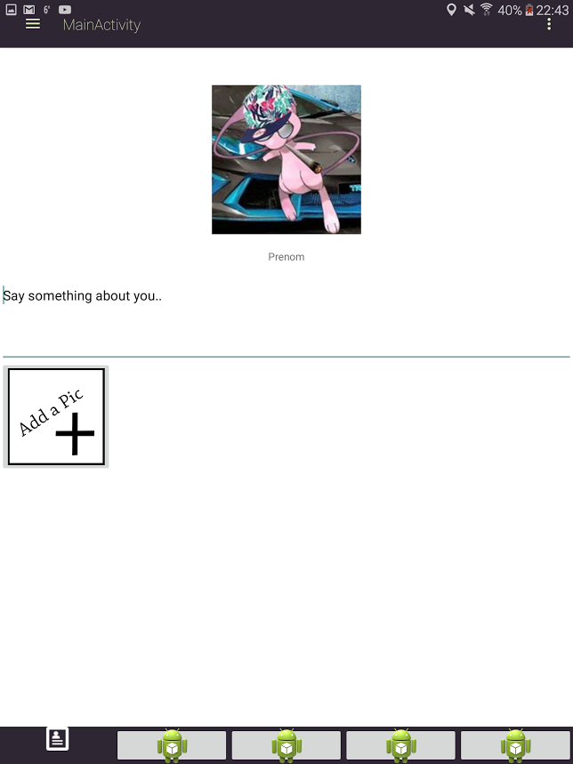
Profgile page
Profile page
Add pictures from Facebook
Say something about you
Shared Facebook Likes & Friends

Slide 9
Conclusion

