Slide 1



Youssef Azzaoui and Hee Namkung

Slide 2


A new and inovative social app !
Be able to see people around you on a map.
Be able to access to their profile, see some of their Faceboook pictures
Discuss with people around you.
Create events on some particular location

Slide 3
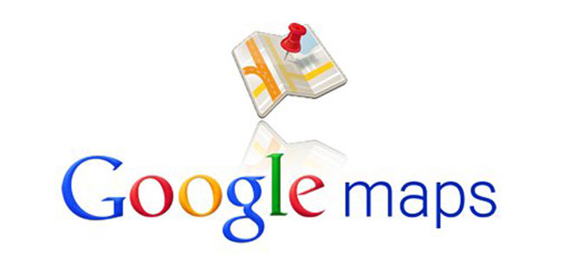



Client-Server architecture and many api involved

Slide 4
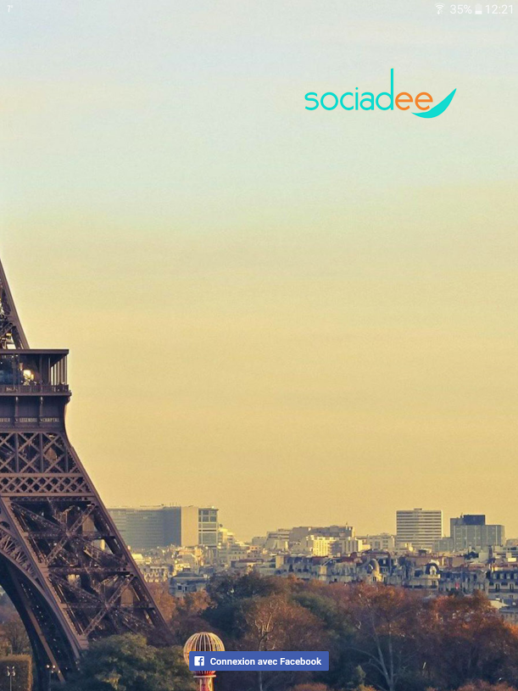
Login activity
Connect to Facebook with GraphAPI , get name , profile picture and facebook token
Send facebook token to server
Server verify token authenticity, get user details from Facebook, check if user already exist within the Database create user on the DB if not or update user details
Server return server-token which is user key in the DB

