Slide 1
Backing up Box.com folders
Tutorial

Slide 2
Frequency
Mandatory: Every 12 months
Recommended: Every 6 months
Perform at the end of the day because files may become inaccessible during back-up

Slide 3
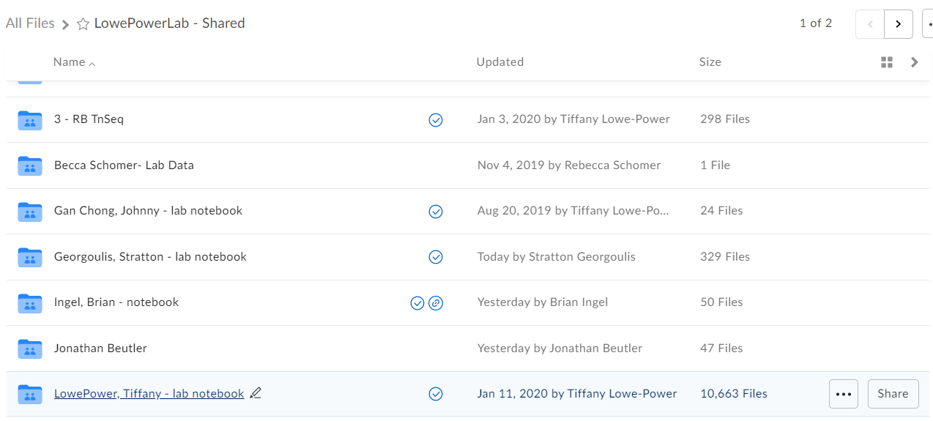
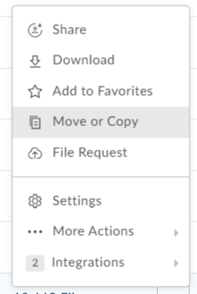

Slide 4
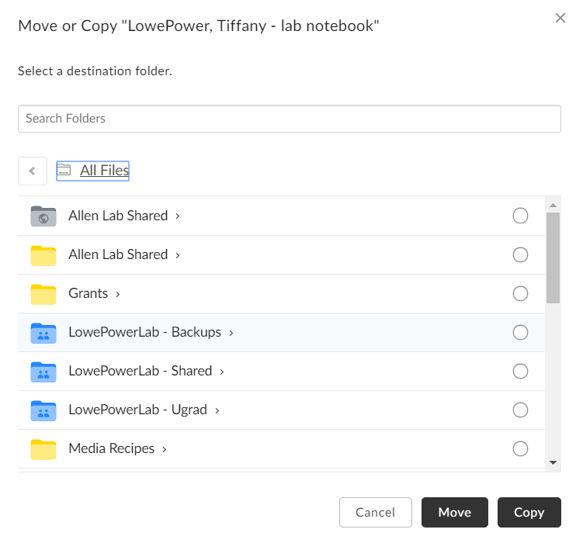
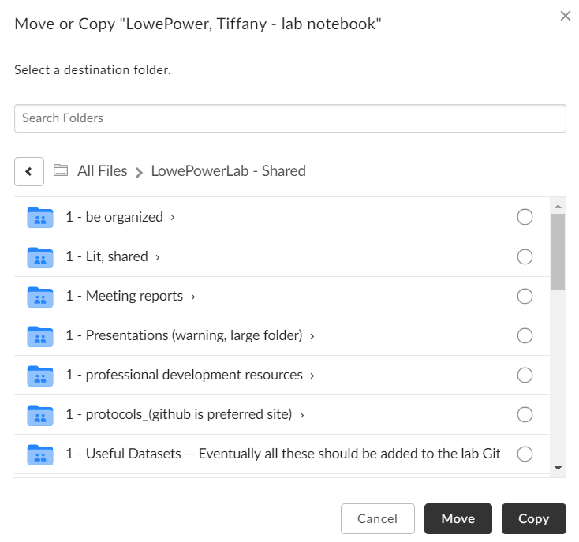
Save in LowePowerLab - Backups

Slide 5
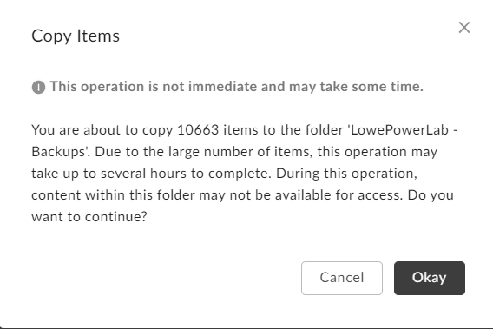

Slide 6
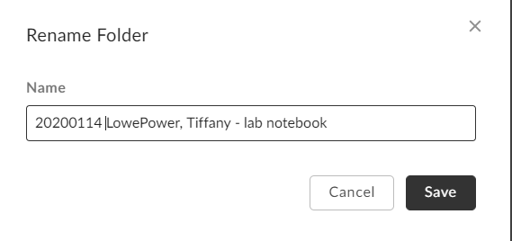
Rename backup File name with timestamp
YYYYMMDD format please

