Slide 1
Canopy Clustering and K-Means Clustering
Machine Learning Big Data
at Hacker Dojo
Anandha L Ranganathan (Anand) analog76@gmail.com

Slide 2
Movie Dataset
Download the movie dataset from http://www.grouplens.org/node/73
The data is in the format UserID::MovieID::Rating::Timestamp
1::1193::5::978300760
2::1194::4::978300762
7::1123::1::978300760

Slide 3
Similarity Measure
Jaccard similarity coefficient
Cosine similarity

Slide 4
Jaccard Index
Distance = # of movies watched by by User A and B / Total # of movies watched by either user.
In other words A  B / A  B.
For our applicaton I am going to compare the the subset of user z₁ and z₂ where z₁,z₂ ε Z
http://en.wikipedia.org/wiki/Jaccard_index

Slide 5
Jaccard Similarity Coefficient.
similarity(String[] s1, String[] s2){
List<String> lstSx=Arrays.asList(s1);
List<String> lstSy=Arrays.asList(s2);
Set<String> unionSxSy = new HashSet<String>(lstSx);
unionSxSy.addAll(lstSy);
Set<String> intersectionSxSy =new HashSet<String>(lstSx);
intersectionSxSy.retainAll(lstSy);
sim= intersectionSxSy.size() / (double)unionSxSy.size();
}

Slide 6
Cosine Similiarty
distance = Dot Inner Product (A, B) / sqrt(||A||*||B||)
Simple distance calculation will be used for Canopy clustering.
Expensive distance calculation will be used for K-means clustering.

Slide 7
Canopy Clustering- Mapper
Canopy cluster are subset of total popultation.
Points in that cluster are movies.
If z₁ subset of the whole population, rated movie M1 and same subset are rated M2 also then the movie M1 and M2 are belong the same canopy cluster.

Slide 8
Canopy Cluster – Mapper
First received point/data is center of Canopy .
Receive the second point and if it is distance from canopy center is less than T1 then they are point of that canopy.
If d(P1,P2) >T1 then that point is new canopy center.
If d(P1,P2) < T1 they are point of centroid P1.
Continue the step 2,3,4 until the mapper complets its job.
Distance is measured between 0 to 1.
T1 value is 0.005 and I expect around 200 canopy clusters.
T2 value is 0.0010.

Slide 9
Canopy Cluster – Mapper
Pseudo Code.
boolean pointStronglyBoundToCanopyCenter = false
for (Canopy canopy : canopies) {
double centerPoint= canopyCenter.getPoint();
if(distanceMeasure.similarity(centerPoint, movie_id) > T1)
pointStronglyBoundToCanopyCenter = true
}
if(!pointStronglyBoundToCanopyCenter){
canopies.add(new Canopy(0.0d));

Slide 10
Data Massaging
Convert the data into the required format.
In this case the converted data to be displayed in <MovieId,List of Users>
<MovieId, List<userId,ranking>>

Slide 11
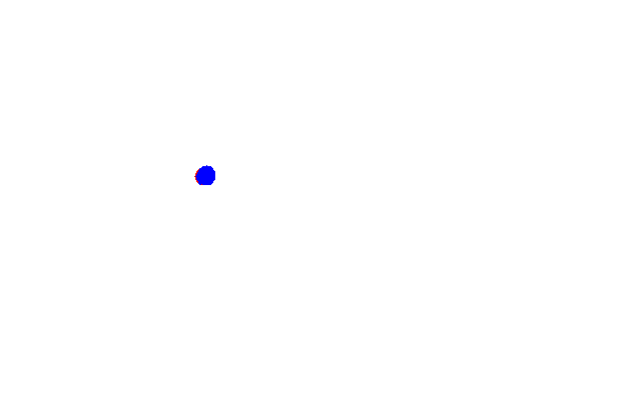
Canopy Cluster – Mapper A

Slide 12
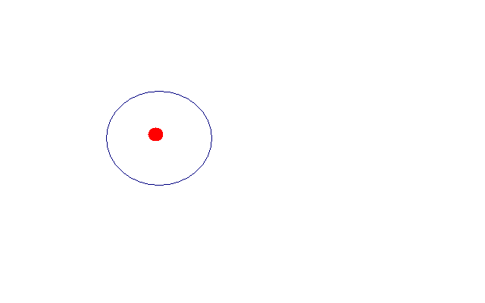
Threshold value

Slide 13
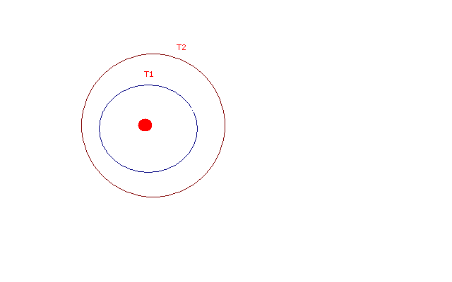

Slide 14
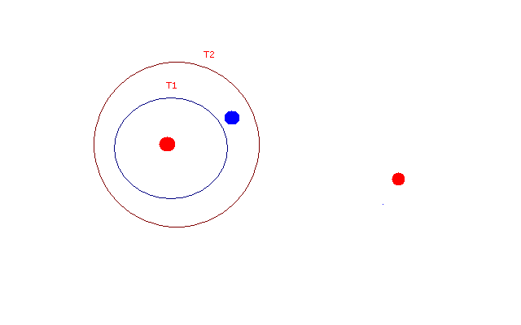

Slide 15
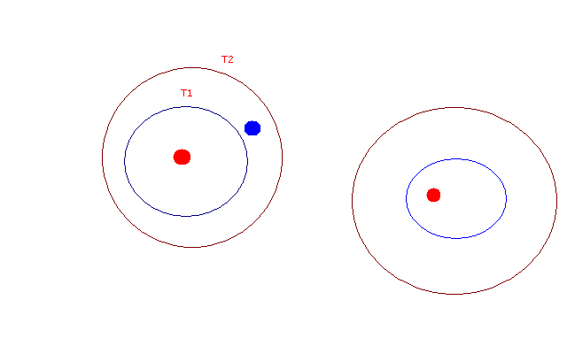

Slide 16
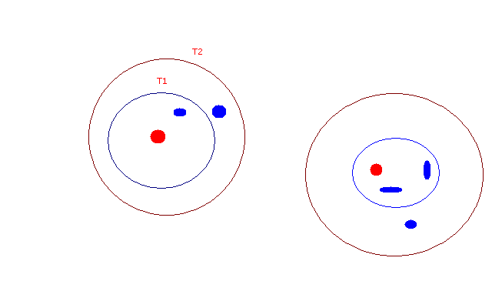

Slide 17
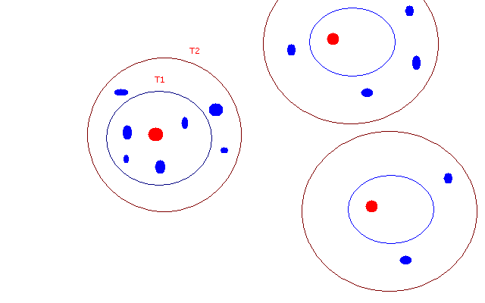

Slide 18
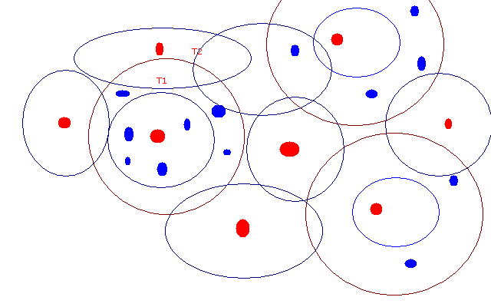

Slide 19
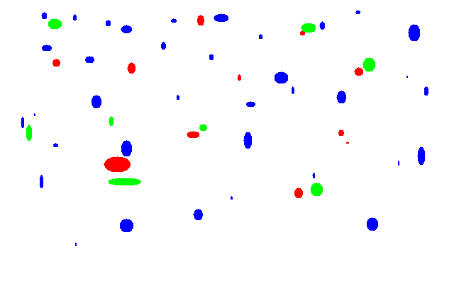
Reducer Mapper A - Red center Mapper B – Green center

Slide 20
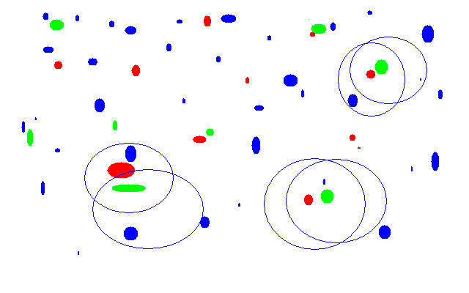
Redundant centers within the threshold of each other.

Slide 21
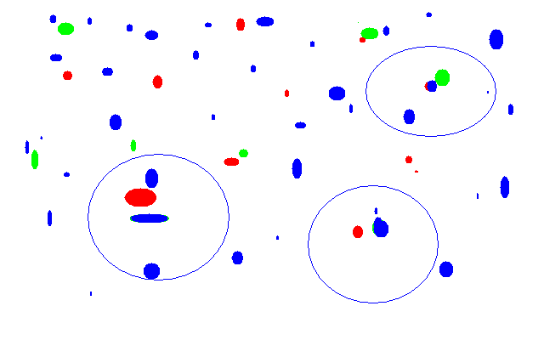
Add small error => Threshold+ξ

Slide 22
So far we found , only the canopy center.
Run another MR job to find out points that are belong to canopy center.
canopy clusters are ready when the job is completed.
How it would look like ?

Slide 23
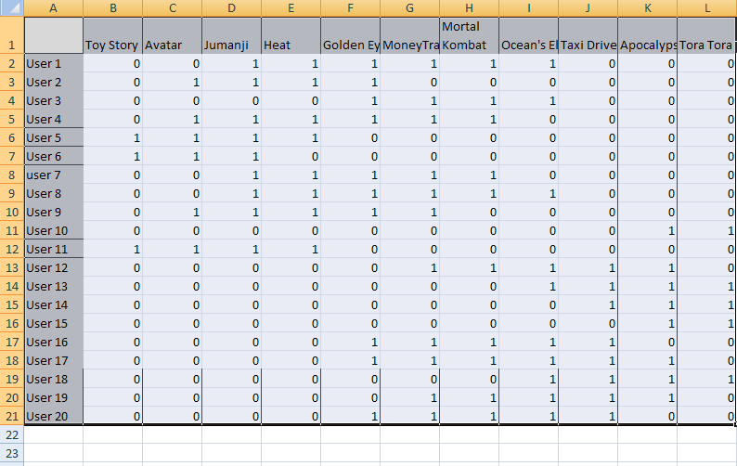
Canopy Cluster - Before MR job Sparse Matrix

Slide 24
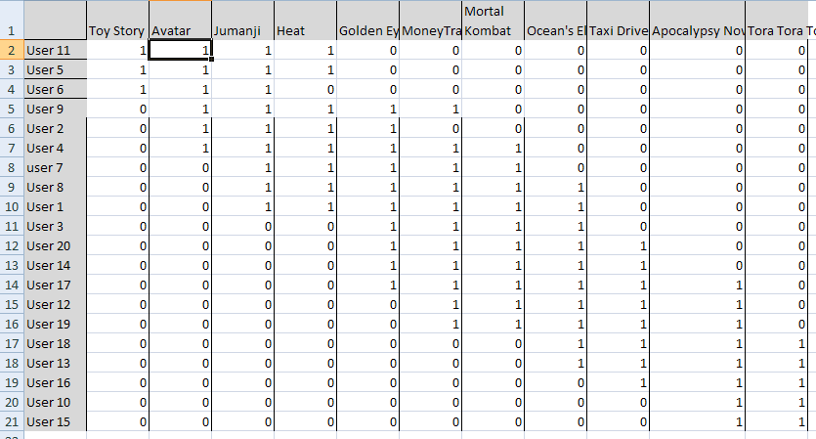
Canopy Cluster – After MR job

Slide 25
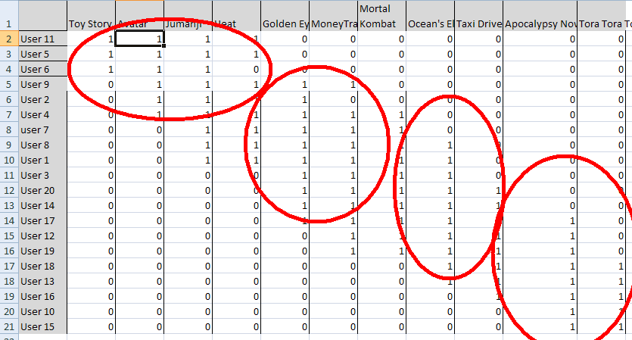
Cells with values 1 are grouped together and users are moved from their original location

Slide 26
K – Means Clustering
Output of Canopy cluster will become input of K-means clustering.
Apply Cosine similarity metric to find out similar users.
To find Cosine similarity create a vector in the format <UserId,List<Movies>>
<UserId, {m1,m2,m3,m4,m5}>

Slide 27
User A | Toy Story | Avatar | Jumanji | Heat
User B | Avatar | GoldenEye | Money Train | Mortal Kombat
User C | Toy Story | Jumanji | Money Train | Avatar
 | Toy Story | Avatar | Jumanji | Heat | Golden Eye | MoneyTrain | Mortal Kombat
UserA | 1 | 1 | 1 | 1 | 0 | 0 | 0
User B | 0 | 1 | 0 | 0 | 1 | 1 | 1
User C | 1 | 1 | 1 | 0 | 0 | 1 | 0

Slide 28
Vector(A) - 1111000
Vector (B)- 0100111
Vector (C)- 1110010
distance(A,B) = Vector (A) * Vector (B) / (||A||*||B||)
Vector(A)*Vector(B) = 1
||A||*||B||=2*2=4
➔ ¼=.25
Similarity (A,B) = .25

Slide 29
Find k-neighbors from the same canopy cluster.
Do not get any point from another canopy cluster if you want small number of neighbors
# of K-means cluster > # of Canopy cluster.
After couple of map-reduce jobs K-means cluster is ready

Slide 30
Find Nearest Cluster of a point - Map
Public void addPointToCluster(Point p ,Iterable<KMeansCluster > lstKMeansCluster) {
kMeansCluster closesCluster = null;
Double closestDistance = CanopyThresholdT1/3
For(KMeansCluster cluster :lstKMeansCluster){
double distance=distance(cluster.getCenter(),point)
if(closesCluster || closestDistance >distance){
closesetCluster = cluster;
closesDistance = distance
}
}
closesCluster.add(point);
}

Slide 31
Find convergence and Compute Centroid - Reduce
Public void computeConvergence((Iterable<KMeansCluster> clusters){
for(Cluster cluster:clusters){
newCentroid = cluster.computeCentroid(cluster);
if(cluster.getCentroid()== newCentroid ){
cluster.converged=true;
}
else
{
cluster.setCentroid(newCentroid )
}
}
Run the process to find nearest cluster of a point and centroid until the centroid becomes static.

Slide 32
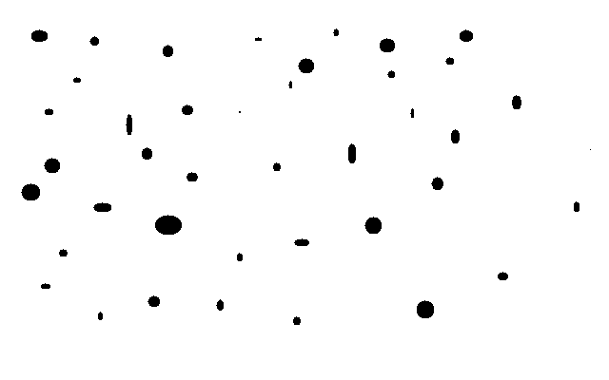
All points –before clustering

Slide 33
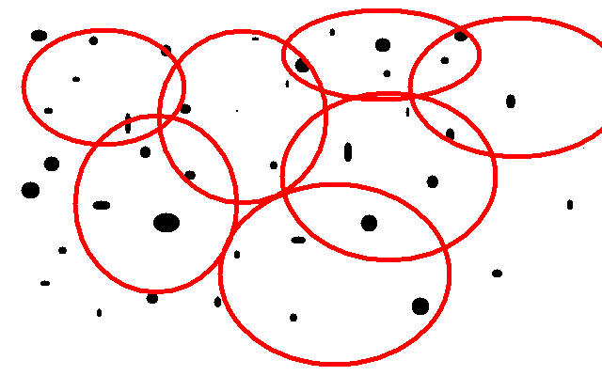
Canopy - clustering

Slide 34
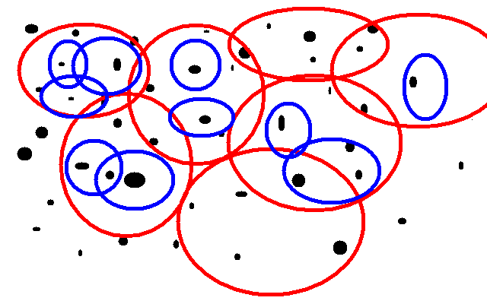
Canopy Clusering and K means clustering.

Slide 35
?

