Slide 1
Project Synopsis
Atharva Muley Aditya Shetty
Vinit Jain Karan Bawari

Slide 2
Index
Introduction
Abstract
Objectives
Literature Review
Problem Definition
Use Case Diagram
Class Diagram
Summary

Slide 3
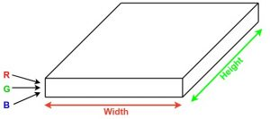
Introduction
When it comes to image recognition, Convolutional Neural Networks (CNN) performs really well.
CNN are used in various classification tasks like images, audio and words.
An input image can be represented as a cuboid having length, width and height.

Slide 4
Abstract
This project introduces the concept of autonomous car by using CNN.
It maps raw pixels from a single front facing camera directly to the steering commands.
Compared to individual explicit decomposition, CNN based approach will provide better performance.
Lane detection, path planning and control will be optimized simultaneously by our system.

Slide 5
Objectives
Creating a model in Convolutional Neural Network that is suitable for recognizing the paths in the environment.
Preprocessing the data received to achieve maximum speed and accuracy.
Investing time to train model so that errors are minimized.
Predict new values based on learned data.
Continue training existing model if further errors occur.

Slide 6
Literature Review
Convolutional neural network are very similar to ordinary neural network i.e they are made up of neurons that have learnable weights and biases.
Layers used to build convolutional neural network :
INPUT Layer (NxMx3) : it will hold raw pixel values of the image with N width, M height and 3 colour channels.
Convolutional layer (NxMx3) : It is used to highlight features in an image according to the filters.
NxMx3 is the dimensionality of filter that is to be applied.

Slide 7
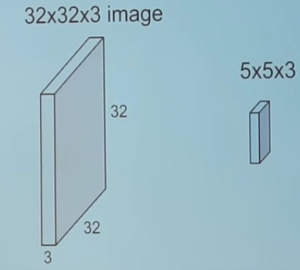
Literature Review
The Filter is then slid over the image and we take dot product between filter and part of the image.
The output of the layer is an activation map that highlights features in the image and the dimensions are dependent on the input image and filter.

Slide 8
Literature Review

Slide 9
Literature Review
Pooling layer : The main function of pooling layer is to reduce spatial size and amount of parameters and computations in network.
Different Pooling methods :
Max Pooling
Average Pooling

Slide 10
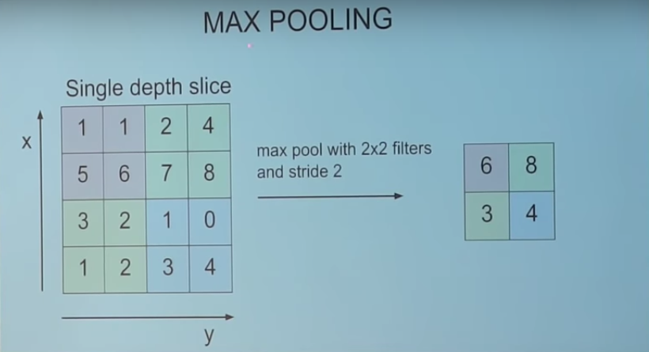
Literature Review
Basic function of pooling is to select maximum value in certain dimension.

Slide 11
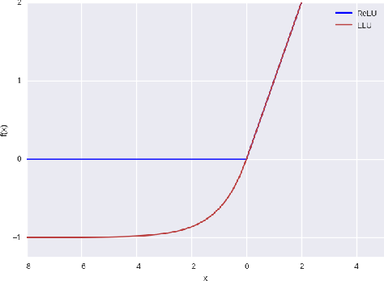
Literature Review
ELU/RELU Layer : It applies activation function elementwise.
It does not change the dimensionality of input.
Flattening : It involves converting the 2 dimensional array to a single long continuous vector.
Fully connected ANN : It is responsible to compute final scores and select a class.

Slide 12
Problem Definition
To develop and implement a self-driving car that is capable of sensing its environment and driving without any human input. The car should also able to take left or right turn when needed and also should be able to stop when an obstacle is encountered.

Slide 13
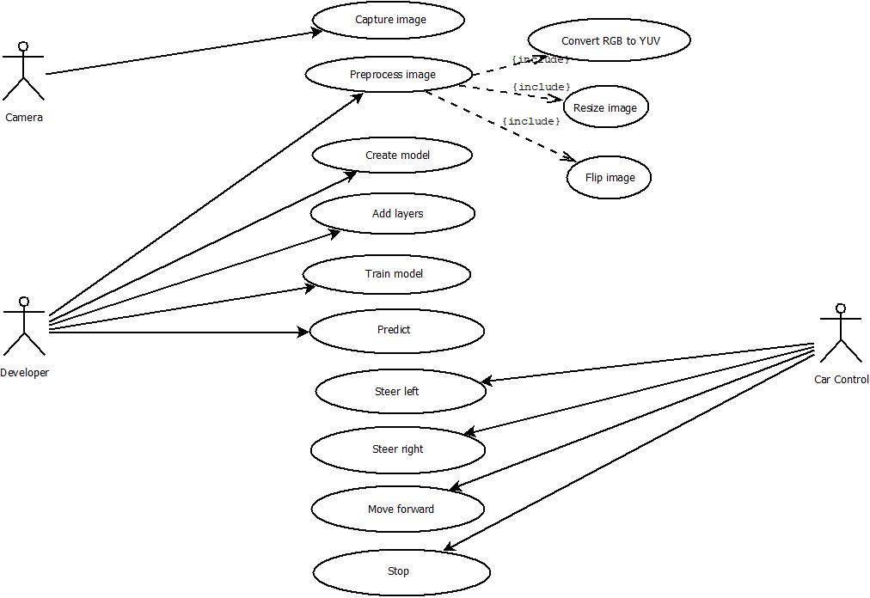

Slide 14
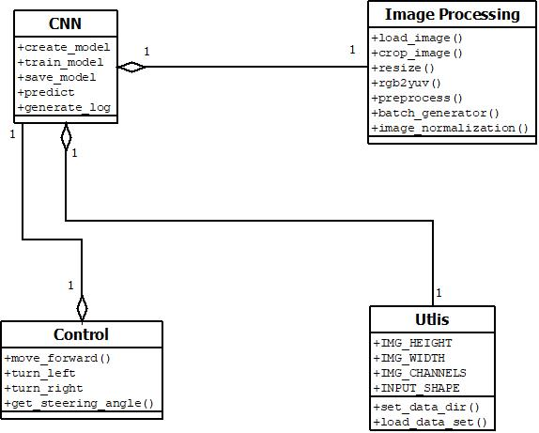

Slide 15
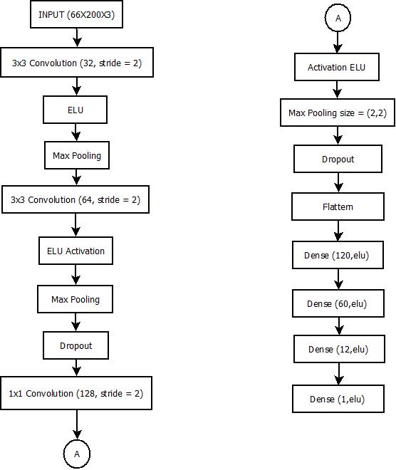

Slide 16
Summary
Convolutional neural network is a promising approach in identifying features in images. Compared to the traditional artificial neural networks, CNNs have proven to be more effective.

