Slide 1

A.P. Shah Institute of Technology
International Conference on Innovations in Computer Technology and Applications (IC2TA-2019)
Self Driving Car

Slide 2
Names of Authors
Karan Bawari
Atharva Muley
Aditya Shetty
Vinit Jain

Slide 3
Outline of presentation
Abstract
Introduction
Literature Review
Problem Statement
Proposed System
Technologies Used
Conclusion

Slide 4
Abstract
Driving in traffic these days is very tiring.
There are also many fatalities caused per year due to human error.
This project aims to develop and implement a self-driving car that is capable of sensing its environment and driving without any human input.
The car should take left or right turn when needed and should be able to stop when an obstacle is encountered.

Slide 5
Introduction
The system uses CNN as its core module.
The system can be tuned to once needs.
An input image is represented as a matrix of RGB.
CNN reduces complexity of Artificial Neural Network (ANN).
Learns the patterns in image and stores it into feature maps.
It uses these feature maps to calculate the steering angles.

Slide 6
Literature Review
Convolutional neural network are very similar to ordinary neural network i.e they are made up of neurons that have learnable weights and biases.
Layers used to build convolutional neural network :
INPUT Layer (NxMx3)
Convolutional layer (NxMx3)
NxMx3 is the dimensionality of filter that is to be applied.

Slide 7
The Filter is then slid over the image and we take dot product between filter and part of the image.
The output of the layer is an activation map that highlights features in the image and the dimensions are dependent on the input image and filter.
Formula for calculating output shape
(Image_dimension - kernel_size + 1)/stride_length
Number of parameters
(kernel_size * input_channels + 1) * output_channels

Slide 8
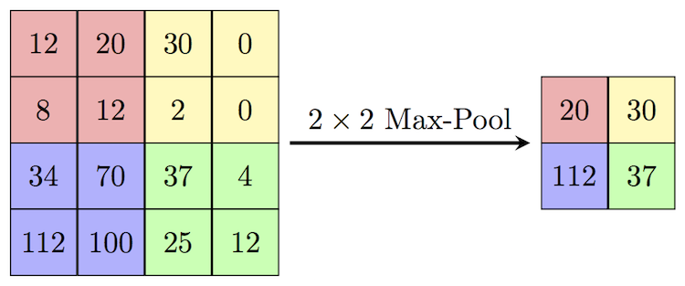
Pooling Layer : The main function of pooling layer is to reduce spatial size and amount of parameters and computations in network.
Example of Max Pooling:

Slide 9
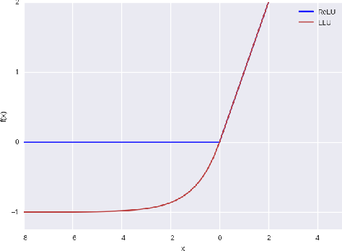
Dropout: The Dropout layer is a regularization technique which prevents overfitting of the Neural Network .It randomly selects neurons during training and sets their value to zero.
ELU/RELU Layer : It has better performance as compared to its counterparts. It shows better Convergence. It doesn't suffer from vanishing gradient problem.

Slide 10
Flattening : This layer flattens the input matrix i.e; converts multi-dimensional inputs into one dimensional output.
Fully connected (Dense layer): The output of flattening layer is input to the fully connected layer. There are generally multiple fully connected layers. The number of layers usually depends and the complexity of the problem and number of data-points to consider.

Slide 11
Problem Definition
To develop a system that is capable to learn to drive by its own.
To automatically detect the features that are useful to drive a car.
It should be able to drive under various different conditions.

Slide 12
Design
Desired Steering
Command
Steering
Calculate
Error
Camera
Preprocessing
CNN
Error
Weight
Updation

Slide 13
Technology Stack
Python (Programming Language)
Anaconda or Miniconda (Virtual environment for python libraries)
Jupyter Notebook (IDE for coding)
Spyder (IDE for coding)

Slide 14
Dependencies
Keras
Tensorflow (as Backend)
Numpy
Scikit-learn
OpenCV
Pandas

Slide 15
Conclusion
Convolutional Neural Networks are very powerful neural networks that can efficiently learn the features of an environment and hence can be used to drive the car.

