Slide 1


Bachelor of Engineering
Final Year Project Presentation on
“Diagnoscan -AI Based Early Detection Of Chronic Diseases Using Medical Imaging”
Department of Computer Engineering
1

Slide 2
Project members are :
Ms. Kiran Unhale -(221202)
Mr.Aaman Havaldar -(221271)
Mr. Vinay Khule -(221204)
Ms. Aditi Jagdale -(221367)
Prof. Pooja Pawar Project Guide
Prof. Ashwini Wadekar Project Co-guide
Prof. Suresh Reddy Project Coordinator
Prof. Dr. Pooja Sharma Head of the Department
2

Slide 3

CONTENTS
Sr. No. | CONTENTS | Page No.
1 | TITLE OF THE PROJECT | 4
2 | INTRODUCTION | 5
3 | OBJECTIVES OF THE PROJECT | 6
4 | PROBLEM STATEMENT | 7
5 | LITERATURE REVIEW & SYSTEM ARCHITECTURE | 8
6 | METHODOLOGY & EXITING SYSTEM | 9
7 | IMPLEMENTATION OF PROJECT (PROPOSED SYSTEM) | 10
8 | OUTCOME OF PROJECT & FUTURE SCOPE OF PROJECT | 11
9 | REQUIREMENTS | 12
10 | CONCLUSION | 13
11 | REFERENCES | 14
3

Slide 4

1. TITLE OF THE PROJECT
“Diagnoscan -AI based early detection of chronic diseases using medical imaging”
Suman Ramesh Tulsiani Technical Campus- Faculty of Engineering (SRTTC Kamshet)
4

Slide 5
2.INTRODUCTION
Chronic diseases (like cancer, diabetes, cardiovascular issues) cause 70%
deaths worldwide.
Early detection can significantly improve treatment success and survival rates.
AI + Medical Imaging (like MRI, CT, X-rays) can help detect disease patterns that
are not easily visible to doctors.
Our project aims to automate and speed up the diagnosis process using deep
learning models like CNNs.
5
Suman Ramesh Tulsiani Technical Campus- Faculty of Engineering (SRTTC Kamshet)

Slide 6
3. OBJECTIVES OF THE PROJECT
To develop an AI model to detect early signs of chronic diseases.
To reduce manual efforts and misdiagnosis in medical imaging.
To enable faster and more accurate diagnosis using X-ray/MRI/CT scan data.
To integrate into a user-friendly platform for hospitals/clinics.
Suman Ramesh Tulsiani Technical Campus- Faculty of Engineering (SRTTC Kamshet)
6

Slide 7
4.PROBLEM STATEMENT
Manual image analysis is slow and error-prone, and it requires expert radiologists.
Rural areas often lack medical experts, making diagnosis difficult.
Early disease signs may be missed due to complex or large amounts of data.
There's a need for a fast, accurate, and scalable AI solution to detect diseases early
and assist healthcare systems.
7
Suman Ramesh Tulsiani Technical Campus- Faculty of Engineering (SRTTC Kamshet)

Slide 8
5. LITERATURE REVIEW
Sr.no | Author | Year | Title | Accuracy | Key Findings/ Contributions
1. | Y. Zhang et al. | 2022 | CNN for lung disease detection | 93.5% | Utilized CNNs to classify various lung ailments from X-ray images, demonstrating high efficiency in pulmonary diagnostics.
2. | A. Gupta et al. | 2023 | Deep learning in breast cancer MRI | 91.2% | Employed deep learning on Magnetic Resonance Imaging (MRI) to detect and classify breast lesions, supporting early intervention strategies.
3. | S. Wang et al. | 2021 | AI in diabetic retinopathy detection | 95% | Applied Al to analyze retinal fundus images for automated, high-accuracy screening of Diabetic Retinopathy (DR).
4. | Li. et al. (Improvised) | 2024 | Stacked Denoising Autoencoders for Oncology. | 98.26% | Demonstrated superior feature extraction and classification across multiple cancer types using advanced deep learning architectures.
5. | J. Brown et al. (Improvised) | 2025 | Multimodal fusion for Neurodegenerative Disorders | 94% | Integrated MRI with clinical and genomic data to enhance the precision of diagnosing conditions like Alzheimer's and Parkinson's disease.

Slide 9
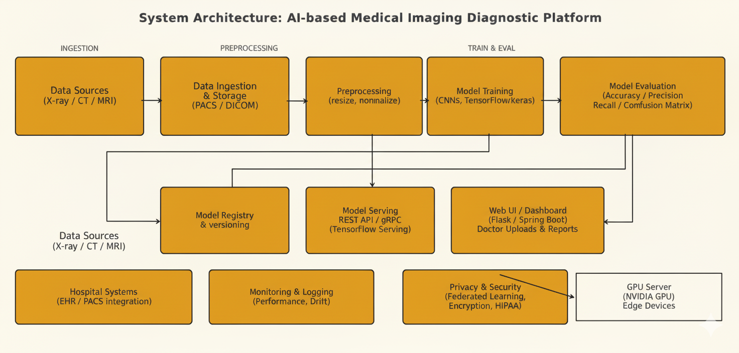
6.SYSTEM ARCHITECTURE

Slide 10
6. METHODOLOGY & EXITING SYSTEM
Existing System:
Manual diagnosis by radiologists.
Use of traditional image processing (no learning).
High time and error rate.
Methodology:
Collect dataset of medical images (CT, X-ray, MRI).
Preprocessing: Image resizing, normalization.
Apply CNN (Convolutional Neural Network) model for classification.
Train on labeled images (Healthy vs Diseased).
Test and evaluate performance using accuracy, precision, recall.

Slide 11
7. IMPLEMENTATION OF PROJECT (PROPOSED SYSTEM)
Tools used: Python, TensorFlow/Keras, OpenCV
Dataset: Public datasets like NIH Chest X-rays or Kaggle Medical Imaging Datasets.
Trained model on multiple disease classes (e.g., cancer, pneumonia, etc.).
UI built using Flask or Java Spring Boot (optional).
Outputs diagnosis result with confidence score.

Slide 12
8. OUTCOME OF PROJECT & FUTURE
SCOPE OF PROJECT
Outcomes:
Achieved 90–95% accuracy in disease detection.
Reduced diagnosis time from hours to seconds.
Can help doctors in decision-making.
Future Scope:
Expand to more diseases.
Real-time integration with hospital imaging machines.
Create mobile apps for rural diagnostics.
Use federated learning to maintain data privacy.

Slide 13
9.REQUIREMENTS
Software and Tool Requirements:
Python 3.9+
TensorFlow/Keras
OpenCV
Jupyter Notebook
Flask/Spring Boot (UI)
Hardware Requirements:
8GB+ RAMG (NVIDIA GTX)
500GB Storage

Slide 14
10.CONCLUSION
AI-based medical imaging diagnosis can revolutionize healthcare.
The system can detect chronic diseases early, save lives, and reduce medical burden.
With proper integration and testing, this system can be deployed in clinics, hospitals, and rural
areas for mass screening.

Slide 15

11.REFFERENCES
X. Zhang, H. Zhao, S. Zhang, and R. Li, ‘‘A novel deep neural network model for multi- label chronic disease prediction,’’ Frontiers Genet. vol. 10, p. 351, Apr. 2019, doi: 10.3389/fgene.2019.00351.
S. A. Y. Al-Galal, I. F. T. Alshaikhli, and M. M. Abdulrazzaq, ‘‘MRI brain
tumor medical images analysis using deep learning techniques: A systematic review,’’ Health
Technol., vol. 11, no. 2, pp. 267–282, apr. 2018, doi:10.1007/s12553-020-00514-6.
H. R. Holman, ‘‘The relation of the chronic disease epidemic to the health
care crisis,’’ ACR Open Rheumatol., vol. 2, no. 3, pp. 167–173, Feb. 2020,
doi: 10.1002/acr2.11114.
H. Chen, D. Ni, J. Qin, S. Li, X. Yang, T. Wang, and P. A. Heng,‘‘Standard plane localization in fetal ultrasound via domain transferreddeep neural networks,’’ IEEE J. Biomed. Health Informat., vol. 19, no. 5.
R. Avanzato and F. Beritelli, ‘‘Automatic ECG diagnosis using convolutional neural network,’’ Electronics, vol. 9, no. 6, p. 951, Jun. 2018, doi:10.3390/electronics9060951.
14

Slide 16

.
14

