Slide 1
Analysis of Network Robustness
Evaluating Architectural Baselines & Out-of-Distribution Resilience @Vanshika_Gupta_23365
-56%
RESNET ACCURACY COLLAPSE
-1.2%
VIT ACCURACY RETENTION
Baseline Evaluation Analysis
ResNet Memorization: Achieves highest training accuracy and rapid loss reduction, but repeatedly suffers from noticeable overfitting. Its local feature mapping lacks OOD robustness.
ViT Stability: Consistently avoids overfitting by relying on global multi-head attention rather than local convolutions, maintaining stable generalization.
ConvNeXT & VGG: ConvNeXT learns smoothly with strong inductive biases (evident on ImageNet-100), while VGG shows steady progression but lacks capacity for complex datasets.
Architectural Inferences
CNN Fragility: ResNet hyper-tunes to local image contours. Under OOD structural noise, these localized feature maps entirely dissolve.
Transformer Dominance: Vision Transformers (ViTs) utilize multi-headed self-attention to calculate macro relationships. By abandoning standard translational biases, they universally exhibit massive geometric resistance.
DSE316/616 Assignment-2
Slide 1 / 3

Slide 2
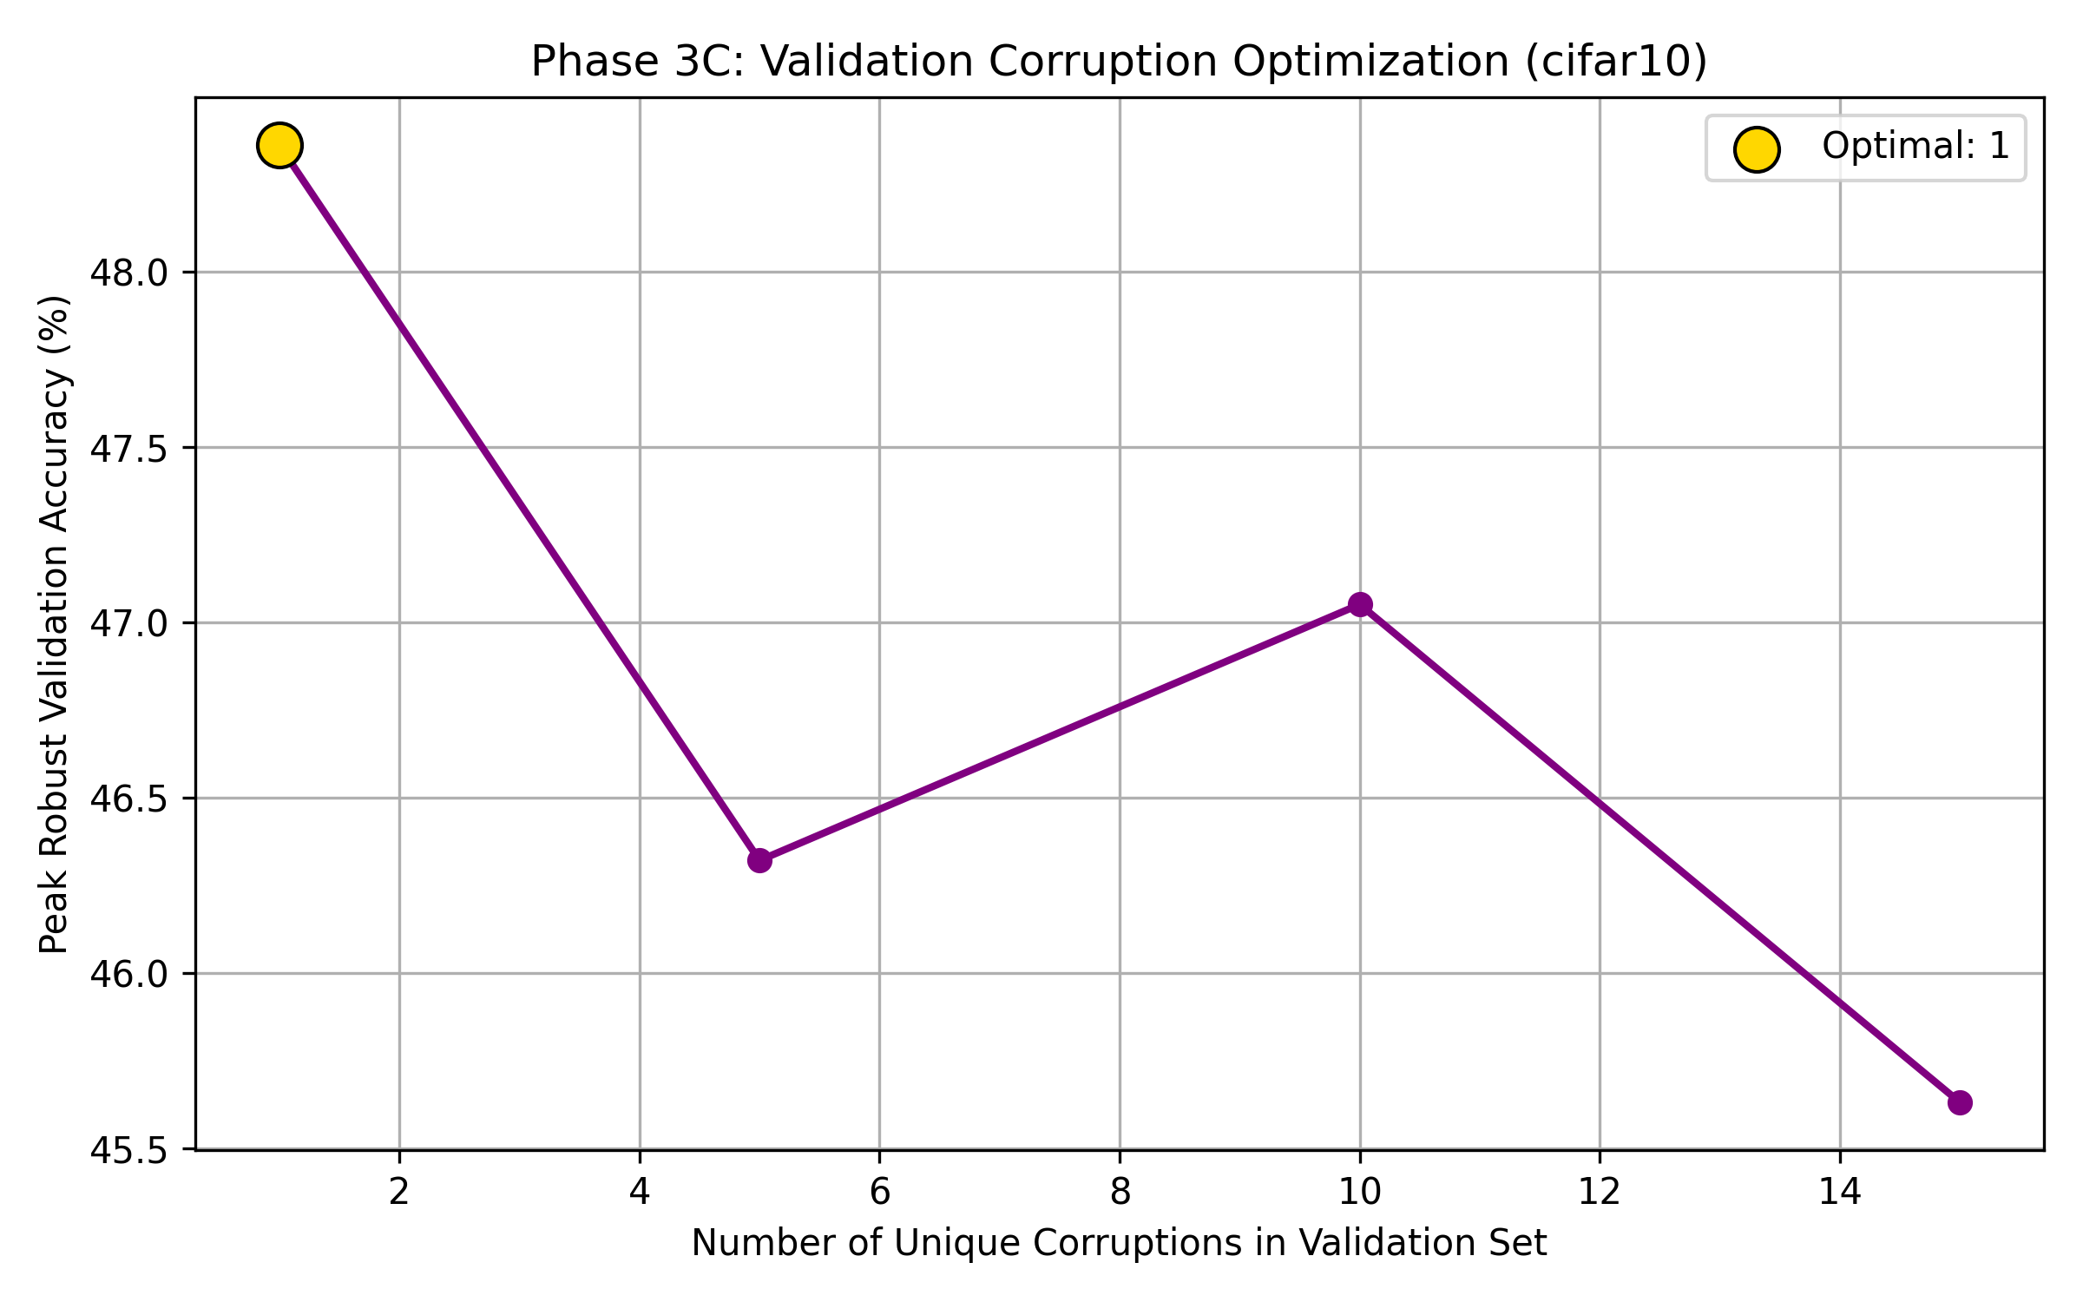
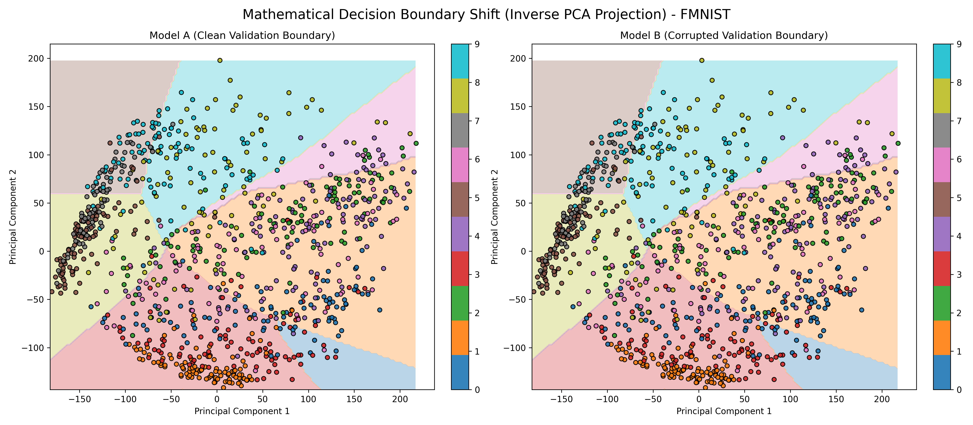
Validation Optimization & Decision Boundaries
Impact of Corrupted Validation Sets on Model Topologies
Optimization Peaks by Dataset
Geographic Tensor Boundaries
Figure: Structural Optimization Sweep (CIFAR-10)
Figure: Inverse PCA Border Maps (F-MNIST)
Robustness peaks correlate heavily to structural complexity:
• CIFAR-10 (Dense): Peaks early at 1 corruption.
• ImageNet-100 (Complex): Peaks at 5 corruptions.
• F-MNIST (Smooth): Requires heavy noise, peaking at 10 corruptions.
The Mapping Shift: Clean validation models generate over-constrained borders highly susceptible to minimal shifts.
Models trained against corrupted validation synthetically relax these boundaries, acting as an organic buffer against OOD spatial deformations.
Phase 3 & 4 Analytics
Slide 2 / 3

Slide 3
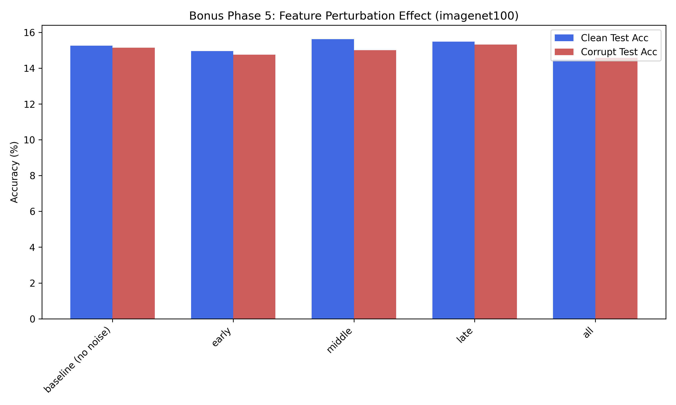
Inter-Layer Topological Disruption
Tracking Structural Matrix Noise & Final Conclusions
Dynamic Feature Perturbation
Topology Inferences
Initial Edge Catastrophe: Injecting noise in early spatial operations permanently destroys downstream global representation. Early matrices are critical bottlenecks.
Deep Layer Regularization: Confining spatial variables exclusively to late classification matrices (e.g., ImageNet middle/late stages) acts identically to pseudo-dropout, marginally augmenting or preserving generalization metrics.
Figure: Feature Disruption at Early, Middle, and Late Arrays (ImageNet-100)
Final Conclusion
ViTs deliver unparalleled geometric resilience natively. Meanwhile, manipulating MLP structural boundaries via targeted validation corruption mathematically creates optimal, wider decision buffers capable of absorbing complex structural OOD vectors dynamically.
Phase 5 & Final Summary
Slide 3 / 3

