Slide 1
MAKE FILE
Required knowledge:
basic shell script commands
write basic makefilefile
organize data in memory
References:
http://www.gnu.org/software/make/manual/make.html#Using-Variables
https://gcc.gnu.org/onlinedocs/gcc-10.2.0/gcc/ARM-Options.html#ARM-Options

Slide 2
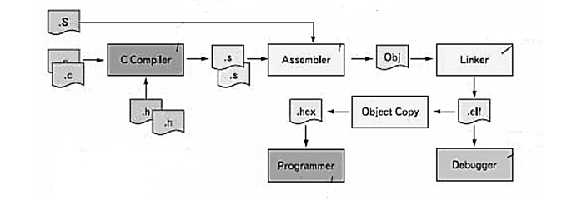
1. The compiler
The process of compiling c program
in embedded
Compiler can be understood as translating a sequence of statements written from a programming language into an equivalent program in the form of a machine language. Simple to understand, we can temporarily say that thanks to this Compiler, the .c file we write is translated into a .hex .bin file to be loaded into any MCU.

Slide 3

2. The makefile
Makefile is a script that contains the following information:
Target: usually the name of a file that is generated by the command below. It can also be the name of an action to carry out (a phony target).
Prerequisites: file(s) that that are used as input to create the target. A target usually depends on several files.
Recipe: usually shell command(s) used to create the target. Can also specify commands for a target that does not depend on any prerequisites. (e.g.; clean)
A syntax consisting of Target, Prerequisites , Recipe is called a Rule.
a rude

Slide 4
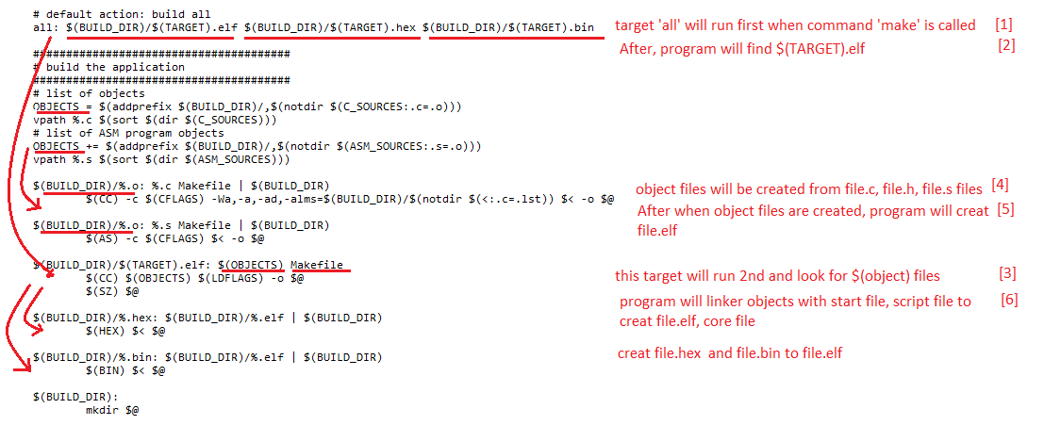
Example a fragment of a Makefile program

Slide 5
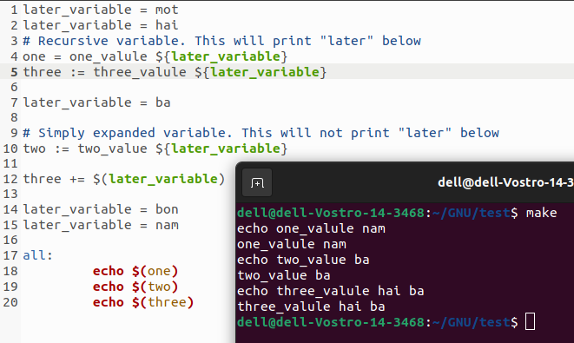
Distinguish = , := and +=

Slide 6
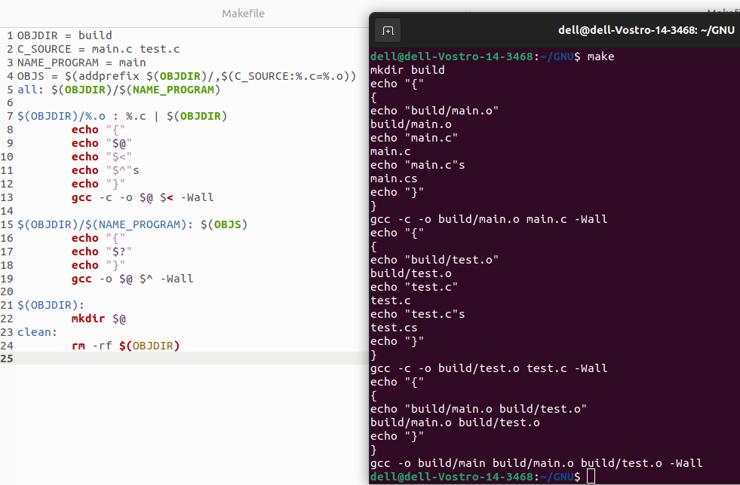
Distinguish $@ , $< ,$^ and $?

Slide 7
Implicit rules -make knows how to figure out how to make some files. Its has implicit rules for updating *.o files from a correspondingly named *.c file using the compiler. We can therefore omit the commands for making *.o files from the object file rules.
Pattern Rules You can define an implicit rule by writing a pattern rule . Pattern rules contain the character “%”. The target is considered a pattern for matching file names. A pattern rule: %.o : %.c
vpath specifies a list of directories that make should search. Most often, the directories are expected to contain prerequisite files that are not in the current directory; however, make uses VPATH as a search list for both prerequisites and targets of rules.

Slide 8
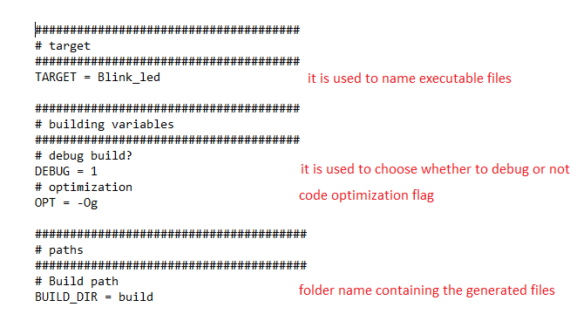
2. Parse template makefile file
declare variable in makefile

Slide 9
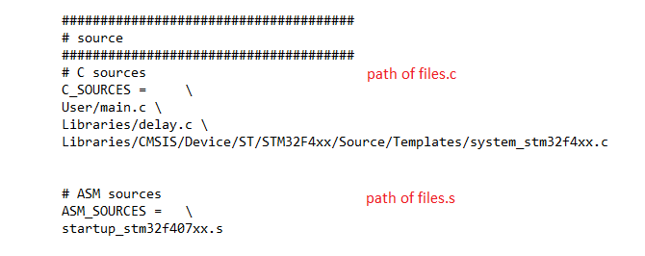
declare variable in makefile

Slide 10
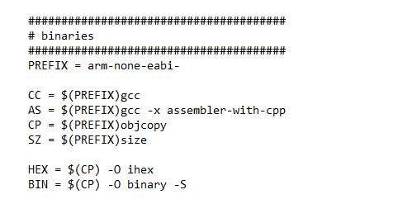
declare variable in makefile

Slide 11
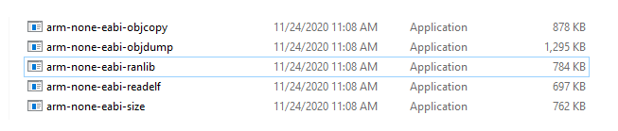
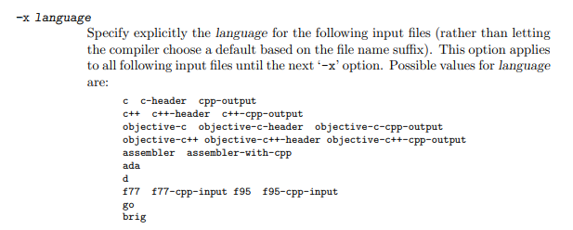

Slide 12
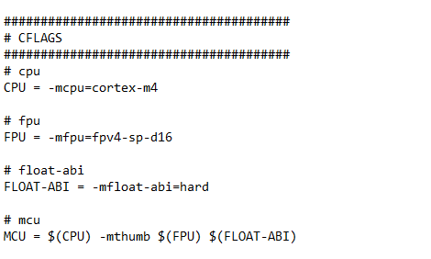
declare variable in makefile

Slide 13
-mcpu=name[+extension...]
This specifies the name of the target ARM processor. GCC uses this name to derive the name of the target ARM architecture (as if specified by ‘-march’) and the ARM processor type for which to tune for performance (as if specified by ‘-mtune’). Where this option is used in conjunction with ‘-march’ or ‘-mtune’, those options take precedence over the appropriate part of this option.
Permissible names are:
‘arm9e’, ‘arm946e-s’, ‘arm966e-s’, ‘arm968e-s’, ‘arm10e’, ‘arm1020e’, ‘arm1022e’, ‘arm926ej-s’, ‘arm1026ej-s’, ‘cortex-r5’, ‘cortex-r7’, ‘cortex-r8’, ‘cortex-m4’, ‘cortex-m7’, ‘cortex-m33’, ‘cortex-m35p’, ‘generic-armv7-a’, ‘cortex-a5’, ‘cortex-a7’, ‘cortex-a8’, ‘cortex-a9’, ‘cortex-a12’, ‘cortex-a15’, ‘cortex-a17’, ‘cortex-a15.cortex-a7’, ‘cortex-a17.cortex’…
-mfpu=name
This specifies what floating-point hardware (or hardware emulation) is available on the target.
Permissible names are:
‘auto’, ‘vfpv2’, ‘vfpv3’, ‘vfpv3-fp16’, ‘vfpv3-d16’, ‘vfpv3-d16-fp16’, ‘vfpv3xd’, ‘vfpv3xd-fp16’, ‘neon-vfpv3’, ‘neon-fp16’, ‘vfpv4’, ‘vfpv4-d16’, ‘fpv4-sp-d16’, ‘neon-vfpv4’, ‘fpv5-d16’, ‘fpv5-sp-d16’, ‘fp-armv8’, ‘neon-fp-armv8’ and ‘crypto-neon-fp-armv8’. Note that ‘neon’ is an alias for ‘neon-vfpv3’ and ‘vfp’ is an alias for ‘vfpv2’

Slide 14
-mfloat-abi=name
Specifies which floating-point ABI to use.
Permissible values are:
‘soft’, ‘softfp’ and ‘hard’.
-mthumb:
this is the instruction that gcc supports for 32-bit ARM instructions

Slide 15
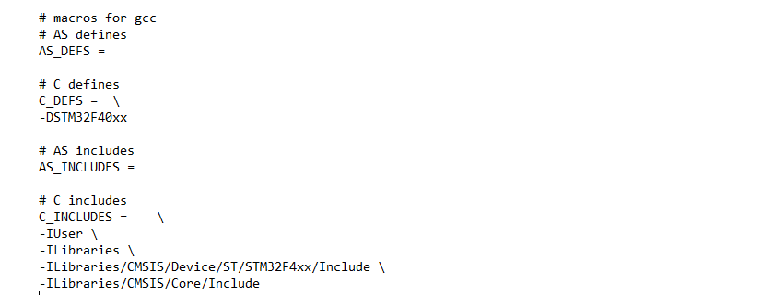
.
declare variable in makefile
-Dname has the same effect as placing the text #define name at the head of each source file.
-lname Where name is the name of the library

Slide 16
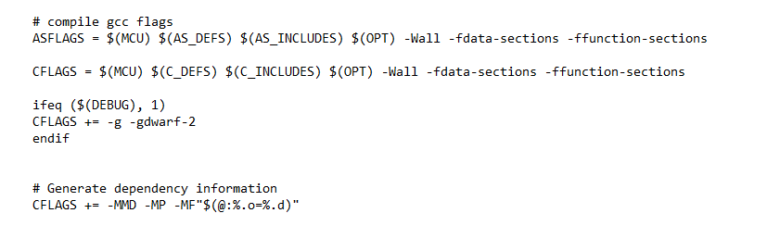
declare variable in makefile

Slide 17
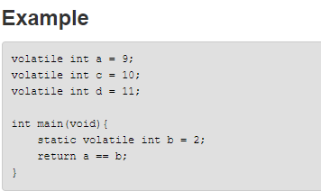
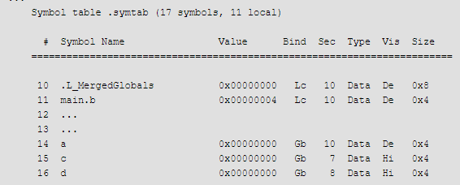
-ffunction-sections
Generates a separate ELF section for each function in the source file. The unused section elimination feature of the linker can then remove unused functions at link time.
Separate the association between functions so that it's ready to be discarded when it's not used
-fdata-sections
Enables or disables the generation of one ELF section for each variable in the source file. The default is -fdata-sections.
Don’t assign value if it is not used

Slide 18
-MD
Lists both system header files and user header files.
-MMD
List only user header files, not system header files.
-MP
This option instructs CPP to add a phony target for each dependency other than the main file, causing each to depend on nothing. These dummy rules work around errors make gives if you remove header files without updating the ‘Makefile’ to match.
-MF file
When used with ‘-M’ or ‘-MM’, specifies a file to write the dependencies to. If no ‘-MF’ switch is given the preprocessor sends the rules to the same place it would send preprocessed output. When used with the driver options ‘-MD’ or ‘-MMD’, ‘-MF’ overrides the default dependency output file. If file is ‘-’, then the dependencies are written to ‘stdout’.

Slide 19
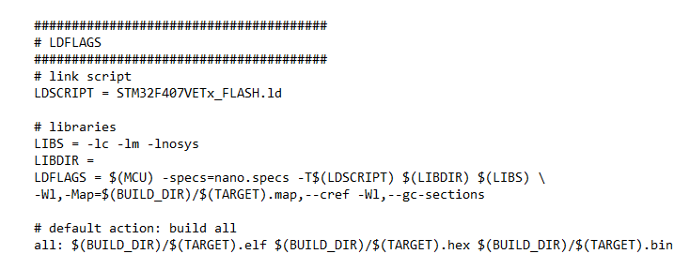
declare variable in makefile
Link: https://gcc.gnu.org/onlinedocs/gcc-9.2.0/gcc.pdf

Slide 20
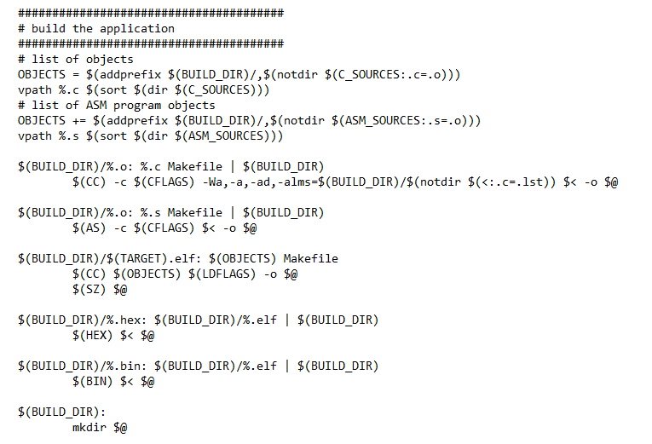
3. Compiling process

Slide 21
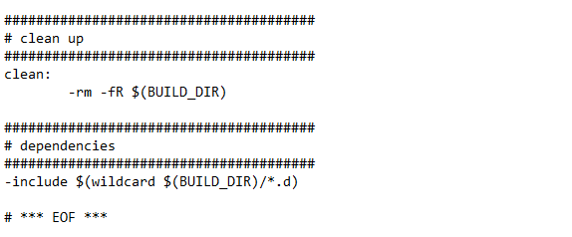

Slide 22
4. Startup file
The startup code consist of few parts below.
Architecture and syntax
Declaration of the Stack area
Declaration of the Heap area
Vector table
Assembler code of Reset handler
Definition of interrupt handler
This module performs:
Set the initial SP
Set the initial PC == Reset_Handler,
Set the vector table entries with the exceptions ISR address
Configure the clock system and the external SRAM mounted on
STM324xG-EVAL board to be used as data memory (optional, to be enabled by user)
Branches to main in the C library (which eventually calls main()).
After Reset the Cortex-M4 processor is in Thread mode, priority is Privileged, and the Stack is set to Main.

Slide 23
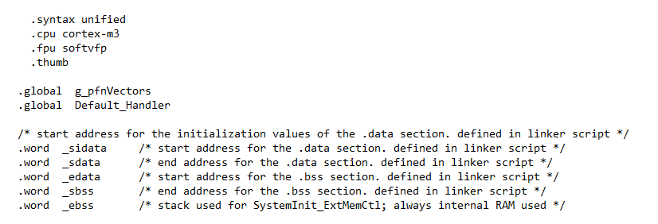
.syntax unifie use modern assembler syntax + auto-generate IT instructions. Put in top of your source file
.cpu cpuType cpuType may for instance be cortex-m0, cortex-m3 or cortex-m4.
.fpu specifies the target FPU architecture, that is the floating-point hardware available on the target.
.thumb type instruction .global would mark a label in the current file as having global scope (available to other modules)
.world declare a 32bit variable in the .data section

Slide 24
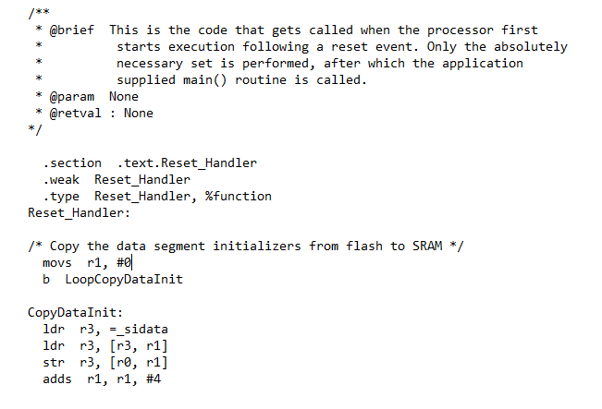

Slide 25
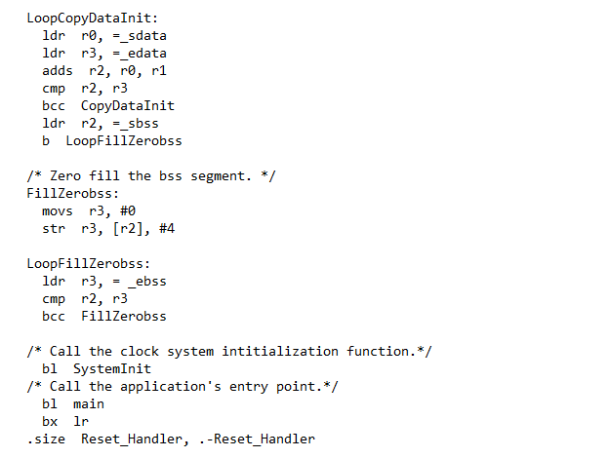
Set the size of Reset_Handler are, and calculate the size by subtracting the address of Reset_Handler from the current address

Slide 26
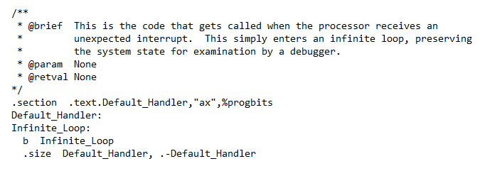
During the code execution, there might be exception or interrupt occurs, and the processor will start executing the exception or interrupt handler.
if the exception handler function is not redefined. it will jump into the Default_Handler function and by default, the handler is just an endless loop by the directive “b .”

Slide 27
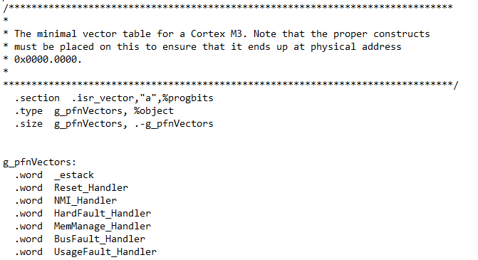

Slide 28
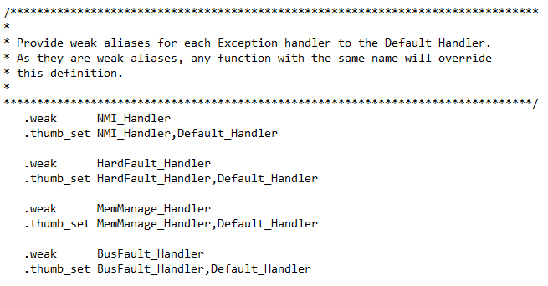
This “.weak” directive sets the weak attribute on the symbol “Default_Handler”, if the symbol does not already exist in the source code, it will be created. And by default, the handler is just an endless loop by the directive “b .”
The default handlers of all of the exception and interrupt handlers except Reset will be set as “Default_Handler” which is an endless loop.

Slide 29
5. Linker script
Set heap size, stack size and stack location accordingto application requirements.
Set memory bank area and size if external memory is used.
The first instruction to execute in a program is called the entry point . The argument is a symbol name:
ENTRY ( symbol )
The “MEMORY ’’ command describes the location and size of blocks of memory in the target, can use it to describe which memory regions may be used by the linker, and which memory regions it must avoid.
The ` SECTIONS ' command tells the linker how to map input sections into output sections, and how to place the output sections in memory. The format of the ` SECTIONS ' command is:
SECTIONS
{
sections - command
sections - command...
}

Slide 30
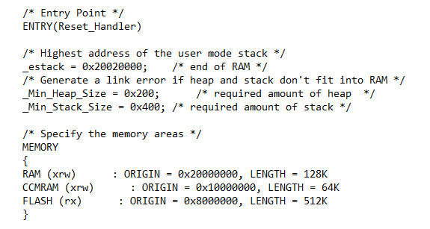

Slide 31
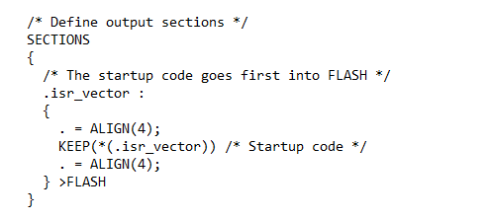
The special symbol ` . ' is the location counter. The special symbol ` . ', which is the location counter.
The expression ` *(.isr_vertor) ' means all ` .isr_vertor ' input sections in all input files.
The KEEP statement specify the area that does not need to be optimized.
The “ >FLASH “ mean this text_code will be written to flash

Slide 32
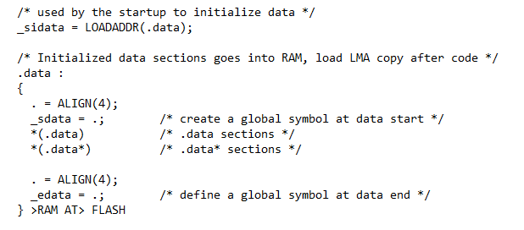
LOADADDR( section )
Return the absolute ` LMA ' of the named ` SECTION '. This is normally the same as ` ADDR ', but it may be different if the ` AT ' attribute is used in the output section definition.

Slide 33
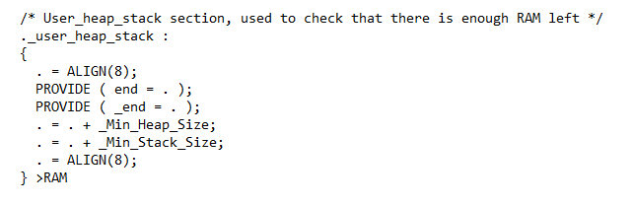
The ` PROVIDE ' keyword may be used to define a symbol, such as ` etext ', only if it is referenced but not defined. The syntax is ` PROVIDE( symbol = expression ) '.

Slide 34
6. Summary
The compiling process is:
Create directory where files are created
mkdir build
2. Compile file main, delay
arm-none-eabi-gcc -c -mcpu=cortex-m4 -mthumb -mfpu=fpv4-sp-d16 -mfloat-abi=hard -DSTM32F40xx -IUser -ILibraries -ILibraries/CMSIS/Device/ST/STM32F4xx/Include -ILibraries/CMSIS/Core/Include -Og -Wall -fdata-sections -ffunction-sections -g -gdwarf-2 -MMD -MP -MF"build/main.d" -Wa,-a,-ad,-alms=build/main.lst User/main.c -o build/main.o
arm-none-eabi-gcc -c -mcpu=cortex-m4 -mthumb -mfpu=fpv4-sp-d16 -mfloat-abi=hard -DSTM32F40xx -IUser -ILibraries -ILibraries/CMSIS/Device/ST/STM32F4xx/Include -ILibraries/CMSIS/Core/Include -Og -Wall -fdata-sections -ffunction-sections -g -gdwarf-2 -MMD -MP -MF"build/delay.d" -Wa,-a,-ad,-alms=build/delay.lst Libraries/delay.c -o build/delay.o

Slide 35
3. Compile file system_stm32f4xx, startup_stm32f407xx
arm-none-eabi-gcc -c -mcpu=cortex-m4 -mthumb -mfpu=fpv4-sp-d16 -mfloat-abi=hard -DSTM32F40xx -IUser -ILibraries -ILibraries/CMSIS/Device/ST/STM32F4xx/Include -ILibraries/CMSIS/Core/Include -Og -Wall -fdata-sections -ffunction-sections -g -gdwarf-2 -MMD -MP -MF"build/system_stm32f4xx.d" -Wa,-a,-ad,-alms=build/system_stm32f4xx.lst Libraries/CMSIS/Device/ST/STM32F4xx/Source/Templates/system_stm32f4xx.c -o build/system_stm32f4xx.o
arm-none-eabi-gcc -x assembler-with-cpp -c -mcpu=cortex-m4 -mthumb -mfpu=fpv4-sp-d16 -mfloat-abi=hard -DSTM32F40xx -IUser -ILibraries -ILibraries/CMSIS/Device/ST/STM32F4xx/Include -ILibraries/CMSIS/Core/Include -Og -Wall -fdata-sections -ffunction-sections -g -gdwarf-2 -MMD -MP -MF"build/startup_stm32f407xx.d" startup_stm32f407xx.s -o build/startup_stm32f407xx.o

Slide 36
4. Linker script to creat build/Blink_led.elf file
arm-none-eabi-gcc build/main.o build/delay.o build/system_stm32f4xx.o build/startup_stm32f407xx.o -mcpu=cortex-m4 -mthumb -mfpu=fpv4-sp-d16 -mfloat-abi=hard -specs=nano.specs -TSTM32F407VETx_FLASH.ld -lc -lm -lnosys -Wl,-Map=build/Blink_led.map,--cref -Wl,--gc-sections -o build/Blink_led.elf
5. See the size of Blink_led.elf file
arm-none-eabi-size build/Blink_led.elf
7. Create executable file
arm-none-eabi-objcopy -O ihex build/Blink_led.elf build/Blink_led.hex
arm-none-eabi-objcopy -O binary -S build/Blink_led.elf build/Blink_led.bin

Slide 37
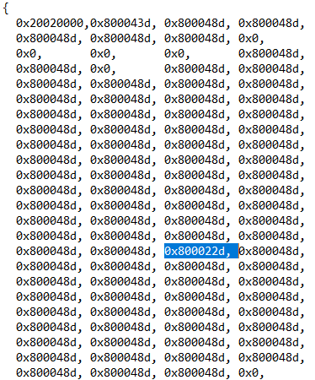
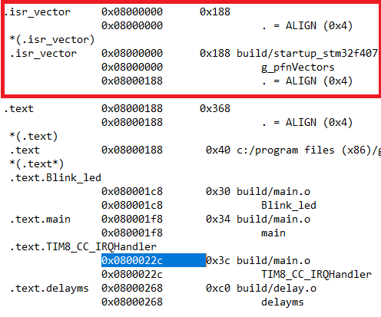
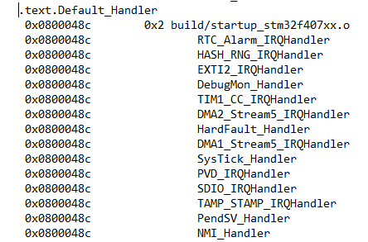
The process of writing code to flash
Compile file.c, file.s and file core into file.o
Set memory areas
Addresses of exception functions are logged if they are function-initialized.
If not initialized, it will return to address of Default_Handler function.

Slide 38
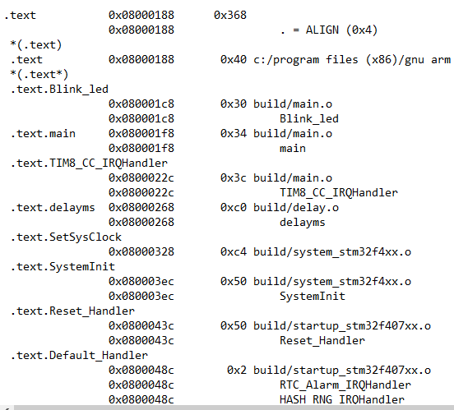
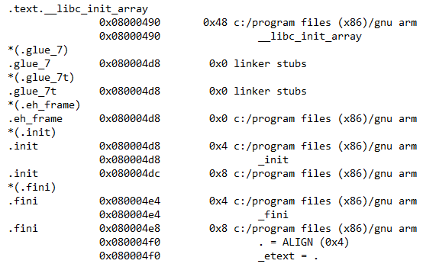
3. Write text code – code of functions in files will be written here

Slide 39
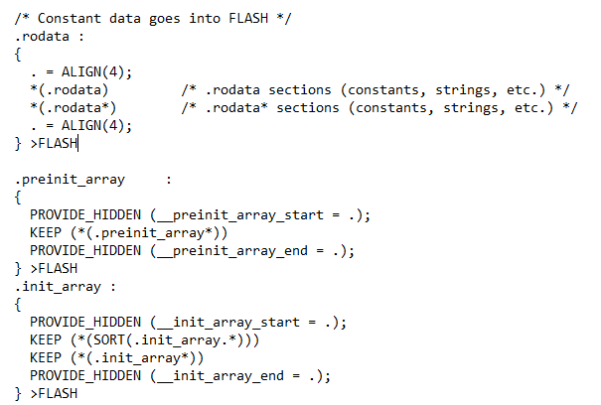
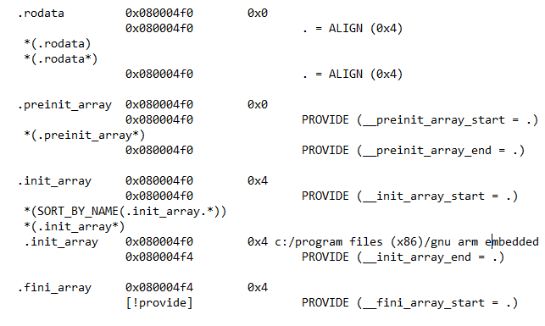
4. Write data into flash
.rodata /* Constant data goes into FLASH */
.preinit_array (not use) /* contain arrays of pointers to functions that will be called on initialization
.init_array (not use) */
.fini_array (not use) /* is an array of functions that will be called on destruction*/
.data /* Initialized data sections goes into RAM, load LMA copy after code */
.ccmram (not use) /* Create a global variable in ccmram area */
.bss /* Uninitialized data section */
._user_heap_stack (not use) /* User_heap_stack section, used to check that there is enough RAM left */

Slide 40
The process start program
Call Reset_Handler
2. Load data to flash to sram
Call SystemInit
Call __libc_init_array /*static constructors – created by gcc*/
Call main
END!

