Slide 1

Where Do Tiny Oriented Objects Lose Their Training Signal?
RESEARCH PROPOSAL · NCKH DPL302m
Candidate-Region Geometry for Real-Time YOLO-OBB Detectors on AI-TOD-R
Group 7
Võ Đức Nhật · Trần Lợi Kiều Nhi · Trần Nguyễn Minh Hải · Nguyễn Tấn Tài
Mentor: Hà Anh
a tiny rotated box between anchor points; the enlarged candidate region (dashed) captures four of them
Notes:
Suggested time: 30 s.
Good morning. We are Group 7. Our proposal asks where tiny oriented objects lose their training signal inside real-time YOLO-OBB detectors, and whether the geometry of the candidate region used during label assignment explains it. The benchmark is AI-TOD-R. Mentor: Hà Anh.
Source: Group7.pdf (research proposal, 11 pages).

Slide 2

Tiny objects are where detectors fail
10.6 px
17.5 AP
0.6 AP
mean object size in AI-TOD-R, with a spread of ±4.9 px; most objects are under 16×16 px [3]
best published result (DCFL) on this benchmark, but only 6.5 AP_{vt} on very tiny objects [3]
Oriented R-CNN on very tiny objects, against 11.2 AP overall [3]
“Tiny-scale objects receive significantly fewer positive samples than larger-scale objects.”
Why real-time detectors?
Drones and edge devices run on tight latency and power budgets; YOLO models export to TensorRT and ONNX [1].
— Xu et al., AI-TOD-R, IEEE TPAMI [3]
AI-TOD-R: 28,036 images · 752,460 oriented boxes · 8 classes · often more than 100 objects per image [3]
Notes:
Suggested time: 50 s.
AI-TOD-R is the oriented tiny-object benchmark: mean object size 10.6 px. Even the best published method, DCFL, reaches 17.5 AP and only 6.5 AP on very tiny objects; Oriented R-CNN gets 0.6 AP there. The dataset authors trace this to label assignment: tiny objects receive far fewer positive samples. We study real-time detectors because the target applications run on drones and edge devices.
Sources: [3] Xu et al., TPAMI 2025 (AI-TOD-R); [1] YOLO26, arXiv:2606.03748.

Slide 3
Too small for the grid, no training signal
1
Candidate selection
2
Ranking
3
Conflict resolution
Keep anchor points whose centres fall inside a candidate region around the ground-truth (GT) box.
Score candidates by classification confidence and box overlap; the best become positives.
An anchor that is positive for several GTs goes to the GT with the highest overlap.
STUDIED IN THIS PROJECT
STUDIED IN THIS PROJECT
Anchor points lie on grids with stride 8, 16 and 32 px.
A 4×12 px object can fall between grid points: no candidate, so no positive and no training signal.
STAL enlarges the candidate region in step 1 only; the true box is still used for regression [1].
stride-8 grid: the 4×12 px box (orange) holds no anchor centre
Notes:
Suggested time: 60 s.
YOLO's task-aligned assigner works in three steps. Step 1 keeps anchor points whose centres fall inside a candidate region; step 2 ranks them; step 3 resolves anchors claimed by several objects. Anchor points sit on stride 8, 16 and 32 grids, so a 4 by 12 pixel object can fall between points and get no candidate at all. We study step 1 and step 3.
Sources: proposal §5.2; [14] TOOD; [2] Ultralytics tal.py; [1] YOLO26.

Slide 4
STAL: one fix, four versions in 2026
STAL in YOLO26 [1]
≤ 8.4.7
No size floor
incl. YOLO26 release 8.4.0, Jan 2026
Small-Target-Aware Label Assignment: during candidate selection only, any box side shorter than 8 px is enlarged to 16 px.
8.4.8 – 8.4.38
Sides < 8 px → 16 px, applied to the real labels (bug, fixed in 8.4.39)
46.6 → 46.8 AP
8.4.39 – 8.4.127
Sides < 8 px → 16 px on a copy = published rule, “STAL-8”
AP_{S} 29.0 → 29.6 · COCO, YOLO11s, single runs
Ablated only on COCO with horizontal boxes. We found no published evaluation on oriented boxes or tiny-object data.
≥ 8.4.128
Sides < 16 px → 16 px, “STAL-16”
Aug 2026; current 8.4.174
Release tags checked 08/10/2026 [2]. YOLOv8- and YOLO11-OBB trained with today’s package use the same shared assigner, so results from different versions are not comparable.
Notes:
Suggested time: 60 s.
YOLO26 introduced STAL: during candidate selection, box sides shorter than 8 px are enlarged to 16 px. On COCO with YOLO11s it moved AP from 46.6 to 46.8 in single runs. But in the public code the rule for oriented boxes changed three times in 2026; today it enlarges every side below 16 px, not 8. Because the assigner is shared, YOLOv8- and YOLO11-OBB trained today also use it.
Sources: [1] YOLO26 §3.3.3; [2] Ultralytics tal.py, release tags v8.4.7/8/38/39/127/128/174 checked 08/10/2026.

Slide 5
Related work leaves this regime open
Work | What it does | Reported result | Gap for this project
AI-TOD-R + DCFL [3] | Rotated Gaussian candidates, coarse-to-fine assignment | 17.5 AP; 6.5 AP_{vt} | Not real-time; no YOLO, no speed
NWD-RKA [5] | Wasserstein similarity + ranking (horizontal boxes) | Faster R-CNN 12.8 → 21.4; RetinaNet +1.6 | Large two-stage, small one-stage gains
RFLA [6] | Gaussian receptive-field prior (horizontal boxes) | Faster R-CNN 11.1 → 21.1; RetinaNet 8.7 → 9.1 | Same pattern; no rotation
GCD [7] | Scale-invariant Gaussian distance (horizontal boxes) | Faster R-CNN 20.1 AP | Verified mainly for horizontal detection
EARL · SARFA-Net · RDCNet [8–10] | Shape-aware candidates (ellipse / rotated frame) | — | No tiny-object dataset
YOLO26 STAL [1] | Enlarges tiny boxes at candidate selection | COCO AP 46.6 → 46.8 (single runs) | Not tested on OBB or tiny data
DIA-YOLO [4] | YOLOv11-OBB with depth input | Compared with AI-TOD-R AP50 | 18,730 images, 4-channel input, no size bins
Numbers as reported by the authors; settings differ between papers, so rows are not ranked against each other.
Notes:
Suggested time: 70 s.
Gaussian assignment methods (NWD-RKA, RFLA, GCD) help two-stage detectors a lot but one-stage detectors only by up to 1.6 AP, and all use horizontal boxes. Shape-aware assigners exist (EARL, SARFA-Net, RDCNet) but were never evaluated on a tiny-object dataset. STAL was only tested on COCO. The only YOLO-OBB numbers next to AI-TOD-R (DIA-YOLO) use a different image set, depth input and no size bins.
Sources: proposal Table 1; [3]–[10].

Slide 6
Six gaps this project targets
1
2
3
STAL is untested where it matters
“STAL” is not one rule
No real-time detector in the benchmark
Ablated only on COCO with horizontal boxes [1].
The oriented-box rule changed three times in 2026 [2].
27 configurations of slow detectors, no speed reported [3].
4
5
6
Shape-aware assignment untested here
The diagnosis is thin
Evaluation settings differ silently
EARL, SARFA-Net, RDCNet: DOTA-like data only [8–10].
Nobody measures neighbours competing for anchors, despite > 100 objects per image [3].
Official evaluator keeps 1,500 detections per image; Ultralytics keeps 300 [2, 15].
Notes:
Suggested time: 60 s.
Six limitations motivate the study: STAL was never tested on oriented or tiny objects; STAL itself has several versions; the AI-TOD-R benchmark has no real-time detector; shape-aware assignment was never tried on tiny oriented objects inside YOLO; no one measures how often neighbouring tiny objects compete for anchor points; and detection caps (1,500 vs 300) differ silently.
Source: proposal §1.2.

Slide 7




Hypothesis and research questions
CENTRAL HYPOTHESIS
For AI-TOD-R-sized objects, the threshold (8 vs 16 px) sets how many candidates an object gets; the shape only sets where they fall and how often neighbours compete. A shape-preserving rule can therefore help only elongated objects in specific layouts, and this is predictable from the labels before training.
O1
O2
O3
O4
RQ1 · Benchmark
RQ2 · Diagnosis
RQ3 · Intervention
RQ4 · Transfer
How do YOLO11-OBB and YOLO26-OBB perform on AI-TOD-R with the official evaluator, by object size and class?
How do the candidate rules change candidate counts, placement and conflicts between neighbours?
Does OA-STAL v2 with a conflict rule improve tiny-object AP at zero inference cost?
Do the findings transfer to a second dataset, in proportion to the objects affected?
O5 · Release code, configurations, prediction files and a written protocol so every table can be reproduced.
Notes:
Suggested time: 70 s.
Our central hypothesis: the threshold of a candidate rule controls how many candidates a tiny object gets; the shape only controls where they fall and how often neighbours compete. So a shape-preserving rule can only help elongated objects in specific layouts, and this can be predicted from the labels before any training. Four research questions follow, each with one objective; objective O5 is reproducibility.
Source: proposal §1.3 and §2.

Slide 8
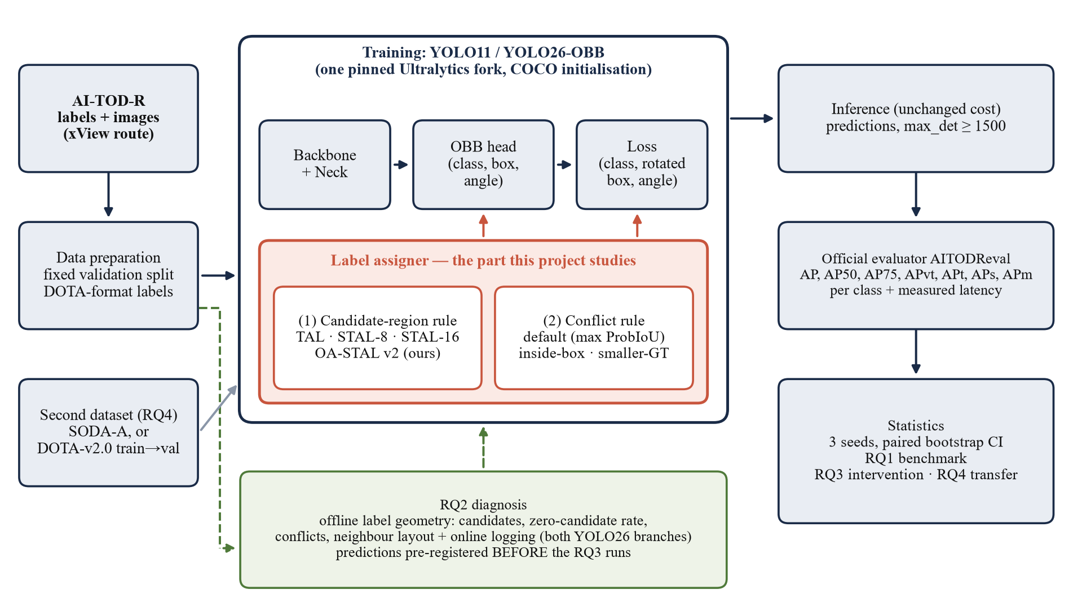
Only the label assigner changes
Red block
the label assigner: candidate-region rule and conflict rule. The only part that differs between experiments.
Green block
RQ2 diagnosis runs first on the labels alone and fixes the predictions that training must confirm or reject.
Right column
every prediction is scored by the official AITODReval; inference cost is identical.
Figure 1 of the proposal. One pinned Ultralytics fork, COCO initialisation.
Notes:
Suggested time: 50 s.
Every experiment trains the same YOLO-OBB model in one frozen copy of the Ultralytics code and changes only the label assigner, the red block. The diagnosis in green runs first, on labels only, and fixes the predictions before training. All predictions are scored by the official AITODReval evaluator.
Source: proposal §5.1, Figure 1.

Slide 9
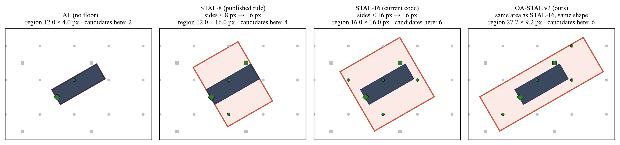
Four candidate rules, one 4×12 px object
Computed for one placement on the anchor grid (proposal Figure 2).
Side by side
End to end
Which layout dominates AI-TOD-R is counted from the labels before training, so the expected sign of the effect is fixed in advance.
0.63 → 0.34
0.12 → 0.49
two parallel 4×12 px objects: share of candidates claimed by both, STAL-16 → similar enlargement
the same two objects placed end to end: the shape-preserving region now overlaps more
Notes:
Suggested time: 60 s.
The four rules on the same rotated 4 by 12 pixel object: plain TAL uses the box itself; STAL-8 enlarges only the 4 px side; STAL-16 makes a 16 by 16 square; OA-STAL v2 keeps centre, angle and shape and grows to the same area as STAL-16. Shape matters for neighbours: side by side, shared candidates fall from 0.63 to 0.34; end to end they rise from 0.12 to 0.49. We count which layout dominates before training.
Source: proposal §5.3, Figure 2; simulation in notes/t07-c3-evidence-dossier.md.

Slide 10
Area sets the count, shape the placement
PROPOSITION 1 · EXPECTED NUMBER OF CANDIDATES
E[N] = area(R) × (1/8² + 1/16² + 1/32²) = (21/1024) × area(R) ≈ 0.0205 × area(R)
Region R placed at a random position on the three anchor grids. Check: simulation of the code’s rotated test gives 5.2–5.3 for a 16×16 region (predicted 5.25) and 2.05 for a 10×10 box (predicted 2.05).
≥ 67%
= count
×2.5
Tiny boxes can be missed
Same area, same expected count
Threshold beats shape
A 4×4 px box gets no candidate under plain TAL with probability ≥ 1 − 0.0205 × 16 (simulation: 67.1%). This is what STAL fixes.
OA-STAL v2 has the area of STAL-16, so it cannot add candidates on average; it can only move them and change conflicts.
For a 10×10 px object: 2.05 expected candidates under STAL-8, 5.25 under STAL-16. 73.4% of AI-TOD-v2 objects are 8–16 px [5].
Notes:
Suggested time: 70 s.
On a grid with spacing s, a randomly placed region of area A contains on average A over s squared grid points; the assigner pools three grids, so the expected count is 0.0205 times the area. Three consequences: a 4 by 4 box has at least a 67% chance of no candidate under plain TAL; rules with equal area give the same expected count, so OA-STAL v2 can only change where candidates fall and how neighbours compete (note: the expected count is equal, the zero-candidate probability can still differ by shape); and the 8-versus-16 threshold is a first-order factor that must be controlled.
Source: proposal §5.3 Proposition 1 [derived]; [5] for the 73.4% statistic.

Slide 11

OA-STAL v2 and the conflict rules
Properties (checked by substitution, unit-tested before training)
OA-STAL v2 · GT = (x, y, w, h, θ), w ≥ h
apply only if √(w·h) < 16 px
k = 16 / √(w·h)
h′ = max(k·h, 8, h)
w′ = max(min(k·w, max(w, 32)), w)
region = (x, y, w′, h′, θ)
Always contains the true box, so never fewer candidates than plain TAL
Square boxes give exactly the STAL-16 region
Shape kept exactly for aspect ratios up to 4; short side never below 8 px
Scoring, targets and regression still use the true box, exactly as in STAL [1].
Training-only: model size, speed and deployment unchanged
Conflict rules tested (step 3)
Default
Inside-box
Smaller-GT
anchor goes to the GT with the highest overlap
an anchor inside exactly one true box goes to that box
the smaller object wins, as in RFLA [6]
Notes:
Suggested time: 70 s.
OA-STAL v2 enlarges a tiny box with the same shape until it has the STAL-16 area, keeps the short side at least 8 px to protect very thin objects, caps the long side at 32 px unless the object is already longer, and never shrinks anything. So it always contains the true box, equals STAL-16 for squares, and keeps the shape for aspect ratios up to 4. For step 3 we test two conflict rules against the default: inside-box and smaller-GT.
Source: proposal §5.4 [design, to be unit-tested before any training].

Slide 12
Eight arms, one pre-declared comparison
Arm | Candidate rule | Conflict rule | Purpose
A0 | TAL (no floor) | default | Lower bound; zero-candidate failure
A1 | STAL-8 (published rule) | default | Published version
A2 | STAL-16 (current code) | default | Main comparator
A3 | TAL + nearest-anchor fallback | default | Cheap control (EARL, RDCNet) [8, 10]
A4 | OA-STAL v2 | default | Main proposal
A5 | Similar enlargement, side trigger | default | Separates threshold from shape (vs A2)
A6 | OA-STAL v2 | inside-box | Effect of the conflict rule
A7 | STAL-16 | inside-box | Conflict rule without shape change
Protocol
Main comparison fixed in advance: A4 vs A2 on AP_{t} and AP_{vt}
Scored only by AITODReval: IoU 0.50:0.05:0.95, 1,500 detections per image
Tuning on a fixed 10% validation split; test set used once per final model
COCO initialisation, because AI-TOD partly reuses DOTA images
YOLO26n, 3 seeds per arm; paired image-level bootstrap 95% CI (10,000 resamples)
Dated pre-registration before any RQ3 run
All arms share one frozen code copy, data split, schedule and seeds; only the assigner differs.
Notes:
Suggested time: 70 s.
Eight arms in one pinned code base. The pre-declared main comparison is A4, OA-STAL v2, against A2, the current STAL-16, on tiny and very tiny AP. A5 separates the threshold from the shape; A6 and A7 isolate the conflict rule. A change counts as an improvement only if the bootstrap interval excludes zero and the gain appears where the label statistics predicted: elongated classes such as ship and bridge, and the dominant neighbour layout.
Source: proposal §5.5, Table 4.

Slide 13




Feasible on free Kaggle GPUs
Data
AI-TOD-R labels are public; images are rebuilt with the AI-TOD script after xView registration (week 1) [15, 16].
Tools
All open source: Ultralytics YOLO11/26-OBB, official AITODReval, MMRotate. Python and PyTorch, as in DPL302m.
Compute
Kaggle: P100 or 2×T4, about 30 GPU-hours per week, 12-hour sessions [18]. Modal up to US$100 as overflow.
Baseline
[estimate] about 14,000 training images × 100 epochs, by measured throughput (images per second). Replaced by the real value in week 2.
Reproduce the published RetinaNet-O row (7.3 AP) within ±1.0 AP to validate our evaluation pipeline [3].
Plan: ~9 runs (RQ1) + 24 (RQ3) + 9 (RQ4) + pilots
Notes:
Suggested time: 60 s.
Data: AI-TOD-R labels are public; images need xView registration, our first task. Tools are all open source. Compute: Kaggle gives a free P100 or two T4s, about 30 GPU-hours a week; Modal up to 100 US dollars is the overflow. The chart is an estimate only: 14,000 images and 100 epochs give 3.9 to 15.6 GPU-hours per run depending on throughput, which we measure in week 2. We reproduce one published baseline row to validate the evaluator.
Source: proposal §4 and §6 (Computational Resource Requirements); [18] Kaggle docs.

Slide 14
Risks and fixed fallbacks
Risk | Likelihood | Planned response
xView access or image rebuilding is delayed | unknown | DOTA-v2.0 train→val as a pre-declared fallback; narrow the claims
OA-STAL v2 gives no gain over STAL-16 | medium–high | Report benchmark and diagnosis; a null result is reported, not hidden
Differences are within seed noise | medium | Three seeds, bootstrap CIs, minimal effect fixed from measured seed variance
Our evaluation pipeline differs from the official one | medium | Reproduce a published baseline row before any comparison
The Ultralytics rule changes again | certain | One frozen code copy; all rules as explicit parameters; commit recorded
Closer prior work appears | unknown | Literature re-check in week 13; no “first” claims
GPU quota is not enough | medium | Fixed cutting order: RQ4 to two arms, then A5, then A6/A7; Modal overflow
Status: no experiment has been run yet. The plan becomes fully runnable after the week-2 checkpoint (data rebuilt, evaluator validated, speed measured).
Notes:
Suggested time: 50 s.
The main scientific risk is that OA-STAL v2 does not beat STAL-16; Proposition 1 already tells us shape only changes placement, and one-stage assignment gains in the literature are at most 1.6 AP. In that case the benchmark and the diagnosis remain the results. Every other risk has a fallback decided in advance. Honest status: no experiment has been run yet.
Source: proposal §4, Table 3.

Slide 15
14-week plan, go/no-go at week 2
Task
Who
1
2
3
4
5
6
7
8
9
10
11
12
13
14
1. Register xView, rebuild AI-TOD-R, pin the fork, unit tests
M1, M2
2. Kaggle pilots, converter + AITODReval, RetinaNet-O baseline
M2, M3
3. Offline label analysis (RQ2); dated pre-registration
M1, M4
4. RQ1 benchmark: YOLO11s / 26n / 26s-OBB
M2, M3
5. RQ3 arms A0–A7 × 3 seeds, online diagnostics
All
6. RQ4 on the second dataset
M3, M4
7. Analysis: diagnosis vs accuracy, error analysis
M1, M4
8. Literature re-check; draft manuscript
All
9. Review with mentor; release code and predictions
All
12/10/2026 → 17/01/2027 · M1–M4 = team members, to be assigned
Go/no-go after week 2: if measured speed implies more than 10 weeks of quota, cut RQ4 to two arms, then A5, then A6/A7.
Notes:
Suggested time: 50 s.
Fourteen weeks, from 12 October 2026 to 17 January 2027. Weeks 1 and 2 are the gate: data rebuilt, evaluator validated, speed measured. Week 3 is the label analysis and the dated pre-registration. Then the RQ1 benchmark, the RQ3 ablation with three seeds, RQ4 transfer, analysis, writing and the release. M1 to M4 are team members; the assignment is still to be fixed.
Source: proposal §6, Table 5.

Slide 16



Expected results and deliverables
Theoretical
Methodological
Practical
A simple geometric account (Proposition 1) of what candidate-region rules can and cannot change for tiny objects, tested against real label statistics.
An evaluation of all STAL versions on oriented tiny objects; a fair, size-binned YOLO-OBB benchmark on AI-TOD-R with released predictions; null results reported as results.
Training-only change, so any gain carries over to existing YOLO deployment (TensorRT/ONNX on edge devices) at no extra cost [1].
O1
Benchmark table + predictions
O2
Label-geometry report, recall analysis
O3
Ablation A0–A7 with 95% CIs
O4
Transfer table
O5
Public repository
Publication target: a Scopus-indexed conference or Q4 journal, conditional on a clean evaluator-matched benchmark, a clear diagnosis finding and confidence intervals on the main comparison. An assignment-level contribution, so no top-tier venue is targeted.
Notes:
Suggested time: 50 s.
We expect three kinds of result: a geometric account of what candidate rules can change, an evaluation of all STAL versions plus a fair size-binned YOLO-OBB benchmark on AI-TOD-R, and a training-only rule tested against pre-registered predictions. Each objective has a deliverable decided in advance. The publication target is deliberately modest and conditional.
Source: proposal §7, Table 6; venue claim C-10 in notes/claims-ledger.md.

Slide 17
Key references
[1] G. Jocher et al., “Ultralytics YOLO26: Unified Real-Time End-to-End Vision Models,” arXiv:2606.03748, 2026.
[2] Ultralytics, ultralytics package, release 8.4.174 (06/10/2026), ultralytics/utils/tal.py.
[3] C. Xu et al., “Oriented Tiny Object Detection: A Dataset, Benchmark, and Dynamic Unbiased Learning,” IEEE TPAMI, 2025. doi:10.1109/tpami.2025.3634161
[4] Kim and Park, “DIA-YOLO,” IEEE Access, vol. 13, 2025. doi:10.1109/ACCESS.2025.3603214
[5] C. Xu et al., “Detecting tiny objects in aerial images: A normalized Wasserstein distance and a new benchmark,” ISPRS J., vol. 190, 2022.
[6] C. Xu et al., “RFLA: Gaussian Receptive Field Based Label Assignment for Tiny Object Detection,” ECCV, 2022.
[7] Guan et al., “Gaussian Combined Distance,” IEEE GRSL, 2025.
[8] “EARL: Elliptical Distribution aided Adaptive Rotation Label Assignment,” IEEE TGRS, vol. 61, 2023.
[9] “SARFA-Net: Shape-Aware Label Assignment and Refined Feature Alignment,” IEEE JSTARS, vol. 18, 2025.
[10] “RDCNet: Rotation-Aware Feature Representation and Aspect-Adaptive Label Assignment,” IEEE JSTARS, vol. 19, 2026.
[14] C. Feng et al., “TOOD: Task-aligned One-stage Object Detection,” ICCV, 2021.
[15] AI-TOD-R project and AITODReval evaluator, github.com/Chasel-Tsui/AI-TOD-R (accessed 08/10/2026).
[16] J. Wang et al., “Tiny Object Detection in Aerial Images,” ICPR, 2020.
[18] Kaggle documentation, Notebooks (accessed 08/10/2026).
Full list with links: Group7.pdf, References [1]–[19].
Notes:
Reference slide; show only if asked. Numbering follows the proposal (Group7.pdf).

Slide 18
Questions and discussion
Points where we would value the mentor’s and the class’s feedback:
1
Is STAL-16, the current code, the right primary comparator?
2
SODA-A or DOTA-v2.0 as the second dataset?
3
Which minimal effect size should count as an improvement?
Group 7 · github.com/VoDucNhatku/nckh-group7-tiny-obb
Notes:
Suggested time: remaining minutes.
Thank you. Three open design questions where feedback would change our plan: the primary comparator, the second dataset, and the minimal effect size. Materials and progress tracking are in the group repository.

