Slide 1


Tiny Oriented
Object Detection
Candidate-region geometry
in YOLO-OBB detectors
Group 7
DPL302m · Research proposal
Notes:
Suggested delivery: 25 seconds.
Our project studies tiny objects in aerial images, especially objects that are rotated. We focus on how YOLO selects positions that learn an object during training. Today we introduce the problem, our proposed method and the experiments we plan to run. This is a proposal presentation, not a report of completed training results.
Sources and asset credits:
Project proposal: NCKH/notes/t07-c3-proposal-v2-EN.pdf, 2026-10-08, C-10 revision of C-3. Proposed study. No model-training results have been produced.
Team names supplied by the user in this conversation: Võ Đức Nhật, Trần Lợi Kiều Nhi, Trần Nguyễn Minh Hải, Nguyễn Tấn Tài. Group 7. Original FPT logo supplied by the user, embedded unchanged.
Conceptual illustration generated for this presentation. It is not a dataset sample, model prediction, or experimental result.

Slide 2
Group 7
Research team
Võ Đức Nhật
Trần Lợi Kiều Nhi
Trần Nguyễn Minh Hải
Nguyễn Tấn Tài
FPT University · DPL302m · Deep Learning
02
Notes:
Suggested delivery: 20 seconds.
We are Group 7. Introduce the four members briefly. Our project belongs to the aerial-object-detection topic and studies a specific training bottleneck in YOLO-OBB.
Sources and asset credits:
Team names supplied by the user in this conversation: Võ Đức Nhật, Trần Lợi Kiều Nhi, Trần Nguyễn Minh Hải, Nguyễn Tấn Tài. Group 7. Original FPT logo supplied by the user, embedded unchanged.
Project proposal: NCKH/notes/t07-c3-proposal-v2-EN.pdf, 2026-10-08, C-10 revision of C-3. Proposed study. No model-training results have been produced.

Slide 3

Why aerial object detection matters
Locate vehicles and ships
across large scenes.
Support traffic monitoring
and maritime analysis.
Tiny targets make the task
difficult even in clear images.
Conceptual aerial scene
03
Notes:
Suggested delivery: 35 seconds.
Aerial images provide a wide view of roads and ports. They are useful for monitoring vehicles and ships, but the wide view also makes individual objects appear very small. This motivates our study. These are possible application contexts, not systems we have deployed.
Sources and asset credits:
Xu et al., Oriented Tiny Object Detection: A Dataset, Benchmark, and Dynamic Unbiased Learning. Read as arXiv:2412.11582v1, physical pp. 3–4, Table I and Section III. Publication DOI: 10.1109/TPAMI.2025.3634161. Local source: NCKH/papers/Xu2024-AI-TOD-R-oriented-tiny.pdf.
Conceptual illustration generated for this presentation. It is not a dataset sample, model prediction, or experimental result.

Slide 4
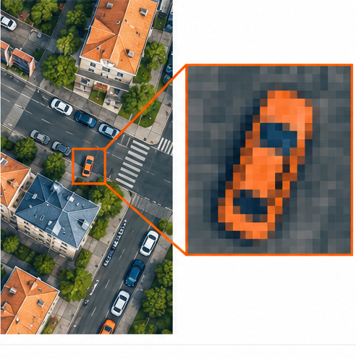
A tiny object contains little visual detail
Only a few pixels may
represent an object.
Its appearance can blend
into the background.
Small localization errors
can strongly affect overlap.
Conceptual zoom, not an AI-TOD-R sample
04
Notes:
Suggested delivery: 40 seconds.
Imagine enlarging a tiny car in an aerial image. We see only a small collection of pixels. A one-pixel shift is much more significant for this object than for a large object. Feature extraction and localization are difficult, and the object may also receive too few training samples.
Sources and asset credits:
Xu et al., Oriented Tiny Object Detection: A Dataset, Benchmark, and Dynamic Unbiased Learning. Read as arXiv:2412.11582v1, physical pp. 3–4, Table I and Section III. Publication DOI: 10.1109/TPAMI.2025.3634161. Local source: NCKH/papers/Xu2024-AI-TOD-R-oriented-tiny.pdf.
Jocher et al., Ultralytics YOLO26: Unified Real-Time End-to-End Vision Models, arXiv:2606.03748v1, pp. 7–8, equations 4–6 and Section 3.2. Local source: NCKH/papers/Jocher2026-YOLO26.pdf. Read as a preprint.
Conceptual illustration generated for this presentation. It is not a dataset sample, model prediction, or experimental result.

Slide 5
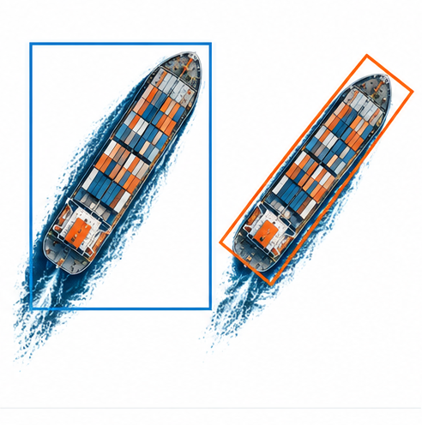
Objects also have an orientation
An OBB follows
the object’s angle.
Useful for long
objects, such as ships.
Horizontal box
Oriented box
05
Notes:
Suggested delivery: 35 seconds.
A horizontal box stays aligned with the image. A rotated box follows the object. For a long ship, this representation can fit its footprint more tightly. OBB means oriented bounding box. Our study combines the difficulty of small size with the difficulty of arbitrary orientation.
Sources and asset credits:
Xu et al., Oriented Tiny Object Detection: A Dataset, Benchmark, and Dynamic Unbiased Learning. Read as arXiv:2412.11582v1, physical pp. 3–4, Table I and Section III. Publication DOI: 10.1109/TPAMI.2025.3634161. Local source: NCKH/papers/Xu2024-AI-TOD-R-oriented-tiny.pdf.
Conceptual illustration generated for this presentation. It is not a dataset sample, model prediction, or experimental result.

Slide 6
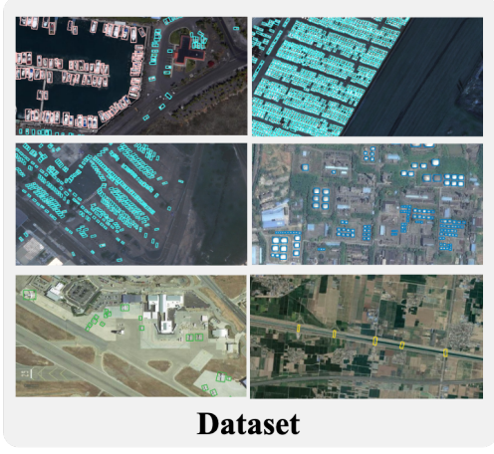
AI-TOD-R: our target benchmark
28,036
images
752,460
oriented object annotations
8 classes
Mean object size: 10.6 ± 4.9 px
Published dataset statistics and image examples from Xu et al.
06
Notes:
Suggested delivery: 40 seconds.
AI-TOD-R is designed for tiny oriented objects. It contains 28,036 images and 752,460 annotations across eight classes. The published mean object size is only 10.6 pixels, with a standard deviation of 4.9 pixels. These are statistics from the dataset paper, not outcomes of our project. The source image on the right is the Dataset panel of Figure 1, extracted without redrawing.
Sources and asset credits:
Xu et al., Oriented Tiny Object Detection: A Dataset, Benchmark, and Dynamic Unbiased Learning. Read as arXiv:2412.11582v1, physical pp. 3–4, Table I and Section III. Publication DOI: 10.1109/TPAMI.2025.3634161. Local source: NCKH/papers/Xu2024-AI-TOD-R-oriented-tiny.pdf.

Slide 7



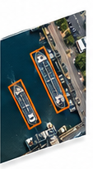
YOLO-OBB and the training pipeline
Input image
Feature maps
Label assignment
Box predictions
Our focus: which feature-map positions learn each object
07
Notes:
Suggested delivery: 40 seconds.
YOLO extracts feature maps and predicts boxes and object classes. During training, label assignment determines which prediction locations learn which labeled object. We focus on that training step. The drawing simplifies the pipeline. Assignment is a training operation, not a module that processes ground-truth labels at inference time. The proposed modification leaves the inference architecture unchanged.
Sources and asset credits:
Project proposal: NCKH/notes/t07-c3-proposal-v2-EN.pdf, 2026-10-08, C-10 revision of C-3. Proposed study. No model-training results have been produced.
Jocher et al., Ultralytics YOLO26: Unified Real-Time End-to-End Vision Models, arXiv:2606.03748v1, pp. 7–8, equations 4–6 and Section 3.2. Local source: NCKH/papers/Jocher2026-YOLO26.pdf. Read as a preprint.
Conceptual illustration generated for this presentation. It is not a dataset sample, model prediction, or experimental result.

Slide 8
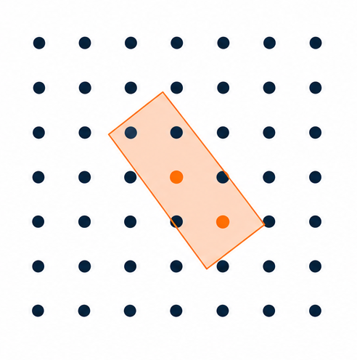
Candidate points and training samples
Anchor points are locations
on the feature maps.
A candidate region filters
which points are eligible.
Scoring and conflict handling
select the final positives.
Conceptual candidate selection
08
Notes:
Suggested delivery: 45 seconds.
The model predicts at feature-map locations called anchor points. A point inside a candidate region is eligible to learn the object. Eligibility does not automatically make it a positive training sample. Later scoring and conflict handling choose the final assignments. Ground truth, or GT, means the object annotation.
Sources and asset credits:
Jocher et al., Ultralytics YOLO26: Unified Real-Time End-to-End Vision Models, arXiv:2606.03748v1, pp. 7–8, equations 4–6 and Section 3.2. Local source: NCKH/papers/Jocher2026-YOLO26.pdf. Read as a preprint.
Local frozen code evidence: NCKH/papers/_text/ultralytics_tal_main_2026-10-01.py, lines 365–425. Version history recorded in NCKH/notes/t07-c3-novelty-rescan.md, Section B.2. Rules in this deck are explicit experimental definitions, not a claim about future package versions.
Conceptual illustration generated for this presentation. It is not a dataset sample, model prediction, or experimental result.

Slide 9
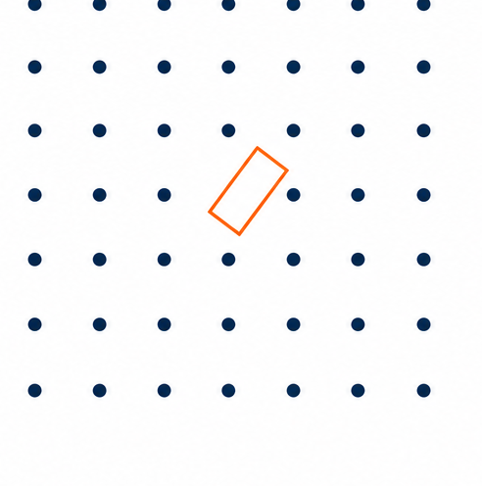
A tiny box can miss every anchor point
A small box may fall
between neighboring points.
No eligible point means
no positive through this filter.
The outcome depends on
size, shape and position.
Toy geometry showing an empty candidate region
09
Notes:
Suggested delivery: 40 seconds.
Here the orange box falls between anchor centers. No point lies inside it, so the initial candidate filter returns an empty set for this object. This is one possible failure mode. It does not happen to every tiny object. Whether it occurs also depends on the shape, orientation and position relative to the lattice.
Sources and asset credits:
Jocher et al., Ultralytics YOLO26: Unified Real-Time End-to-End Vision Models, arXiv:2606.03748v1, pp. 7–8, equations 4–6 and Section 3.2. Local source: NCKH/papers/Jocher2026-YOLO26.pdf. Read as a preprint.
Scope correction from proposal review, 2026-10-08: equal area implies equal expected candidate count only under a uniform lattice offset. It does not imply equal zero-candidate probability. Size sqrt(w*h) does not imply both sides fall in the same size interval. Omit the proposal's broad never-evaluated statement about STAL.
Conceptual illustration generated for this presentation. It is not a dataset sample, model prediction, or experimental result.

Slide 10
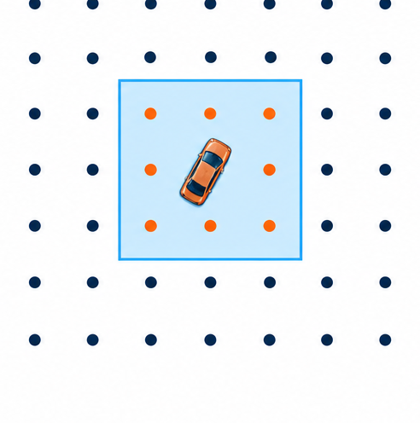
STAL enlarges the candidate region
A larger search region
can include more points.
The original object box
remains the training target.
Only the candidate-selection
step uses the enlarged region.
Conceptual STAL candidate region
10
Notes:
Suggested delivery: 40 seconds.
STAL stands for Small-Target-Aware Label Assignment. It expands the region used to find candidates for a tiny object. The original annotation remains the regression target and is used in scoring. We are enlarging the area in which the model looks for training points, not pretending that the actual object is larger. This diagram is conceptual and does not reproduce the exact per-side threshold rule.
Sources and asset credits:
Jocher et al., Ultralytics YOLO26: Unified Real-Time End-to-End Vision Models, arXiv:2606.03748v1, pp. 7–8, equations 4–6 and Section 3.2. Local source: NCKH/papers/Jocher2026-YOLO26.pdf. Read as a preprint.
Local frozen code evidence: NCKH/papers/_text/ultralytics_tal_main_2026-10-01.py, lines 365–425. Version history recorded in NCKH/notes/t07-c3-novelty-rescan.md, Section B.2. Rules in this deck are explicit experimental definitions, not a claim about future package versions.
Conceptual illustration generated for this presentation. It is not a dataset sample, model prediction, or experimental result.

Slide 11
Candidate rules to compare
Rule | Trigger for each side d | Replacement
No floor | None | Keep d
STAL-8 | d < 8 px | Set that side to 16 px
STAL-16 | d < 16 px | Set that side to 16 px
Example: a 25 × 4 px box changes under both STAL rules
The threshold applies to each side, not to √(width × height).
11
Notes:
Suggested delivery: 45 seconds.
We will compare three explicit rules in a frozen code version. The published STAL rule changes a side below eight pixels to sixteen. The later rule documented in our code review uses sixteen as the trigger as well. The threshold applies separately to width and height. A 25 by 4 pixel box changes under both rules because its short side is four pixels, even though its effective size is ten pixels. We do not assume that every object in the eight-to-sixteen size bin is unaffected by STAL-8.
Sources and asset credits:
Jocher et al., Ultralytics YOLO26: Unified Real-Time End-to-End Vision Models, arXiv:2606.03748v1, pp. 7–8, equations 4–6 and Section 3.2. Local source: NCKH/papers/Jocher2026-YOLO26.pdf. Read as a preprint.
Local frozen code evidence: NCKH/papers/_text/ultralytics_tal_main_2026-10-01.py, lines 365–425. Version history recorded in NCKH/notes/t07-c3-novelty-rescan.md, Section B.2. Rules in this deck are explicit experimental definitions, not a claim about future package versions.
Scope correction from proposal review, 2026-10-08: equal area implies equal expected candidate count only under a uniform lattice offset. It does not imply equal zero-candidate probability. Size sqrt(w*h) does not imply both sides fall in the same size interval. Omit the proposal's broad never-evaluated statement about STAL.

Slide 12
The research gap we will test
What does each candidate rule do
to tiny oriented objects?
Existing methods already use shape-aware assignment.
Our focus is a controlled comparison inside YOLO-OBB
on AI-TOD-R, with one evaluator and explicit rules.
We study a specific setting. We do not claim a new mechanism class.
12
Notes:
Suggested delivery: 40 seconds.
Shape-aware label assignment already exists in methods such as EARL, SARFA-Net, RDCNet and DCFL. Our proposed contribution is narrower. We want a controlled account of how the STAL rules behave in YOLO-OBB on AI-TOD-R, followed by an intervention and an explanation of any change. The literature search does not justify saying that no one has ever evaluated STAL on any tiny-object dataset.
Sources and asset credits:
Project proposal: NCKH/notes/t07-c3-proposal-v2-EN.pdf, 2026-10-08, C-10 revision of C-3. Proposed study. No model-training results have been produced.
Related work: NCKH/notes/t07-c3-proposal-v2-EN.pdf, Section 3 and Table 1. EARL, SARFA-Net, RDCNet and DCFL already use shape/orientation-aware assignment. This deck makes no claim to be the first such method.
Scope correction from proposal review, 2026-10-08: equal area implies equal expected candidate count only under a uniform lattice offset. It does not imply equal zero-candidate probability. Size sqrt(w*h) does not imply both sides fall in the same size interval. Omit the proposal's broad never-evaluated statement about STAL.

Slide 13
Our research questions
01
Benchmark
How do YOLO-OBB models perform by object size?
02
Diagnosis
Where do candidates and final positives disappear?
03
Intervention
Can a different region or conflict rule improve detection?
04
Generalization
Do the findings hold on a second dataset?
13
Notes:
Suggested delivery: 45 seconds.
We organize the project around four questions. First, establish a benchmark. Second, diagnose the assignment process. Third, test a controlled change. Fourth, examine whether the finding transfers. Each question provides evidence for the next one. An accuracy increase alone is insufficient to prove our proposed explanation.
Sources and asset credits:
Project proposal: NCKH/notes/t07-c3-proposal-v2-EN.pdf, 2026-10-08, C-10 revision of C-3. Proposed study. No model-training results have been produced.

Slide 14
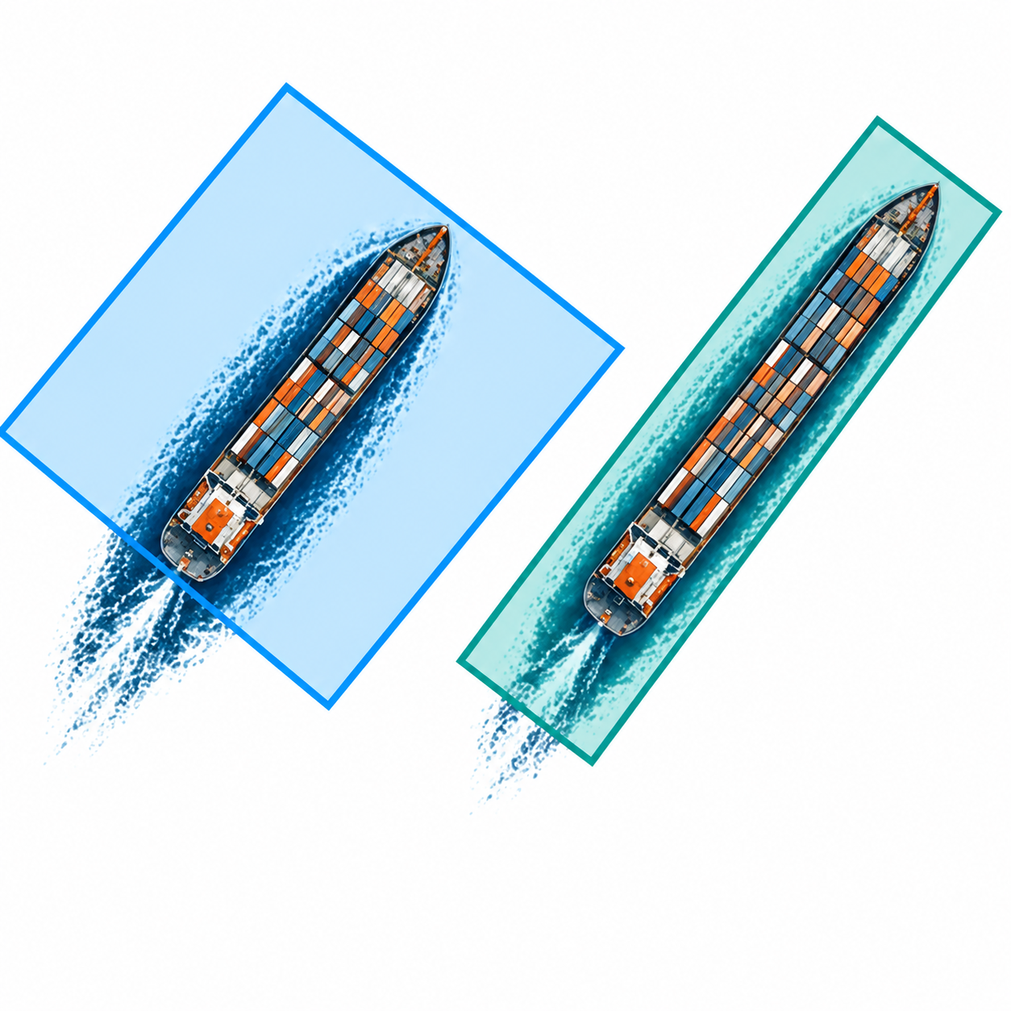
Proposed idea: OA-STAL v2
Enlarge a small region while
retaining its orientation.
Protect thin sides and limit
excessive elongation.
Keep the original box
as the learning target.
Conceptual region comparison. OA-STAL is a proposal.
14
Notes:
Suggested delivery: 45 seconds.
OA-STAL v2 is our proposed orientation-aware candidate rule. It expands small regions with the aim of preserving useful shape information. A short-side floor and conditional long-side cap protect very thin objects. Exact aspect-ratio preservation applies only when those safeguards do not engage. We do not promise that it will outperform STAL. Larger or differently shaped regions may help some configurations and hurt others. The original annotation stays unchanged.
Sources and asset credits:
Project proposal: NCKH/notes/t07-c3-proposal-v2-EN.pdf, 2026-10-08, C-10 revision of C-3. Proposed study. No model-training results have been produced.
Scope correction from proposal review, 2026-10-08: equal area implies equal expected candidate count only under a uniform lattice offset. It does not imply equal zero-candidate probability. Size sqrt(w*h) does not imply both sides fall in the same size interval. Omit the proposal's broad never-evaluated statement about STAL.
Conceptual illustration generated for this presentation. It is not a dataset sample, model prediction, or experimental result.

Slide 15
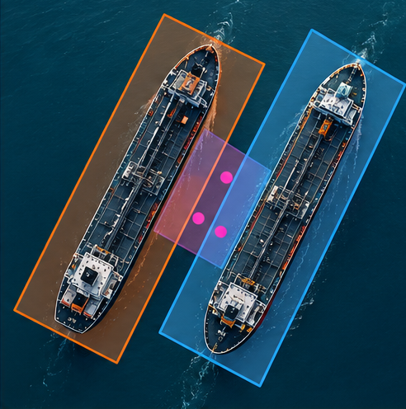
Neighboring objects can compete for points
Expanded regions may overlap
in a crowded scene.
One point can become eligible
for multiple objects.
We will test which object
should receive that point.
Conceptual shared candidates between neighboring ships
15
Notes:
Suggested delivery: 40 seconds.
An expanded region can overlap a neighbor's region. The shared anchor must ultimately learn one object. We will first measure these conflicts, then compare the existing rule with explicit alternatives. One proposed alternative gives priority to the single original box that contains the point, when exactly one does. The other follows a smaller-object preference. A change can help side-by-side objects yet hurt end-to-end objects, so the neighborhood arrangement matters.
Sources and asset credits:
Project proposal: NCKH/notes/t07-c3-proposal-v2-EN.pdf, 2026-10-08, C-10 revision of C-3. Proposed study. No model-training results have been produced.
Local frozen code evidence: NCKH/papers/_text/ultralytics_tal_main_2026-10-01.py, lines 365–425. Version history recorded in NCKH/notes/t07-c3-novelty-rescan.md, Section B.2. Rules in this deck are explicit experimental definitions, not a claim about future package versions.
Conceptual illustration generated for this presentation. It is not a dataset sample, model prediction, or experimental result.

Slide 16
A controlled experiment
Configuration | Candidate region | Purpose
Baseline | STAL-16 | Reference result
Threshold control | STAL-8 / no floor | Isolate enlargement rule
Region intervention | OA-STAL v2 | Test candidate geometry
Conflict intervention | OA-STAL v2 + rule | Test shared-point handling
Same model and training recipe within each contrast
Repeat primary comparisons with 3 random seeds.
16
Notes:
Suggested delivery: 45 seconds.
This table summarizes the main comparisons rather than every planned arm. We will freeze one code fork and hold the model, split and training recipe fixed within each contrast. First isolate the candidate-region change, then the conflict rule. Primary comparisons use three random seeds. YOLO26n is the planned compact model for the main ablations. Larger-model benchmarking is a separate question.
Sources and asset credits:
Project proposal: NCKH/notes/t07-c3-proposal-v2-EN.pdf, 2026-10-08, C-10 revision of C-3. Proposed study. No model-training results have been produced.
Local frozen code evidence: NCKH/papers/_text/ultralytics_tal_main_2026-10-01.py, lines 365–425. Version history recorded in NCKH/notes/t07-c3-novelty-rescan.md, Section B.2. Rules in this deck are explicit experimental definitions, not a claim about future package versions.

Slide 17
How we will evaluate the idea
Detection quality
Assignment behavior
AP for very tiny and tiny objects
Per-class AP
Recall of the labeled objects
Objects with zero candidates
Final positives per object
Points lost through conflicts
Official AITODReval evaluator
3 seeds and uncertainty intervals
17
Notes:
Suggested delivery: 45 seconds.
Average precision, or AP, summarizes detection quality across precision and recall. We will report it separately for very tiny and tiny objects and for each class. We will also measure the mechanism: empty candidate sets, final positives, and conflicts. Candidate count and the probability of having no candidate are different quantities. Equal average counts do not imply equal coverage. The official evaluator uses up to 1,500 detections per image. We will repeat primary contrasts and report uncertainty, with the seed and image resampling procedure fixed before interpretation.
Sources and asset credits:
Project proposal: NCKH/notes/t07-c3-proposal-v2-EN.pdf, 2026-10-08, C-10 revision of C-3. Proposed study. No model-training results have been produced.
Xu et al., Oriented Tiny Object Detection: A Dataset, Benchmark, and Dynamic Unbiased Learning. Read as arXiv:2412.11582v1, physical pp. 3–4, Table I and Section III. Publication DOI: 10.1109/TPAMI.2025.3634161. Local source: NCKH/papers/Xu2024-AI-TOD-R-oriented-tiny.pdf.
Scope correction from proposal review, 2026-10-08: equal area implies equal expected candidate count only under a uniform lattice offset. It does not imply equal zero-candidate probability. Size sqrt(w*h) does not imply both sides fall in the same size interval. Omit the proposal's broad never-evaluated statement about STAL.

Slide 18
Proposed 14-week roadmap
Weeks 1–2
Verify feasibility
Data access, converter, evaluator
and measured GPU throughput
Weeks 3–6
Diagnose and benchmark
Analyze labels and establish
the internal detector baselines
Weeks 6–11
Run controlled comparisons
Compare candidate rules
and test a second dataset
Weeks 12–14
Analyze and write
Explain errors, report uncertainty
and package reproducible code
18
Notes:
Suggested delivery: 35 seconds.
The proposal plans fourteen weeks. The first two weeks are a feasibility gate, not full-scale training. We need to obtain the images, run the evaluator, validate the prediction conversion and measure throughput. Only after those checks will we commit to the larger experiment plan. Later phases cover diagnosis, benchmarking, interventions and analysis. The exact schedule may shrink if the pilot shows that the compute budget is insufficient.
Sources and asset credits:
Project proposal: NCKH/notes/t07-c3-proposal-v2-EN.pdf, 2026-10-08, C-10 revision of C-3. Proposed study. No model-training results have been produced.

Slide 19
Current status and expected outputs
Proposal stage
Planned outputs
Data setup and pilot runs
still need verification.
No training result is claimed.
A reproducible YOLO-OBB benchmark
An explanation of assignment failures
A tested candidate-region intervention
A negative result can still clarify when the proposed rule fails
19
Notes:
Suggested delivery: 35 seconds.
Our project is currently at the proposal stage. Data reconstruction, evaluator execution and pilot throughput are still pending. We have not trained a model or measured an AP gain. The planned deliverables are a reproducible benchmark, an assignment diagnosis and a tested intervention. If the intervention fails, a useful outcome requires a concrete mechanism-backed explanation. A plain leaderboard or an unsupported negative result is not enough.
Sources and asset credits:
Project proposal: NCKH/notes/t07-c3-proposal-v2-EN.pdf, 2026-10-08, C-10 revision of C-3. Proposed study. No model-training results have been produced.

Slide 20
Discussion
Can better training-sample selection
help detect tiny oriented objects?
We will test the idea with controlled comparisons
and explain where it helps or fails.
Key references
Xu et al. · AI-TOD-R · TPAMI · DOI 10.1109/TPAMI.2025.3634161
Jocher et al. · YOLO26 · arXiv:2606.03748
Related assignment methods: EARL, RFLA and RDCNet
20
Notes:
Suggested delivery: 25 seconds.
To conclude, our project asks whether selecting better training samples helps tiny oriented-object detection. The focus is the candidate region and the assignment of shared points. We will judge the idea through controlled experiments and measured failure modes. Thank the lecturer and classmates, then invite questions about the scope and experimental design.
Sources and asset credits:
Project proposal: NCKH/notes/t07-c3-proposal-v2-EN.pdf, 2026-10-08, C-10 revision of C-3. Proposed study. No model-training results have been produced.
Xu et al., Oriented Tiny Object Detection: A Dataset, Benchmark, and Dynamic Unbiased Learning. Read as arXiv:2412.11582v1, physical pp. 3–4, Table I and Section III. Publication DOI: 10.1109/TPAMI.2025.3634161. Local source: NCKH/papers/Xu2024-AI-TOD-R-oriented-tiny.pdf.
Jocher et al., Ultralytics YOLO26: Unified Real-Time End-to-End Vision Models, arXiv:2606.03748v1, pp. 7–8, equations 4–6 and Section 3.2. Local source: NCKH/papers/Jocher2026-YOLO26.pdf. Read as a preprint.
Related work: NCKH/notes/t07-c3-proposal-v2-EN.pdf, Section 3 and Table 1. EARL, SARFA-Net, RDCNet and DCFL already use shape/orientation-aware assignment. This deck makes no claim to be the first such method.

