Slide 1
Automotive Parts Ordering System
Group 1 – Matthew Rowe – Sean Vogel – RJ Catalano

Slide 2
Use Case Presentation
Use Case Diagram
Use Case Specifications
Actor Dictionary

Slide 3
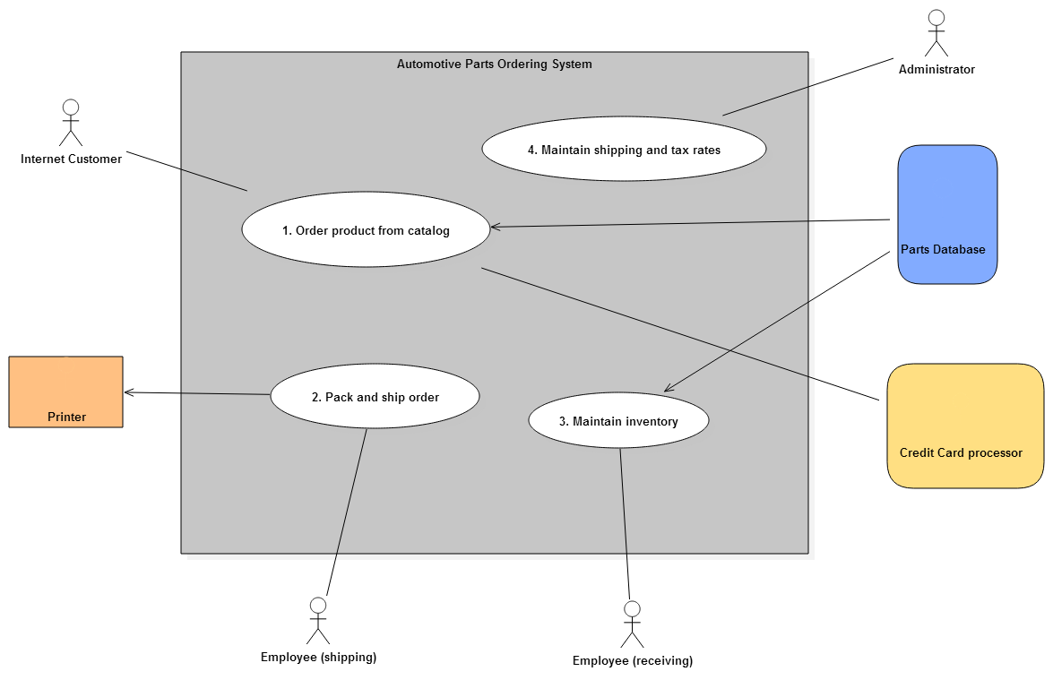
Use Case Diagram

Slide 4

1. Order Product From Catalog
Name | Order Product from Catalog
id | 1
Scope | Automotive Parts Ordering System
Priority | High
Summary | Allows online customers the ability to order auto parts online from our catalog.
Primary Actor | Internet Customer
Supporting Actor(s) | Parts Database and Credit Card Processor
Stakeholders
Generalization
Include
Extend
Precondition
Trigger
Normal Flow | Internet Customer accesses online catalog System queries Parts Database and displays parts in list form Internet Customer chooses parts to add to cart System maintains items, quantities, and price in cart Internet Customer selects to complete order System requests Internet Customers name and mailing address Internet customer provides name and mailing address System calculates total including tax and shipping costs System request Internet Customer’s Credit Card information Internet Customer provides Credit Card info System Sends payment info to Credit Card Processor Credit Card Processor Authorizes payment System Acknowledges payment to complete order
Sub-Flows
Alternate Flow/Exceptions | Exceptions: Customer leaves website abandoning sale Credit Card Declined
Postcondition | System Generates Picking/Packing Ticket
Open Issues
Source | Statement Stakeholders
Author | Group 1
Revision and Date | Rev 1.1 2/24/2015

Slide 5
2. Pack and Ship Order
Use Case Specification
Name | Pack and ship order
id | 2
Scope | Automotive Parts Ordering System
Priority | High
Summary
Primary Actor | Employee (shipping)
Supporting Actor(s) | Printer
Stakeholders
Generalization
Include
Extend
Precondition | Order(s) to be filled exist
Trigger
Normal Flow | Employee (shipping) selects an open order System sends pick list of items in the order to Printer Employee (shipping) retrieves items from warehouse Employee (shipping) packages items for shipping Employee (shipping) adjusts order status to packed System sends invoice and shipping labels to Printer Employee (shipping) adjusts order status to complete
Sub-Flows
Alternate Flow/Exceptions
Postcondition
Open Issues | Exception: Part on back order
Source | Statement Stakeholders
Author | Group 1
Revision and Date | Rev 1.1 2/24/2015

Slide 6
3. Maintain Inventory
Use Case Specification
Name | Maintain Inventory
id | 3
Scope | Automotive Parts Ordering System
Priority | High
Summary | Allows Employee (Receiving) to accept shipments and update inventory in the system.
Primary Actor | Employee (Receiving)
Supporting Actor(s) | Parts Database
Stakeholders
Generalization
Include
Extend
Precondition | New Shipment arrives at warehouse
Trigger
Normal Flow | Employee (Receiving) receives shipment invoice. Employee (Receiving) queries Parts Database with part numbers on shipment invoice. Parts Database acknowledges part numbers are part of catalog. Employee (Receiving) updates quantity in system.
Sub-Flows
Alternate Flow/Exceptions | Exceptions Certain parts received not in Parts Database
Postcondition
Open Issues
Source | Statement Stakeholders
Author | Group 1
Revision and Date | Rev 1.1 2/24/2015

Slide 7
4. Maintain Shipping and Tax Rates
Use Case Specification
Name | Maintain Shipping and Tax Rates
id | 4
Scope | Automotive Parts Ordering System
Priority | high
Summary | Administrator system to update or set local tax rates and shipping and handling charges.
Primary Actor | Administrator
Supporting Actor(s)
Stakeholders
Include
Precondition
Trigger
Normal Flow | Set Local Tax Rates Administrator accesses system. System displays administrator menu. Administrator selects to set local tax rate. System prompts for city/state and tax rate. Administrator enters local tax rate information. System acknowledges new rate. Set Shipping and Handling Administrator accesses system. System displays administrator menu. Administrator selects to set shipping and handling prices. System prompts for shipping rates for all priority types. Administrator enters rates for each priority type. System acknowledges new shipping and handling rate.
Sub-Flows
Alternate Flow/Exceptions
Postcondition
Open Issues
Source | Statement Stakeholders
Author | Group 1
Revision and Date | Rev 1.1 2/24/2015

Slide 8
Actor Dictionary
Actor | Description | Use Case(s)
Internet Customer | Browses parts catalog. Selects part(s) and quantity of item. Supplies required information. Pays for order. | Order product from catalog
Employee(shipping) | Receives orders from system. Prints pack list of items in the order. Packs and ships order. | Pack and ship order
Employee(receiving) | Receives incoming shipment. Verifies parts are in catalog. Adjusts quantity on hand if part valid. | Maintain inventory
Administrator | Adjusts shipping charges and tax rates. | Maintain shipping and tax rates
Parts Database | Legacy read only database that provides list of products in catalog. Stores information about all products in catalog. | Order product from catalog Maintain inventory
Credit Card Processor | Receives credit card number, expiration date and charge amount. Returns a confirmation code if charge successful. | Order product from catalog
Printer | Prints packing slips and labels. | Pack and ship order

