Slide 1

DSP Midterm, Group 03
Speech and silence
segmentation
Võ Thanh Quân: Binary Search
Vương Quốc Trung: Histogram
Đinh Huỳnh Nguyên Khang: Statistics
Notes:
Hello. We are Group 03. We compare Binary Search, Histogram and Statistics for speech and silence segmentation.
Design reference: /home/quan/Downloads/Introduction to Coding Workshop by Slidesgo.pptx
Template by Slidesgo. Background artwork by Freepik. https://slidesgo.com/

Slide 2

Shared experiment settings
4 TRAIN WAVs. 4 separate TEST WAVs.
25 ms windows centered on 10 ms decisions.
Normalize STE separately for each WAV.
Merge all silence shorter than 200 ms.
Red: LAB. Blue: predicted boundaries.
F0 is shown as an independent estimate.
Notes:
We use four TRAIN WAVs and four separate TEST WAVs. Each 25 ms window is centered on a 10 ms decision cell. We normalize STE per WAV, then fill silence below 200 ms. Red boundaries come from LAB. Blue boundaries come from the algorithm. F0 is an independent estimate.
Sources (reference only): speech_silence/features.py, pipeline.py and demo.py.
Design reference: /home/quan/Downloads/Introduction to Coding Workshop by Slidesgo.pptx
Template by Slidesgo. Background artwork by Freepik. https://slidesgo.com/

Slide 3

Binary Search
Võ Thanh Quân
Normalize STE
Apply median
LAB frame labels
Keep overlap
Bisect threshold
Score TRAIN
TRAIN
Median = 15. Shared T = 0.0016054242.
Same TEST features
Median = 15
Fixed threshold
Speech or silence
Fill short silence
Under 200 ms
TEST
Notes:
TRAIN selects a median order after STE normalization. LAB labels split the frames into two classes. We keep overlap values and bisect to balance their energy errors. Boundary errors, then MAE, select median 15. The shared threshold is about 0.0016. TEST uses the same processing, followed by the 200 ms silence rule.
Sources (reference only): TT1_BinarySearch/algorithm.py, speech_silence/pipeline.py.
Design reference: /home/quan/Downloads/Introduction to Coding Workshop by Slidesgo.pptx
Template by Slidesgo. Background artwork by Freepik. https://slidesgo.com/

Slide 4
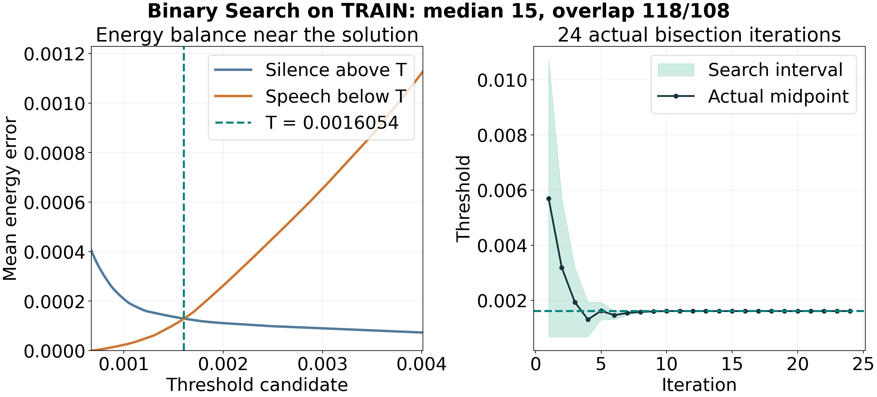
Binary Search: finding the balance
TRAIN overlap. 24 actual bisection iterations.
Notes:
The left plot uses the actual TRAIN overlap. Increasing T reduces Silence energy above T and increases Speech energy below T. The green line marks their balance. The right plot records the real midpoint and search interval over 24 iterations. It converges to the shared threshold. The curves and iteration history come from the same solver used for classification.
Sources (reference only): TT1_BinarySearch/ket_qua/tim_nguong_binary.png
Design reference: /home/quan/Downloads/Introduction to Coding Workshop by Slidesgo.pptx
Template by Slidesgo. Background artwork by Freepik. https://slidesgo.com/

Slide 5
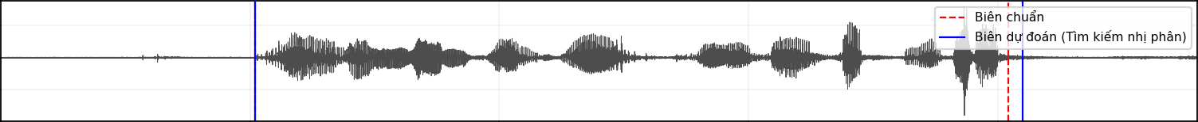
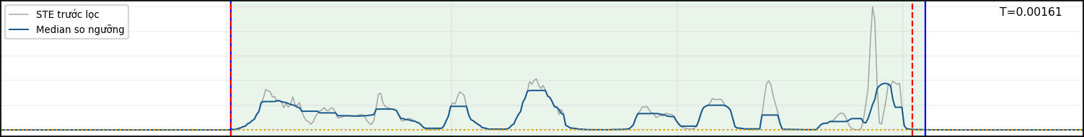
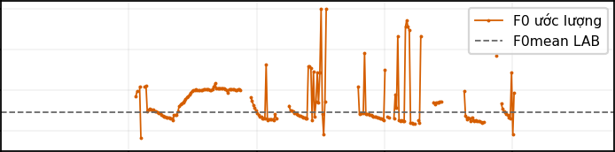
Binary Search: phone_F2
MAE 30 ms
Start matches. End 60 ms late.
Amplitude
t (s)
0
1
2
3
4
Grey: raw STE. Blue: median STE.
T = 0.0016054242
STE
t (s)
0
1
2
F0 (Hz)
3
4
Tail median STE remains
400
above the fixed threshold
300
200
Extra: 0. Missed: 0.
100
t (s)
0
1
2
3
4
Notes:
For phone_F2, Start matches. End 60 ms late. MAE is 30 ms. Tail median STE remains above the fixed threshold. Extra and missing boundaries are zero.
Sources (reference only): TT1_BinarySearch/ket_qua/phone_F2.png; TT1_BinarySearch/ket_qua/ket_qua.csv. LAB start/end: 1.02 / 4.04 s. Predictions: 1.02 / 4.10 s. The cause is a plot interpretation. LAB mean F0 is not a reference trajectory.
Design reference: /home/quan/Downloads/Introduction to Coding Workshop by Slidesgo.pptx
Template by Slidesgo. Background artwork by Freepik. https://slidesgo.com/

Slide 6
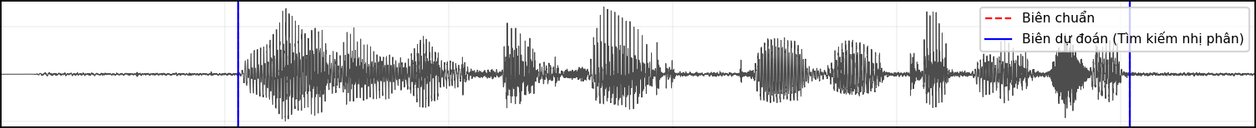
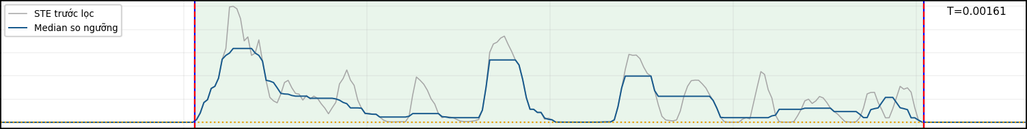
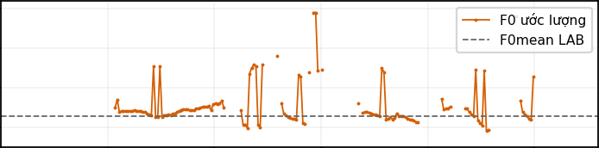
Binary Search: phone_M2
MAE 0 ms
Start matches. End matches.
Amplitude
t (s)
0
1
2
Grey: raw STE. Blue: median STE.
T = 0.0016054242
STE
t (s)
0
1
F0 (Hz)
2
Both LAB timestamps match
400
the detected transitions
300
200
Extra: 0. Missed: 0.
100
t (s)
0
1
2
Notes:
For phone_M2, Start matches. End matches. MAE is 0 ms. Both LAB timestamps match the detected transitions. Extra and missing boundaries are zero.
Sources (reference only): TT1_BinarySearch/ket_qua/phone_M2.png; TT1_BinarySearch/ket_qua/ket_qua.csv. LAB start/end: 0.53 / 2.52 s. Predictions: 0.53 / 2.52 s. The cause is a plot interpretation. LAB mean F0 is not a reference trajectory.
Design reference: /home/quan/Downloads/Introduction to Coding Workshop by Slidesgo.pptx
Template by Slidesgo. Background artwork by Freepik. https://slidesgo.com/

Slide 7
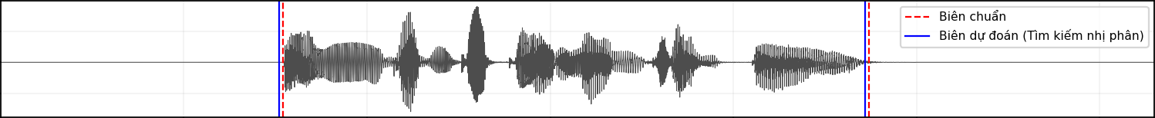
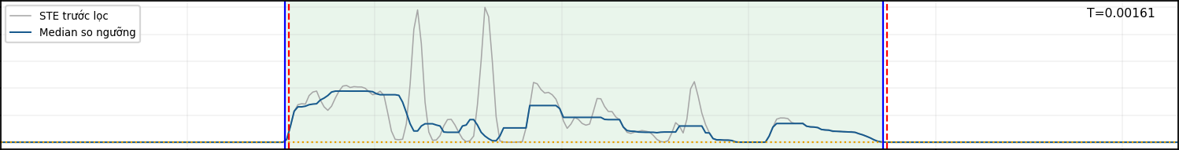
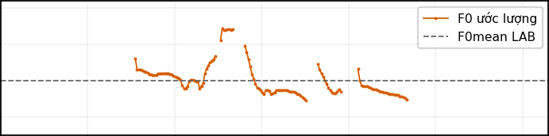
Binary Search: studio_F2
MAE 10 ms
Start 10 ms early. End 10 ms early.
Amplitude
t (s)
0
1
2
3
Grey: raw STE. Blue: median STE.
T = 0.0016054242
STE
t (s)
0
1
F0 (Hz)
2
3
Energy crosses T before
400
the LAB transitions
300
200
Extra: 0. Missed: 0.
100
t (s)
0
1
2
3
Notes:
For studio_F2, Start 10 ms early. End 10 ms early. MAE is 10 ms. Energy crosses T before the LAB transitions. Extra and missing boundaries are zero.
Sources (reference only): TT1_BinarySearch/ket_qua/studio_F2.png; TT1_BinarySearch/ket_qua/ket_qua.csv. LAB start/end: 0.77 / 2.37 s. Predictions: 0.76 / 2.36 s. The cause is a plot interpretation. LAB mean F0 is not a reference trajectory.
Design reference: /home/quan/Downloads/Introduction to Coding Workshop by Slidesgo.pptx
Template by Slidesgo. Background artwork by Freepik. https://slidesgo.com/

Slide 8
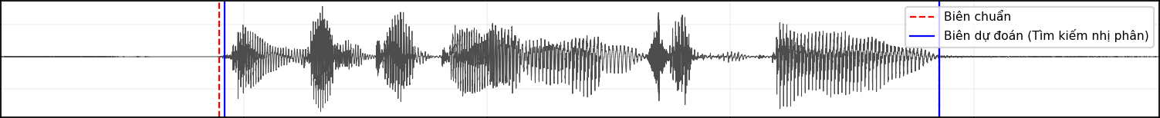
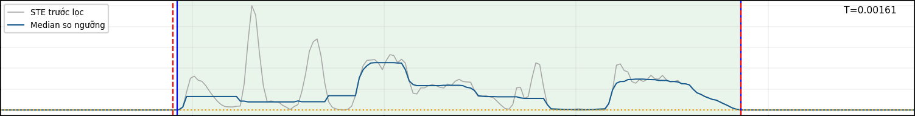
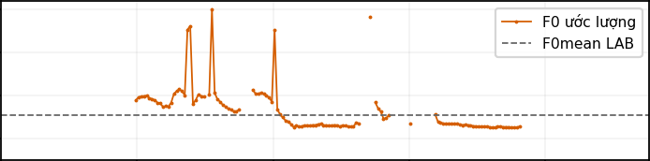
Binary Search: studio_M2
MAE 5 ms
Start 10 ms late. End matches.
Amplitude
t (s)
0
1
2
Grey: raw STE. Blue: median STE.
T = 0.0016054242
STE
t (s)
0
1
F0 (Hz)
2
Possible cause: weak
400
energy near the onset
300
200
Extra: 0. Missed: 0.
100
t (s)
0
1
2
Notes:
For studio_M2, Start 10 ms late. End matches. MAE is 5 ms. Possible cause: weak energy near the onset. Extra and missing boundaries are zero.
Sources (reference only): TT1_BinarySearch/ket_qua/studio_M2.png; TT1_BinarySearch/ket_qua/ket_qua.csv. LAB start/end: 0.45 / 1.93 s. Predictions: 0.46 / 1.93 s. The cause is a plot interpretation. LAB mean F0 is not a reference trajectory.
Design reference: /home/quan/Downloads/Introduction to Coding Workshop by Slidesgo.pptx
Template by Slidesgo. Background artwork by Freepik. https://slidesgo.com/

Slide 9
Histogram
Vương Quốc Trung
TRAIN histograms
128 bins
Try W candidates
Eight values
Score TRAIN boundaries
Errors, then MAE
TRAIN
Selected W = 30. Smooth over 3 bins.
TEST histogram
Normalized STE
First two peaks
Adaptive threshold
Classify and merge
Silence under 200 ms
TEST
Notes:
We build 128-bin histograms and smooth the counts over three bins. TRAIN selects W from eight candidates using boundary errors, then MAE. The selected W is 30. For each TEST recording, we choose the first two local peaks along the energy axis. We combine their locations with more weight on the first peak. The threshold therefore adapts to each WAV. If fewer than two peaks exist, we use the mean STE of that WAV. After classification, we fill silence below 200 ms.
Sources (reference only): TT2_Histogram/algorithm.py, speech_silence/pipeline.py.
Design reference: /home/quan/Downloads/Introduction to Coding Workshop by Slidesgo.pptx
Template by Slidesgo. Background artwork by Freepik. https://slidesgo.com/

Slide 10
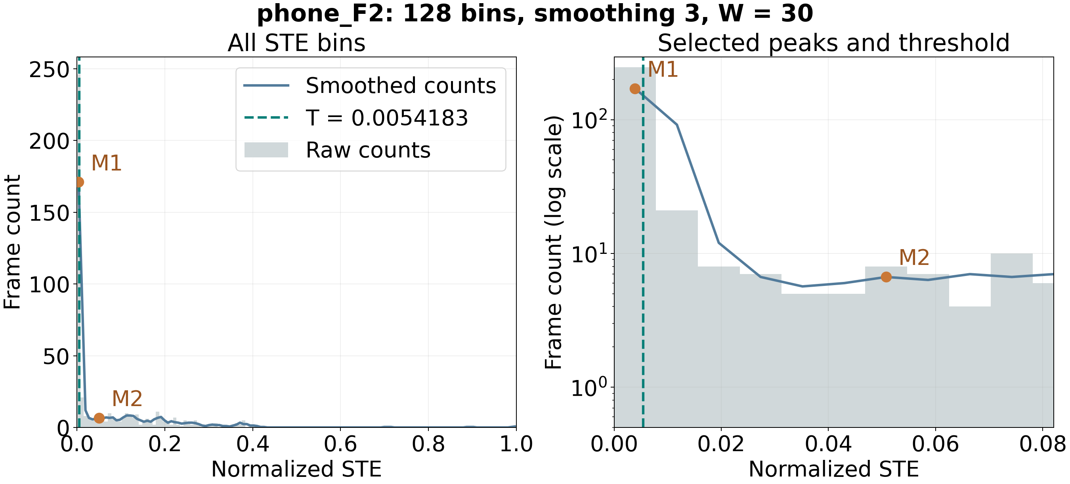
Histogram: selected peaks and threshold
phone_F2. W = 30 from TRAIN.
Notes:
These are the actual energy counts for phone_F2. The blue line is the three-bin smoothing. M1 and M2 are the first two local peaks along the energy axis. The green line marks T. W equals 30, so T stays close to M1. The zoom uses logarithmic counts to make the smaller second peak visible. No TEST labels select these peaks.
Sources (reference only): TT2_Histogram/ket_qua/phone_F2_histogram.png
Design reference: /home/quan/Downloads/Introduction to Coding Workshop by Slidesgo.pptx
Template by Slidesgo. Background artwork by Freepik. https://slidesgo.com/

Slide 11
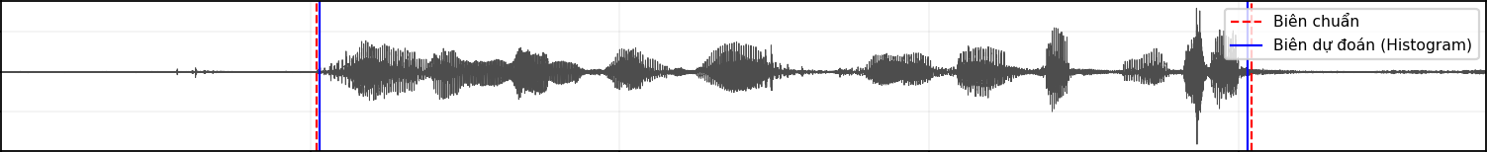
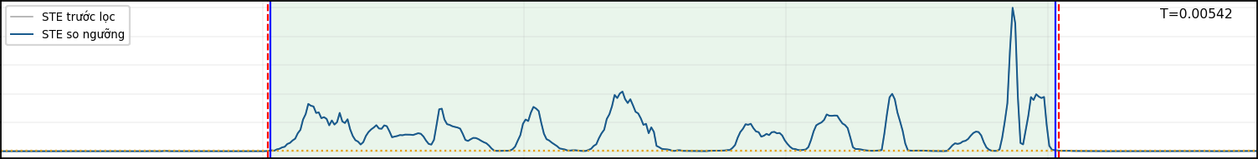
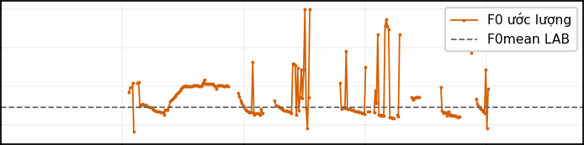
Histogram: phone_F2
MAE 10 ms
Start 10 ms late. End 10 ms early.
Amplitude
t (s)
0
1
2
3
4
Normalized STE
T = 0.0054183468
STE
t (s)
0
1
2
F0 (Hz)
3
4
Possible cause: weak
400
energy near the boundaries
300
200
Extra: 0. Missed: 0.
100
t (s)
0
1
2
3
4
Notes:
For phone_F2, Start 10 ms late. End 10 ms early. MAE is 10 ms. Possible cause: weak energy near the boundaries. Extra and missing boundaries are zero.
Sources (reference only): TT2_Histogram/ket_qua/phone_F2.png; TT2_Histogram/ket_qua/ket_qua.csv. LAB start/end: 1.02 / 4.04 s. Predictions: 1.03 / 4.03 s. The cause is a plot interpretation. LAB mean F0 is not a reference trajectory.
Design reference: /home/quan/Downloads/Introduction to Coding Workshop by Slidesgo.pptx
Template by Slidesgo. Background artwork by Freepik. https://slidesgo.com/

Slide 12
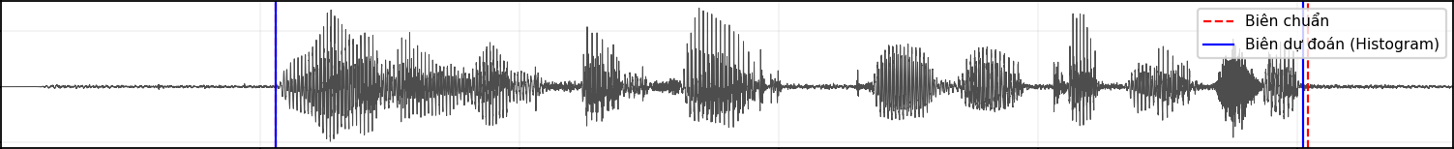
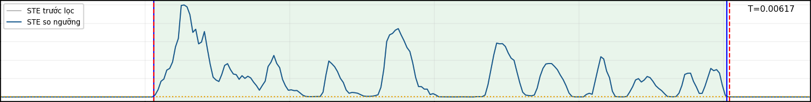
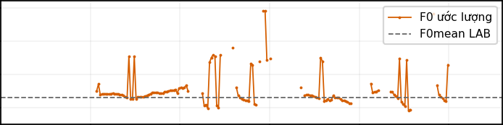
Histogram: phone_M2
MAE 5 ms
Start matches. End 10 ms early.
Amplitude
t (s)
0
1
2
Normalized STE
T = 0.0061743952
STE
t (s)
0
1
F0 (Hz)
2
Possible cause: weak
400
energy near the boundaries
300
200
Extra: 0. Missed: 0.
100
t (s)
0
1
2
Notes:
For phone_M2, Start matches. End 10 ms early. MAE is 5 ms. Possible cause: weak energy near the boundaries. Extra and missing boundaries are zero.
Sources (reference only): TT2_Histogram/ket_qua/phone_M2.png; TT2_Histogram/ket_qua/ket_qua.csv. LAB start/end: 0.53 / 2.52 s. Predictions: 0.53 / 2.51 s. The cause is a plot interpretation. LAB mean F0 is not a reference trajectory.
Design reference: /home/quan/Downloads/Introduction to Coding Workshop by Slidesgo.pptx
Template by Slidesgo. Background artwork by Freepik. https://slidesgo.com/

Slide 13
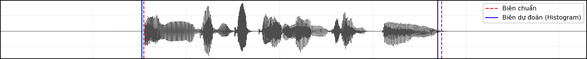
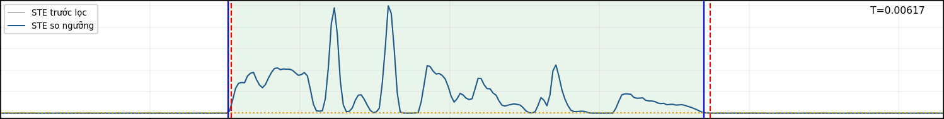
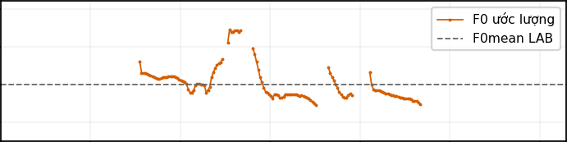
Histogram: studio_F2
MAE 15 ms
Start 10 ms early. End 20 ms early.
Amplitude
t (s)
0
1
2
3
Normalized STE
T = 0.0061743952
STE
t (s)
0
1
F0 (Hz)
2
3
Onset window includes speech.
400
Tail energy falls below T.
300
200
Extra: 0. Missed: 0.
100
t (s)
0
1
2
3
Notes:
For studio_F2, Start 10 ms early. End 20 ms early. MAE is 15 ms. Onset window includes speech. Tail energy falls below T.. Extra and missing boundaries are zero.
Sources (reference only): TT2_Histogram/ket_qua/studio_F2.png; TT2_Histogram/ket_qua/ket_qua.csv. LAB start/end: 0.77 / 2.37 s. Predictions: 0.76 / 2.35 s. The cause is a plot interpretation. LAB mean F0 is not a reference trajectory.
Design reference: /home/quan/Downloads/Introduction to Coding Workshop by Slidesgo.pptx
Template by Slidesgo. Background artwork by Freepik. https://slidesgo.com/

Slide 14
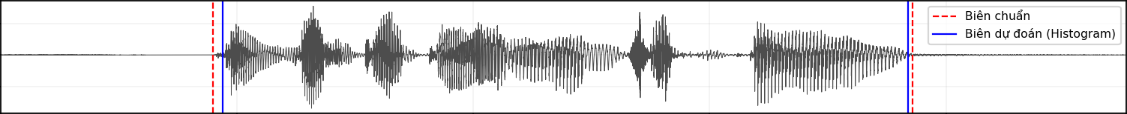
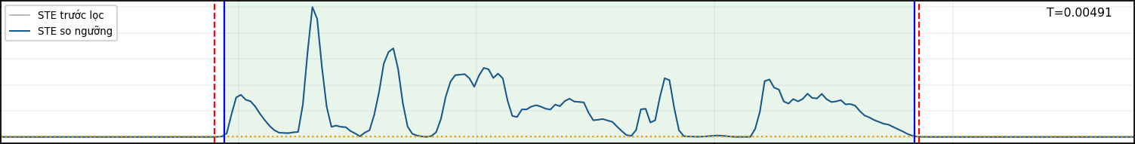

Histogram: studio_M2
MAE 15 ms
Start 20 ms late. End 10 ms early.
Amplitude
t (s)
0
1
2
Normalized STE
T = 0.0049143145
STE
t (s)
0
1
F0 (Hz)
2
Possible cause: weak
400
energy near the boundaries
300
200
Extra: 0. Missed: 0.
100
t (s)
0
1
2
Notes:
For studio_M2, Start 20 ms late. End 10 ms early. MAE is 15 ms. Possible cause: weak energy near the boundaries. Extra and missing boundaries are zero.
Sources (reference only): TT2_Histogram/ket_qua/studio_M2.png; TT2_Histogram/ket_qua/ket_qua.csv. LAB start/end: 0.45 / 1.93 s. Predictions: 0.47 / 1.92 s. The cause is a plot interpretation. LAB mean F0 is not a reference trajectory.
Design reference: /home/quan/Downloads/Introduction to Coding Workshop by Slidesgo.pptx
Template by Slidesgo. Background artwork by Freepik. https://slidesgo.com/

Slide 15
Gaussian Statistics
Đinh Huỳnh Nguyên Khang
TRAIN STE
Normalize each WAV
LAB classes
Silence and speech
Mean and std
Gaussian crossing
TRAIN
503 silence, 794 speech. T = 0.0027634166.
Normalized TEST STE
Same 25 ms windows
Fixed TEST threshold
Shared across WAVs
Classify and merge
Silence under 200 ms
TEST
Notes:
Statistics uses labeled normalized STE from all four TRAIN recordings. LAB labels give 503 silence frames and 794 speech frames. We calculate each class mean and standard deviation, then choose a Gaussian crossing between the class means. The learned threshold is about 0.00276. We keep it fixed for every TEST WAV. This method uses unfiltered normalized STE. After classification, we fill silence shorter than 200 ms.
Sources (reference only): TT3_Statistics/algorithm.py, TT3_Statistics/ket_qua/tham_so_huan_luyen.json.
Design reference: /home/quan/Downloads/Introduction to Coding Workshop by Slidesgo.pptx
Template by Slidesgo. Background artwork by Freepik. https://slidesgo.com/

Slide 16
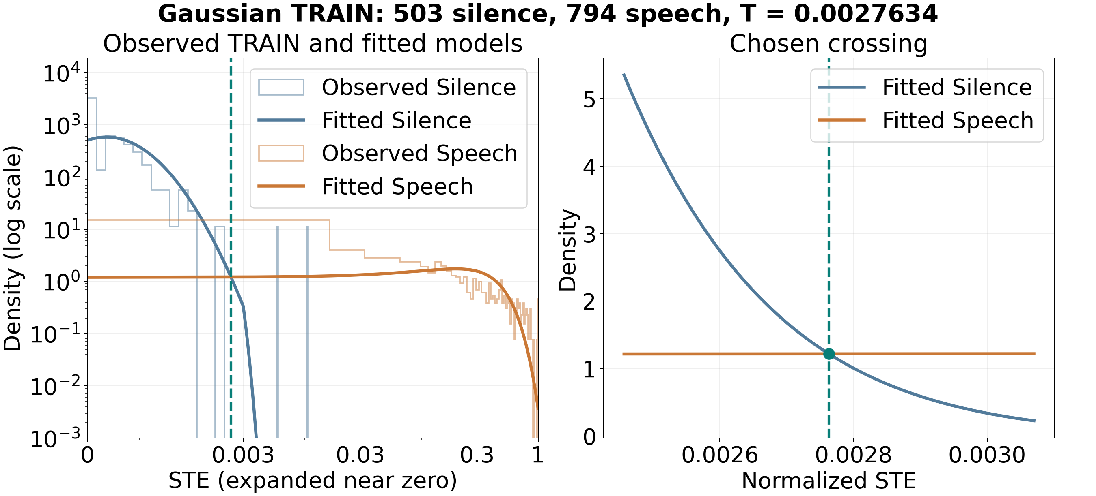
Gaussian: observed data and crossing
TRAIN estimates. Zoom on the chosen crossing.
Notes:
The left panel compares observed TRAIN features with the two fitted Gaussian models. Silence is concentrated near zero, while Speech spreads more widely. Expanded axes make both visible. The right panel zooms on the selected crossing at about 0.00276. Observations do not perfectly follow Gaussian curves. The crossing provides the shared threshold used on TEST.
Sources (reference only): TT3_Statistics/ket_qua/tim_nguong_gaussian.png
Design reference: /home/quan/Downloads/Introduction to Coding Workshop by Slidesgo.pptx
Template by Slidesgo. Background artwork by Freepik. https://slidesgo.com/

Slide 17
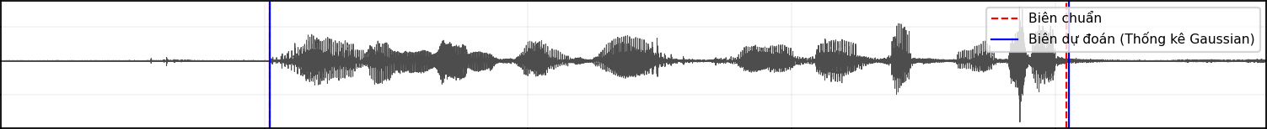
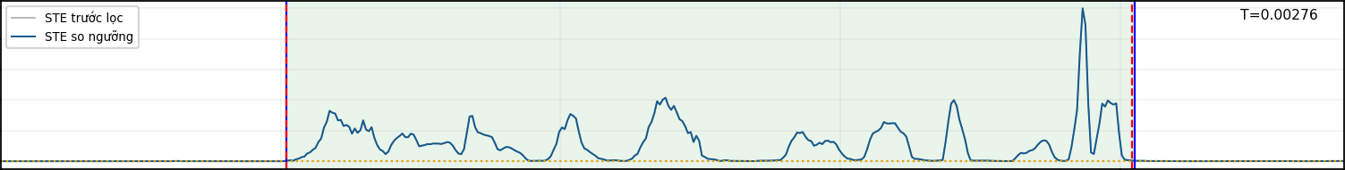
Statistics: phone_F2
MAE 5 ms
Start matches. End 10 ms late.
Amplitude
t (s)
0
1
2
3
4
Normalized STE
T = 0.0027634166
STE
t (s)
0
1
2
F0 (Hz)
3
4
Tail STE remains above
400
the shared threshold
300
200
Extra: 0. Missed: 0.
100
t (s)
0
1
2
3
4
Notes:
For phone_F2, Start matches. End 10 ms late. MAE is 5 ms. Tail STE remains above the shared threshold. Extra and missing boundaries are zero.
Sources (reference only): TT3_Statistics/ket_qua/phone_F2.png; TT3_Statistics/ket_qua/ket_qua.csv. LAB start/end: 1.02 / 4.04 s. Predictions: 1.02 / 4.05 s. The cause is a plot interpretation. LAB mean F0 is not a reference trajectory.
Design reference: /home/quan/Downloads/Introduction to Coding Workshop by Slidesgo.pptx
Template by Slidesgo. Background artwork by Freepik. https://slidesgo.com/

Slide 18
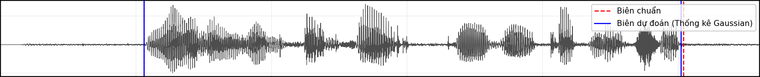
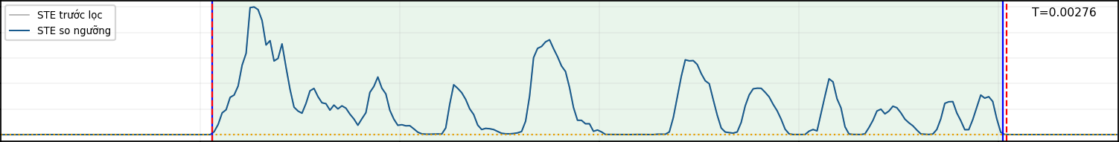
Statistics: phone_M2
MAE 5 ms
Start matches. End 10 ms early.
Amplitude
t (s)
0
1
2
Normalized STE
T = 0.0027634166
STE
t (s)
0
1
F0 (Hz)
2
Possible cause: weak
400
energy near the boundaries
300
200
Extra: 0. Missed: 0.
100
t (s)
0
1
2
Notes:
For phone_M2, Start matches. End 10 ms early. MAE is 5 ms. Possible cause: weak energy near the boundaries. Extra and missing boundaries are zero.
Sources (reference only): TT3_Statistics/ket_qua/phone_M2.png; TT3_Statistics/ket_qua/ket_qua.csv. LAB start/end: 0.53 / 2.52 s. Predictions: 0.53 / 2.51 s. The cause is a plot interpretation. LAB mean F0 is not a reference trajectory.
Design reference: /home/quan/Downloads/Introduction to Coding Workshop by Slidesgo.pptx
Template by Slidesgo. Background artwork by Freepik. https://slidesgo.com/

Slide 19
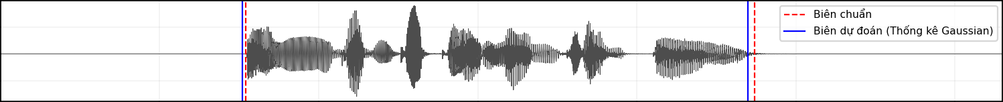

Statistics: studio_F2
MAE 15 ms
Start 10 ms early. End 20 ms early.
Amplitude
t (s)
0
1
2
3
Normalized STE
T = 0.0027634166
STE
t (s)
0
1
F0 (Hz)
2
3
Onset window includes speech.
400
Tail energy falls below T.
300
200
Extra: 0. Missed: 0.
100
t (s)
0
1
2
3
Notes:
For studio_F2, Start 10 ms early. End 20 ms early. MAE is 15 ms. Onset window includes speech. Tail energy falls below T.. Extra and missing boundaries are zero.
Sources (reference only): TT3_Statistics/ket_qua/studio_F2.png; TT3_Statistics/ket_qua/ket_qua.csv. LAB start/end: 0.77 / 2.37 s. Predictions: 0.76 / 2.35 s. The cause is a plot interpretation. LAB mean F0 is not a reference trajectory.
Design reference: /home/quan/Downloads/Introduction to Coding Workshop by Slidesgo.pptx
Template by Slidesgo. Background artwork by Freepik. https://slidesgo.com/

Slide 20
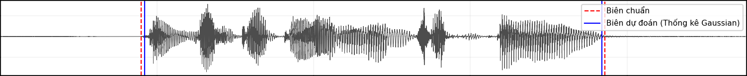

Statistics: studio_M2
MAE 10 ms
Start 10 ms late. End 10 ms early.
Amplitude
t (s)
0
1
2
Normalized STE
T = 0.0027634166
STE
t (s)
0
1
F0 (Hz)
2
Possible cause: weak
400
energy near the boundaries
300
200
Extra: 0. Missed: 0.
100
t (s)
0
1
2
Notes:
For studio_M2, Start 10 ms late. End 10 ms early. MAE is 10 ms. Possible cause: weak energy near the boundaries. Extra and missing boundaries are zero.
Sources (reference only): TT3_Statistics/ket_qua/studio_M2.png; TT3_Statistics/ket_qua/ket_qua.csv. LAB start/end: 0.45 / 1.93 s. Predictions: 0.46 / 1.92 s. The cause is a plot interpretation. LAB mean F0 is not a reference trajectory.
Design reference: /home/quan/Downloads/Introduction to Coding Workshop by Slidesgo.pptx
Template by Slidesgo. Background artwork by Freepik. https://slidesgo.com/

Slide 21
Statistics has the lowest mean TEST MAE (ms)
TEST file | Binary | Histogram | Statistics
phone_F2 | 30 | 10 | 5
phone_M2 | 0 | 5 | 5
studio_F2 | 10 | 15 | 15
studio_M2 | 5 | 15 | 10
Mean | 11.25 | 11.25 | 8.75
Notes:
On these four TEST WAVs, Binary Search and Histogram both average 11.25 ms. Statistics averages 8.75 ms, the lowest in our comparison. All three methods match eight reference boundaries with zero extra or missing boundaries. The mean row averages the four files. These results apply to this TEST set.
Sources (reference only): the three TT*/ket_qua/ket_qua.csv and tong_hop.csv files.
Design reference: /home/quan/Downloads/Introduction to Coding Workshop by Slidesgo.pptx
Template by Slidesgo. Background artwork by Freepik. https://slidesgo.com/

Slide 22

Thank you
Group 03
Võ Thanh Quân
Vương Quốc Trung
Đinh Huỳnh Nguyên Khang
Template: Slidesgo. Artwork: Freepik.
Notes:
Thank you for listening.
Design reference: /home/quan/Downloads/Introduction to Coding Workshop by Slidesgo.pptx
Template by Slidesgo. Background artwork by Freepik. https://slidesgo.com/

