Slide 1


C PROGRAM SOLVE THE SYSTEM OF EQUATIONS
Group 6 | Instructor: Le Thi Thu Lan

Slide 2

About group
Vo Tue Nam
Truong Hoai Nam
Nguyen Tien Dat
CE140557
CE161034
CE150672

Slide 3
Table content
Work assignment
Internal assessment
Function Introduction
Description of the algorithm
Q&A

Slide 4

Works assignment
NamVT:
Menu - Logical processing
Equations with integer solutions
Read and write files
NamTH:
First degree equation
Quadratic equation
DatNT:
System of equations with two solutions
Cubic equation

Slide 5
Internal assessment
ALL ON TIME
YES
EXTREMELY GOOD
GOOD
Complete the work
Function works as described
Friendliness
Teamwork

Slide 6
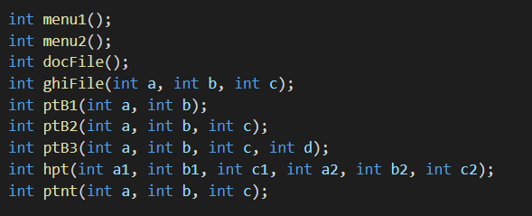
Function Introduction
3 Menus
2 functions to process files
5 functions to solve equations

Slide 7
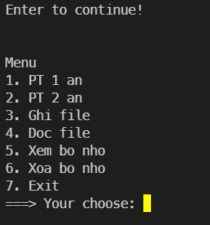
Main Menu
7 options:
1 → Menu 1
2 → Menu 2
3 → Write new variable to file
4 → Read this file → Save value to variable
5 → Check the variables will receive the value in the file
6 → Clear value of those variables
7 → Exit program
Entering characters outside the menu will give an error

Slide 8
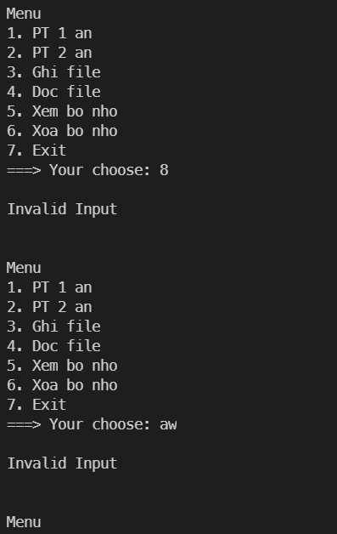
Check input error report
All 3 menus have a mechanism like this

Slide 9
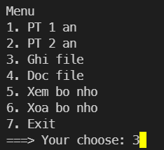
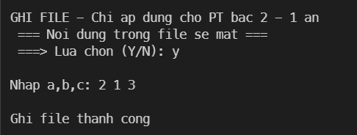
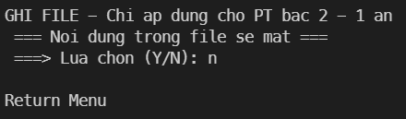
3 → Write new variable to file

Slide 10
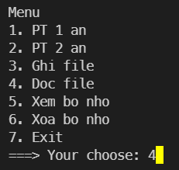
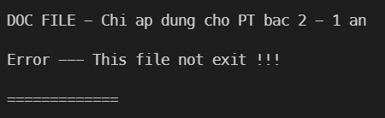
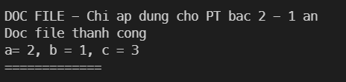
4 → Read this file → Save value to variable

Slide 11
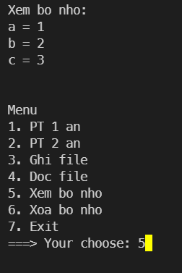
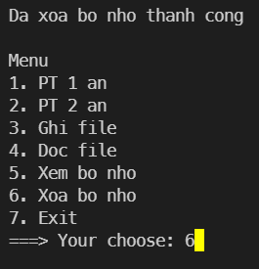
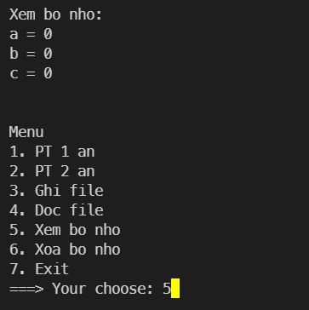
5 → Check variables 6 → Clear variables

Slide 12
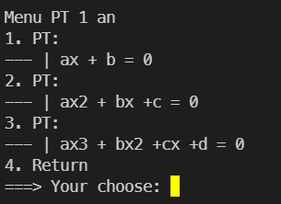
Menu1
4 Options
1 → First degree equation
2 → Quadratic equation
3 → Cubic equation
4 → Return main Menu

Slide 13
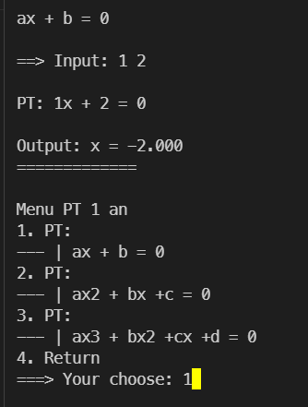
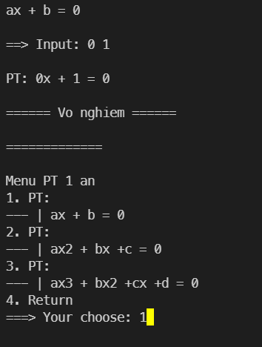
1.1 First degree equation

Slide 14
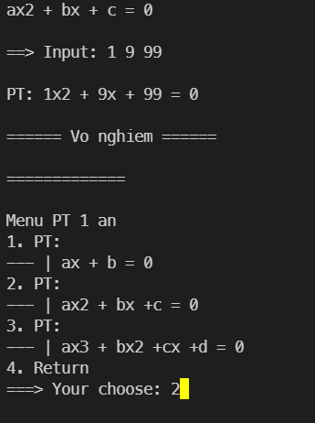
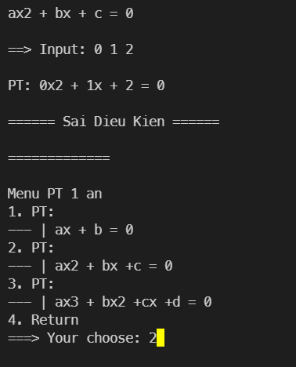
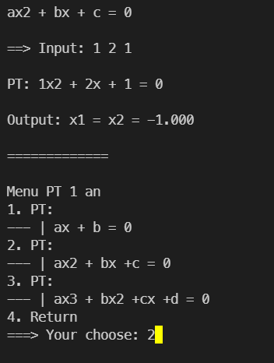
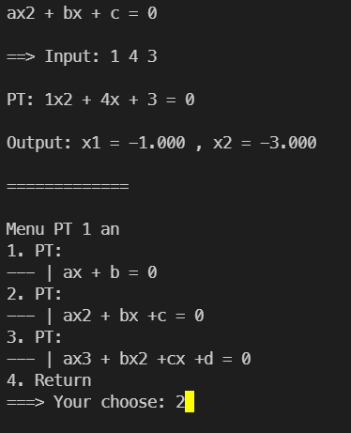
1.2 Quadratic equation

Slide 15
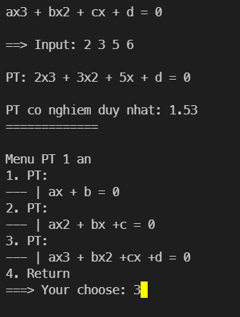
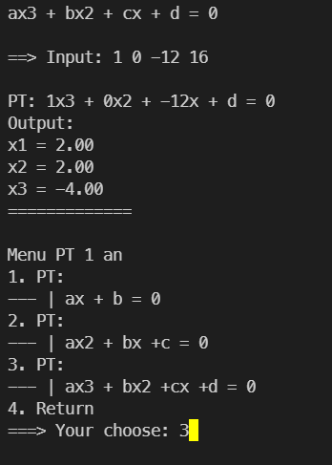
1.3 Cubic equation

Slide 16
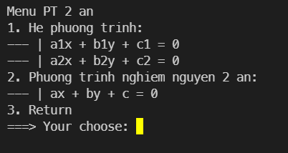
Menu 2
3 Options
1 → Equations with integer solutions
2 → Quadratic equation
3 → Return main Menu

Slide 17
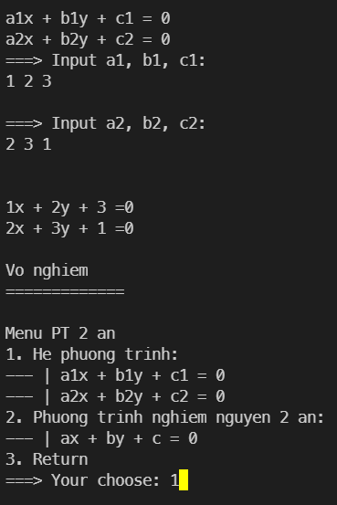
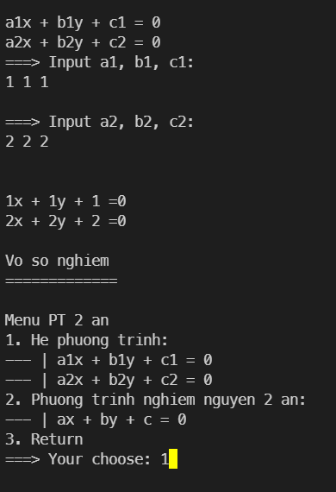
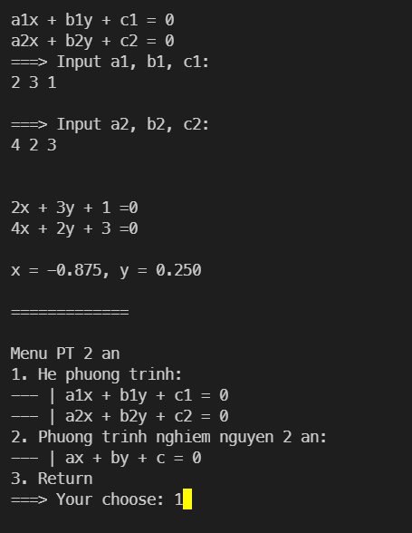
2.1 Equations with integer solutions

Slide 18
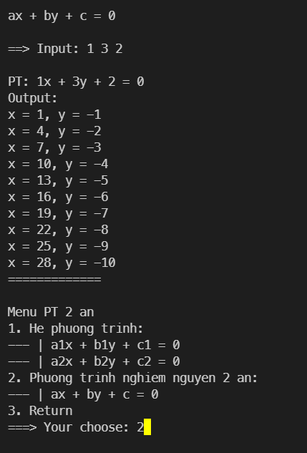
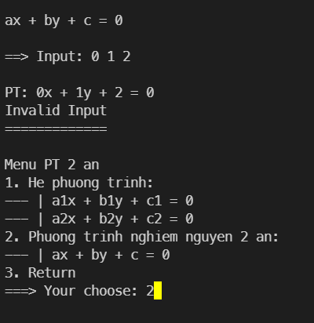
2.2 Quadratic equation

Slide 19
Description of the algorithm
Menu
Menu1
1 → First degree equation
Menu2
1 → Equations with integer solutions
2 → Quadratic equation
3 → Return main Menu
2 → Quadratic equation
3 → Cubic equation
4 → Return main Menu

Slide 20

Demo + Q&A

Slide 21

Thank you for your attention

