Slide 1


ATM
Instructor: Lương Hoàng Hướng

Slide 2

Member
Vo Tue Nam
Le Quoc Thai
Le Hoang Tieu Phung
Nguyen Ly Phuong Uyen

Slide 3
TABLE OF CONTENT
PROBLEM DEFINITION
PROJECT DETAILS
Contents

Slide 4
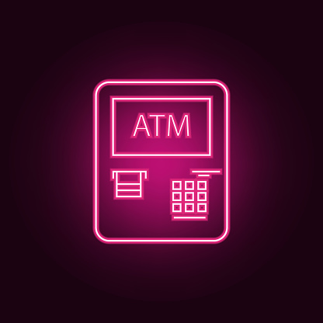
PROBLEM
DEFINITION
An automated Teller Machine
A computerized device that provides the clients the financial institution without the need for the cashier .The client is identified by inserting unique card number and some security information. A user can assess the ATM system / screen only after entering the correct user name and the password on the very first screen which is installed on the the ATM room.

Slide 5
PROJECT DETAILS
1.Le Hoang Tieu Phung
Draw ideas
Start: 1/12/2019
End: 1/12/2019
All
2.Le Quoc Thai
Write document
Start: 2/12/2019
End: 3/12/2019
All
3.Vo Tue Nam
Coding
Start: 4/12/2019
End: 7/12/2019
All
Draw UML and diagram
Start: 8/12/2019
End: 8/12/2019
4.Nguyen Ly Phuong Uyen
All

Slide 6
USER REQUIREMENT
List of funtions
Input
Output
- Admin:
+ Create account user
+ Delete account user
+ View transaction history
- User:
+ Desposit
+ Withdrawal
+ Balance Enquiry
+ Transfer money
+ Change Password
- Create an account Admin
- Create an acount User
- Information of the function is required

