Slide 1

Sequence Diagram
Teacher: KHUAT THUY PHUONG
Team:
VO VAN MINH
NGUYEN QUOC HUY

Slide 2

Content
Research Sequence Diagram

Slide 3

Conception
The Sequence Diagram models the collaboration of objects based on a time sequence. It shows how the objects interact with others in a particular scenario of a use case.

Slide 4
The diagram's purpose
The sequence diagram is used primarily to show the interactions between objects in the sequential order that those interactions occur.
One of the primary uses of sequence diagrams is in the transition from requirements expressed as use cases to the next and more formal level of refinement. Use cases are often refined into one or more sequence diagrams.
This documentation is very useful when transitioning a system to another person or organization.

Slide 5
The diagram's purpose
An organization's business staff: sequence diagrams useful to communicate how the business currently works by showing how various business objects interact.
A business-level sequence diagram can be used as a requirements document to communicate requirements for a future system implementation.
An organization's technical staff: sequence diagrams useful in documenting how a future system should behave.
During the design phase, architects and developers can use the diagram to force out the system's object interactions, thus fleshing out overall system design.

Slide 6
Diagram’s elements
Target
Lifeline
Message
Synchronous message
Asynchronous message
Instantaneos message
Self message
Guard
Alternative
Option
Loop

Slide 7

Diagram’s elements - Target
Objects as well as classes can be targets on a sequence diagram
Object
Where 'name' is the name of the object in the context of the diagram and 'Type' indicates the type of which the object is an instance. 'Type' can be an abstract type as well.
Both name and type are optional, but at least one of them should be present.
Notes:
Note that the object doesn't have to be a direct instance of Type, a type of which it is an indirect instance is possible too.

Slide 8
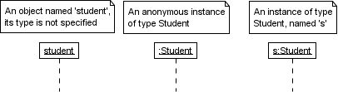
Diagram’s elements - Target
Object
Example:
Notes:
Note that the object doesn't have to be a direct instance of Type, a type of which it is an indirect instance is possible too.

Slide 9

Diagram’s elements - Target
Multi Object
Use when you want present a collection
Notes:
.

Slide 10

Diagram’s elements - Target
Class
Use when you want present a class
Only class messages (e.g. shared or static methods) can be sent to a class. Note that the text of a class is not underlined, which is how you can distinguish it from an object
Notes:
Class không có gạch dưới, để phân biệt với object

Slide 11
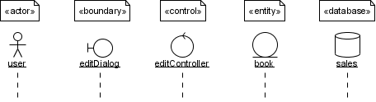
Diagram’s elements - Target
Other target
Target not only present object or class, some often used stereotypes for objects are «actor», «boundary», «control», «entity» and «database». They can be displayed with icons as well.

Slide 12
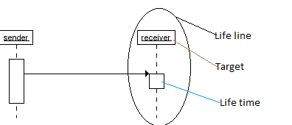
Diagram’s elements - Life line
Life line is a named element which represents an individual participant in the interaction. Lifelines represent only one interacting entity.
Inside life line is target which is object or class, and life time present how long that target interactive with each other

Slide 13
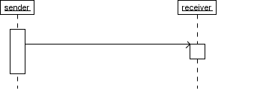
Diagram’s elements - Message
Message
When a target sends a message to another target, it is shown as an arrow between their lifelines. The arrow originates at the sender and ends at the receiver.
Near the arrow, the name and parameters of the message are shown.

Slide 14
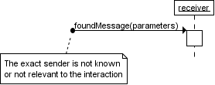
Diagram’s elements - Message
Anonymous message
Depending on the context, this could mean that either the sender is not known, or that it is not important who the sender was.
The arrow of a anonymous message originates from a filled circle.

Slide 15
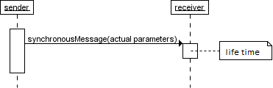
Diagram’s elements - Message
Synchronous message
A synchronous message is used when the sender waits until the receiver has finished processing the message, only then does the caller continue (i.e. a blocking call).
Most method calls in object-oriented programming languages are synchronous.
A closed and filled arrowhead signifies that the message is sent synchronously.

Slide 16
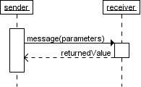
Diagram’s elements - Message
Synchronous message
Life time starts when the message is received and ends when the object is done handling the message.
A dashed arrow signifies that the message is returned synchronously.
from receiver to sender.
Optionally, a value that the receiver returns to the sender can be placed near the return arrow.
Notes:
Message thể hiện cho method, life time thể hiện thời gian thực thi method và trả về kết quả

Slide 17
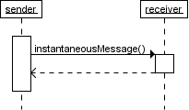
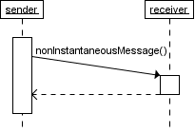
Diagram’s elements - Message
Instanatneous message
Messages are often considered to be instantaneous, i.e. the time it takes to arrive at the receiver is negligible. For example, an in-process method call. Such messages are drawn as a horizontal arrow.
Sometimes however, it takes a considerable amount of time to reach the receiver (relatively speaking of course) . For example, a message across a network. Such a non-instantaneous message is drawn as a slanted arrow.
in-process method call across network
Notes:
Instantaneous : ingay laapj tucws
negligible: ko dang ke

Slide 18
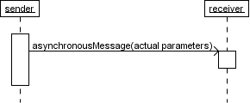
Diagram’s elements - Message
Asynchronous message
With an asynchronous message, the sender does not wait for the receiver to finish processing the message, it continues immediately.
Messages sent to a receiver in another process or calls that start a new thread are examples of asynchronous messages.
An open arrowhead is used to indicate that a message is sent asynchrously.
Notes:
Asynchronous : khong dong bo

Slide 19
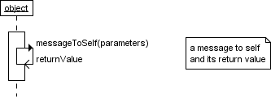
Diagram’s elements - Message
Self message
A message that an object sends itself can be shown as follows :
Notes:
(vd:đệ quy)

Slide 20
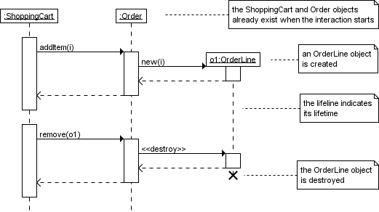
Diagram’s elements - Message
Creation and destruction
Targets that exist at the start of an interaction are placed at the top of the diagram. Any targets that are created during the interaction are placed further down the diagram, at their time of creation.
Notes:
tương tự gọi new object
String date=new SimpleDateFormat("dd/MM/yyyy").format(new Date());

Slide 21
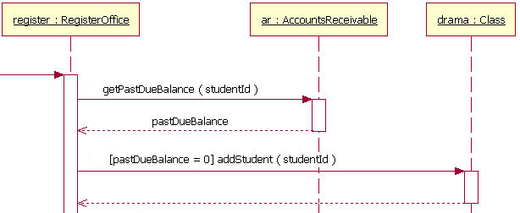
Diagram’s elements - Guard
Guard
When modeling object interactions, there will be times when a condition must be met for a message to be sent to the object
A guard could only be assigned to a single message and placed above the message line
Guard
the guard is the text "[pastDueBalance = 0]." By having the guard on this message, the addStudent message will only be sent if the accounts receivable system returns a past due balance of zero
Notes:
tóm lại The guard đơn giản là điều kiện giữa các khối lệnh trong method

Slide 22
Diagram’s elements - Guard
Combined fragments
In most case, the guard is not sufficient to handle the logic required, despite we have combined fragments.
A combined fragment is used to group sets of messages together to show conditional flow in a sequence diagram
3 type of combined fragments:
Alternative
Option
Loop

Slide 23
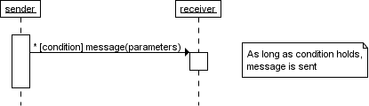
Diagram’s elements - Guard
Alternative - Condition interaction
The message is only sent if a certain condition is met. The guard is simply that condition between brackets.
Notes:
tương tự if

Slide 24
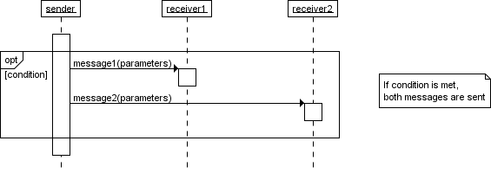
Diagram’s elements - Guard
Option - Condition interaction
The combined fragment is shown as a large rectangle with an option operator plus a guard, and contains all the conditional messages under that guard.
Notes:
tương tự if

Slide 25
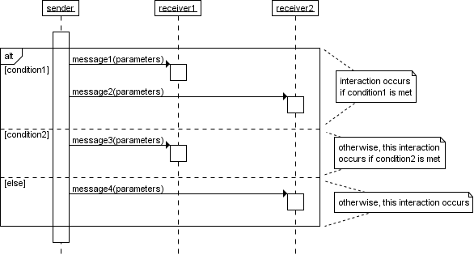
Diagram’s elements - Guard
Option - Condition interaction
Notes:
tương tự if...else if … else

Slide 26
Diagram’s elements - Guard
Loop - Repeated interaction
When a message is prefixed with an asterisk (the '*'-symbol), it means that the message is sent repeatedly.
A guard indicates the condition that determines whether or not the message should be sent (again). As long as the condition holds, the message is repeated.
Notes:
tương tự if...else if … else

Slide 27
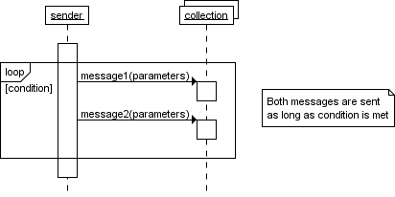
Diagram’s elements - Guard
Loop - Repeated interaction
If you want to show that multiple messages are sent in the same iteration, a 'loop' combined fragment can be used. The operator of the combined fragment is 'loop' and the guard represents the condition to control the repetition.
Notes:
tương tự while

Slide 28
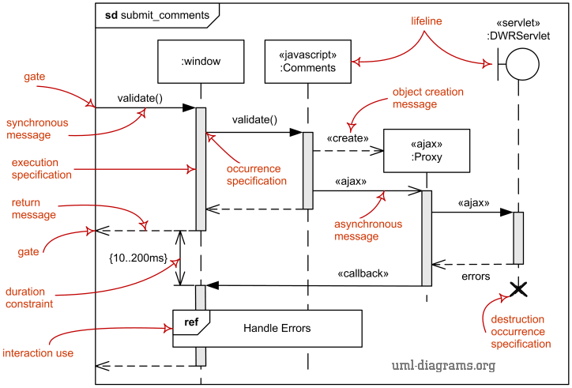
Conlcusion

Slide 29
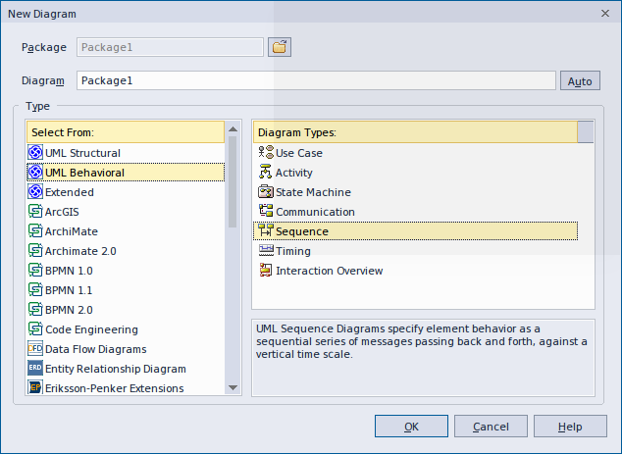
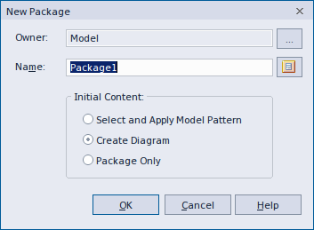
Big example with enterprise architect
How to create a sequence diagram in enterprise architect:

Slide 30
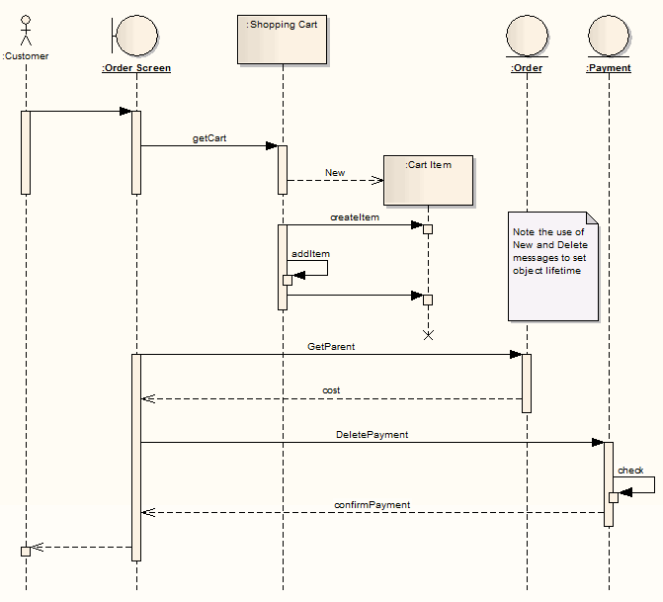
Big example with enterprise architect

Slide 31
Thank you for your time and attention!
Sources:
http://www.ibm.com/developerworks/rational/library/3101.html
http://www.tracemodeler.com/articles/a_quick_introduction_to_uml_sequence_diagrams/
http://www.sparxsystems.com/enterprise_architect_user_guide/8.0/modeling_languages/sequencediagram.html

