Slide 1

ANGULAR 2
Vo Van Minh
Bui Thi Thuy Quynh
Notes:
NOTE:
To change the image on this slide, select the picture and delete it. Then click the Pictures icon in the placeholder to insert your own image.

Slide 2
Content
Introduction
Module
Component
Template
Directive
Pipe
Service
Form
Tutorials

Slide 3


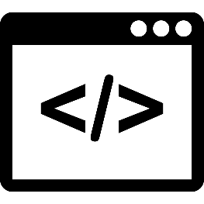
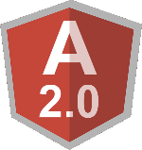
1. Introduction
What is Angular?
Developed by Misko Hevery at Brat Tech LLC, 2009.
JavaScript framework for single page applications (SPAs).
Help organizing HTML, JavaScript and CSS.
Mainly maintained by Google.
Back-end Server

Slide 4

1. Introduction
Why use Angular?

Slide 5


1. Introduction
What language to use with Angular 2?
JavaScript
But all browser don’t support the newest version of JavaScript.
There are ways to access these features:
TypeScript
Dart
Transpile
Notes:
Transpile: Means is get changed into JavaScript.
To transpile from TypeScript to JavaScript use tsc (transcript compiler) command.

Slide 6

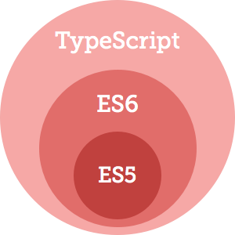

1. Introduction
TypeScript: Our language of choice?
Microsoft’s extension of JavaScript.
Use of all ES2015 (ES6) features.
Class-based OOP.

Slide 7

1. Introduction
TypeScript: Our language of choice?
Angular 2 source with TypeScript
main.js
Instead, we will use
main.ts
Learn more TypeScript at http://www.typescriptlang.org
Notes:
Our browsers don’t know how to read TypeScript out of the box, so we have two options when it comes to changing our TypeScript code into JavaScript

Slide 8



1. Introduction
TypeScript: Our language of choice?
Transpiling locations

Slide 9
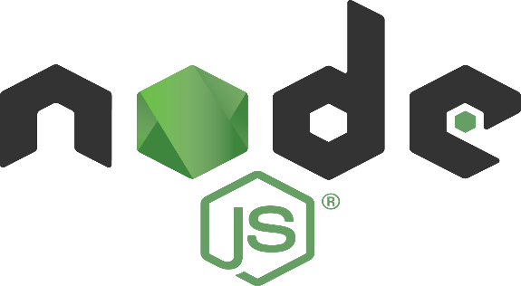
1. Introduction
NodeJS: Our server of choice?
Open-source
Software platform for server-side.
Written in JavaScript.
Cross-platform (Linux, Windows, Mac OS,…).

Slide 10
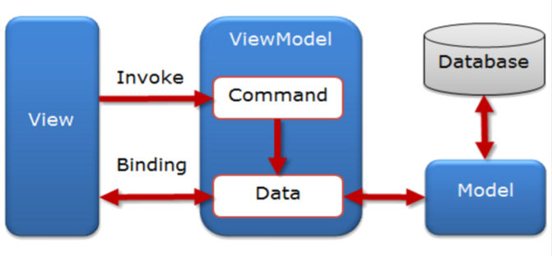
1. Introduction
MVVM in Angular 2.

Slide 11
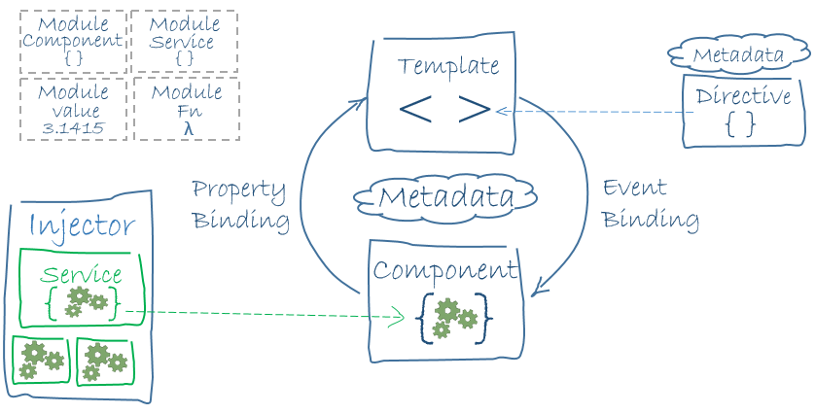
1. Introduction
Architecture of Angular 2.

Slide 12
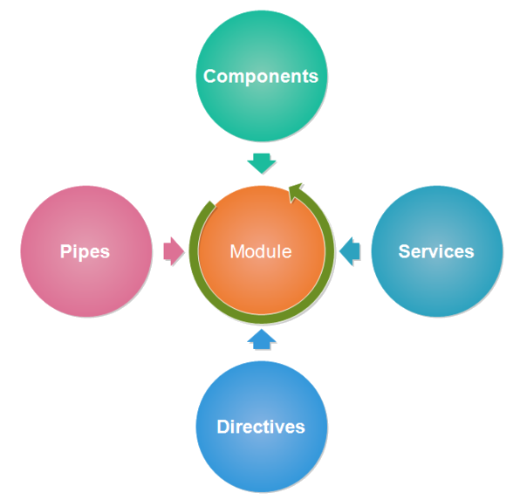
2. Module
Angular apps are modular.
Modules are containers.
Angular app has at least one module – root module (named AppModule).

Slide 13
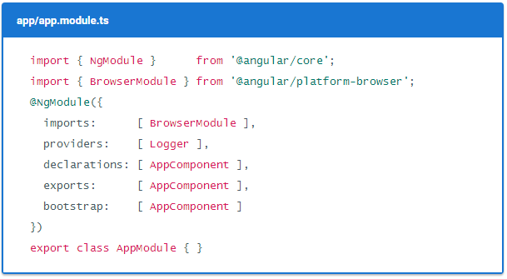
2. Module
Structure of a Angular module in code:

Slide 14
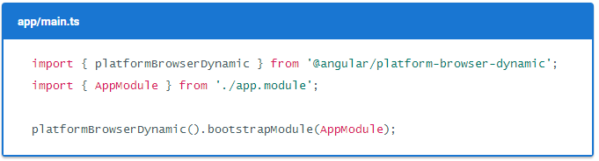
2. Module
To launch an Angular application:

Slide 15
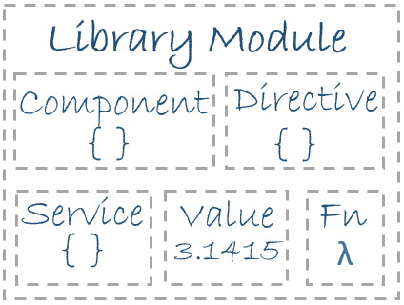

2. Module
Library module:
A collection of Javascript modules.
Two type library module:
User library module.
System library module (begin with the @angular prefix).

Slide 16
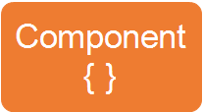
3. Component
What is component?
Encapsulates the template, data and the behaviour of a view.
Angular app has at least one component– root component (named AppComponent)

Slide 17
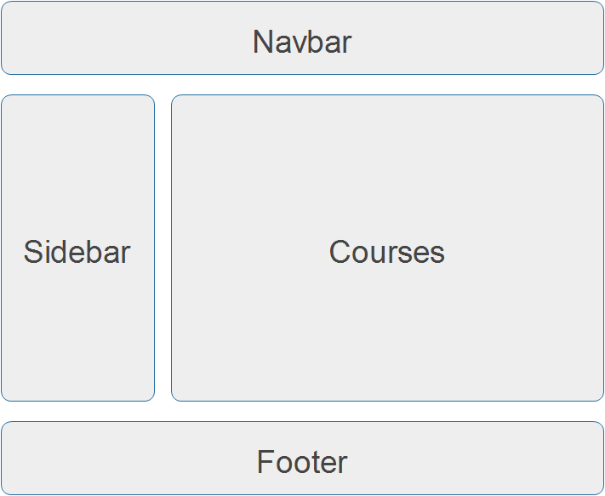
3. Component
For examples:

Slide 18
3. Component
For examples:

Slide 19
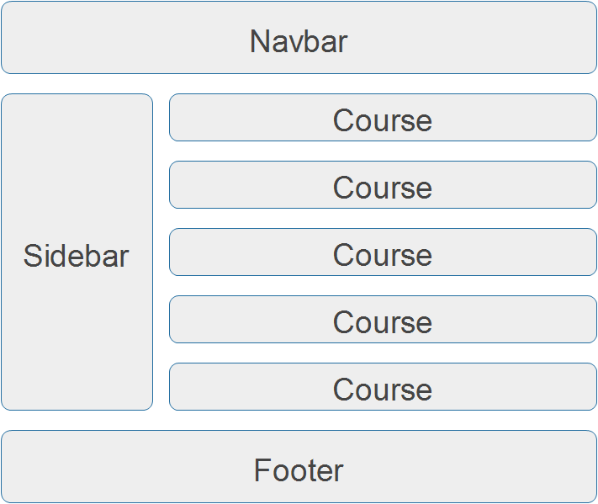
3. Component
For examples:

Slide 20
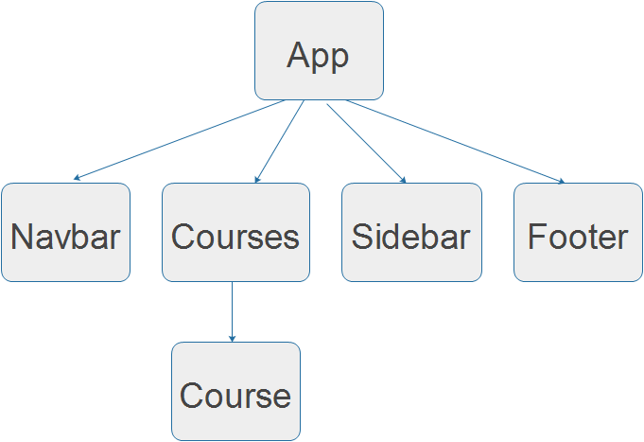
3. Component
For examples:

Slide 21
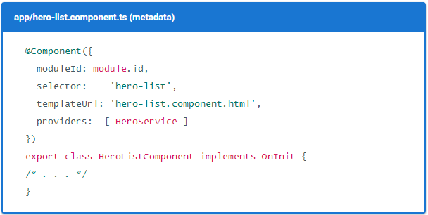
3. Component
Structure of an Angular component in code:

Slide 22
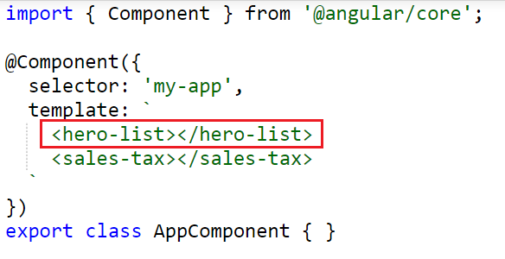
3. Component
In another component:

Slide 23
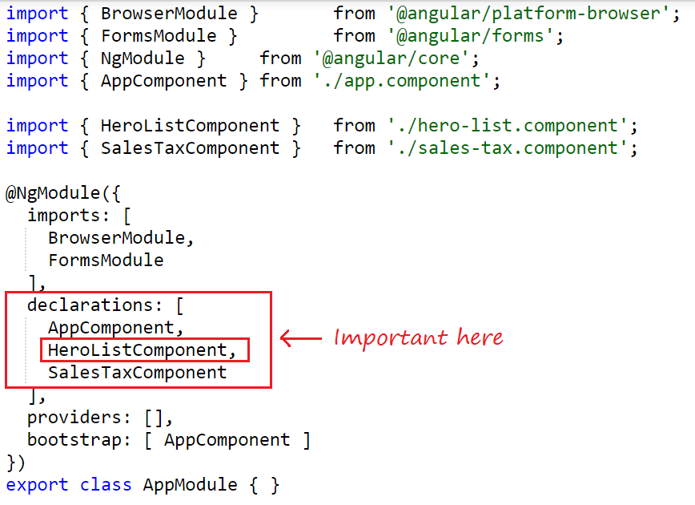
3. Component
NOTE: In the AppModule

Slide 24
4. Template
What is template?
View in MVVM.
Look like regular HTML, except for a few differences (uses Angular’s template syntax).

Slide 25
4. Template
Template syntax:
HTML.
Interpolation.
Template expression.
Binding syntax.

Slide 26
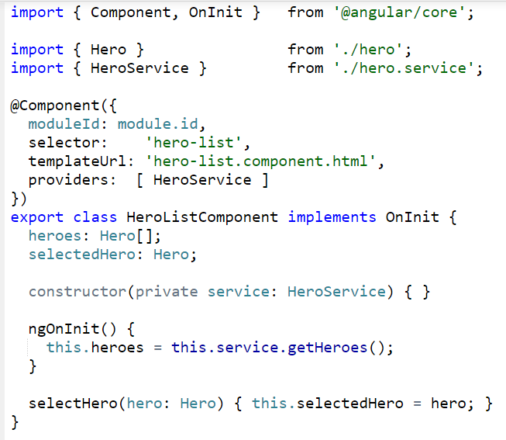
4. Template
For examples:

Slide 27
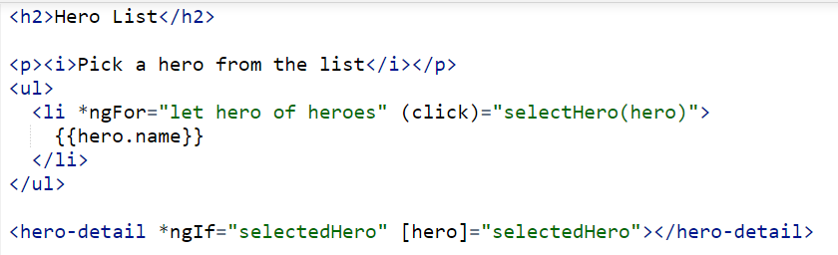
4. Template
For examples:

Slide 28
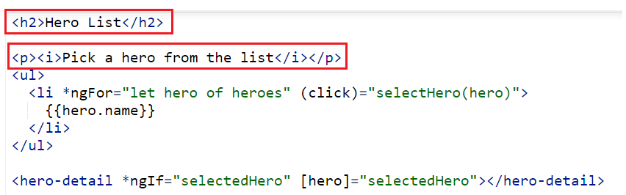
4. Template
Template syntax:
HTML.

Slide 29
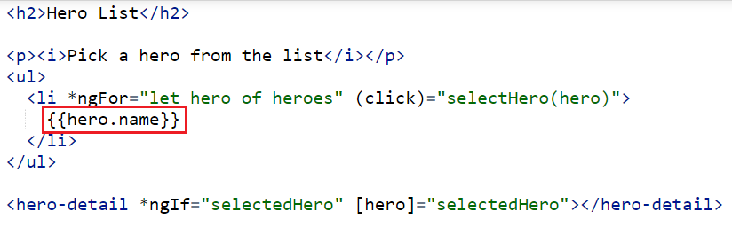
4. Template
Template syntax:
Interpolation: Presentation by the double-curly braces {{ }}.
Assignments attribute or text value for HTML tags

Slide 30
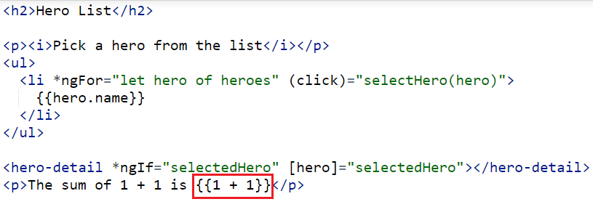
4. Template
Template syntax:
Template expression: produces a value.

Slide 31
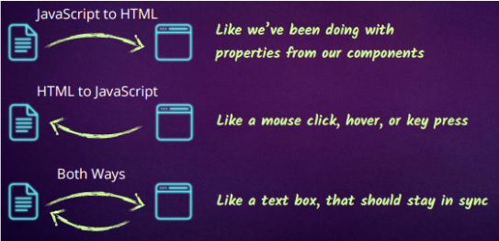
4. Template
Template syntax:
Binding syntax.

Slide 32
4. Template
Template syntax:
Binding syntax.
Data direction | Syntax | Binding type
One-way from data source to view targets | {{expression}} [target] = "expression" | Interpolation Property
One-way from view targets to data source | (target) = "statement" | Event
Two-way | [(target)] = "expression" | Two-way

Slide 33
4. Template
Template syntax:
Binding syntax.
Binding type | Examples
Property | <img [src]=”product.image” />
Event | <button (click)=”onSave()”>Save</button>
Two-way | <input [(ngModel)]=”product.name” />

Slide 34
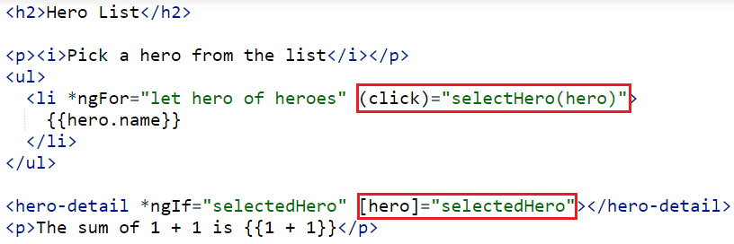
4. Template
Template syntax:
Binding syntax

Slide 35
5. Directive
What is directive?
A class that allows us to extend or control DOM.
Examples:

Slide 36
5. Directive
Three kinds of Angular directives:
Components - Directives with a template.
Attributes directives - Altering the appearance or behaviour of an existing element.
Examples: ngModel.
Structural directives - Altering layout by adding, removing and replacing elements in DOM.
Examples: ngIf, ngFor, ngSwitch.

Slide 37
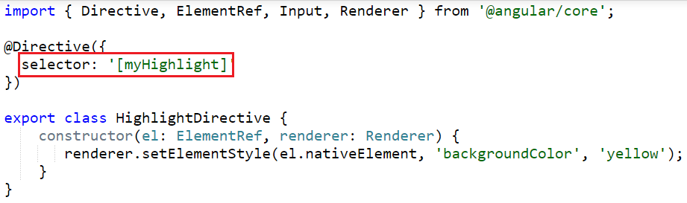
5. Directive
Create a attribute directives

Slide 38
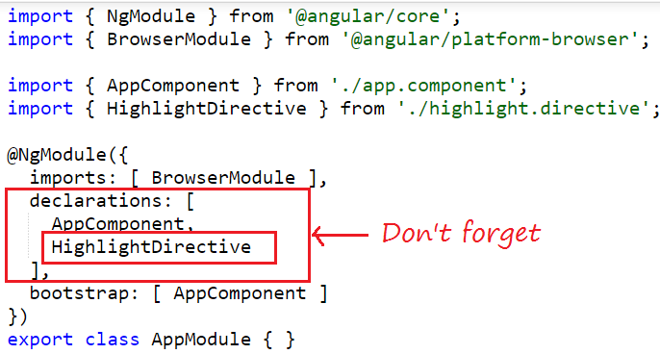
5. Directive
Create a attribute directives

Slide 39


5. Directive
Create a attribute directives
Results:

Slide 40
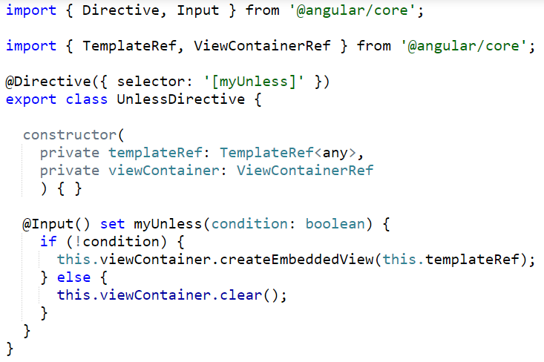
5. Directive
Create a structural directives

Slide 41
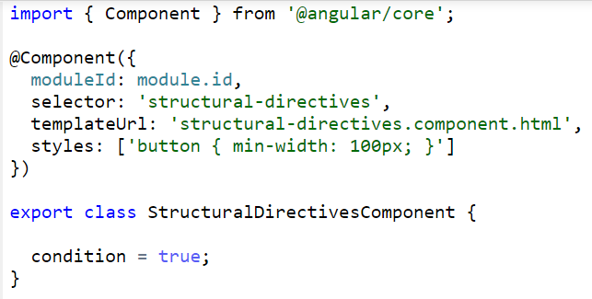
5. Directive
Create a structural directives

Slide 42
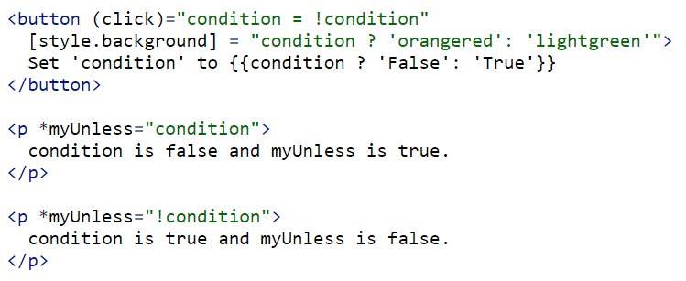
5. Directive
Create a structural directives

Slide 43
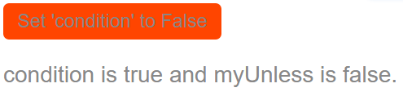
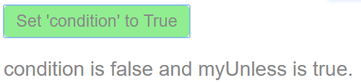
5. Directive
Create a structural directives
Results:
condition = true
condition = false

Slide 44
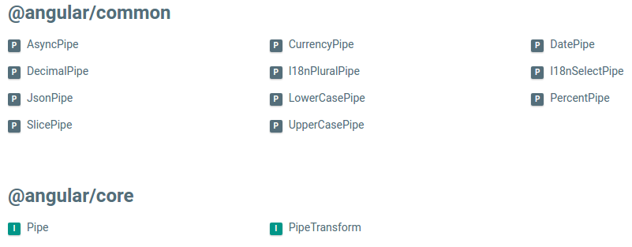
6. Pipe
Pipes transform displayed values within a template.
Some of pipes in Angular:

Slide 45
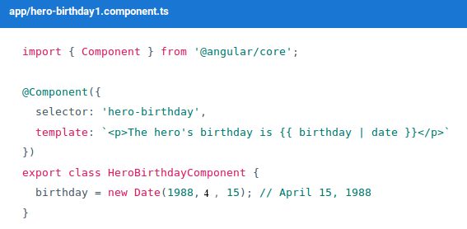
6. Pipe
Using pipes

Slide 46


6. Pipe
Parameterizing a Pipe

Slide 47
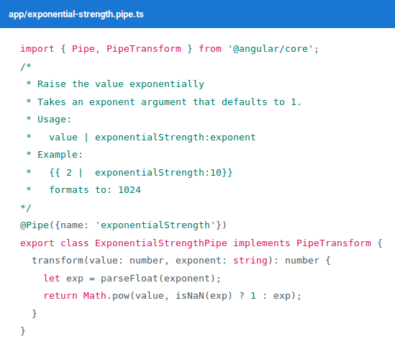
6. Pipe
Custom Pipes

Slide 48
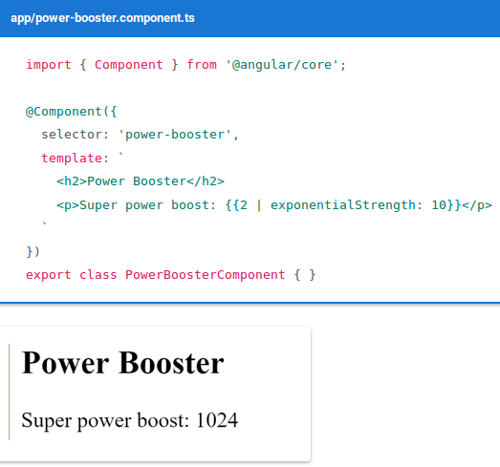
6. Pipe
Custom Pipes

Slide 49
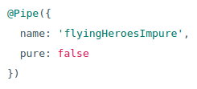
6. Pipe
Pure and Impure Pipes
Pure (default)
Impure Pipes
The impure AsyncPipe
Promise
Observable
The impure caching pipe
JsonPipe

Slide 50
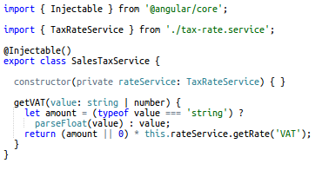
7. Service
Service is a broad category encompassing any value, function, or feature that your application needs.
The definition of a service:

Slide 51
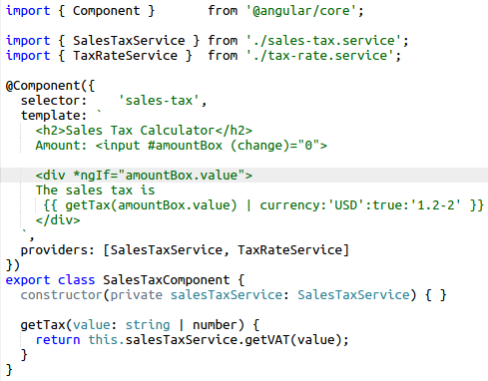
7. Service
Use service:

Slide 52
7. Service
NOTE:
@Injectable() - Dependency injection
providers
constructor (service: ServiceName)

Slide 53
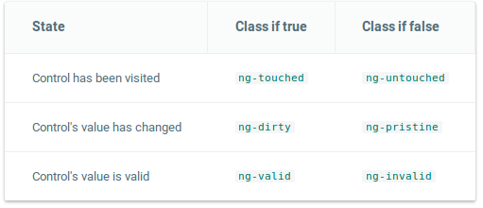
8. Form
Input - user interactions
Input, Click, Enter, Select,...

Slide 54
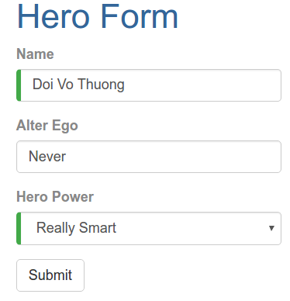
8. Form
An Angular form has two parts: an HTML-based template and a code-based Component to handle data and user interactions.
We'll discuss and learn to build the following a form:

Slide 55
8. Form
We will build this form in the following sequence of small steps:
Create the Hero model class
Create the component that controls the form
Create a template with the initial form layout
Bind data properties to each form input control with the ngModel two-way data binding syntax
Track change-state and validity with ngModel
Add custom CSS to provide visual feedback
Show and hide validation error messages
Handle form submission with ngSubmit
Disable the form’s submit button until the form is valid

Slide 56
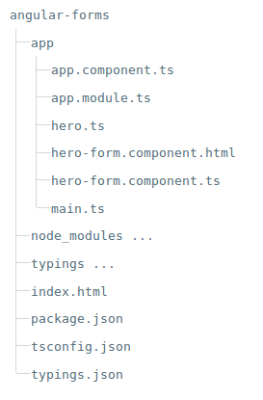
8. Form
Our project folder structure should look like this:

Slide 57
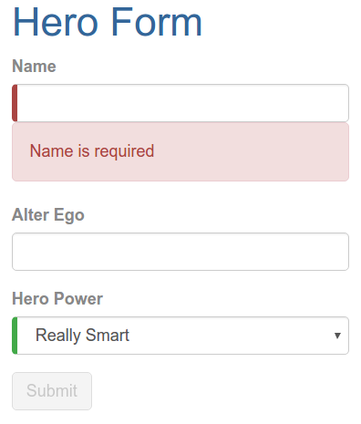
8. Form
Here are some pictures of the project:

Slide 58
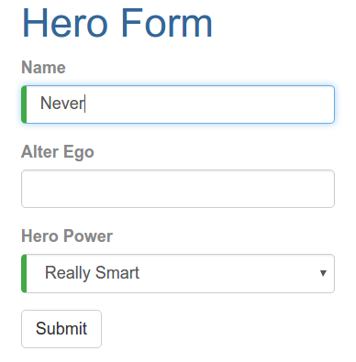
8. Form
Here are some pictures of the project:

Slide 59
Advanced
Animation
Router
HTTP
Security
Cheatset

Slide 60
Tutorials
1. Install
1.2. Install nodejs v6.x.x and npm v3.5.x
On Windows:
Download and Install at https://nodejs.org/en/download/
On Ubuntu 16.04:
Step 1: curl -sL https://deb.nodesource.com/setup_6.x | sudo -E bash -
Step 2: sudo apt-get install -y nodejs
You can test it with the following command:
node -v or npm -v

Slide 61
Tutorials
1.2. The tool options
Visual studio code
angular-cli: A command line interface for Angular.
Install: npm install -g angular-cli
Create a new project: ng new projectName
Run: cd projectName & ng serve
Use eclipse:
Install 2 plugin are angular2-eclipse and TypeScript.
Other:
Sublime text
Notepad,...

Slide 62
Tutorials
2. Build the application
Here are the steps:
Step 1: Create and configure the project.
Step 2: Define the web page that hosts the application.
Step 3: Create your application.
Step 4: Create model, components, services, html, css,.. and add it to your application.
Step 5: Start up your application.
Step 6: Build and run the application

Slide 63

Tutorials
Step 1: Create and configure the project
Create the project folder:
mkdir angular2
cd angular2
Create configuration files:
package.json
tsconfig.json
typings.json
systemjs.config.js
Install packages:

Slide 64
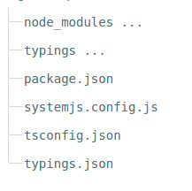
Tutorials
You should now have the following structure in angular2 project:

Slide 65

Tutorials
If the typings folder doesn't show up after running npm install, you'll need to install it manually with the command:

Slide 66
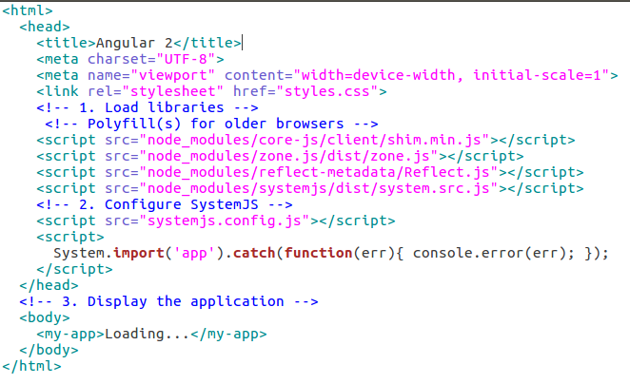
Tutorials
Step 2: Define the web page that hosts the application: create index.html file:

Slide 67

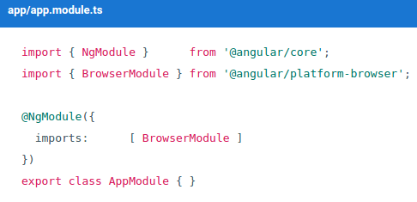
Tutorials
Step 3: Create your application.
Create an app subfolder off the project root directory:
Create the file app/app.module.ts:

Slide 68
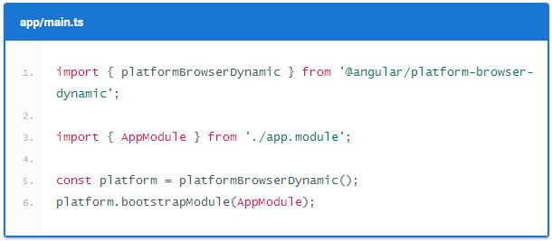

Tutorials
Step 4: Create model, components, services, HTML, CSS,.. and add it to your application.
Step 5: Start up your application: create main.ts file:
Step 6: Build and run the application:

Slide 69
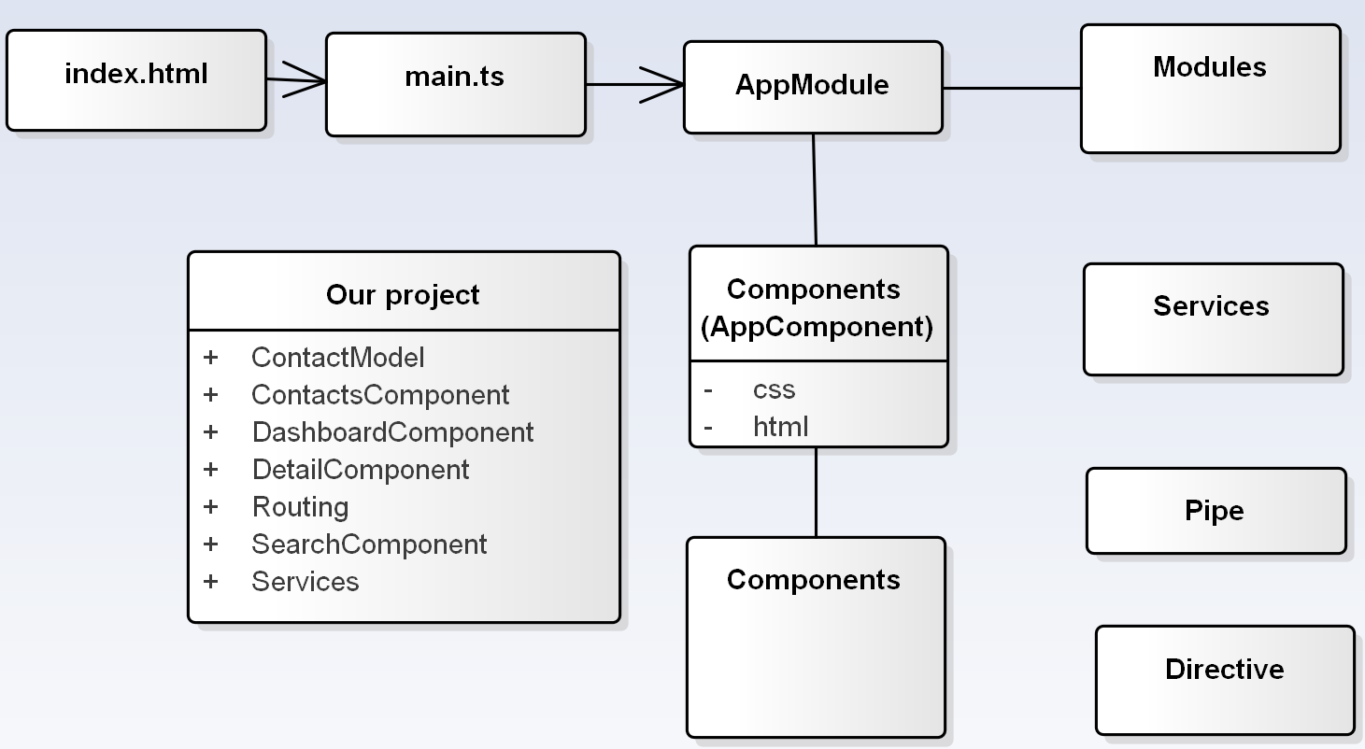
Tutorials

Slide 70
References
https://angularjs.org/
https://angular.io/docs/ts/latest/
https://www.youtube.com/watch?v=_-CD_5YhJTA

Slide 71
THANK YOU FOR LISTENING

