Slide 1

SPEAKING & WRITING VSTEP B1
Lesson 11

Slide 2

SPEAKING
Part 1: Social Interaction
Studying
Fashion

Slide 3


What is your major? Are you interested in what you learn?
My major is History. It’s really fascinating to learn about how the society we live in changed. Our world is shaped by the past, and to understand the world of today, we need to understand the events that created it.

Slide 4

What do you find most interesting about your course?
I can learn about the culture of England and America. It’s very helpful and interesting. I enrich knowledge and broaden my mind about the world.

Slide 5

Do you care about fashion?
No, I don’t really care about fashion. I’m not focused on the outfits. I just wear something that make me feel comfortable and look neat

Slide 6
Do you often wear traditional clothes? If yes, when?
No, I don’t have many opportunities to wear “ao dai”. I just wear “ao dai” in some special cases like Tet holiday or traditional festivals

Slide 7
What is your favourite item of clothing?
Hoody, t-shirt, shirt, skirt, dress, sleeveless shirt, sweater, trousers, jeans, shorts,

Slide 8
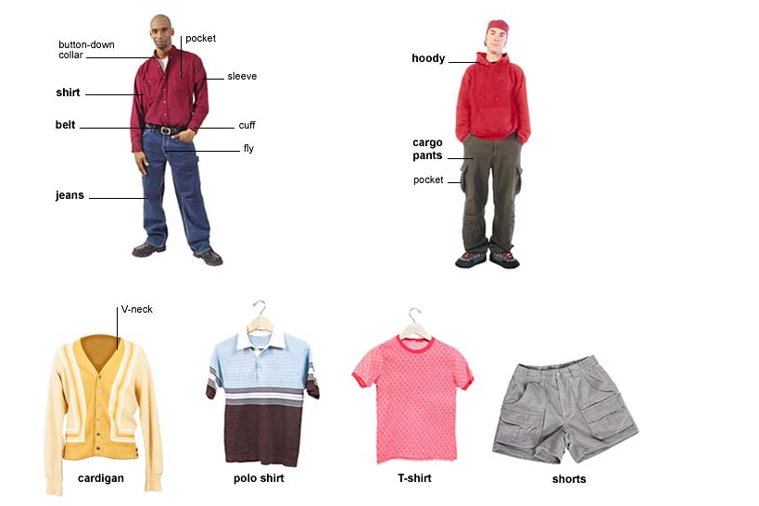

Slide 9
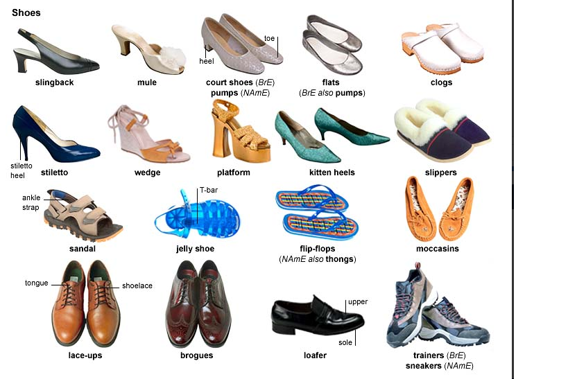

Slide 10
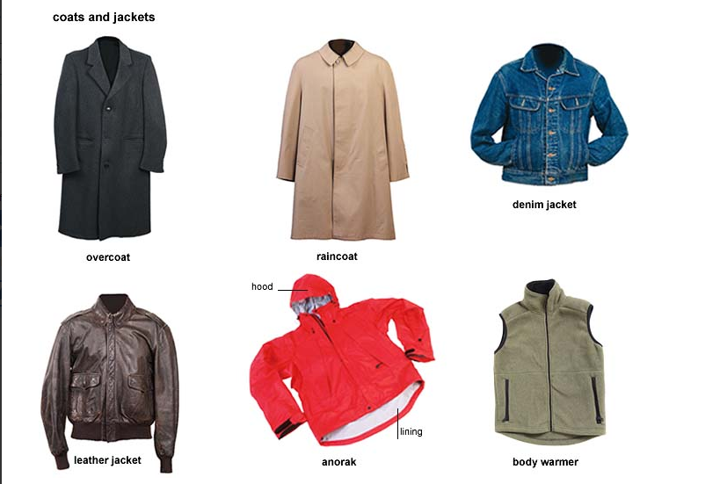

Slide 11
What is your favourite item of clothing?
I like casual clothes like T-shirt, jeans or shorts. Wearing casual allows me to be more comfortable, especially in hot weather

Slide 12

Solution discussion
You are planning to move out and buy a new house. Among the following options, which would you choose to buy: an apartment in the city, a house in the countryside, or a house in the city?

Slide 13
 | Advantage | Disadvantage
An apartment in the city | Affordable, convenient | Lack of private space
A house in the countryside | Cheap Enjoy fresh air and quietness Privacy | Lack of high-tech equipment
A house in the city | Freedom Privacy Comfort | Expensive Air pollution

Slide 14
Part 3: Topic Development
Topic: Fast food is harmful

Slide 15
Fast food is harmful
To traditional food
Your own idea
To environment
To human health

Slide 16
Fast food is more and more popular. However, it’s undeniable that fast food is harmful
Firstly, fast food contains high amounts of cholesterol and salt that have negative effects on blood pressure and other health problems.

Slide 17
Secondly, the environment is affected by fast food. People eat and then throw the plastic bags and paper wrappings.
Thirdly, the young tend to eat fast food more than traditional food so of course, there is a rapid decline of traditional food’s profit.

Slide 18
In conclusion, due to serious side effects of fast food above, you should decrease your fast food consumption and head towards a healthier way of eating.

Slide 19
What are possible ways go make people eat less fast food?
+ raise awareness of people about the drawbacks of fast food
+limit fast food advertising
+propagandize the benefits of eating fresh food

Slide 20
How can companies make fast food less harmful?
+ use fresh ingredients
+ ensure food safety

Slide 21
Do you think the disadvantages of fast food outweight its advantages?
Yes. Although eating fast food helps us save time and money, its harmfulness is undeniable. So I think the disadvantages of fast food outweight its advantages.

Slide 22
WRITING
TASK 1
Write a letter

Slide 23
You have a full-time job and are also doing a part-time evening course. You now find that you cannot continue the course. Write a letter to the course tutor. In your letter:
+describe the situation
+explain why you cannot continue at this time
+say what action you would like to take

Slide 24
Dear Mr Richard, I registered for the Social Marketing evening course at the Cambridge Institute of Technology last July. This is a useful course for my professional growth but sadly it contradicts my office schedule and I find no other way than to discontinue it. I am hoping that you would allow me to continue it online instead.

Slide 25
The course started on July 4th, 2018 and the class is scheduled for every other day from 7.00 pm to 9.00 pm which is intended for employees like me. I joined the lectures for the first two weeks without any problem. However, I have recently been assigned to some new tasks in my office and I cannot leave my desk before 7.30 pm. Hence, I cannot continue this course as the timing contradicts my office hours.

Slide 26
As a solution and since I really want to complete this course, I would request you to let me continue it online. I have already talked to Mr Leonardo, the admin manager, and he recommended me the online course. If you permit me to continue it online, I will be able to watch the recorded lectures and attend the final exam at the end of this course. Thanks in advance for your cooperation. I am looking forward to hearing from you soon. Yours sincerely,

Slide 27
Dear Mr Smith, I trust you are doing great. I would like to inform you that I am unable to continue your evening lectures on computer networking course due to the recent responsibilities in my office. As an IT officer in a bank, I find this course enormously important and relevant to my profession. I am hoping that you would allow me to take the online course instead.

Slide 28
My bank is going to open two new branches in Chittagong and I have to stay there for approximately 3 to 4 months to manage the branding, advertising and operational activities. In that case, I am afraid I am unable to attend your lectures.

Slide 29
Hence, it is my humble request to you to transfer my course from classroom lectures type to online lectures. This would enable me to finish the course wherever I stay for my professional needs. I would be much obliged for your cooperation in this matter. I am looking forward to receiving your positive response soon. Yours sincerely,

Slide 30
Secondly, fast food is loaded with fats and carbs. It means that you are taking in large amount of unhealthy calories which leads to weight gain and ultimately obesity.

Slide 31
Finally, the food is rapidly prepared, remarkably cheap and served immediately in fast-food restaurants. Food safety is not remained.

