Slide 1


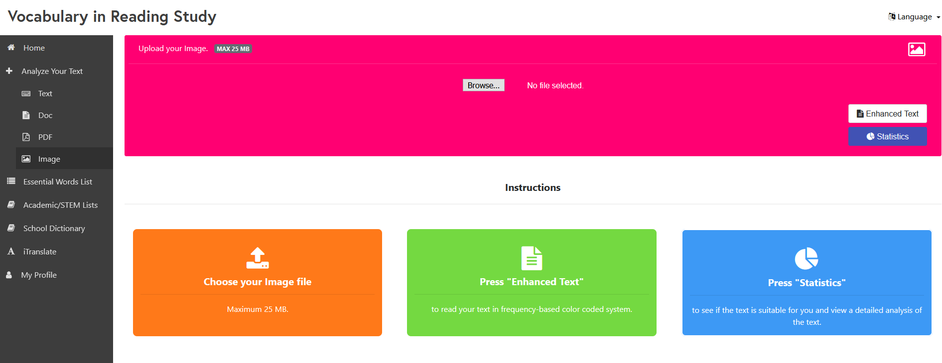
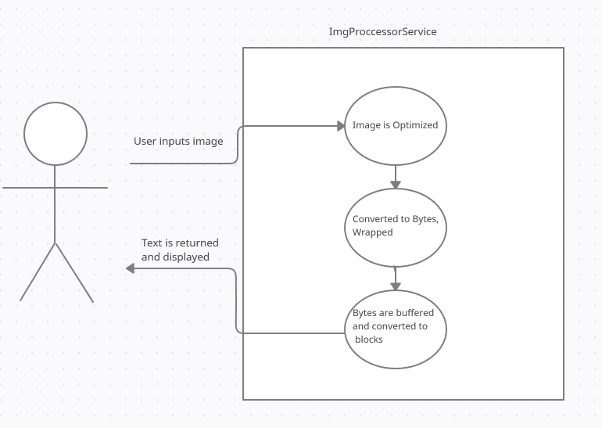
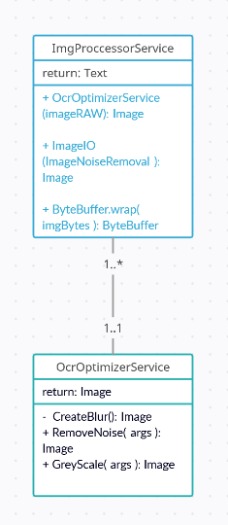
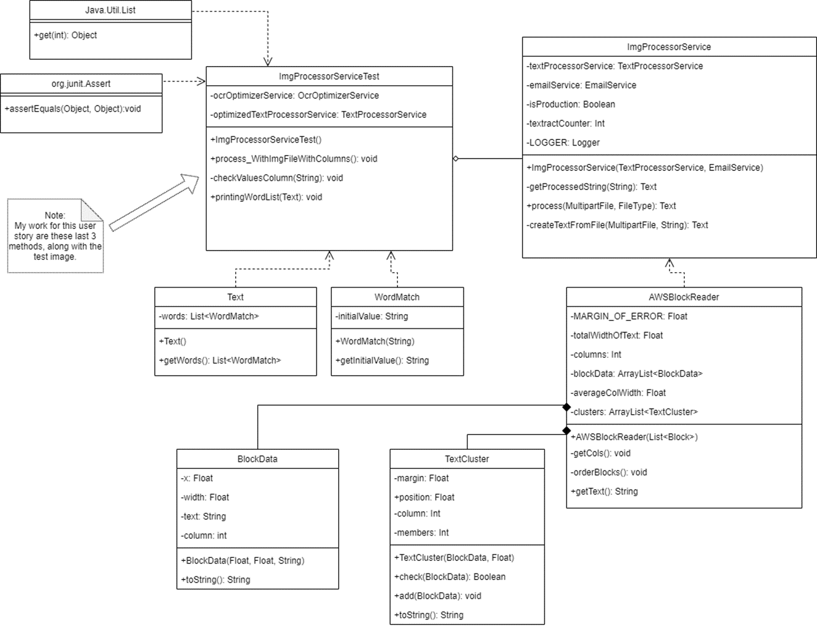
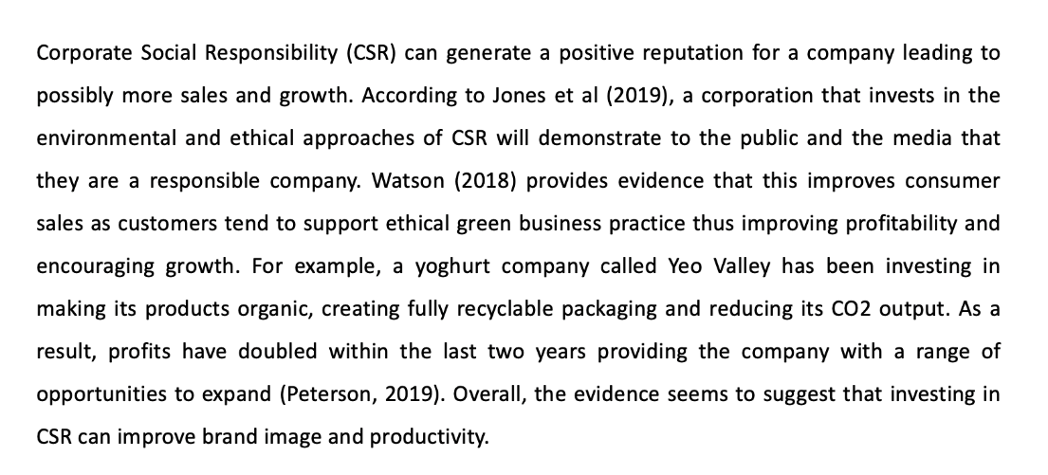
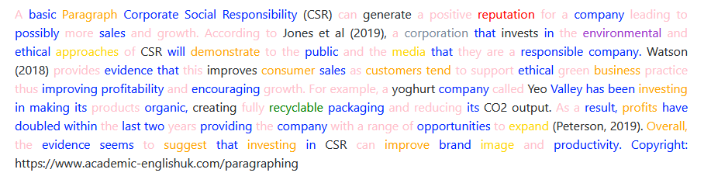
School of Computing & Information Sciences
Spring 2020 Senior Design Project
Vocabulary In Readying Study (VIRS)
Students: Diego Chacin
Mentor: Seyedjafar Ehsanzadehsorati
Instructor: Dr. Masoud Sadjadi, Florida International University
Problem
Current System
Requirements
The image recognition part of the site was not functioning properly
When a JPG or PNG image was uploaded to the Optical Character Recognition (OCR) software tesseract, the text returned would come out unorganized, missing words, and out of order.
This led to a confusing and impractical experience for users when using this feature of the website.
[1]
[2]
[1] This is where the user would choose an image to upload to the OCR. The words often come out of order and some are missing.
The user must be able to input any image, JPG or PNG and be returned an easy to read, legible output.
System Design
Object Design
Implementation
[3]
[3] The system that will be used will first optimize the image (using OCR optimization techniques), convert that image to bytes, then wrap it in a byte buffer so that it can be read by the OCR
[4]
[4]The class diagram [] shows the system as it was set up by AWS along with optimization additions from previous groups.
Found in red is my contribution to the system, an OCR Optimization Service function that will take an image, grey scale and blur it in order to reduce image noise and improve its readability for the OCR.
-ocrOptimizationService(input, options, extensions)
Verification
Screenshots
[5]
[6]
To verify that the OCR optimizations were working as intended, multiple test images were inputted with different qualities and formats
Low quality, a lot of image noise, block of text
High quality, easily readable, block of text
Low quality, a lot of image noise, column format
High quality, easily
readable, column format
[5] [6] This figure shows the properly formatted text after optimizations to the OCR were implemented
Summary
Using techniques that helps optical character recognition software function more efficiently, I was able to have the image processing portion of the website more consistently and accurately detect text in images. I was also able to modify parts of the text printing code in order to have the text be presented in the proper order.
Acknowledgement
I would like to thank Seyedjafar Ehsanzadehsorati for his guidance throughout the project as well as Adam Eide for his assistance and mentorship.

