Slide 1

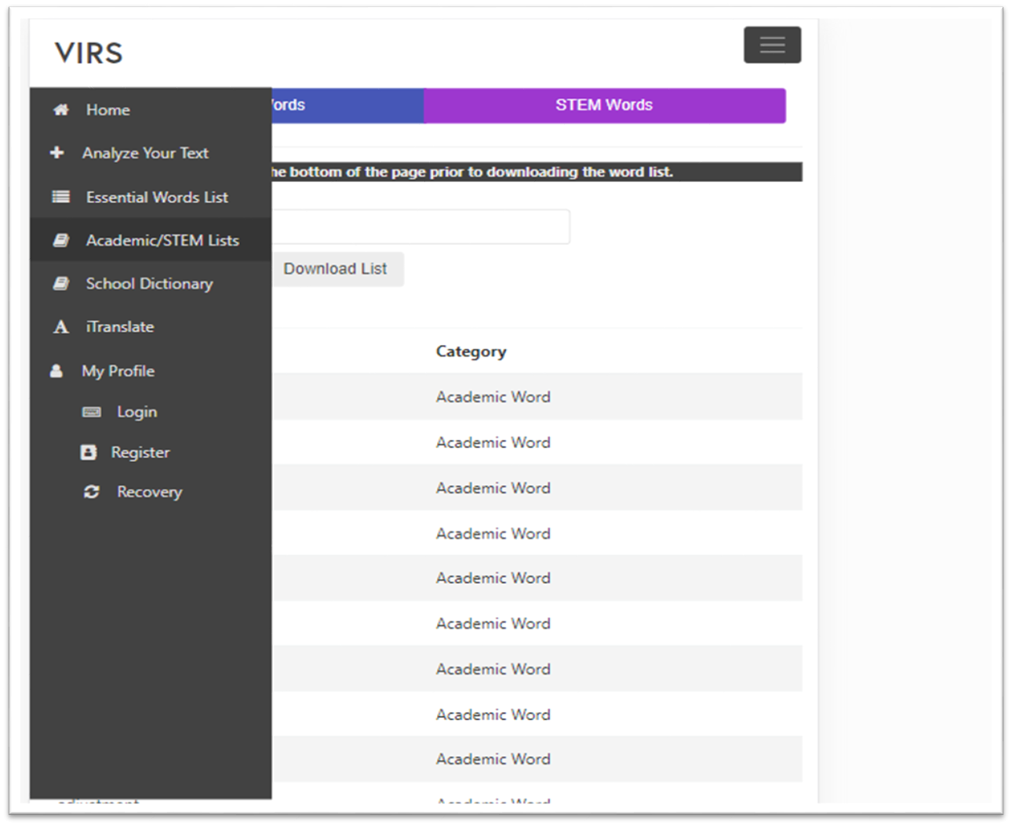
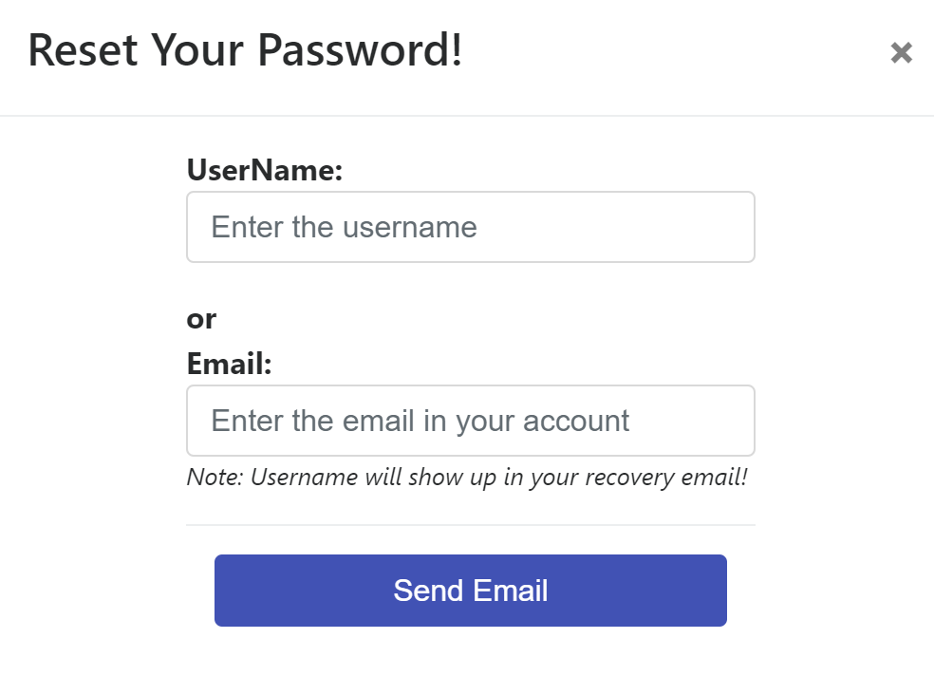
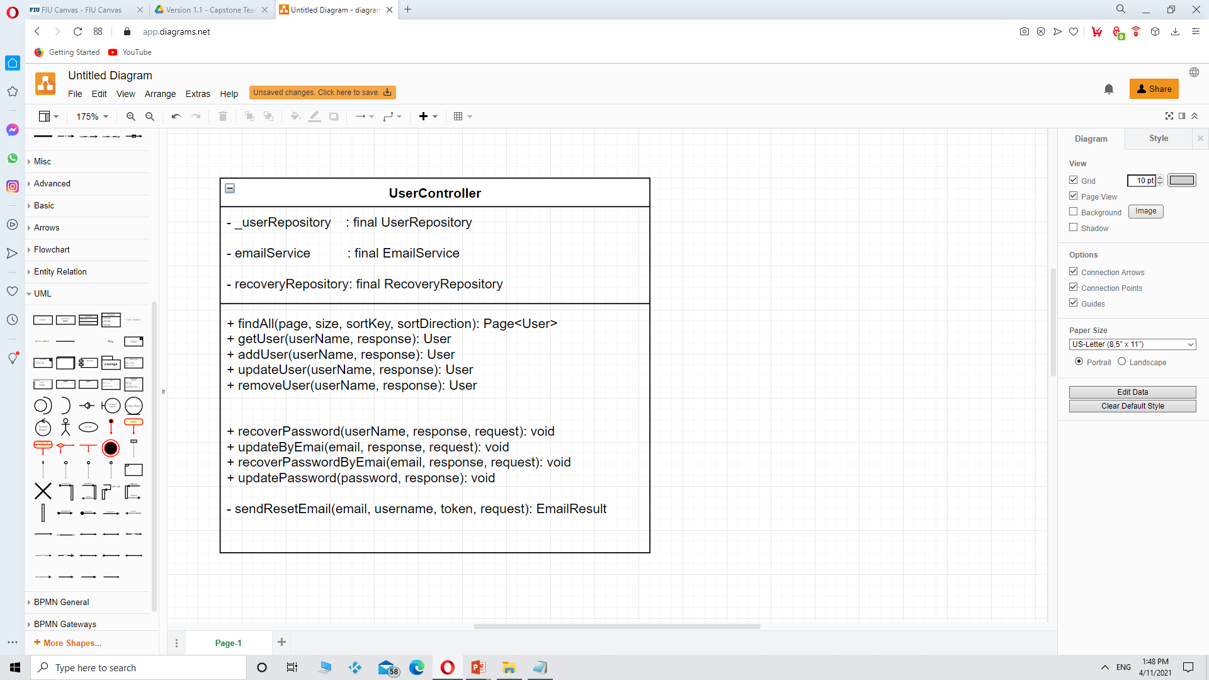
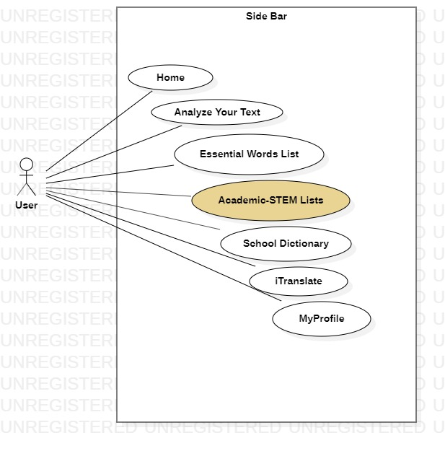

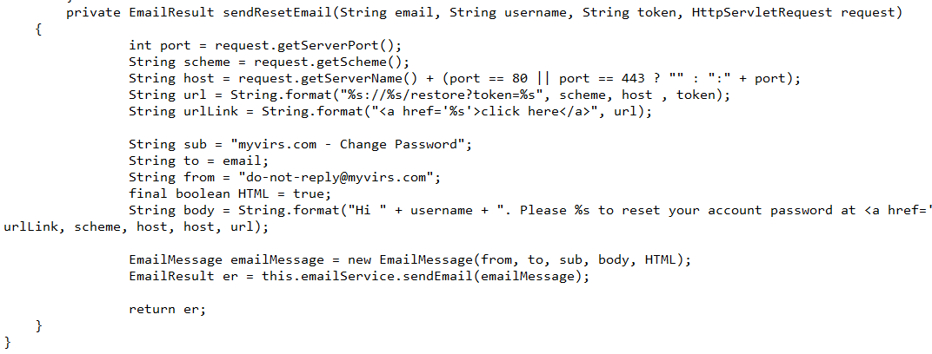
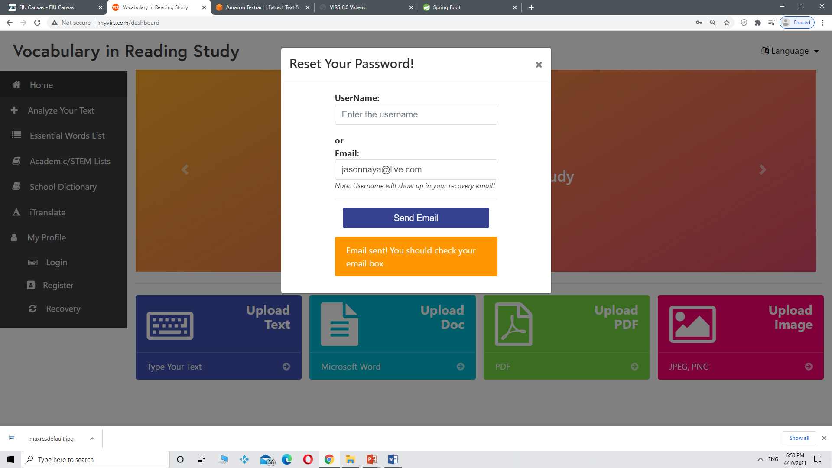
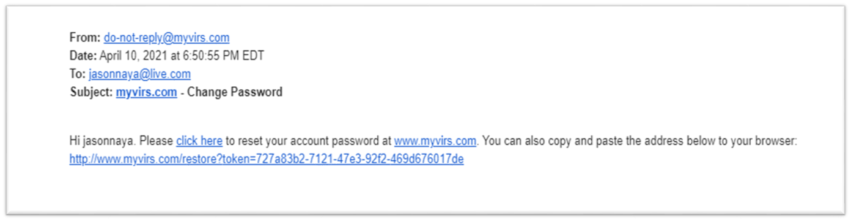
Knight Foundation School of Computing & Information Sciences
Spring 2021 Senior Design Project
Vocabulary in Reading Study (VIRS v7)
Students: Jason Naya
Mentor: Seyedjafar Ehsanzadehsorati
Instructor: Dr. Masoud Sadjadi, Florida International University
Problem
Current System
Requirements
Some background:
In a nutshell, Vocabulary in Reading Study is an online platform that processes and analyses text from a variety of file types (such as .txt files, PDFs, Word documents, and images), evaluates its difficulty, and resolves a grade level for the given text. In addition, there is an option to register and login users, as well as another one to list all words on the database with its corresponding category.
Three problems were observed by the team:
  When the latest lists were uploaded a series of commas would show up alongside each of the word sometimes.
  A registered user was able to change his/her password but was not able to recover his/her username.
  The School Dictionary Section contained unrelated groups of list which would belong in two separate sections for greater convenience.
Words on each table should be processed fast and displayed correctly after a file is uploaded. The file should have extension .CSV and will contain two columns: word and category in order to be processed successfully. Any other format will result in an error display, or a logical error.
The user must be able not only to recover his/her password but also his/her username once registered. This includes a note on the Recovery Section which informs the user on this new feature. A Unit Test must be carried out.
The School Dictionary Section should be cleared up by removing the Academic and STEM lists and migrating them to a new section called Academic/STEM Lists.
Figure 1. New Academic/STEM Lists Section and Rest Password
On the previous version a bunch of commas would appear after each of the words displayed on the tables. The newer version of the platform displays the lists correctly, and even adds a feature to download the lists. (Regine Donatien developed the Download List feature.)
Version 6 of the platform was able to successfully change a forgotten password given a username or an email address. However, it was missing a feature to recover the username which was needed to login. Version 7 resolved this problem by including the username within the recovery email’s header. A note was added in the frontend to let the user know.
There were five lists on the School Dictionary Section: High, Medium, and Low Frequency lists; and Academic and STEM lists. This particular page was packed with information that might have been daunting to a visitor. In order to tackle this problem a new section was created (Academic/STEM Lists) which now includes Academic and STEM words online clearing up the School Dictionary section.
System Design
Object Design
Implementation
There were no changes to the System Design inherited from the previous version.
Backend is written in Java (Spring Boot)
Angular (Typescript) Model View Controller is used for the frontend.
MySQL is used as the database and the data queries are autogenerated by Spring Data JPA.
The application is deployed on AWS elastic beanstalk.
One of the main technologies integrated is Textract which is responsible for text extraction.
The sendEmail button of the sidebar.component.html file located in the front-end section of the code will reach out to the backend when clicked. The code to handle the request is located in the User Controller. This class is responsible for adding new users, updating their information, deleting a user, etc. It is also responsible for the execution of the password recovery procedure which I modified. Originally, it would Handle three parameters: email, token, and request. I added a forth parameter which points to the user’s username. This variable is included Within the body of the message to be sent in case the user has forgotten it.
As you can see in Figure 5, the new Section was added to the Side Bar. This section was named Academic/STEM Lists and it includes both lists with originally were part of the School Dictionary Section.
Figure 3. UML Class UserController
username
In order to fix the comma problem I wrote a helper program to format the lists and to update the database. The program execution lasted for 20 minutes as the lists
were huge and the word processing and
Insertion process were not trivial.
Figure 4. UserController code snippet
Figure 5. Use Case Diagram for the new side bar
Figure 2. Amazon Textract Technology
The highlighted method was modified in order to include the username in the recovery email. Figure 4 shows how a username variable was created and passed as a parameter to the method. The arrow points to the location were the variable is placed within the code.
Verification
Screenshots
Summary
Test Case ID: TC11_Username_Recovery_Sunny
  Description: An email is received with the username displayed correctly.
  Test steps:
    Navigate to the sidebar
    Click on Recovery
    Enter the email address on corresponding field.
    Click on Send Email
  Expected result: An email will be received with the corresponding username included in its body.
  Actual result: As expected
  Status(Pass/Fail): Pass
Test Case ID: TC11_Username_Recovery_Rainy
  Description: An email is not send when email is not registered in the system,
  Test steps:
    Navigate to the sidebar
    Click on Recovery
    Enter the email address on corresponding field.
    Click on Send Email
  Expected result: The email will not be sent and an error will be displayed: The user was NOT found.
  Status(Pass/Fail): Pass
The website had multiple issues that needed to be addressed such as the one pertaining to the commas. I went ahead an correctly reformatted the file in order to match the system specification which completely solved the issue. In addition to that, I added a new section, namely the Academic/STEM Lists, by transferring excessive information from another one (School Dictionary) to make the look and feel of these pages much more cleaner and balanced. Finally, I added a feature to recover a lost username which the previous version was missing, and ran multiple tests to ensure that it was working successfully.
Figure 6. Recovery email sent after email address was submitted.
jasonnaya
Figure 7. Recovery email received with username included.
After entering the information and submitting it and email was received which facilitates a password change while it shows the user’s username. If the user was attempting to recover the username, then the email might be disregarded altogether, otherwise the user may click on the link provided in order to change his/her password.
Acknowledgement
I thank Seyedjafar Ehsanzadehsorati for assistance, cooperation and mentorship that I received throughout this process.

