Slide 1

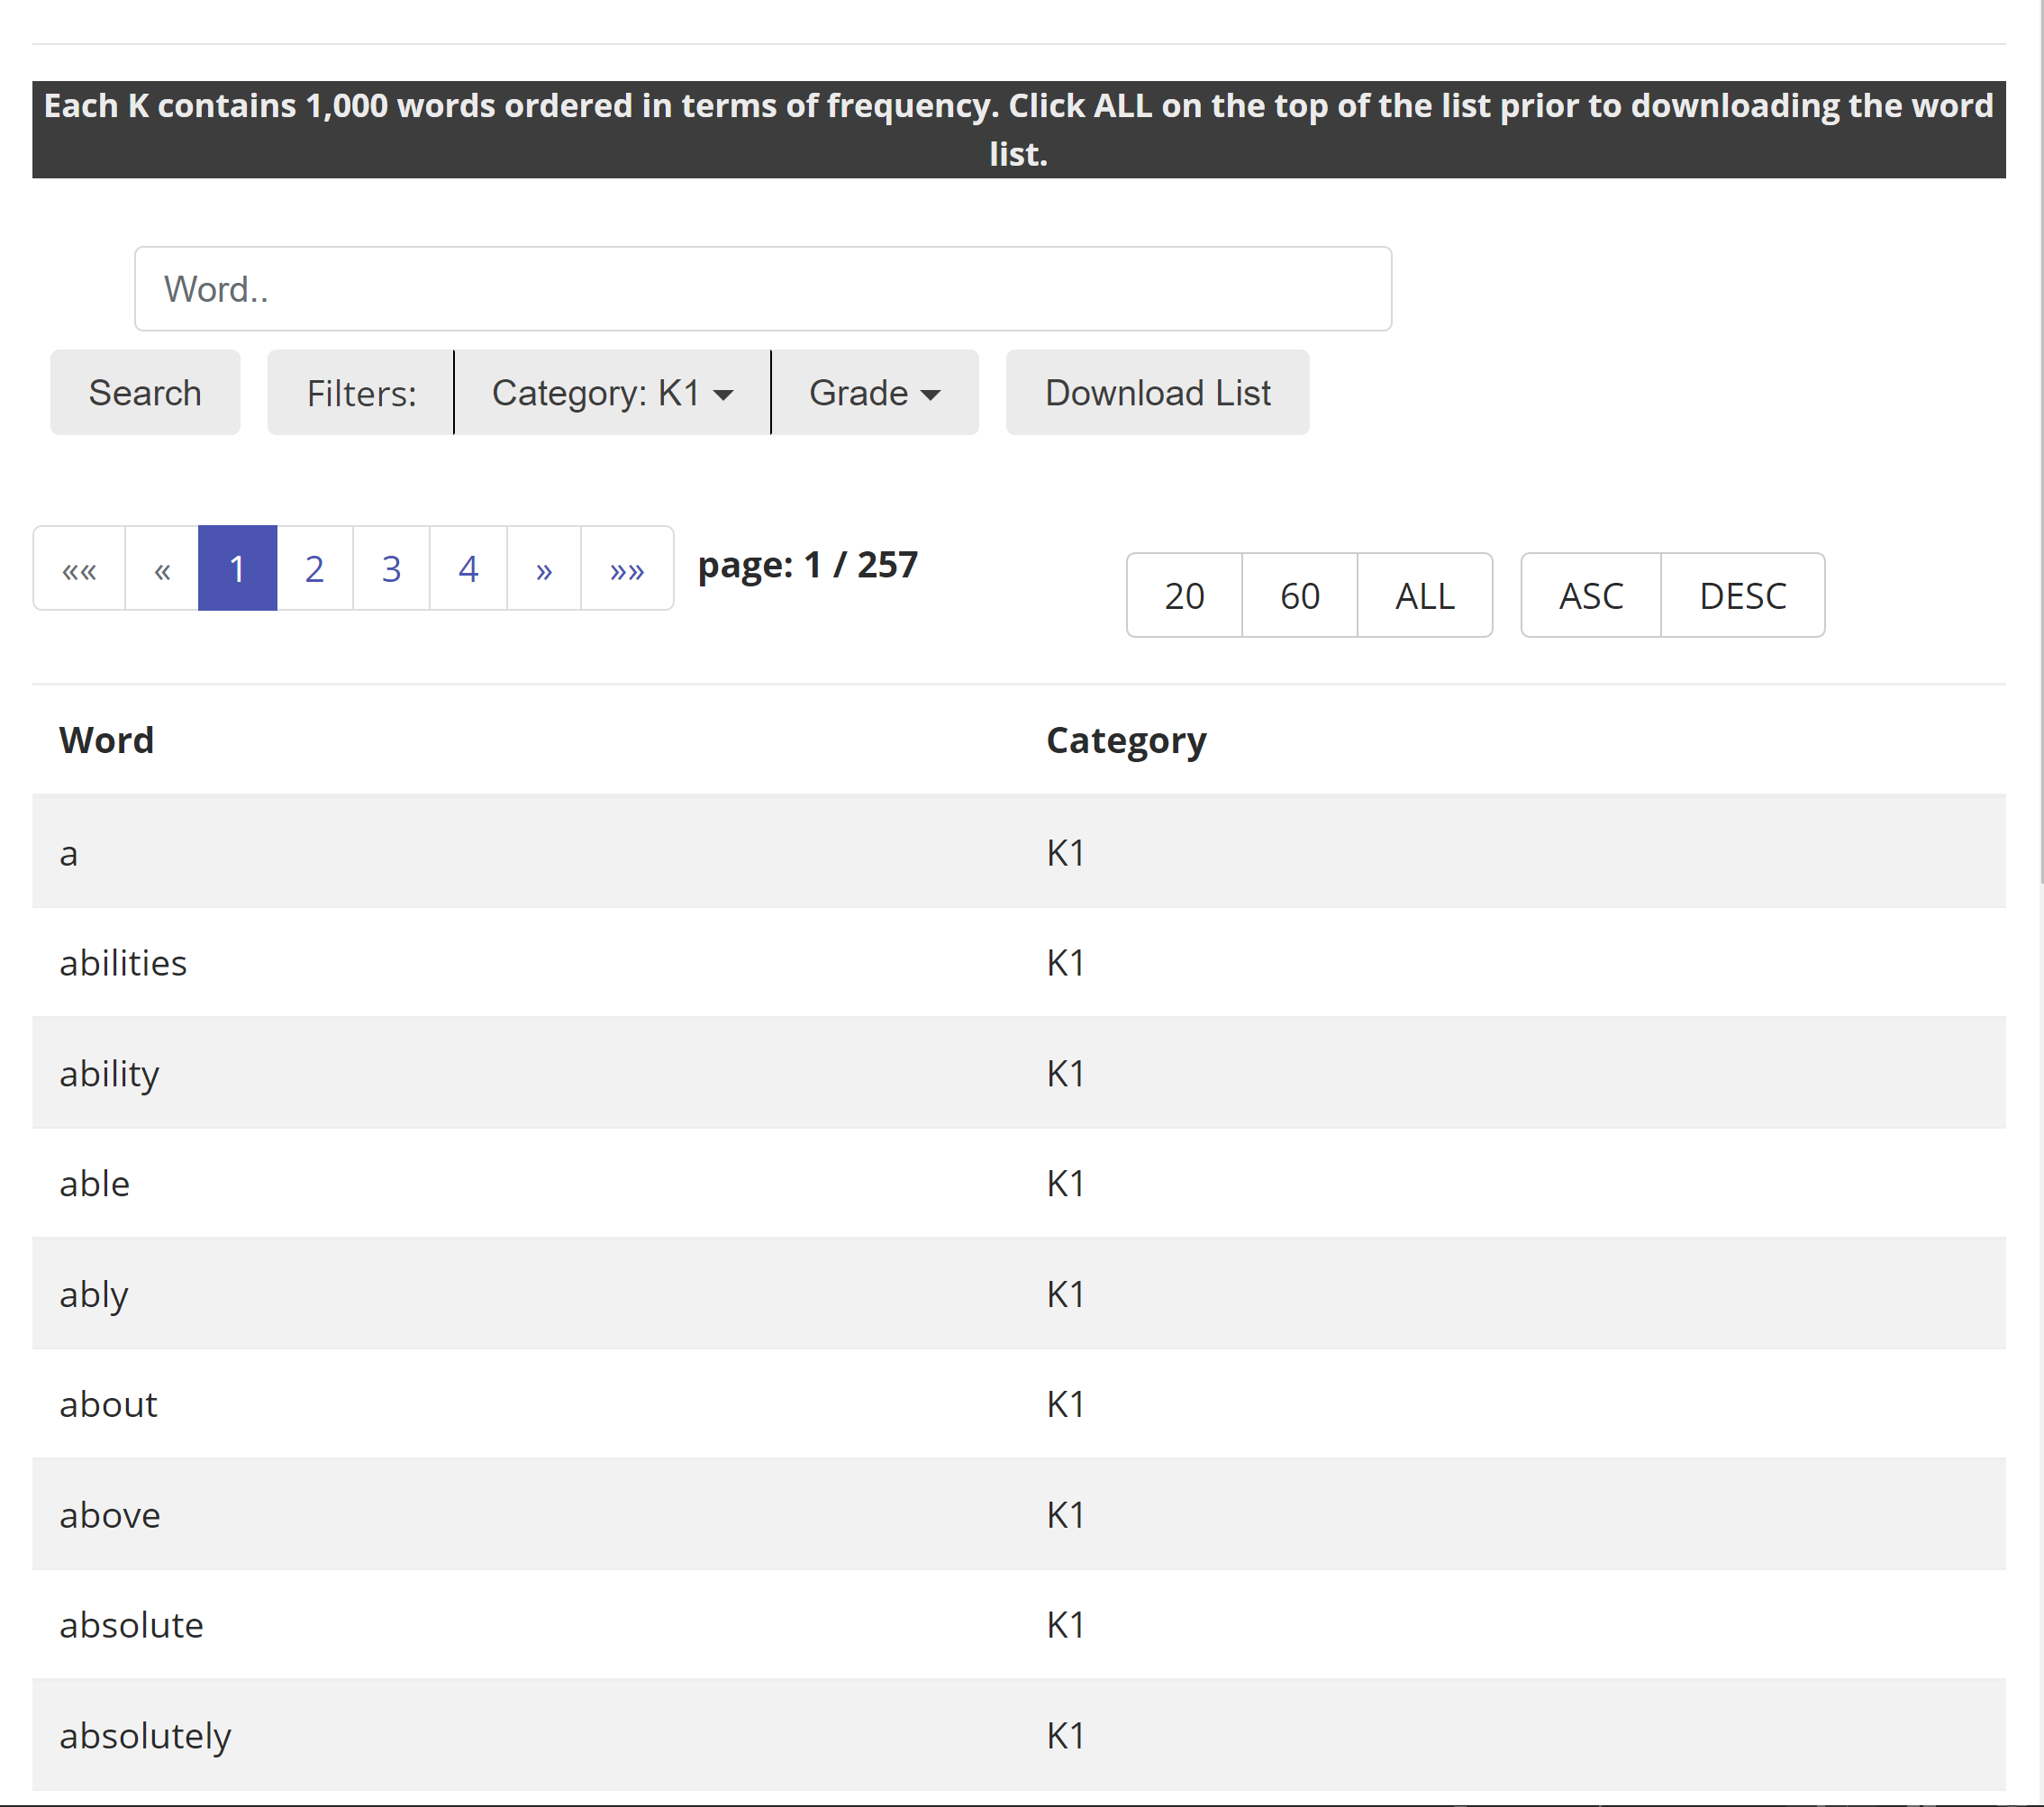
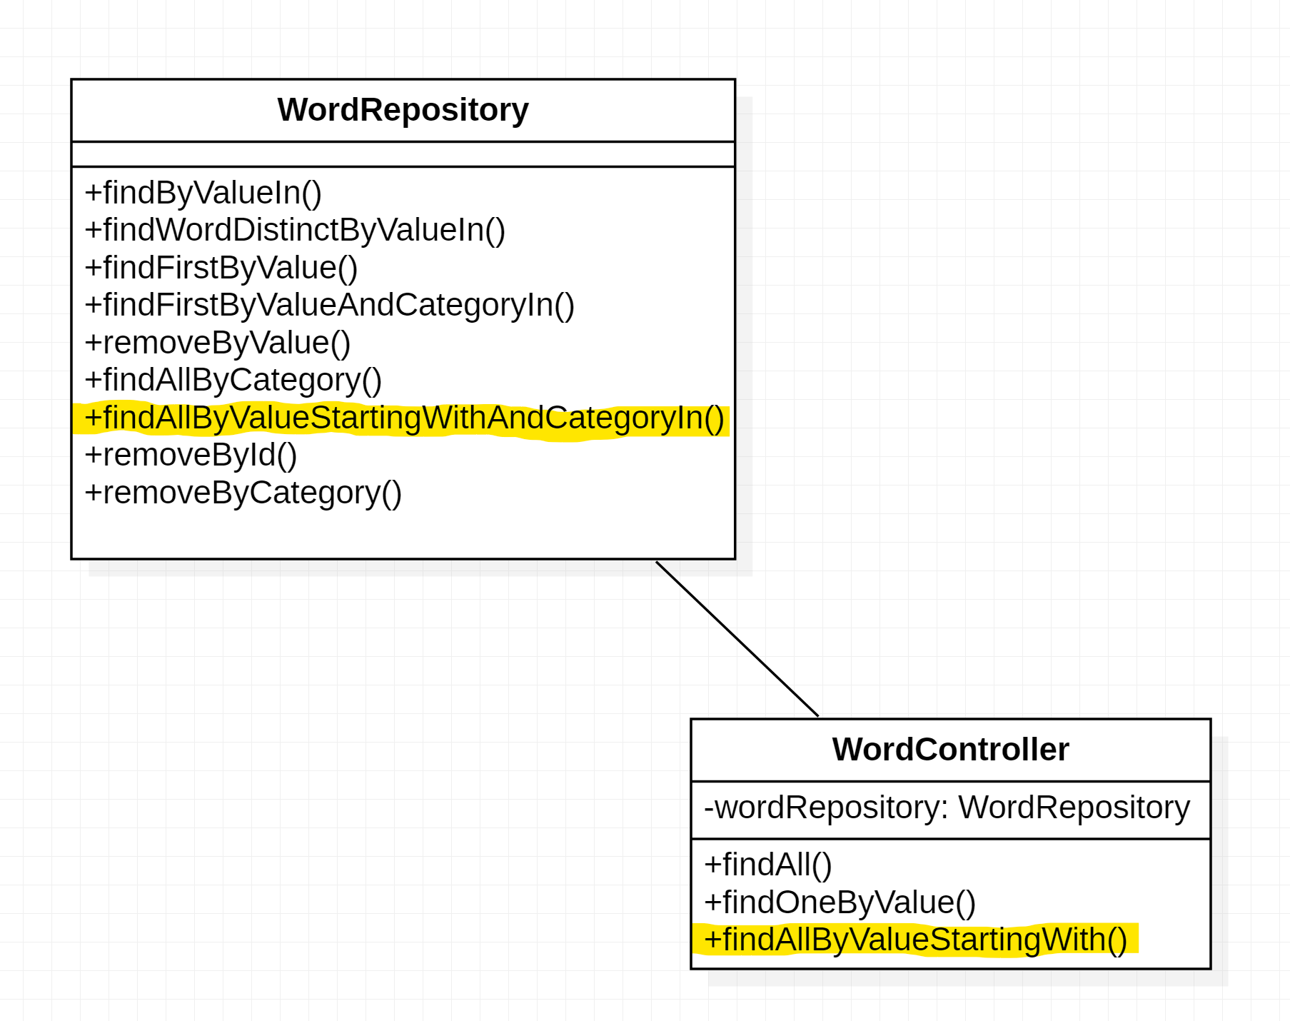
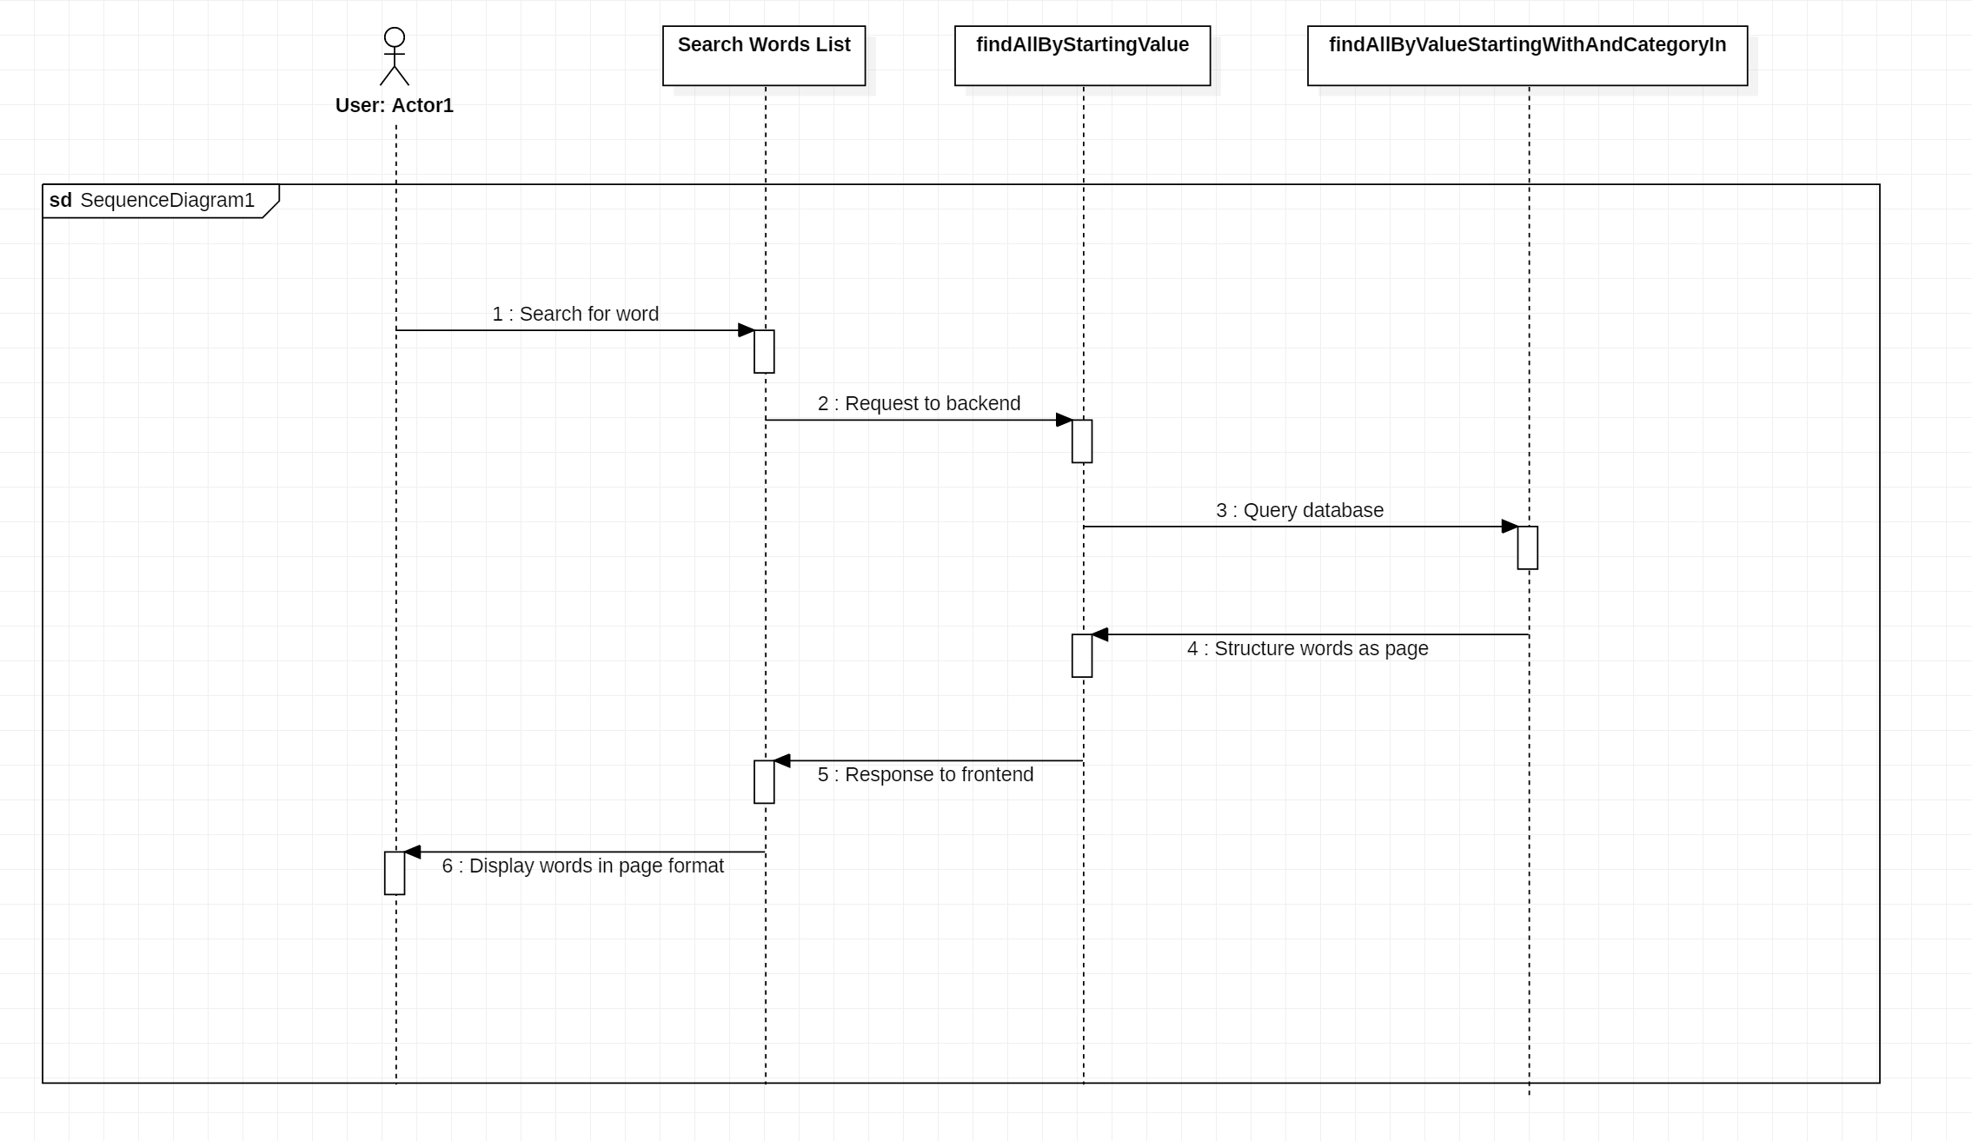
Knight Foundation School of Computing and Information Sciences
Fall 2022 Senior Design Project
Vocabulary In Reading Study (VIRS)
Students: Denzel Merrell
Mentor: Eric Dwyer
Instructor/Faculty: Dr. Masoud Sadjadi, Florida International University
PROBLEM
CURRENT SYSTEM
REQUIREMENTS
The original site’s search functionality only allowed for searching from within a specific category.
The PO requested a search page that would allow for searching within any category and allows searching by substrings. (ex: searching “ba” would return all words beginning with “ba”
In the original system, there were three different navigation options for searching within categories
The new system combines this functionality into a single frontend component, a single UI navigation option and a single endpoint being hit in the backend
The user must be able to type a value into the search box and receive back all words that begin with that value.
The user must be able to filter by category as well as sort order to further constrain the search requirements.
SYSTEM DESIGN
OBJECT DESIGN
IMPLEMENTATION
Object design for word searching within the site
The highlighted methods are my implementations
The findAllByValueStartingWithAndCategoryIn() method queries the database based on the user provided (or default) word and category
The findAllByValueStartingWith() method is called when a request is made from the frontend
When the appropriate endpoint is hit and given appropriate parameters (value, category, sort order), the backend of the system retrieves words from a sql database
These words are sent as a response to the frontend, where they are displayed to the user in a table format on the interface
It calls findAllByValueStartingWithAndCategoryIn() , structures the words into a page format, then sends it as a response
VERIFICATION
SUMMARY
Test Case ID: Search_Word_List
Description: The user can search for any word by specifying a starting query for the value and a category
Test steps:
Navigate to virs code directory
Run ‘virs.cmd build’ and ‘virs.cmd run’ command
Navigate to localhost:8080
Click ‘Search Words List'
Type a string into the search bar (for example: "ba")
Optionally select a category from the filter dropdown (default category should be k1)
Expected result: All words beginning with "ba" and in the specified category will be displayed
Actual result: As expected
Status(Pass/Fail): Pass
I implemented backend search functionality for the websites new searching page
The original system only allowed for searching within specific categories separated into different navigation tabs on the user interface
The new system consolidates that functionality into a single navigation tab, a single endpoint in the backend and implements a live search features which allows the user to find all words beginning with a query.
ACKNOWLEDGEMENT
The material presented in this poster is based upon the work supported Eric Dwyer. I thank Eric for his/her/their assistance and mentorship that I received throughout the senior design project.

