Slide 1


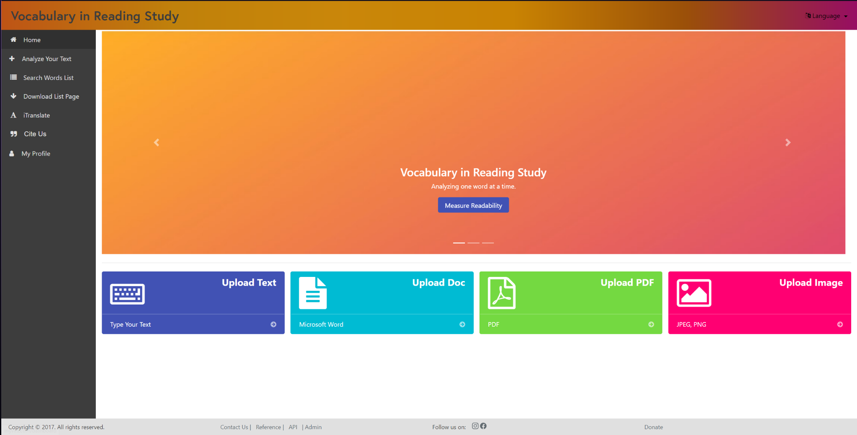
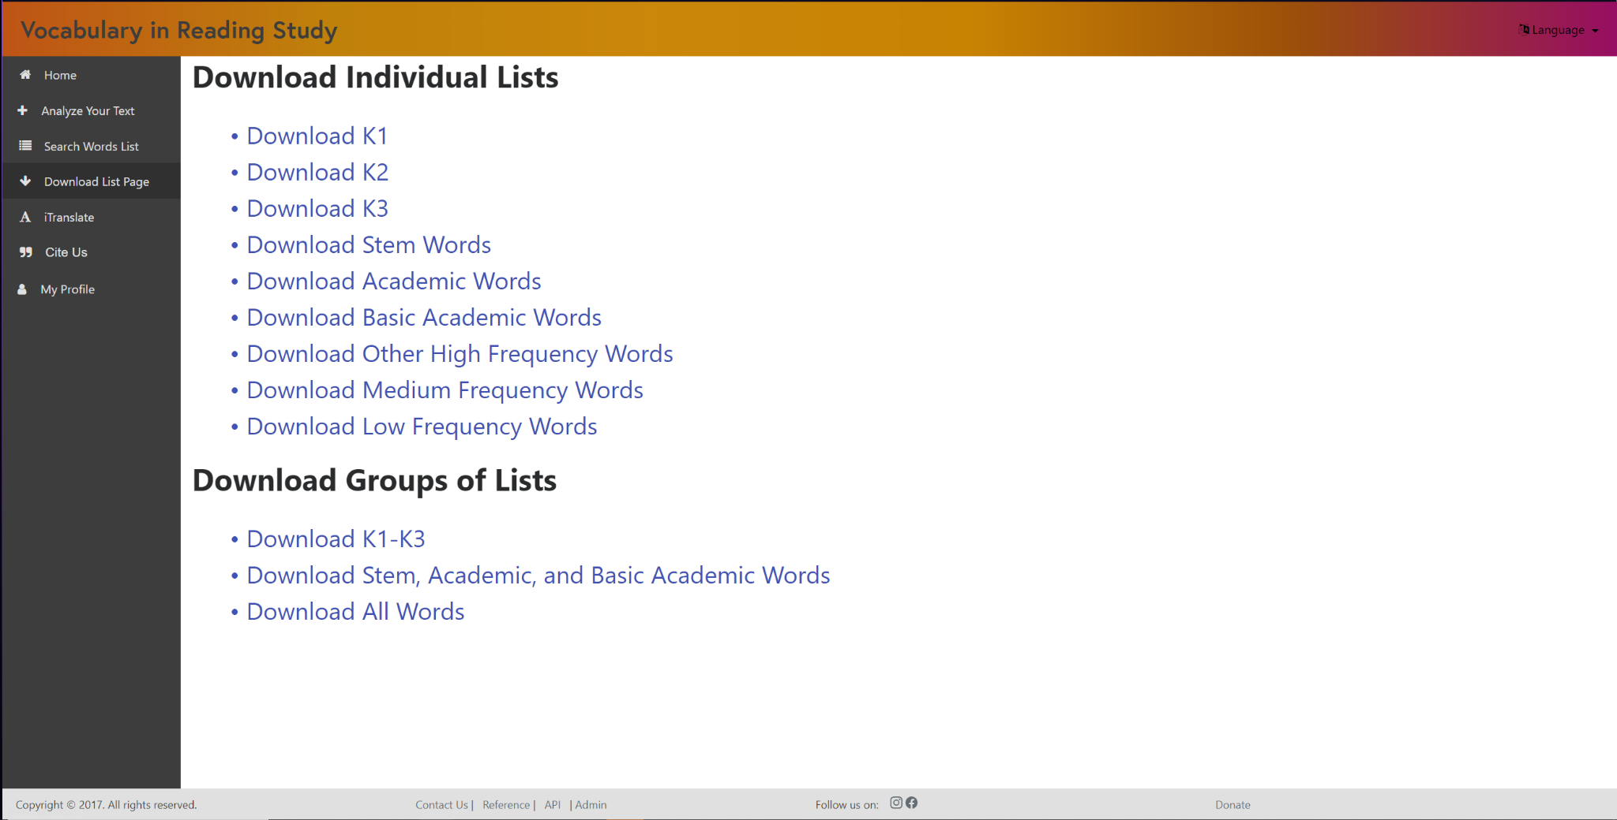
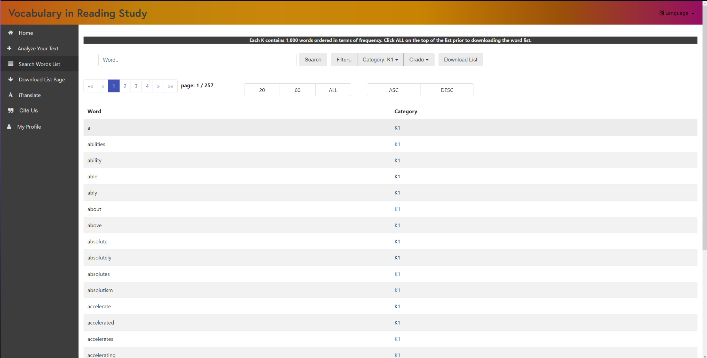
Knight Foundation School of Computing and Information Sciences
FALL 2022 Senior Design Project
Vocabulary In Reading Studies (VIRS)
Students: Lucas Stumpf
Mentor: Eric Dwyer, Seyedjafar Ehsanzadehsorati
Instructor/Faculty: Dr. Masoud Sadjadi, Florida International University
INTRODUCTION
PROBLEM
REQUIREMENTS
Vocabulary In Reading Studies or VIRS, is a service that allows the user to upload text in various forms. This text is then analyzed by the software and words are shown in different categories to show the current text’s difficulty. This is to aid learning in the future through specific text selection according to the appropriate difficulty for a classroom.
1.The service had incorrect defaulting compared to what the product owner wanted
2. The UI of the service was incredibly clunky and clustered to the user
3. Browsing through out the lists of words was inefficient and not user friendly
1. VIRS should be able to grab the uploaded text by the user and correctly default the words into the appropriate categories
2. The user should be able to filter through the word list without needing to go to another tab just to look at another list
3. The user should be able to download whatever list they want by simply clicking on a specific list they want to download
CURRENT SYSTEM
SCREENSHOTS
SUMMARY
Although our start for the project was rough since we could not access last years work due to some technical difficulties, our team was able to push through and use that time to come up with ways we could change the service for the better upon receiving access. After finally being able to access the code to change the website we successfully changed the amount of redundant tabs and compiled tasks together for a better user experience. Along with that we were able to employ the product owners wants in the correct design of the word processing and word identifying. Applying our own touch to the words list with a brand new filtering system that allows the user to keep all their searches within one page and not need to change into multiple tabs.
This is the new homepage of the current system. With the older version the website was incorrectly colored according to the product owner as well as it included redundant tabs for simple tasks. With this newer version we were able to reduce the amount of tabs necessary for the website as well as compressing some of the tasks for a simpler user experience
Above: Updated Downloads pages with Specific Lists
Below: Improved Words list with Filtering System
ACKNOWLEDGEMENT
The material presented in this poster is based upon the work supported by Eric Dwyer. We/I thank Eric Dwyer for his/her/their assistance and mentorship that I/we received throughout the senior design project.

