Slide 1


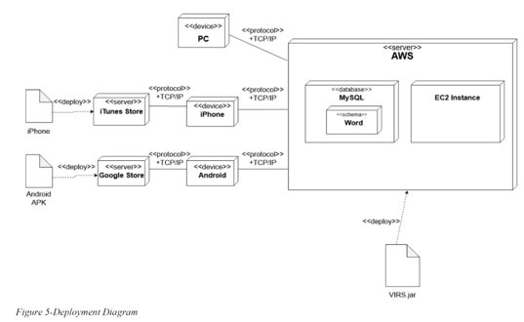
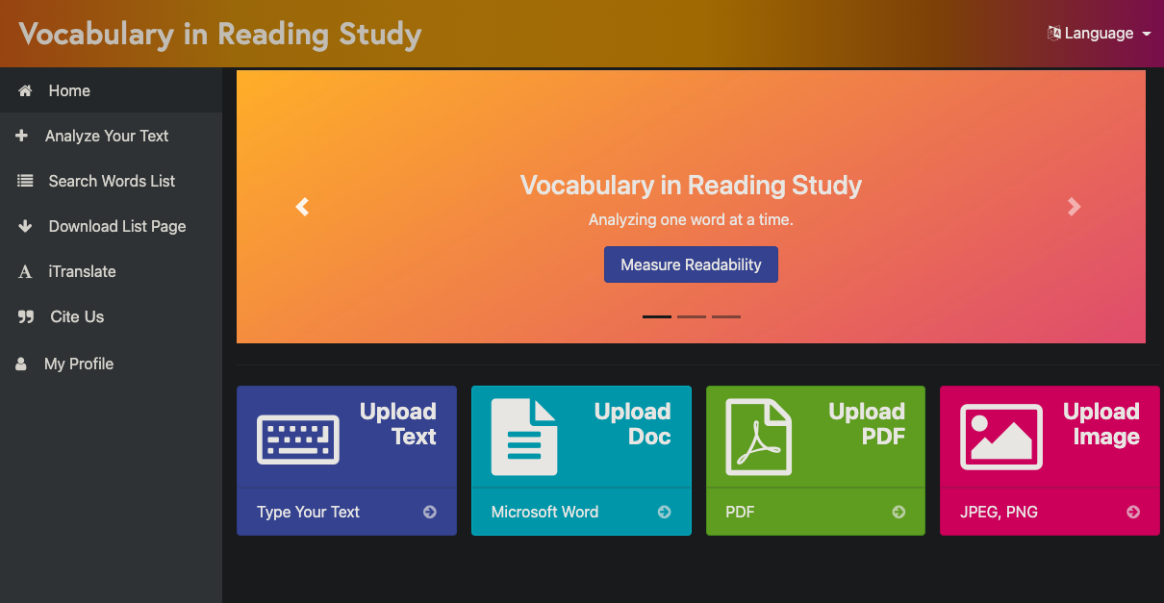
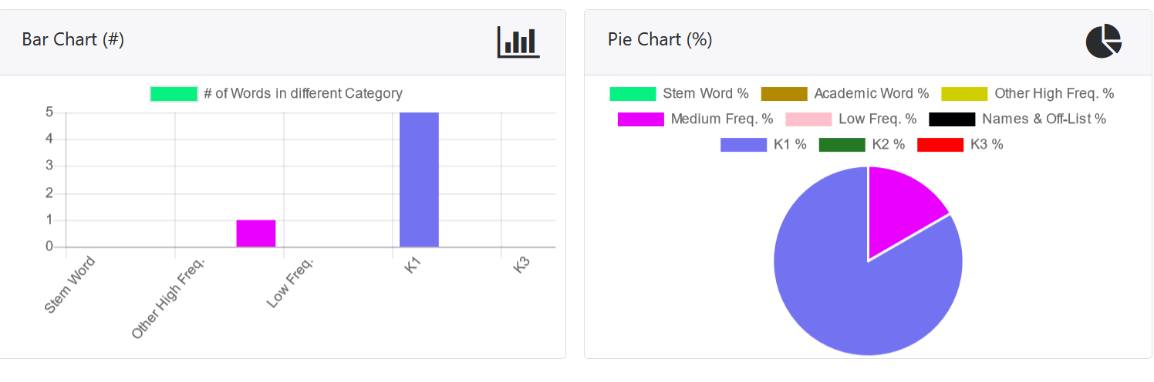
Knight Foundation School of Computing and Information Sciences
FALL 2022 Senior Design Project
Vocabulary In Reading Studies (VIRS)
Students: Jose Rodriguez
Mentor: Eric Dwyer, Seyedjafar Ehsanzadehsorati
Instructor/Faculty: Dr. Masoud Sadjadi, Florida International University
INTRODUCTION
PROBLEM
REQUIREMENTS
Vocabulary In Reading Study (VIRS) is a service where users can submit images, txt,, docx files, to name a few. The service is then able to extract words from these formats and provide a detailed data representation relating to these words and categorization based on multiple filtes as to which those words may fall under.
1.The service was not correctly defaulting the correct information that the user would be expecting in default scenarios.
2. The UI of the service was not user-friendly and made the service difficult to use.
The UI should be user friendly and supportive so that new users can easily begin using features.
Defaulting in the word searching should be streamlined and not have major implications on application performance.
UI/UX improvements for users to be more engaged with the application and have better user retention. Allowing the user to have a unified and simple experience is key for the implementation.
NEW SYSTEM
MAJOR IMPROVEMENTS
SUMMARY
Plenty implementation efforts went into this sprint to update the graphical interface as well as add in the correct defaulting functionality. My focus of this project was to try and implement a practcai and efficient CI/CD process where the next team can easily and quickly begin their implementations and not be hampered by poor coding practices. We worked with what we had offered to us in AWS, we were able to leverage CI/CD pipelines, blue-green deployments as well as other DevOps principals such as frequent code commits, code-reviews and the like. Setting these principals in place we hope future students can continue to follow suit which will hepl their career growth as engineers.
Here we can see the current implementation of VIRS where many front end changes were made in order to give users that unified and stream lined experience while using VIRS. Besides front end changes many QOL changes were added and improved to back end logic in order to remove bottlenecks within word searching.
One of the major improvements added was to the statistics functionality to the VIRS application. Users can get a quick visualization of the words they are interested in receiving more information about. This feature is crucial to the goal of VIRS and the need of visual representation of data when it comes to learning the language.
ACKNOWLEDGEMENT
The material presented in this poster is based upon the work supported by Eric Dwyer. We/I thank Eric Dwyer for his/her/their assistance and mentorship that I/we received throughout the senior design project.

