Slide 1

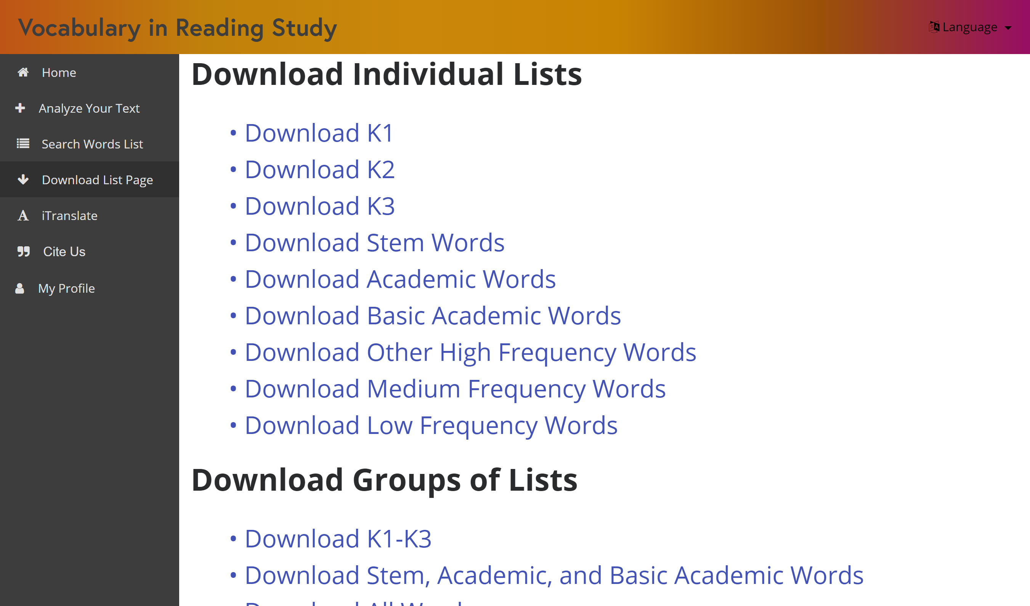
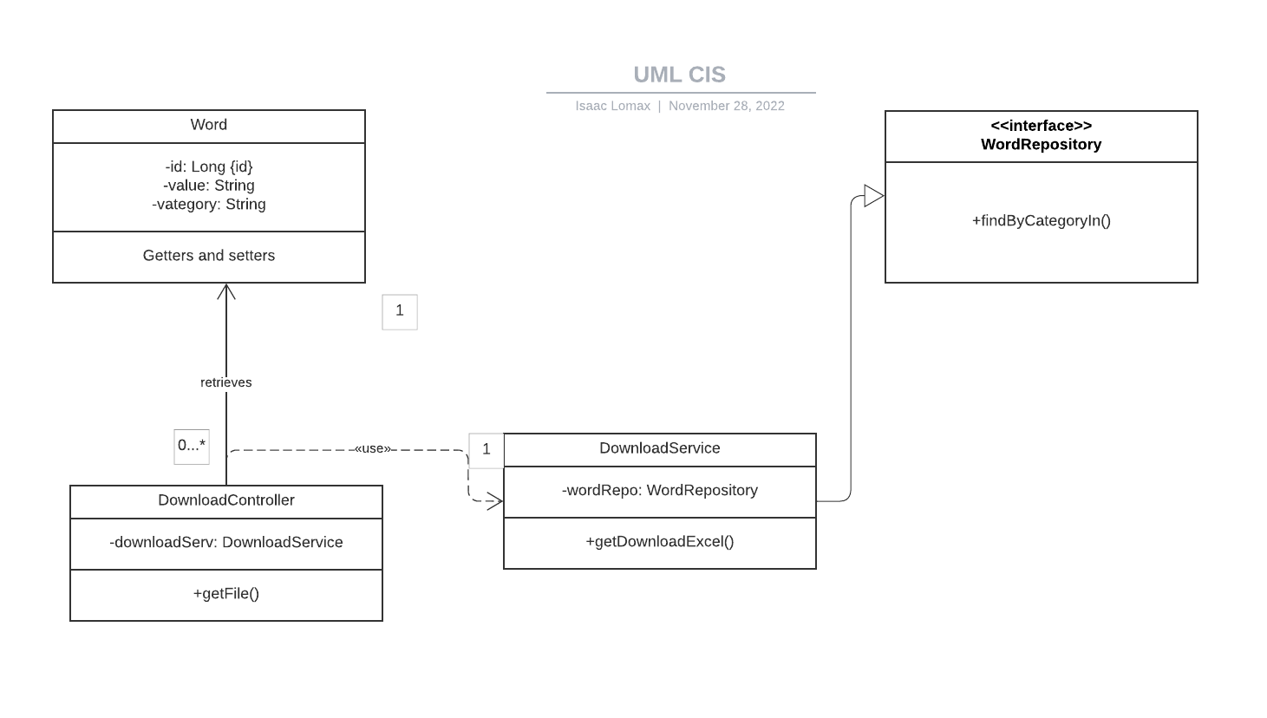
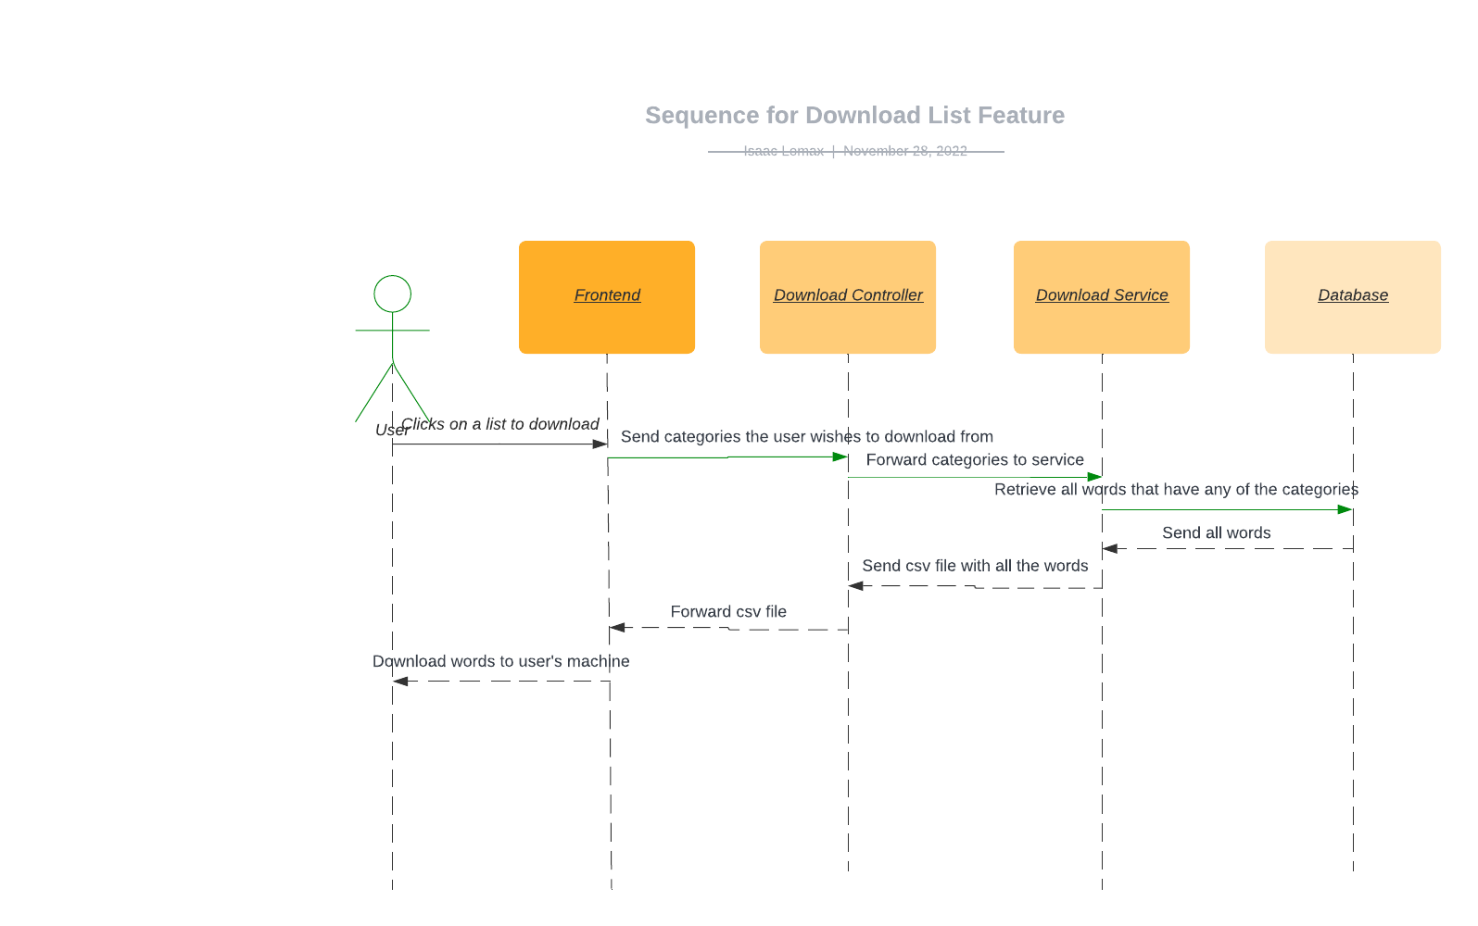
Florida International University
Fall 2022 Senior Design Project
VIRS Vocabulary in Learning
Students: Isaac Lomax
Mentor: Eric Drywer, Product Owner
Instructor/Faculty: Masoud Sadjadi, Florida International University
PROBLEM
CURRENT SYSTEM
REQUIREMENTS
Due to the change to a single search page instead of the previous 3 pages we had to add a new feature that would allow the user to download a words list without having to display all the databases words at once. Previously the system made a words list from the current view and made it into an csv file. Users had to be actively viewing the words list they wanted to download.
Create a download list page that will download the words list directly from the SQL database.
SYSTEM DESIGN
OBJECT DESIGN
IMPLEMENTATION
Backend is written in Java.
MySQL is used as the database and the data queries are autogenerated by Spring Data JPA.
The application is deployed on AWS elastic beanstalk.
Feature Specific:
The download list page uses angular for the frontend.
The feature uses a JPA method retrieval to retrieve from database. The feature also uses Spring boot controllers and services to create the csv file and to send it to the frontend.
VERIFICATION
SUMMARY
Verify that the lists download from the website. Verify that the downloaded csv corresponds with the selected word categories.
The new component is able to download the words list directly from the database..
ACKNOWLEDGEMENT
The material presented in this poster is based upon the work supported by Florida International University. We/I thank Eric Dwyer and Masoud Sadjadi for their assistance and mentorship that I/we received throughout the senior design project.
VERIFICATION

