Slide 1


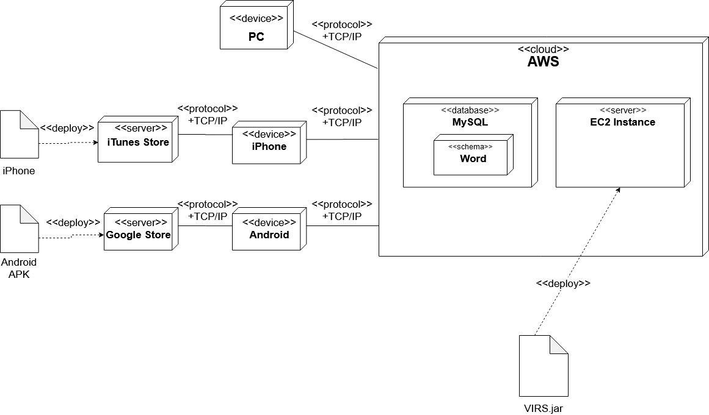
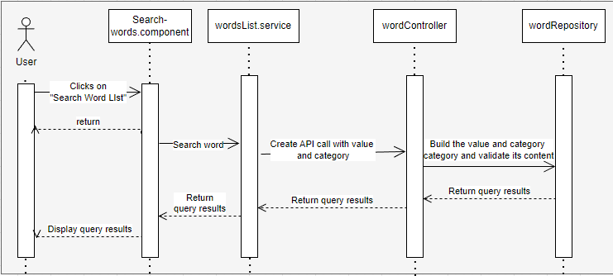
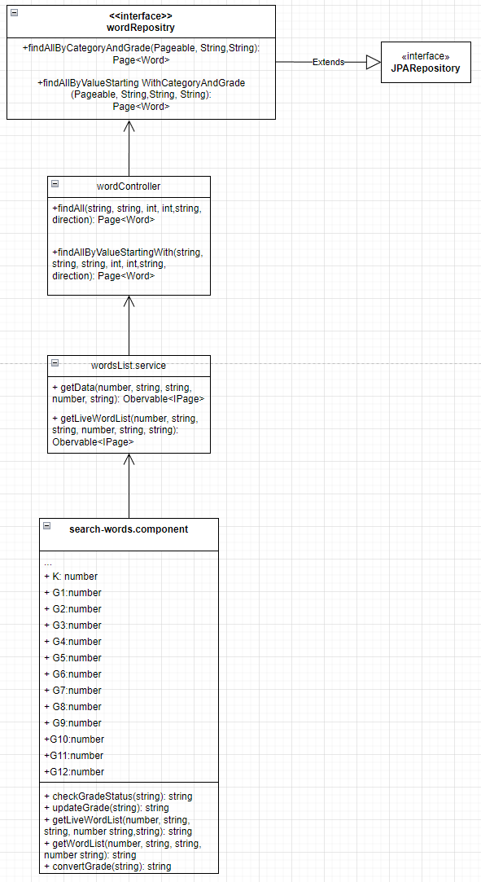
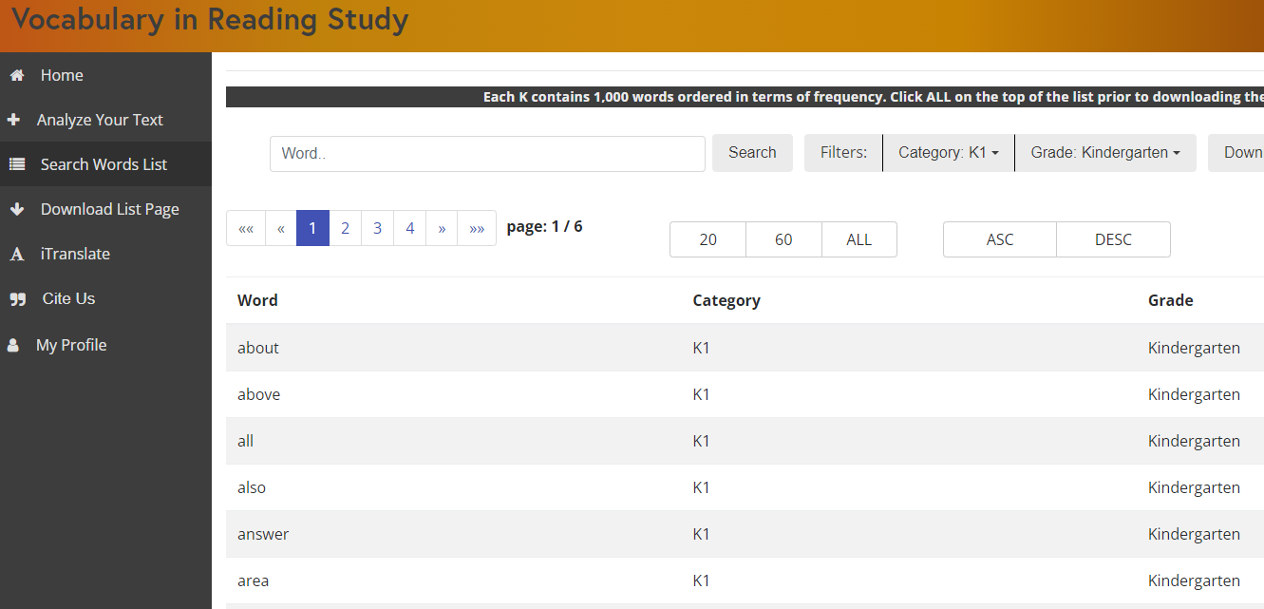
Knight Foundation School of Computing and Information Sciences
Spring 2023 Capstone II Project
Vocabulary In Reading Studies (VIRS)
Student: Evers Perez
Mentor: Eric Dwyer
Instructor/Faculty: Dr. Masoud Sadjadi, Florida International University
INTRODUCTION
PROBLEM
REQUIREMENTS
Vocabulary In Reading Study (VIRS) is a service where users can submit images, txt,, docx files, to name a few. The service is then able to extract words from these formats and provide a detailed data representation relating to these words and categorization based on multiple filters as to which those words may fall under.
1.Words do not have a grade level attribute in which the user is able to search words based on this values. This restricts the usage of the program, delivering a more diverse platform.
2. The image, document, PDF readers are not working, depreciating the content of the site. Without these, many of the users will not longer be interested.
Existing functionality must still be available with the new implementation
Make the grade level’s searchable and results are displayed accurately
Display the grade levels and ensure the text displayed can be properly interpreted by the user.
Make sure that the doc, PDF, and image import works as intended.
System Design
Implementation
Frontend:
Angular Typescript, Bootstrap, CSS and HTML5
Backend:
Java Spring Boot and MySQL.
The figure above shows the life-cycle of the “Search word list functionality”. In the wordRepository, the interface extends JPAReposiitory and it uses the Word class to build the query with the pertaining arguments
Class Diagram
MAJOR IMPROVEMENTS
SUMMARY
Being the lead for this project, I received exposure to taking in the responsibility from a whole team. The CI/CD environment we developed on was thoroughly executed with every sprint. Our team was able to learn software development and QA roles in this semester while practicing optimal software development principles. VIRS is now a more complete application and the range of its users will now be expanded.
As you can see from the picture above, the new column was added with the pertaining attributes. The corresponding filter functionality now updates in real time for both the filter text and grid data. Implementation was done by adding the grade data in the API call and adding it to associated classes like the IWord interface.
ACKNOWLEDGEMENT
Thank you, Eric, for all the guidance you provided us. We truly hope the future of this application is bright and we’re more than grateful for having participated in this.

